Slide 1
Mathematics for Computer Science MIT 6.042J/18.062J
Proof by Cases:
Friends & Strangers

Slide 2
Friends & Strangers
Six people. Every two are
either friends or strangers.
Claim: there is a set of
3 mutual friends or
3 mutual strangers

Slide 3
Friends & Strangers
People are circles
3 mutual strangers
3 mutual friends
red line shows friends
blue line shows strangers

Slide 4
Friends & Strangers
Take 3 minutes to find a counter-example
--or convince yourself there isn’t any counterexample, that is, the Claim is true.

Slide 5
A Proof of the Claim
Person has a line to each of
the 5 other people.
lines are red or blue, so at
least 3 must be the same color.
has ≥ 3
friends

Slide 6
A Proof of the Claim
Person has a line to each of
the 5 other people.
has ≥ 3
friends

Slide 7
A Proof of the Claim
Case 1: some pair of these friends
are friends of each other,
then we have 3 mutual friends:

Slide 8
A Proof of the Claim
Case 2: no pair of these friends are
friends of each other,
so we have 3 mutual strangers:

Slide 9
A Proof of the Claim
Since the Claim is true in either case,
and one of these cases always holds,
the Claim is always true.
QED

Slide 10
Ramsey’s Theorem
For any k, every large enough group of people will include either
k mutual friends, or
k mutual strangers.

Slide 11
Ramsey’s Theorem
For any k, every large enough group of people will include either
size-k red clique, or
size-k blue clique.
Let R(k) be the large enough size.
So we’ve proved that R(3) ≤ 6.

Slide 12
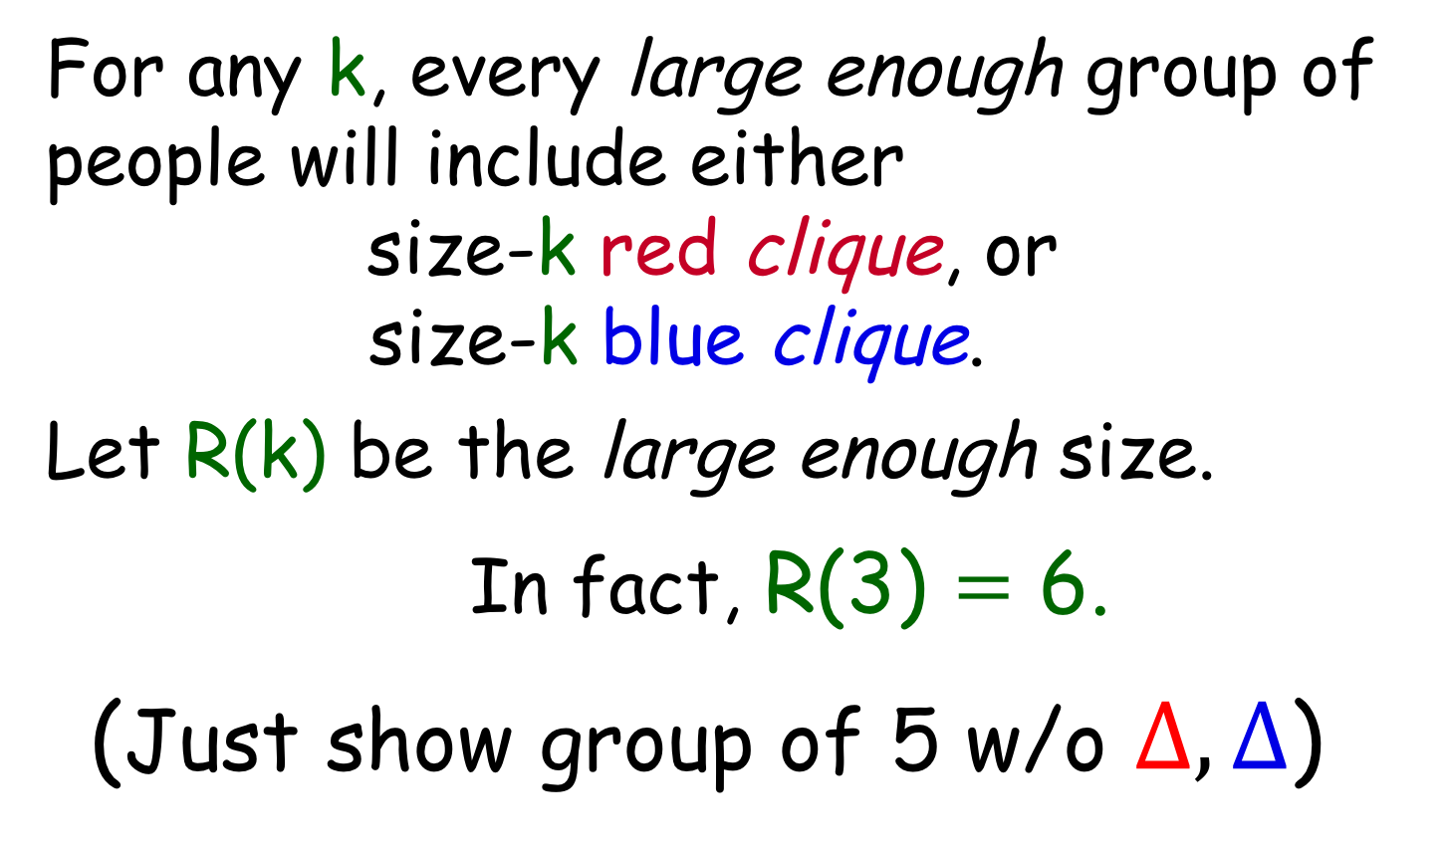
Ramsey’s Theorem
For any k, every large enough group of people will include either
size-k red clique, or
size-k blue clique.
Let R(k) be the large enough size.
In fact, R(3) $=$ 6.
(Just show group of 5 w/o $∆, ∆$)

Slide 13
Ramsey’s Numbers
Turns out that R(4) = 18 (not easy!)
R(5) is unknown!
Paul Erdös considered finding R(6)
a hopeless challenge!
So in our second class, we have reached a research frontier!

