Slide 1
Mathematics for Computer Science MIT 6.042J/18.062J
Simple Graphs
Degrees, Isomorphism, Paths

Slide 2
Types of Graphs
Simple
Graph
Directed Graph
next week
Multi-Graph
this week

Slide 3
A simple graph:
Definition:
A simple graph G consists of
a nonempty set, V, of vertices
a set, E, of edges
(edge = set of 2 vertices)

Slide 4
A simple graph G:
V={a,b,c,d,e,f}
E={{a,d},{a,e},{b,c},{b,e},
{b,f},{c,f},{d,f},{e,f}}
d
b
c
a
f
e
picture of G

Slide 5
A Simple Graph
edge
vertices, V
undirected edges, E
::= { , }
“adjacent ”

Slide 6
A simple graph G
G=(V,E)
V={a,b,c,d,e,f}
E={{a,d},{a,e},{b,c},{b,e},{b,f},{c,f},{d,f},{e,f}}
A drawing of G:
Terminology:
V <-> vertices
E <-> edges
{a,d} in E <->
a,d adjacent in G
d
b
c
a
f
e

Slide 7
A simple graph G
Could use (V,E) to model:
Computer networks:(computers,connections)
Social networks: (people, contacts)
Road networks: (intersections, roads)
d
b
Could also need:
multiple edges,
edge directions,
labels on verts
and edges, etc.
c
a
f
e

Slide 8
Vertex Degree

Slide 9
Vertex degree
degree of a vertex is
# of incident edges
deg( ) = 2

Slide 10
Vertex degree
degree of a vertex is
# of incident edges
deg( ) = 4

Slide 11
Possible Graph?
Impossible Graph
Is there a graph with
vertex degrees 2,2,1?
NO!
orphaned edge
2
1
2

Slide 12
Handshaking Lemma
sum of degrees is
twice # edges
Proof: Each edge contributes
2 to the sum on the right

Slide 13
Handshaking Lemma
sum of degrees is
twice # edges
2+2+1 = odd,
so impossible

Slide 14
Sex in America: Men more Promiscuous?
Study claims:
Men average many more
partners than women.
Graph theory shows
this is nonsense

Slide 15
Sex Partner Graph
M
F
partners

Slide 16


Counting pairs of partners
now divide by both sides by |M|

Slide 17
Average number of partners
1.035
Averages differ solely by
ratio of females to males.
No big difference
Nothing to do with promiscuity

Slide 18
Isomorphism

Slide 19
The Graph Abstraction
Same graph (different layouts)
122
257
122
257
145
99
306
67
99
67
306
145

Slide 20
The Graph Abstraction
picture of a graph
122
257
67
99
145
306

Slide 21
The Graph Abstraction
picture of same graph
122
67
257
99
145
306

Slide 22
The Graph Abstraction
picture of same graph
257
67
122
99
145
306

Slide 23
The Graph Abstraction
picture of same graph
67
122
99
257
145
306

Slide 24
The Graph Abstraction
picture of same graph
67
122
99
257
145
306

Slide 25
The Graph Abstraction
picture of same graph
67
122
99
257
145
306

Slide 26
The Graph Abstraction
picture of same graph
145
99
257
122
306
67

Slide 27
The Graph Abstraction
Same graph (different labels)
122
145
Albert
Grant
Sharat
257
306
67
Christos
Sonya
99
Jessica

Slide 28
The Graph Abstraction
All that matters
are the connections:
graphs with the
same connections
are isomorphic

Slide 29
Isomorphism
two graphs are isomorphic
when there is an
edge-preserving
matching
of their vertices.

Slide 30
Are these isomorphic?
Hay
Dog
Pig
Corn
Cow
Cat
Beef
Tuna
f(Dog) = Beef
f(Cat) = Tuna
f(Cow) = Hay
f(Pig) = Corn

Slide 31
Edges preserved?
Hay
Dog
Pig
Corn
Cow
Cat
Beef
Tuna

Slide 32
Edges preserved?
YES!
Hay
Dog
Pig
Corn
Cow
Cat
Beef
Tuna

Slide 33
Nonedges preserved?
Hay
Dog
Pig
Corn
Cow
Cat
Beef
Tuna

Slide 34
Nonedges preserved?
YES!
Hay
Dog
Pig
Corn
Cow
Cat
Beef
Tuna
isomorphic!

Slide 35
Formal Def of Graph Isomorphism
G₁ isomorphic to G₂ means
edge-preserving vertex matching:
∃ bijection f:V₁ → V₂ with
u—v in E₁ iff f(u)—f(v) in E₂

Slide 36
Nonisomorphism
degree 2
all degree 3

Slide 37
Proving nonisomorphism
If some property preserved by
isomorphism differs for two
graphs, then they’re not isomorphic:
# of nodes,
# of edges,
degree distributions, ….

Slide 38
Finding an isomorphism?
many possible mappings: large search
can use properties preserved by
isomorphisms as a guide, for example:
a deg 4 vertex adjacent to a deg 3
can only match with
a deg 4 vertex also adjacent to a deg 3
but even so…

Slide 39
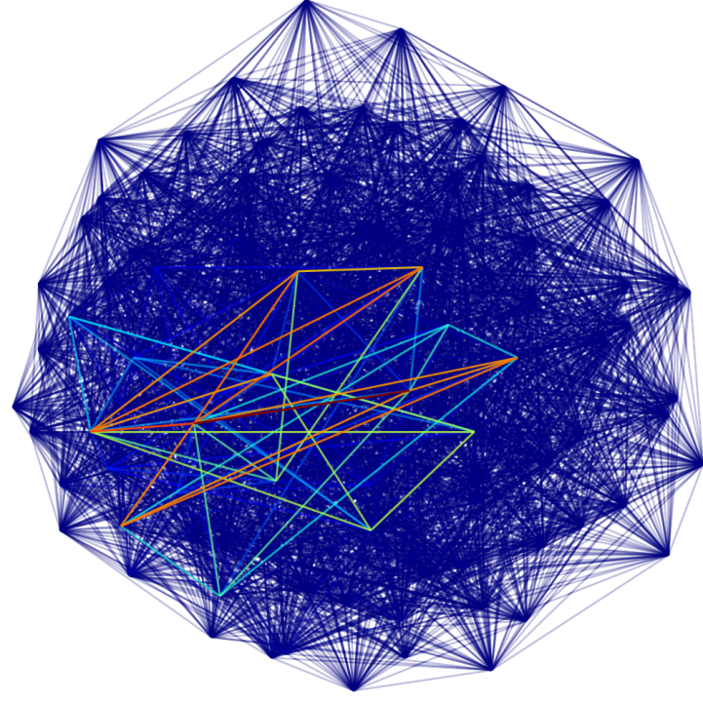
Are these two graphs isomorphic?
...nothing known is sure to be much faster than searching thru all bijections for an isomorphism

Slide 40
Connectedness

Slide 41
Paths
Path: sequence of adjacent vertices
(

Slide 42
Paths
Path: sequence of adjacent vertices
(

Slide 43
Paths
Path: sequence of adjacent vertices
(

Slide 44
Paths
Path: sequence of adjacent vertices
(

Slide 45
Paths
Path: sequence of adjacent vertices
(

Slide 46
Paths
Path: sequence of adjacent vertices
(
)

Slide 47
Connectedness
two vertices are connected
iff there is a path from one
to the other.
a graph is connected iff every
two vertices are connected.

Slide 48
Simple Paths
Simple Path: all vertices different
(
)

Slide 49
Simple Paths
Simple Path: (doesn’t cross itself)
(
)

Slide 50
Paths & Simple Paths
Lemma:
The shortest path between
two vertices is simple!
Proof: (by contradiction) suppose path from u to v crossed itself:
c
u
v

Slide 51
Paths & Simple Paths
Lemma:
The shortest path between
two vertices is simple!
Proof: (by contradiction) suppose path from u to v crossed itself:
then path without c---c is shorter!
c
u
v

Slide 52
Paths & Simple Paths
Lemma:
The shortest path between
two vertices is simple!
Then path without c ···c is shorter:
c
u
v

Slide 53
Team Problems
Problems
1—3

