Slide 1
Mathematics for Computer Science
MIT 6.042J/18.062J
Introduction to
Probability Theory
lec 11F.1

Slide 2
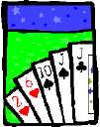
Counting in Probability
What is the probability of getting
exactly two jacks
in a poker hand?
lec 11F.2

Slide 3
Counting in Probability
Outcomes: 5-card hands
Event: hands w/2Jacks
Pr{2 Jacks} ::=
≈ 0.04
lec 11F.3

Slide 4
Probability: 1st Idea
A set of basic experimental
outcomes
A subset of outcomes is an
event
The probability of an event:
lec 11F.4

Slide 5
The Monty Hall Game
Applied Probability:
Let’s Make A Deal
(1970’s TV Game Show)
lec 11F.5

Slide 6
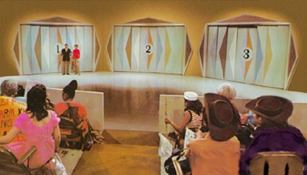
Monty Hall Webpages
http://www.letsmakeadeal.com
lec 11F.6

Slide 7
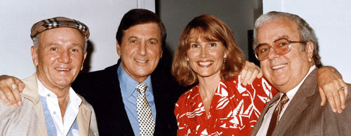
Monty Hall Webpages
Monty Carol Merill
http://www.letsmakeadeal.com
lec 11F.7

Slide 8
The Monty Hall Game
goats behind two doors
prize behind third door
contestant picks a door
Monty reveals a goat
behind an unpicked door
Contest sticks, or switches
to the other unopened door
lec 11F.8

Slide 9
Monty Hall Experiments
We’ll collect data by giving
a few more contestants
a chance to play.
lec 11F.9

Slide 10
Analyzing Monty Hall
Marilyn Vos Savant explained Game
in magazine -- bombarded by letters
(even from PhD’s) debating:
sticking & switching equally good
switching better
lec 11F.10

Slide 11
Analyzing Monty Hall
Determine the outcomes.
-- using a tree of possible
steps can help
lec 11F.11

Slide 12
Monty Hall SWITCH strategy
2
L
L
W
W
W
L
L
W
W
W
L
L
1
3
2
3
SWITCH
Wins: 6
Lose: 6
3
2
1
3
1
1
2
2
3
3
3
1
Prize
location
1
2
2
1
3
2
Door
Picked
1
Door
Opened

Slide 13
Monty Hall STICK strategy
STICK
Lose: 6
Wins: 6
Win by sticking
iff
Lose by switching.

Slide 14
Analyzing Monty Hall
A false conclusion:
sticking and switching have
same # winning outcomes, so
probability of winning
is the same for both: 1/2.
lec 11F.14

Slide 15
Analyzing Monty Hall
Another false argument:
after door opening, 1 goat
and 1 prize are left. Each
door is equally likely to have
the prize (by symmetry), so
both strategies win with
probability: 1/2.
lec 11F.15

Slide 16
Analyzing Monty Hall
What’s wrong?
Let’s look at the outcome
tree more carefully.
lec 11F.16

Slide 17
Monty Hall SWITCH strategy
2
L
1/18
1/2
1
1/2
3
L
1/18
1/3
2
1
3
1/3
W
1/9
1
3
1
2
1/9
W
1/3
W: 6/9 = 2/3
L: 6/18 = 1/3
1/3
W
1
3
1/9
1/3
1
1/3
1/2
1
L
1/18
2
1/3
2
1/3
1/2
3
L
1/18
1/3
3
1
Prize
location
1
W
1/9
3
1/3
1
W
1
2
1/9
1/3
2
1
1
W
1/9
1/3
Door
Picked
1/2
2
L
1/18
3
1/2
1
Door
Opened
L
1/18

Slide 18
Probability: 2nd Idea
Outcomes may have
differing probabilities!
Not always uniform.
lec 11F.18

Slide 19
Finding Probability
Intuition is important but dangerous.
Stick with 4-part method:
Identify outcomes (tree helps)
Identify event (winning)
Assign outcome probabilities
Compute event probabilities
lec 11F.19

Slide 20
really simple analysis
SWITCH strategy wins iff
prize door not picked:
L
Pr{switch wins}
yes
no
W
picks prize door
lec 11F.20

Slide 21
Probability Spaces
Sample space: a countable set, , whose elements are called outcomes.
Probability function,
Pr: →[0, 1], such that
lec 11F.21

Slide 22
Probability Spaces
An event is a subset, E ⊆ S.
Cor: The Sum Rule
lec 11F.22

Slide 23
Probability Spaces
Sample space, , whose elements are called outcomes.
Probability function,
Pr: P()→[0,1]
(a) Pr{} = 1,
(b) the Sum Rule:
lec 11F.23

Slide 24
Sum Rule
for disjoint A, B
Pr{A ∪ B} =
Pr{A} + Pr{B}
lec 11F.24

Slide 25
Sum Rule
For pairwise disjoint A₀,A₁,…
lec 11F.25

Slide 26
Difference Rule
Pr{A-B} =
Pr{A} - Pr{A∩B}
because by Sum Rule:
Pr{A} = Pr{A∩B}+Pr{A-B}
lec 11F.26

Slide 27


Inclusion-Exclusion
Pr{A∪B} =
Pr{A} + Pr{B}
-Pr{A∩B}
lec 11F.27

Slide 28
Inclusion-Exclusion
lec 11F.28

Slide 29
The Union Bound
lec 11F.29

Slide 30
Monotonicity
Pr{A} ≤ Pr{A∪B}
lec 11F.30

Slide 31




Boole’s Inequality
lec 11F.31

Slide 32
Team Problems
Problems
1−4
lec 11F.32

