Slide 1
Very Great Expectations, Gambler’s Ruin
Mathematics for Computer Science MIT 6.042J/18.062J

Slide 2
Repeating Tails
Flip a fair coin until a head;
F ::= #tails. If flip TTTH
then F =3.
Flip again until head. If flip
fewer than F tails, repeat.

Slide 3
Repeating Tails
1st try: TTH, must repeat
2nd try: H, must repeat
3rd try: TH, must repeat
4th try: TTTH, done!
R ::= #repeats
R = 4 here

Slide 4
Repeating Tails
E[R|F=k] =
mean time to flip T^{k}

Slide 5
Repeating Tails
E[R|F=k] =
mean time to flip T^{k}

Slide 6
Repeating Tails
E[R|F=k] =
mean time to flip T^{k}

Slide 7
Infinite Expectation
Can’t use Law of Large Nums
what does sample data look like?
Infrequent large nums increase
the average.
But if E[R] = ∞, maybe

Slide 8
Infinite Expectation
Problems
1--3

Slide 9
(let’s go to Vegas)
Gambler’s Ruin

Slide 10
Gambler’s Ruin
Place $1 bets until going broke or reaching target
What is Pr[reach target]?

Slide 11
Gambler’s Ruin
T
”target"
$$$
n
"initial capital"
# of bets

Slide 12
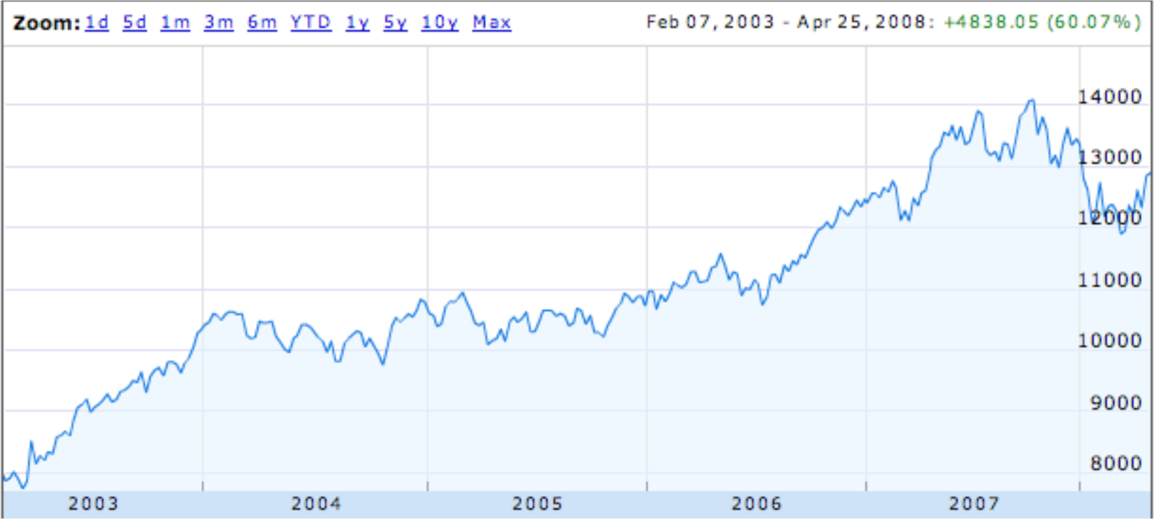
Dow Jones Trend
random steps with “up” bias?

Slide 13
Gambling: Fair Case
Suppose we’re playing a fair game:
Pr[win bet] = 1/2.
What is Pr[reach $200] if we start with $100?
1/2
What about Pr[reach $600] if we start with $500?
5/6

Slide 14
Gambling: Fair Case
In general, if we start with $n
Pr[reach $T] = n/T
What about an unfair game?

Slide 15
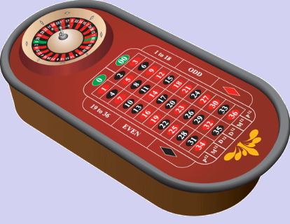
Gambling: Slightly Unfair
Betting black in US roulette
Pr{win bet} = 18/38 = 9/19 < 1/2

Slide 16
US Roulette
What is Pr[reach $500+100] starting with $500? (5/6 when fair)
< 1 / 37,000
What is Pr[reach $1,000,100] starting
with $1,000,000? (≈ 1 when fair)
< 1 / 37,000
no matter how many $ at start!

Slide 17
Gambler’s Ruin
Parameters
p ::= Pr{win $1 bet}
n ::= initial capital
T ::= gambler’s target
What is Pr[reach target]?

Slide 18
Gambler’s Ruin
In fair game (p = ½):

Slide 19
Gambler’s Ruin
In unfair game (p < ½):
intended
profit

Slide 20
Profit $100 in US Roulette
Pr[Profit $100] < (9/10)¹⁰⁰
< 1/37,648

Slide 21
Gambler’s Ruin
View as random walk on a line.
…
…
$0
$1
n-1
n
n+1
T-1
T
p
p ::=Pr{win a bet}
k
k+1
q ::= 1-p = Pr{lose a bet}
k-1
k
q
What is Pr{reach T before 0}?

Slide 22
General Approach
p
…
…
n-1
n
n+1
q
w_{n} ::= Pr{hit target | start at n}
= Pr{target | n+1} • Pr{win bet}
= w_{n+1} • p
+ Pr{target | n-1} • Pr{lose bet}
+ w_{n-1} • q

Slide 23
General Approach
p
…
…
n-1
n
n+1
q
w_{n} = pw_{n+1} + qw_{n-1}, so
w_{n+1} = (1/p)w_{n} - (q/p)w_{n-1}
we have a linear recurrence!

Slide 24
Linear Recurrence
w_{n+1} = (1/p)w_{n} - (q/p)w_{n-1}
w₀ = 0 (Gambler is broke)
w_{T} = 1 (Gambler is at target)
Solve using generating functions, with one twist:
We know w_{T} instead of w₁!

Slide 25
Linear Recurrence
w_{n+1} = (1/p)w_{n} - (q/p)w_{n-1}
w₀ = 0 (Gambler is broke)
w_{T} = 1 (Gambler is at target)
Solve using generating functions
and get:

Slide 26
Linear Recurrence
Twist: we don’t know w₁
for r ::= q/p ≠ 1.
But w_{T} = 1, so can solve for w₁. Then

Slide 27
Winning when Biased Against
intended profit
Suppose p < q, so r ::= q/p > 1.

Slide 28
Winning when Biased Against
(r ::= q/p > 1.)
w_{n} < (1/r)^{T-n}
T-n = intended profit
w_{n} < (1/r)^{intended profit}
Bound for Pr{intended profit} does not depend on n!
Since (1/r) < 1, w_{n} is exponentially decreasing in intended profit!

Slide 29
Profit $100 in US Roulette
p = 18/38
q = 20/38
1/r = 9/10
Pr{Profit $100} < (9/10)¹⁰⁰
< 1/37,648

Slide 30
Profit $200 in US Roulette
p = 18/38
q = 20/38
1/r = 9/10
Pr{Profit $200} < (9/10)²⁰⁰
< 1/70,000,000

Slide 31
What About the Fair Case?
(r ::= q/p = 1)
Uh oh, dividing by 0.
Use l’Hôpital’s Rule
d(r^{n}-1)/dr
nr^{n-1}
lim_{r→1} = =
d(r^{T}-1)/dr
Tr^{T-1}

Slide 32
Team Problems
Problem
4

