Slide 1
Mathematics for Computer Science MIT 6.042J/18.062J
Simple Graphs
Isomorphism
Stable Marriage

Slide 2
The Graph Abstraction
Same graph, different layouts
122
257
122
257
145
99
306
67
99
67
306
145

Slide 3
The Graph Abstraction
picture of a graph
122
257
67
99
145
306

Slide 4
The Graph Abstraction
picture of same graph
122
67
257
99
145
306

Slide 5
The Graph Abstraction
picture of same graph
257
67
122
99
145
306

Slide 6
The Graph Abstraction
picture of same graph
67
122
99
257
145
306

Slide 7
The Graph Abstraction
picture of same graph
67
122
99
257
145
306

Slide 8
The Graph Abstraction
picture of same graph
67
122
99
257
145
306

Slide 9
The Graph Abstraction
picture of same graph
145
99
257
122
306
67

Slide 10
The Graph Abstraction
Same layout, different vertices
122
145
Albert
Grant
Sharat
257
306
67
Christos
Sonya
99
Jessica

Slide 11
The Graph Abstraction
All that matters
are the connections:
graphs with the
same connections
are isomorphic

Slide 12
Isomorphism
two graphs are isomorphic
when there is an
edge-preserving
bijection
between their vertices.

Slide 13
Are these isomorphic?
Hay
Dog
Pig
Corn
Cow
Cat
Beef
Tuna
f(Dog) = Beef
f(Cat) = Tuna
f(Cow) = Hay
f(Pig) = Corn

Slide 14
Edges preserved?
Hay
Dog
Pig
Corn
Cow
Cat
Beef
Tuna

Slide 15
Edges preserved?
YES!
Hay
Dog
Pig
Corn
Cow
Cat
Beef
Tuna

Slide 16
Nonedges preserved?
Hay
Dog
Pig
Corn
Cow
Cat
Beef
Tuna

Slide 17
Nonedges preserved?
YES!
Hay
Dog
Pig
Corn
Cow
Cat
Beef
Tuna
isomorphic!

Slide 18
Formal Def of Graph Isomorphism
G₁ isomorphic to G₂ means
edge-preserving vertex matching:
∃ bijection f:V₁ → V₂ with
u—v in E₁ iff f(u)—f(v) in E₂

Slide 19
Nonisomorphism
degree 2
all degree 3

Slide 20
Proving nonisomorphism
If some property preserved by
isomorphism differs for two
graphs, then they’re not isomorphic:
# of nodes,
# of edges,
degree distributions, ….

Slide 21
Finding an isomorphism?
many possible mappings: large search
can use properties preserved by
isomorphisms as a guide, for example:
a deg 4 vertex adjacent to a deg 3
can only match with
a deg 4 vertex also adjacent to a deg 3
but even so…

Slide 22
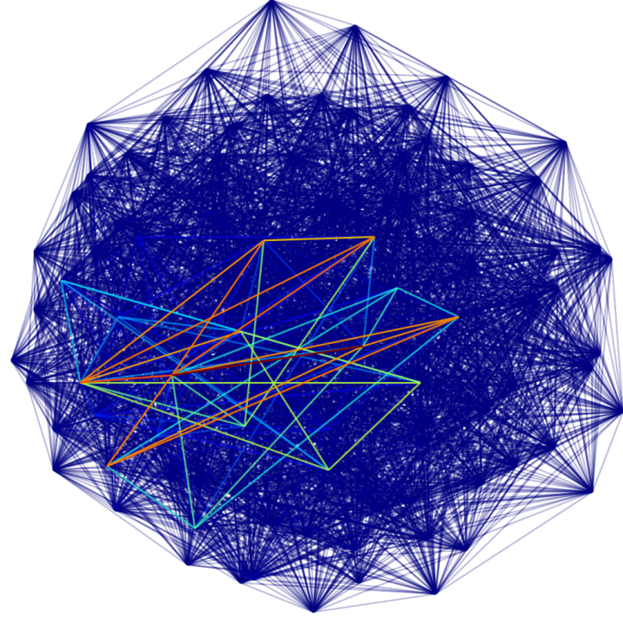
Are these two graphs isomorphic?
...nothing known is sure to be much faster than searching thru all bijections for an isomorphism

Slide 23
Mathematics for Computer Science MIT 6.042J/18.062J
Stable Matching

Slide 24
Stable Marriage
A Marriage Problem
1 2 3 4 5
Boys
Girls
A B C D E

Slide 25
Stable Marriage
Preferences
Boys Girls
1 : CBEAD A : 35214
2 : ABECD B : 52143
3 : DCBAE C : 43512
4 : ACDBE D : 12345
5 : ABDEC E : 23415

Slide 26
Stable Marriage
1: CBEAD
2 : ABECD
3 : DCBAE
4 : ACDBE
5 : ABDEC
Preferences
Try “greedy”
strategy for boys

Slide 27
Stable Marriage
Preferences
Marry Boy 1 with Girl C
(his 1st choice)
1: CBEAD
2 : ABECD
3 : DCBAE
4 : ACDBE
5 : ABDEC
1
C

Slide 28
Stable Marriage
Preferences
2 : ABE D
3 : D BAE
4 : A DBE
5 : ABDE

Slide 29
Stable Marriage
Preferences
2 : ABED
3 : DBAE
4 : ADBE
5 : ABDE

Slide 30
Stable Marriage
Next:
Preferences
Marry Boy 2 with Girl A
(his remaining 1st choice)
2 : ABED
3 : DBAE
4 : ADBE
5 : ABDE
2
A

Slide 31
Stable Marriage
Final “boy greedy” marriages
1 C
2 A
3 D
4 B
5 E

Slide 32
Stable Marriage
Trouble!
1
C
4
B

Slide 33
Stable Marriage
Boy 4 likes Girl C better than his wife.
1
C
4
B

Slide 34
Stable Marriage
and vice-versa
1
C
4
B

Slide 35
Stable Marriage
a rogue couple
1
C
4
B

Slide 36
Stable Marriage
Stable Marriage Problem:
Marry everyone without any rogue couples!

Slide 37
Stable Marriage
Let’s try it!

Slide 38
Stable Marriage
Let’s Try it!
Volunteers?:
5 Boys & 5 Girls

Slide 39
Stable Marriage
Preferences
Boys Girls
1 : CBEAD A : 35214
2 : ABECD B : 52143
3 : DCBAE C : 43512
4 : ACDBE D : 12345
5 : ABDEC E : 23415

Slide 40
Stable Marriage I
5 A
2 B
4 C
3 D
1 E
“boy optimal”

Slide 41
Stable Marriage II.
3 A
5 B
4 C
1 D
2 E
all girls get 1st choice

Slide 42
Stable Marriage
More than a puzzle:
College Admissions
(original Gale & Shapley paper, 1962)
Matching Hospitals & Residents.
Matching Dance Partners.

Slide 43
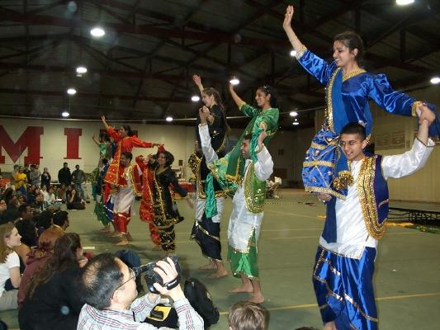
Stable Marriage

Slide 44
The Mating Ritual
(day by day)

Slide 45
Mating Ritual
Morning: boy serenades favorite girl
Angelina
Billy Bob
Brad

Slide 46
Mating Ritual
Morning: boy serenades favorite girl
Afternoon: girl rejects all but favorite
if you’re not Brad
take a hike!
Angelina
Billy Bob
Brad

Slide 47
Mating Ritual
Morning: boy serenades favorite girl
Afternoon: girl rejects all but favorite
Evening: rejected boy writes off girl
…
Angelina
…
Billy Bob

Slide 48
Mating Ritual
Stop when no girl rejects.
Each girl marries her
favorite suitor (if any).

Slide 49
Mating Ritual
Termination:
there exists a Wedding Day.
Partial Correctness:
everyone is married.
marriages are stable.

Slide 50
Stable Marriage: termination
total # remaining names
on boy’s lists:
strictly decreasing
& -valued
So ∃ Wedding Day

Slide 51
Mating Ritual: variables
Carole’s preferred suitor:
favorite (Carole)
::= max{suitors (Carole)}
using Carole’s preference
order.

Slide 52
Mating Ritual
Different girls have different
favorites, because boys
serenade one girl at a time.
(favorite: Girls→Boys
is an injection)

Slide 53
Mating Ritual: girls improve
Lemma:
A girl’s favorite tomorrow
will be at least as desirable
as today’s.
…because today’s favorite will
stay until she rejects him for someone better.

Slide 54
Mating Ritual: girls improve
Lemma:
A girl’s favorite tomorrow
will be at least as desirable
as today’s.
(favorite (G) is weakly
increasing for each G)

Slide 55
Mating Ritual: boys get worse
Lemma:
A boy’s 1st love tomorrow
will be no more desirable
than today’s.
…because boys work straight down their lists.

Slide 56
Mating Ritual: boys get worse
Lemma:
A boy’s 1st love tomorrow
will be no more desirable
than today’s.
(serenading (B) is weakly
decreasing for each B)

Slide 57
Mating Ritual: invariant
If G is not on B’s list, then she
has a better current favorite.
Proof: When G rejected B she
had a better suitor, and
favorite (G) is weakly increasing.

Slide 58
On Wedding Day
Each girl has ≤ 1 suitors
(by def of wedding day)
Each boy is married, or
has no girls on his list

Slide 59
Mating Ritual: everyone marries
Everyone is married on wedding day
Proof: by contradiction.
If B is not married, his list is empty.
By Invariant, all girls have favorites
better than B -- so they do have a favorite.
That is, all girls are married,
so all boys are married.

Slide 60
Mating Ritual: stable marriages
Marriages are Stable:
Bob won’t be in rogue couple with
case 1: a girl G on his final list,
since he’s already married to the best of them.

Slide 61
Mating Ritual: stable marriages
Marriages are Stable:
Bob won’t be in rogue couple with
case 2: a girl G not on his list,
since by invariant, G likes her spouse better than Bob.

Slide 62
Mating Ritual
Who does better,
boys or girls?
Girls’ suitors get better, and boy’s sweethearts get worse, so girls do better?
No!

Slide 63
Boy Optimal
Mating Ritual is Optimal for all Boys at once.
Pessimal for all Girls.

Slide 64
Boy Optimal
Prove boy optimal by contradiction:
Suppose some boy does not get his
optimal girl. So he must have crossed
off his optimal on some earlier “bad”
day. Consider the 1st bad day.

Slide 65
Boy Optimal
On 1st bad day some boy, Keith, crosses off
his optimal girl, Nicole.
This must happen
because some boy, Tom, whom Nicole likes
better than Keith, is serenading her.
Nicole is optimal for Keith
Nicole prefers Tom to Keith

Slide 66
Boy Optimal
On 1st bad day, Tom has not
crossed off his optimal girl and
is serenading Nicole, so
Nicole is optimal or better for Tom

Slide 67
Boy Optimal
So assuming there is a bad day,
Nicole is optimal or better for Tom
Nicole is optimal for Keith
Nicole prefers Tom to Keith
Now there must be some other
stable marriages with Keith
married to Nicole.
But then Nicole & Tom are rogue, contradicting stability.

Slide 68
Girl Pessimal
Similar, easier, argument
implies each girl gets
her worst possible boy.

Slide 69
Stable Marriage
More questions, rich theory
other stable marriages
possible?
-can be many
do better by lying?
boys -No! girls -Yes!

Slide 70
Team Problems
Problems
1-4

