Slide 1
Mathematics for Computer Science MIT 6.042J/18.062J
Simple Graphs
Isomorphism
Stable Marriage

Slide 2
The Graph Abstraction
Same graph, different layouts
122
257
122
257
145
99
306
67
99
67
306
145

Slide 3
The Graph Abstraction
picture of a graph
122
257
67
99
145
306

Slide 4
The Graph Abstraction
picture of same graph
122
67
257
99
145
306

Slide 5
The Graph Abstraction
picture of same graph
257
67
122
99
145
306

Slide 6
The Graph Abstraction
picture of same graph
67
122
99
257
145
306

Slide 7
The Graph Abstraction
picture of same graph
67
122
99
257
145
306

Slide 8
The Graph Abstraction
picture of same graph
67
122
99
257
145
306

Slide 9
The Graph Abstraction
picture of same graph
145
99
257
122
306
67

Slide 10
The Graph Abstraction
Same layout, different vertices
122
145
Albert
Grant
Sharat
257
306
67
Christos
Sonya
99
Jessica

Slide 11
The Graph Abstraction
All that matters
are the connections:
graphs with the
same connections
are isomorphic

Slide 12
Isomorphism
two graphs are isomorphic
when there is an
edge-preserving
bijection
between their vertices.

Slide 13
Are these isomorphic?
Hay
Dog
Pig
Corn
Cow
Cat
Beef
Tuna
f(Dog) = Beef
f(Cat) = Tuna
f(Cow) = Hay
f(Pig) = Corn

Slide 14
Edges preserved?
Hay
Dog
Pig
Corn
Cow
Cat
Beef
Tuna

Slide 15
Edges preserved?
YES!
Hay
Dog
Pig
Corn
Cow
Cat
Beef
Tuna

Slide 16
Nonedges preserved?
Hay
Dog
Pig
Corn
Cow
Cat
Beef
Tuna

Slide 17
Nonedges preserved?
YES!
Hay
Dog
Pig
Corn
Cow
Cat
Beef
Tuna
isomorphic!

Slide 18
Formal Def of Graph Isomorphism
G₁ isomorphic to G₂ means
edge-preserving vertex matching:
∃ bijection f:V₁ → V₂ with
u—v in E₁ iff f(u)—f(v) in E₂

Slide 19
Nonisomorphism
degree 2
all degree 3

Slide 20
Proving nonisomorphism
If some property preserved by
isomorphism differs for two
graphs, then they’re not isomorphic:
# of nodes,
# of edges,
degree distributions, ….

Slide 21
Finding an isomorphism?
many possible mappings: large search
can use properties preserved by
isomorphisms as a guide, for example:
a deg 4 vertex adjacent to a deg 3
can only match with
a deg 4 vertex also adjacent to a deg 3
but even so…

Slide 22
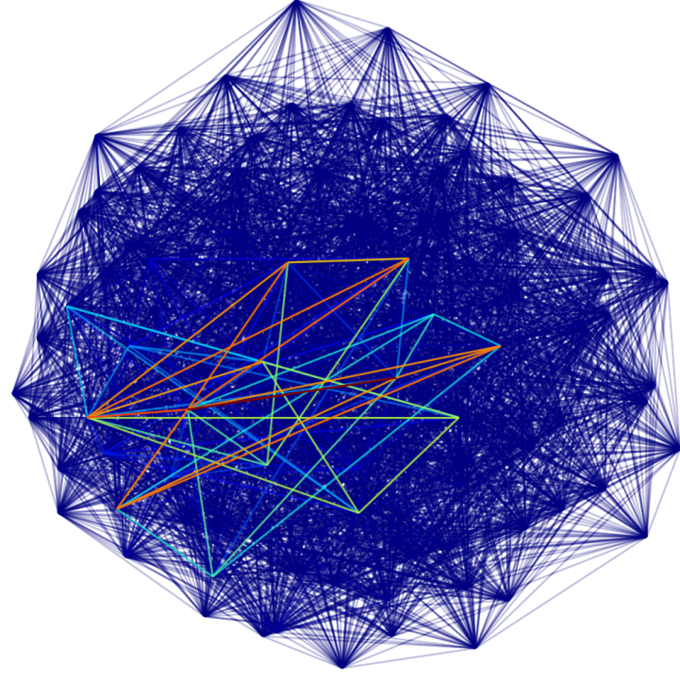
Are these two graphs isomorphic?
...nothing known is sure to be much faster than searching thru all bijections for an isomorphism

Slide 23
Mathematics for Computer Science MIT 6.042J/18.062J
Stable Matching

Slide 24
Stable Marriage
A Marriage Problem
1 2 3 4 5
Boys
Girls
A B C D E

Slide 25
Stable Marriage
Preferences
Boys Girls
1 : CBEAD A : 35214
2 : ABECD B : 52143
3 : DCBAE C : 43512
4 : ACDBE D : 12345
5 : ABDEC E : 23415

Slide 26
Stable Marriage
1: CBEAD
2 : ABECD
3 : DCBAE
4 : ACDBE
5 : ABDEC
Preferences
Try “greedy”
strategy for boys

Slide 27
Stable Marriage
Preferences
Marry Boy 1 with Girl C
(his 1st choice)
1: CBEAD
2 : ABECD
3 : DCBAE
4 : ACDBE
5 : ABDEC
1
C

Slide 28
Stable Marriage
Preferences
2 : ABE D
3 : D BAE
4 : A DBE
5 : ABDE

Slide 29
Stable Marriage
Preferences
2 : ABED
3 : DBAE
4 : ADBE
5 : ABDE

Slide 30
Stable Marriage
Next:
Preferences
Marry Boy 2 with Girl A
(his remaining 1st choice)
2 : ABED
3 : DBAE
4 : ADBE
5 : ABDE
2
A

Slide 31
Stable Marriage
Final “boy greedy” marriages
1 C
2 A
3 D
4 B
5 E

Slide 32
Stable Marriage
Trouble!
1
C
4
B

Slide 33
Stable Marriage
Boy 4 likes Girl C better than his wife.
1
C
4
B

Slide 34
Stable Marriage
and vice-versa
1
C
4
B

Slide 35
Stable Marriage
a rogue couple
1
C
4
B

Slide 36
Stable Marriage
Stable Marriage Problem:
Marry everyone without any rogue couples!

Slide 37
Stable Marriage
Let’s try it!

Slide 38
Stable Marriage
Let’s Try it!
Volunteers?:
5 Boys & 5 Girls

Slide 39
Stable Marriage
Preferences
Boys Girls
1 : CBEAD A : 35214
2 : ABECD B : 52143
3 : DCBAE C : 43512
4 : ACDBE D : 12345
5 : ABDEC E : 23415

Slide 40
Stable Marriage I
5 A
2 B
4 C
3 D
1 E
“boy optimal”

Slide 41
Stable Marriage II.
3 A
5 B
4 C
1 D
2 E
all girls get 1st choice

Slide 42
Stable Marriage
More than a puzzle:
College Admissions
(original Gale & Shapley paper, 1962)
Matching Hospitals & Residents.
Matching Dance Partners.

Slide 43
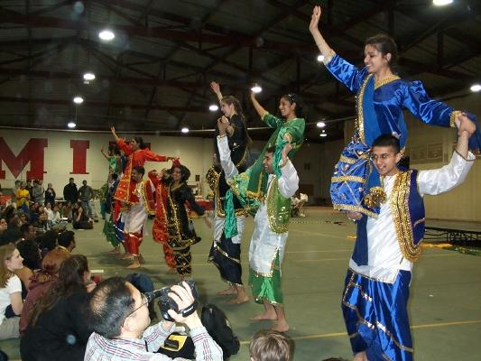
Stable Marriage

Slide 44
Team Problems
Problems
1-4

