Slide 1
Mathematics for Computer Science MIT 6.042J/18.062J
Harmonic Sum
Integral Method

Slide 2
Mathematics for Computer Science MIT 6.042J/18.062J
Geometric & Harmonic Sums

Slide 3
Geometric Sum

Slide 4
Geometric Sum
G_{n}-xG_{n}=
1 - x^{n+1}

Slide 5
Geometric Sum
G_{n}-xG_{n}=
1 - x^{n+1}

Slide 6
Geometric Series
a series is an infinite sum

Slide 7
Infinite Geometric Series

Slide 8
Infinite Geometric Series
for |x| < 1

Slide 9
Harmonic Sums, Integral Method

Slide 10
Book Stacking
table
Copyright © Albert R. Meyer, 2007. All rights reserved.

Slide 11
Book Stacking
How far out?
?
overhang
Copyright © Albert R. Meyer, 2007. All rights reserved.

Slide 12
Book Stacking
One book
book center
of mass
Copyright © Albert R. Meyer, 2007. All rights reserved.

Slide 13
Book Stacking
One book
book center
of mass
Copyright © Albert R. Meyer, 2007. All rights reserved.

Slide 14
Book Stacking
balances if
center of mass
over table
book center
of mass
One book
1
2
Copyright © Albert R. Meyer, 2007. All rights reserved.

Slide 15
n books
1
2
n
Copyright © Albert R. Meyer, 2007. All rights reserved.

Slide 16
n books
1
2
n
center
of mass
Copyright © Albert R. Meyer, 2007. All rights reserved.

Slide 17
n books
1
2
n
Copyright © Albert R. Meyer, 2007. All rights reserved.

Slide 18
n books
1
2
center of mass
of the whole stack
n
balances if
center of mass
over table
Copyright © Albert R. Meyer, 2007. All rights reserved.

Slide 19
n+1 books
1
2
center of mass
of all n+1 books
at table edge
center of mass of top n books at edge of book n+1
n
n+1
∆overhang
Copyright © Albert R. Meyer, 2007. All rights reserved.

Slide 20
Δ-overhang ::=
horizontal distance from
n-book to (n+1)-book
centers of mass

Slide 21
Δ-overhang
Δ
n
1
1/2

Slide 22
center of n-stack at x = 0.
center of n+1st book is at x = 1/2,
so center of n+1-stack is at

Slide 23
n+1 books
1
2
center of mass
of all n+1 books
center of mass of top n books
n
n+1

Slide 24
Book stacking summary
B_{n} ::= overhang of n books
B₁ = 1/2
B_{n+1} = B_{n} +
B_{n} =

Slide 25
Harmonic Sums
n^{th} Harmonic number
B_{n} = H_{n}/2

Slide 26
Integral estimate for H_{n}
1
1
x+1
1
2
1
3
1
1
2
1
3
0 1 2 3 4 5 6 7 8

Slide 27
Integral estimate for H_{n}
H_{n} = area of rectangles
> area under 1/(x+1) =

Slide 29
ln (n+1) ≤ H_{n}

Slide 30
Book stacking
for overhang 3, need B_{n} ≥ 3
H_{n} ≥ 6
integral bound: ln(n+1) ≥ 6
so ok with n ≥ ⎡e⁶-1⎤ = 403 books
actually calculate H_{n}:
227 books are enough.

Slide 31
Book stacking
H_{n}→∞ as n→∞,
so overhang can be
as big as desired!

Slide 32
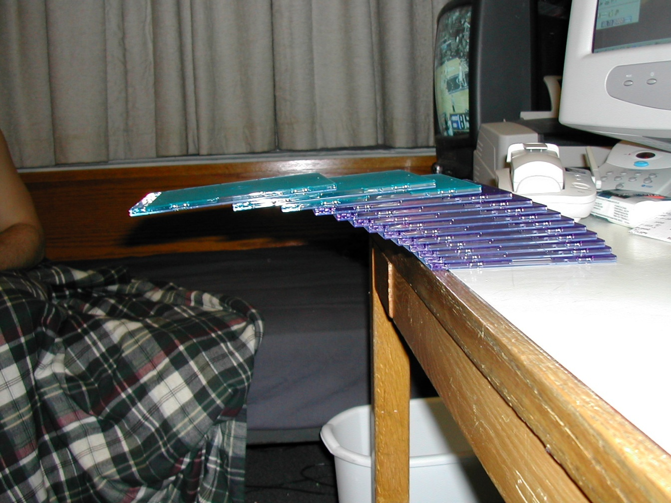
CD case past the edge
see 6.042 Spring02 demo page for credits

Slide 33
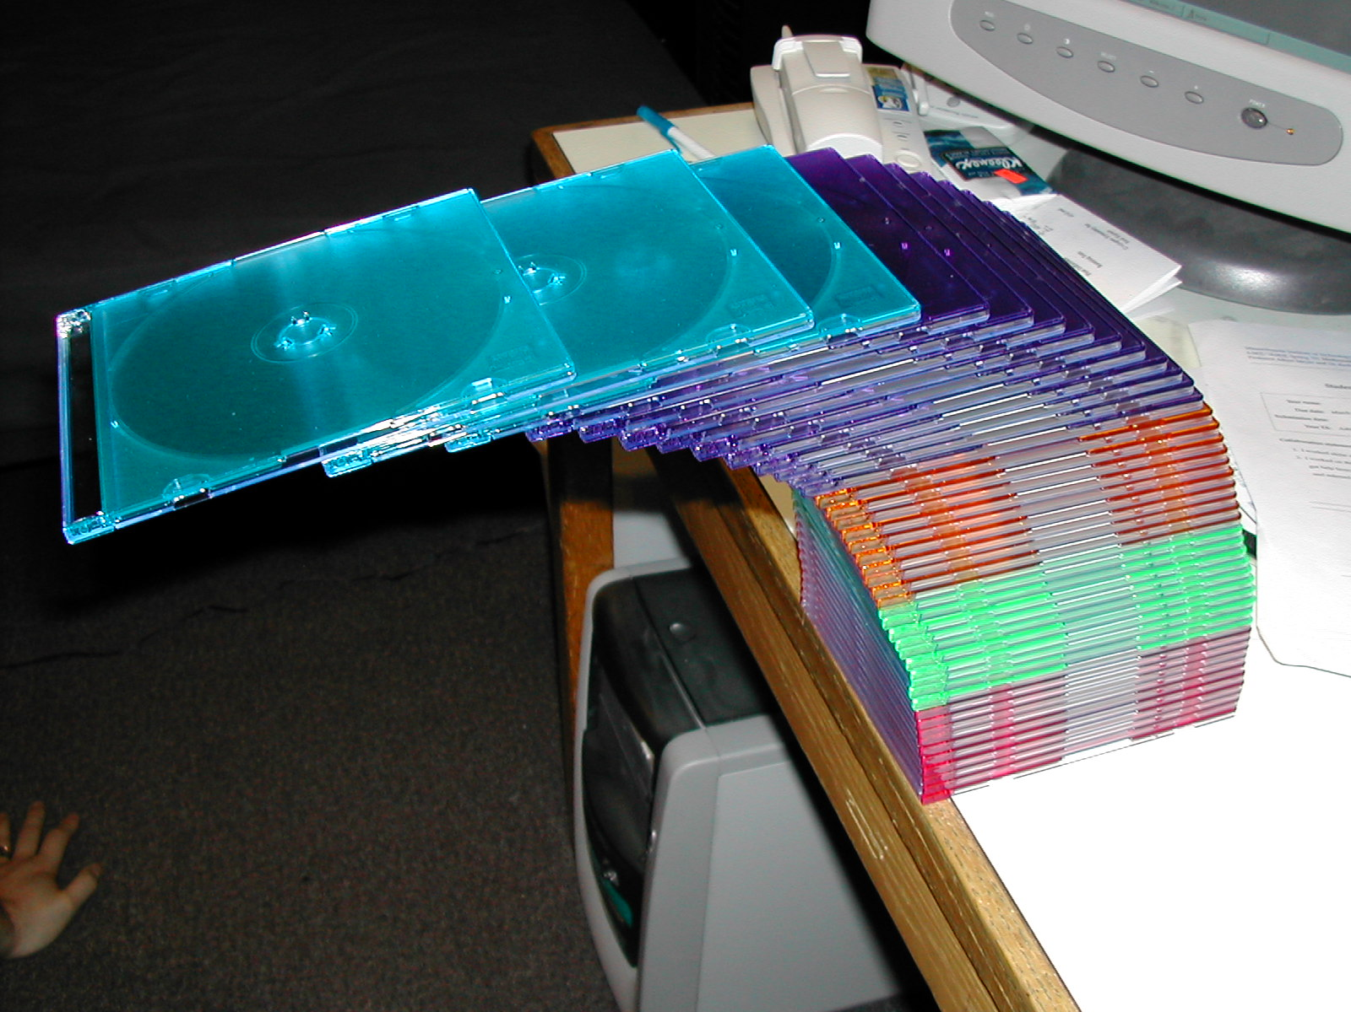
CD cases over the edge
43 cases high --top 4 cases completely off the table --1.8 or 1.9 case-lengths

Slide 34
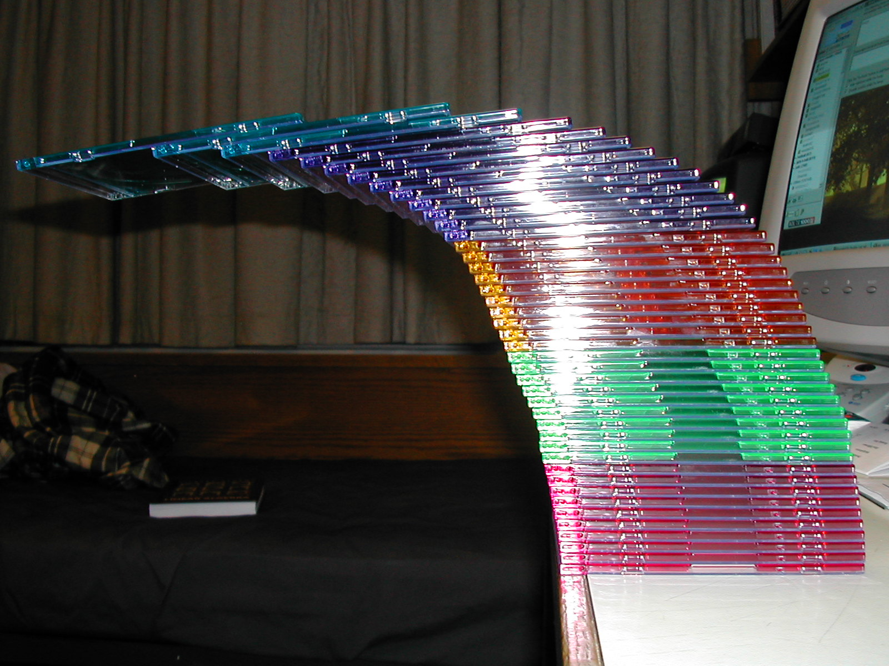
stack of 43 CD’s

Slide 35
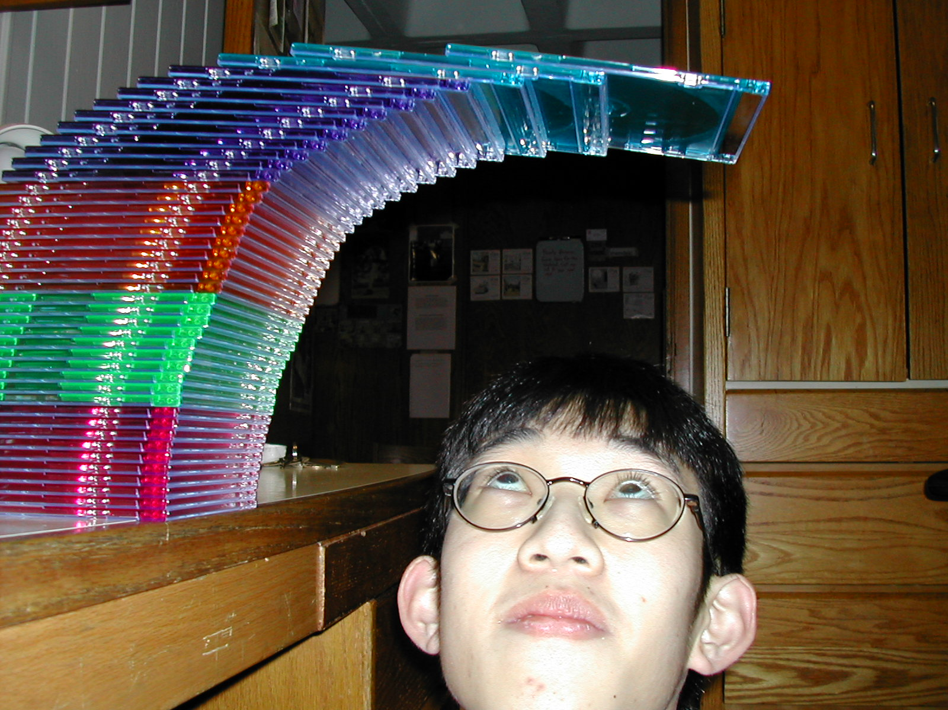
stack of 43 CD’s
see 6.042 Spring02 demo page for credits

Slide 36
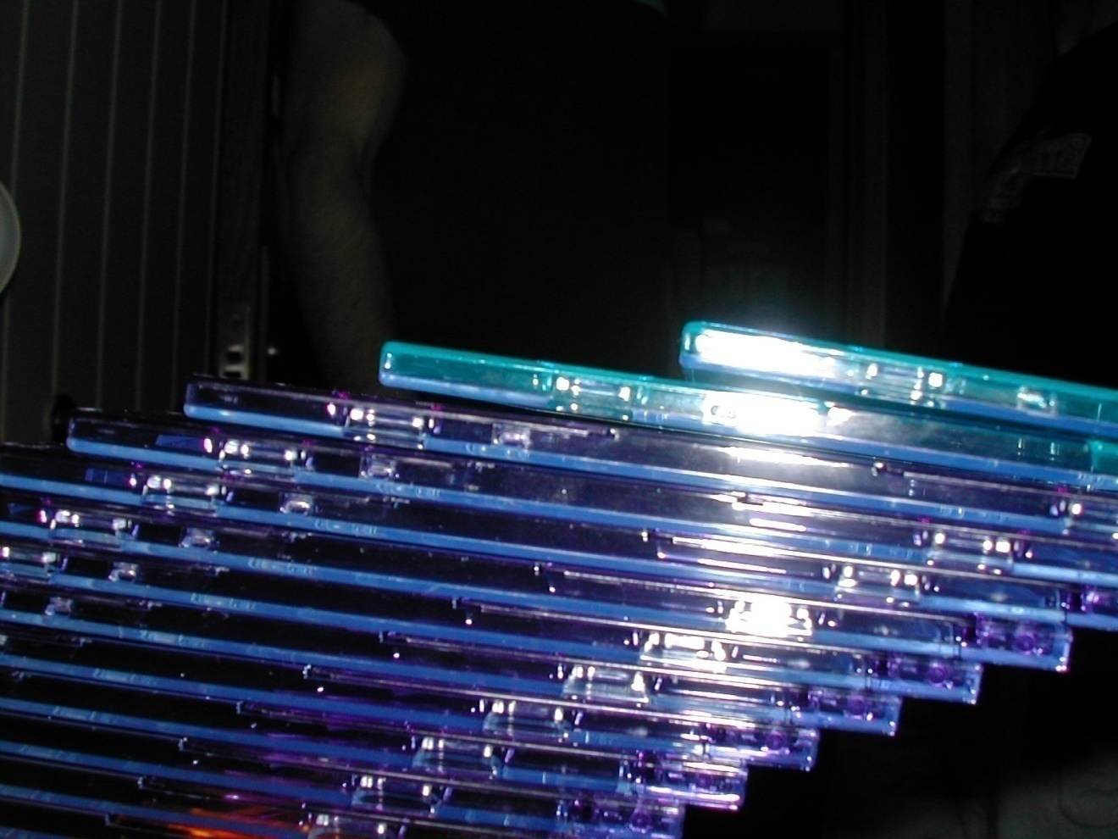
don’t sneeze

Slide 37
Upper bound for H_{n}
1
1
2
1
3
1
1
2
1
3
0 1 2 3 4 5 6 7 8

Slide 38
Upper bound for H_{n}

Slide 39
Asymptotic bound for H_{n}
ln(n+1) < H_{n} < 1+ ln(n)
H_{n} ∼ ln(n)

Slide 40
Asymptotic Equivalence
Def: f(n) ~ g(n)

Slide 41
Asymptotic Equivalence ~
Example: (n² + n) ~ n²
pf:

Slide 42
Team Problems
MiniQuiz
then Probs 1&2
Notes:
36

Slide 43
Team Problems
Problems
1―4
Notes:
36

Slide 44
Closed form for n!
Turn product into a sum taking logs:
ln(n!) = ln( 1·2·3···(n – 1)·n ) =
ln 1 + ln 2 + · · · + ln(n – 1) + ln(n)

Slide 45
Closed form for n!
Integral Method to bound
ln n
ln(x)
…
ln(x+1)
ln 5
ln 4
ln 3
ln
n-1
ln n
ln 5
ln 2
ln 4
…
ln 3
ln 2
1
2
3
4
5
n–2
n–1
n

Slide 46
Closed form for n!
reminder:

Slide 47
Closed form for n!
exponentiating:

Slide 48
Stirling’s Formula
A precise approximation:

