Slide 1
Mathematics for Computer Science MIT 6.042J/18.062J
Euler’s Theorem

Slide 2
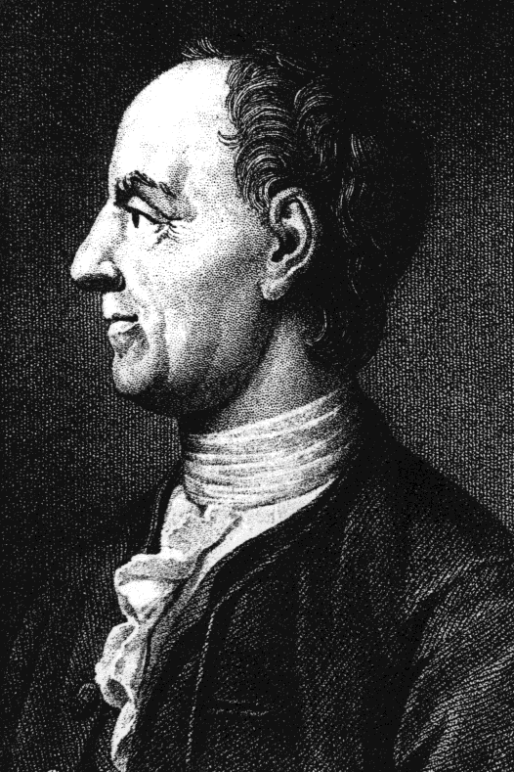
Euler’s Theorem
For k relatively
prime to n,
k^{φ(n)} ≡ 1 (mod n)

Slide 3
Fermat’s “Little” Theorem
special case:
k^{p-1} ≡ 1 (mod p)
for prime p
k ∊ [1,p)

Slide 4
Euler φ function
φ(n) ::= # k ∈ [0,n) s.t.
k has a (mod n) inverse

Slide 5
Proof of Euler’s Theorem
n* ::=
{m∈[1,n)| m rel prime to n}
Note: m,k ∈ n* implies
m⋅k rel. prime to n
rem(mk,n) ∈ n*

Slide 6
Permuting n*
Lemma:
For k∈n*, the mapping
m → rem(km, n)
is a bijection from n* to n*
mult by k∈n*, permutes n*
lec 6W.6

Slide 7
permuting (mod 9)
φ(9) = 3²-3 = 6
9*=
 | 1 | 2 | 4 | 5 | 7 | 8

Slide 8
permuting (mod 9)
φ(9) = 3²-3 = 6
 | 1 | 2 | 4 | 5 | 7 | 8
2⋅ | 2 | 4 | 8 | 1 | 5 | 7
9*=
 | 1 | 2 | 4 | 5 | 7 | 8

Slide 9
permuting (mod 9)
φ(9) = 3²-3 = 6
9*=
 | 1 | 2 | 4 | 5 | 7 | 8
2⋅ | 2 | 4 | 8 | 1 | 5 | 7
7⋅ | 7 | 5 | 1 | 8 | 4 | 2

Slide 10
Proof of Euler’s Thm
say n*= {m₁,m₂,…,m_{s}}, k∈n*
none of
≡ (mod n) because k cancels
so each m_{i}k ≡ m_{j} (mod n)
for a unique m_{j.}
m₁k, m₂k, …, m_{s}k

Slide 11
Proof of Euler’s Thm
in particular,
m₁⋅m₂ ∙∙∙ ⋅m_{s}
≡ (m₁k)⋅(m₂k)∙∙∙(m_{s}k) (mod n)
now cancel the m_{i}’s

Slide 12
Proof of Euler’s Thm
in particular,
1
≡ ( k)⋅( k) ∙∙∙ ( k) (mod n)

Slide 13
Proof of Euler’s Thm
in particular,
1
≡ k^{s} (mod n)

Slide 14
Proof of Euler’s Thm
in particular,
1 ≡ k^{s} (mod n)
φ(n)
QED

Slide 15
Proof of Euler’s Thm
So

Slide 16
Proof of Euler’s Thm

Slide 17
Proof of Euler’s Thm

Slide 18
Proof of Euler’s Thm
But OK to cancel , so
1 ≡ k^{φ(n)} (mod n).
QED

