Slide 1
Induction

Slide 2
The Idea of Induction
Color the integers ≥ 0
0, 1, 2, 3, 4, 5, ?, …
I tell you, 0 is red, & any int
next to a red integer is red,
then you know that
all the ints are red!

Slide 3
The Idea of Induction
Color the integers ≥ 0
0, 1, 2, 3, 4, 5, …
I tell you, 0 is red, & any int
next to a red integer is red,
then you know that
all the ints are red!

Slide 4
Induction Rule

Slide 5
Induction Rule

Slide 6
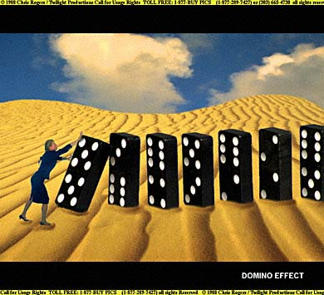
Like Dominos…

Slide 7
Example Induction Proof
Let’s prove:
(for r ≠ 1)

Slide 8
Example Induction Proof
Statements in magenta form a
template for inductive proofs:
Proof: (by induction on n)
The induction hypothesis, P(n), is:
(for r ≠ 1)

Slide 9
Example Induction Proof
Base Case (n = 0):
1
OK!

Slide 10
Example Induction Proof
Inductive Step: Assume P(n)
where n ≥ 0 and prove P(n+1):

Slide 11
Example Induction Proof
Now from induction
hypothesis P(n) we have
so add r^{n+1} to both sides

Slide 12
Example Induction Proof
adding r^{n+1} to both sides,
This proves
P(n+1)
completing the
proof by induction.

Slide 13
an aside: ellipsis
Means you
should see a pattern:
“☹” is an ellipsis.
Can lead to confusion (n = 0?)
sum (∑) notation more precise

Slide 14
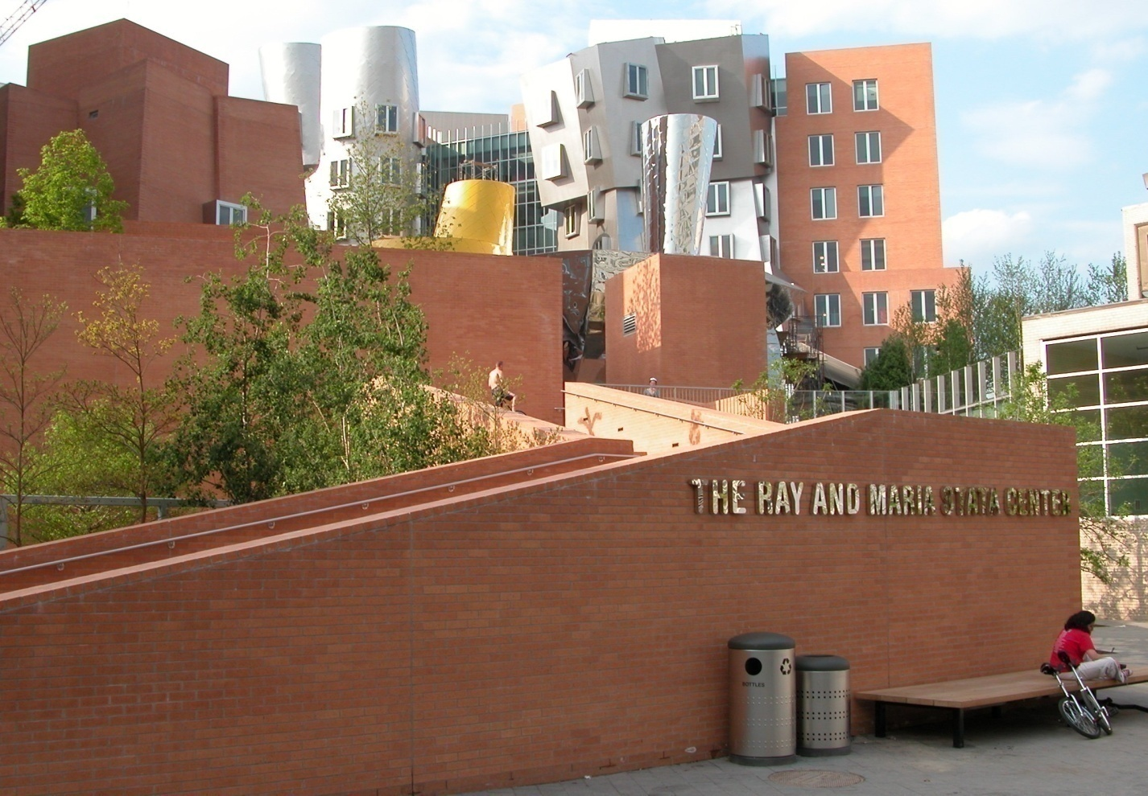
The MIT Stata Center

Slide 15
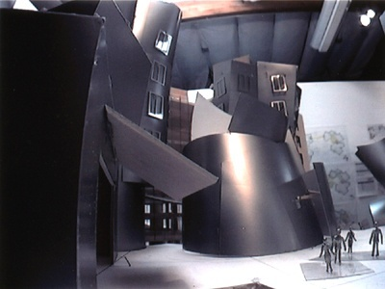
Design Mockup: Stata Lobby

Slide 16

Mockup: Plaza Outside Stata
Goal: Tile the plaza
, except for 1×1
square in the middle for Bill.
(Picture source: http://www.microsoft.com/presspass/exec/billg/default.asp)

Slide 17

Plaza Outside Stata
Gehry speciﬁes L-shaped tiles covering
three squares:
For example, for 8 x 8 plaza might tile for Bill
this way:

Slide 18
Plaza Outside Stata
Theorem: For any 2^{n}⋅2^{n} plaza, we can
make Bill and Frank happy.
Proof: (by induction on n)
P(n) ::= can tile 2^{n}⋅2^{n} with Bill in middle.
Base case: (n=0)
(no tiles needed)

Slide 19
Plaza Outside Stata
Induction step: assume can tile
2^{n}⋅2^{n}, prove can tile 2^{n+1}⋅2^{n+1}

Slide 20
Plaza Outside Stata
Now what?...

Slide 21
Plaza Outside Stata
The fix:
prove something stronger
—that we can find a tiling
with Bill in any square.

Slide 22
Plaza Theorem
Theorem: For any 2^{n}⋅2^{n} plaza, we
can make Bill and Frank happy.
Proof: (by induction on n)
revised induction hypothesis P(n) ::=
can tile with Bill anywhere
Base case: (n=0) as before

Slide 23
Plaza Proof
Inductive step:
Assume we can get Bill anywhere in 2^{n}⋅2^{n}
Prove we can get Bill anywhere in 2^{n+1}⋅2^{n+1}

Slide 24
Plaza Proof
Now group the squares together,
and fill the center Bill’s with a tile.
Done!

Slide 25
Recursive Procedure
Note: The induction proof
implicitly defines a
recursive procedure
for tiling with Bill anywhere.

Slide 26
plaza outside Stata
The fix:
prove something else
--that we can always
find a tiling with
Bill in the corner.

Slide 27
plaza outside Stata
Once have Bill in corner,
can get Bill in middle:

Slide 28
plaza outside Stata
method:
rotate the squares as indicated.

Slide 29



plaza outside Stata
after rotation have:

Slide 30
plaza outside Stata
now group the 4 squares together,
and insert a tile.
Done!
Bill in
middle

Slide 31
plaza theorem
Theorem: For any 2^{n}⋅2^{n} plaza, we can
make Bill and Frank happy.
Proof: (by induction on n)
REVISED induction hypothesis P(n) ::=
can tile 2^{n}⋅2^{n} with Bill in the corner
Base case: (n=0) as before

Slide 32
plaza proof
Induction step:
Assume we can get Bill in corner of 2^{n}⋅2^{n}.
Prove we can get Bill in corner of 2^{n+1}⋅2^{n+1}.

Slide 33
plaza proof
method: rotate the squares as indicated.

Slide 34
plaza proof
after rotation have:

Slide 35
plaza proof
now group the squares together,
and fill the center with a tile.
Done!

Slide 36
ingenious induction hypothesis
Note 1: To prove
“Bill in middle,” we
proved something else: “Bill in corner.”

Slide 37
stronger induction hypotheses
Note 2: It may help to
choose a stronger hypothesis
than the desired result.
(example in class problem)

Slide 38
recursive procedure
Note 3: The induction proof
of “Bill in corner” implicitly
defines a recursive procedure
for finding corner tilings.

