Slide 1
Mathematics for Computer Science MIT 6.042J/18.062J
Euler’s Function

Slide 2
Euler φ function
φ(n) ::= # k∈0,1 …,n-1
s.t. k rel. prime to n
[0,n)

Slide 3
Euler φ function
φ(n) ::= # k∈ [0,n)
s.t. gcd(k,n) = 1

Slide 4
Euler φ function
gcd1{n} ::=
{k ∈ [0,n) | gcd(k,n)=1}
so φ(n) = |gcd1{n}|
(some books write
n* for gcd1{n})

Slide 5
Euler φ function
gcd1{n} ::=
{k ∈ [0,n) | gcd(k,n)=1}
gcd1{7} = {1,2,3,4,5,6}
gcd1{12} =
{0,1,2,3,4,5,6,7,8,9,10,11}

Slide 6
Euler φ function
gcd1{n} ::=
{k ∈ [0,n) | gcd(k,n)=1}
φ(7) = |{1,2,3,4,5,6}|
gcd1{12} =
{0,1,2,3,4,5,6,7,8,9,10,11}

Slide 7
Euler φ function
gcd1{n} ::=
{k ∈ [0,n) | gcd(k,n)=1}
φ(7) = 6
gcd1{12} =
{0,1,2,3,4,5,6,7,8,9,10,11}

Slide 8
Euler φ function
gcd1{n} ::=
{k ∈ [0,n) | gcd(k,n)=1}
φ(7) = 6
φ(12) =
|{ 1, 5, 7, 11}|

Slide 9
Euler φ function
gcd1{n} ::=
{k ∈ [0,n) | gcd(k,n)=1}
φ(7) = 6
φ(12) = 4

Slide 10
Calculating φ
If p prime, everything in
[1,p) is rel. prime to p, so
φ(p) = p – 1

Slide 11
Calculating φ
φ(9)?
0,1,2,3,4,5,6,7,8
0,1,2,3,4,5,6,7,8
k rel. prime to 9 iff
k rel. prime to 3
3 divides every 3rd number
so, φ(9) = 9-(9/3) = 6

Slide 12
Calculating φ(p^{k})
0,1,...,p,...,2p,.....,p^{k}-p,...,p^{k}-1
0,1,...,p,...,2p,.....,p^{k}-p,...,p^{k}-1
p divides every pth number
p^{k}/p of these numbers
are not rel. prime to p^{k}

Slide 13
Calculating φ(p^{k})
so
φ(p^{k}) = p^{k} – p^{k}/p

Slide 14
Calculating φ(p^{k})
so
φ(p^{k}) = p^{k} – p^{k-1}

Slide 15
Calculating φ(a⋅b)
Lemma:
For a, b relatively prime,
φ(a⋅b) = φ(a)⋅φ(b)
pf: Pset 5. Another
way later by “counting.”

Slide 16
Calculating φ(a⋅b)
φ(12) = φ(3⋅4)
= φ(3)⋅φ(4)
= (3 - 1)⋅(2² - 2²⁻¹)
= 2⋅(4 - 2) = 4

Slide 17
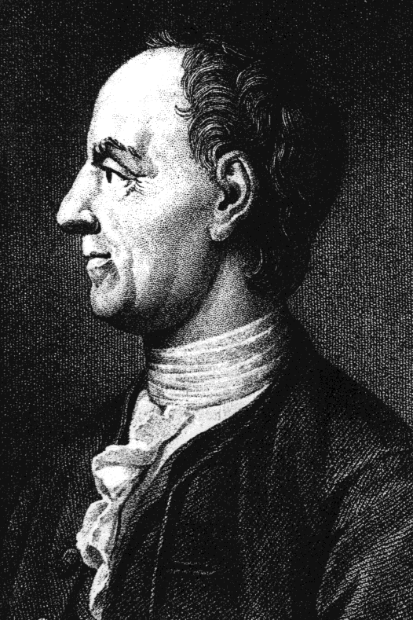
Euler’s Theorem
For k relatively
prime to n,
k^{φ(n)} ≡ 1 (mod n)

Slide 18
Fermat’s “Little” Theorem
special case:
k^{p-1} ≡ 1 (mod p)
for prime p
k ∊ [1,p)

Slide 19
Euler φ function
φ(n) ::= # k ∈ [0,n) s.t.
k has a (mod n) inverse

