Slide 1
Mathematics for Computer Science MIT 6.042J/18.062J
Simple Graphs:
Isomorphism

Slide 2
The Graph Abstraction
Same graph (different layouts)
122
257
122
257
145
99
306
67
99
67
306
145

Slide 3
The Graph Abstraction
Same graph (different labels)
122
145
Albert
Grant
Sharat
257
306
67
Christos
Sonya
99
Jessica

Slide 4
The Graph Abstraction
All that matters
are the connections:
graphs with the
same connections
are isomorphic

Slide 5
Isomorphism
two graphs are isomorphic
when there is an
edge-preserving
matching
of their vertices.

Slide 6
Are these isomorphic?
Hay
Dog
Pig
Corn
Cow
Cat
Beef
Tuna
f(Dog) = Beef
f(Cat) = Tuna
f(Cow) = Hay
f(Pig) = Corn

Slide 7
Edges preserved?
Hay
Dog
Pig
Corn
Cow
Cat
Beef
Tuna

Slide 8
Edges preserved?
YES!
Hay
Dog
Pig
Corn
Cow
Cat
Beef
Tuna

Slide 9
Nonedges preserved?
YES!
Hay
Dog
Pig
Corn
Cow
Cat
Beef
Tuna
isomorphic!

Slide 10
Formal Def of Graph Isomorphism
G₁ isomorphic to G₂ means
edge-preserving vertex matching:
∃ bijection f:V₁ → V₂ with
u—v in E₁ IFF f(u)—f(v) in E₂

Slide 11
Nonisomorphism
degree 2
all degree 3

Slide 12
Proving nonisomorphism
If some property preserved by
isomorphism differs for two
graphs, then they’re not isomorphic:
# of nodes,
# of edges,
degree distributions, ….

Slide 13
Finding an isomorphism?
many possible mappings: large search
can use properties preserved by
isomorphisms as a guide, for example:
a deg 4 vertex adjacent to a deg 3
can only match with
a deg 4 vertex also adjacent to a deg 3
but even so…

Slide 14
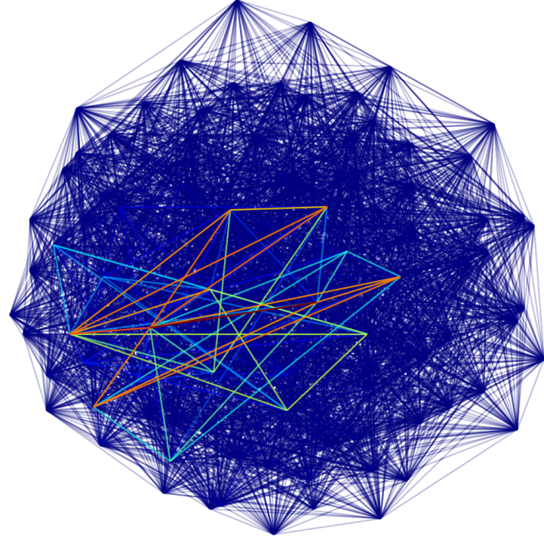
Are these two graphs isomorphic?
...nothing known is sure to be much faster than searching thru all bijections for an isomorphism

