Slide 1
Mathematics for Computer Science MIT 6.042J/18.062J
Arithmetic
Sums

Slide 2
Sum for Children
89 + 102 + 115 + 128 + 141 +
154 + ··· +
193 + ··· +
232 + ··· +
323 + ··· +
414 + ··· + 453 + 466

Slide 3
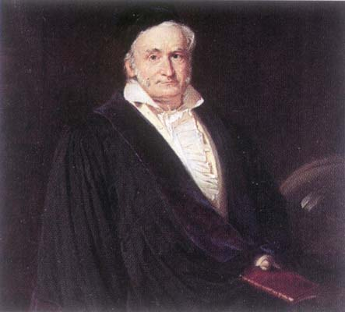
C. F. Gauss
Picture source: http://www-groups.dcs.st-and.ac.uk/~history/PictDisplay/Gauss.html

Slide 4
Sum for Children
Nine-year old Gauss saw
30 numbers, each 13 greater than the previous one.
(So the story goes.)

Slide 5
Sum for Children
1st + 30th = 89 + 466 = 555
2nd + 29th =
(1st+13) + (30th－13) = 555
3rd + 28th =
(2nd+13) + (29th－13) = 555


Slide 6
Sum for Children
Sum of k^{th} term and (31－k)^{th} term
is invariant! 15 pairs of terms, so
Total = 555 15
= (1st + last) ⋅ (# terms/2)
= (1st + last)/2 ⋅ (# terms)

Slide 7
Sum for Children
89 + (89+13) + ⋯ +(89+29･13)
F + (F+d) + ⋯
+(L-d) + L
=::A
L + (L-d) + ⋯
+(F+d) + F
= A
(F+L)+(F+L) + ⋯ +(F+L) +(F+L)
= 2A

Slide 8
Sum for Children
89 + (89+13) + ⋯ +(89+29･13)
F + (F+d) + ⋯ + (F+nd)
=::A
(F+nd)+(F+(n-1)d) +⋯+ F
= A
(2F+nd)+(2F+nd)+ ⋯ +(2F+nd)
= 2A

Slide 9
Arithmetic Sum

Slide 10
Sum for Children
Example:
1 + 2 + … + (n-1) + n =

