Slide 1
Gambler’s Ruin
Mathematics for Computer Science MIT 6.042J/18.062J
Probability of Winning

Slide 2
Gambler’s Ruin
Place $1 bets until going broke or hitting target
What is Pr[hit target]?

Slide 3
Gambler’s Ruin
T
”target"
$
$
n
"initial capital"
# of bets

Slide 4
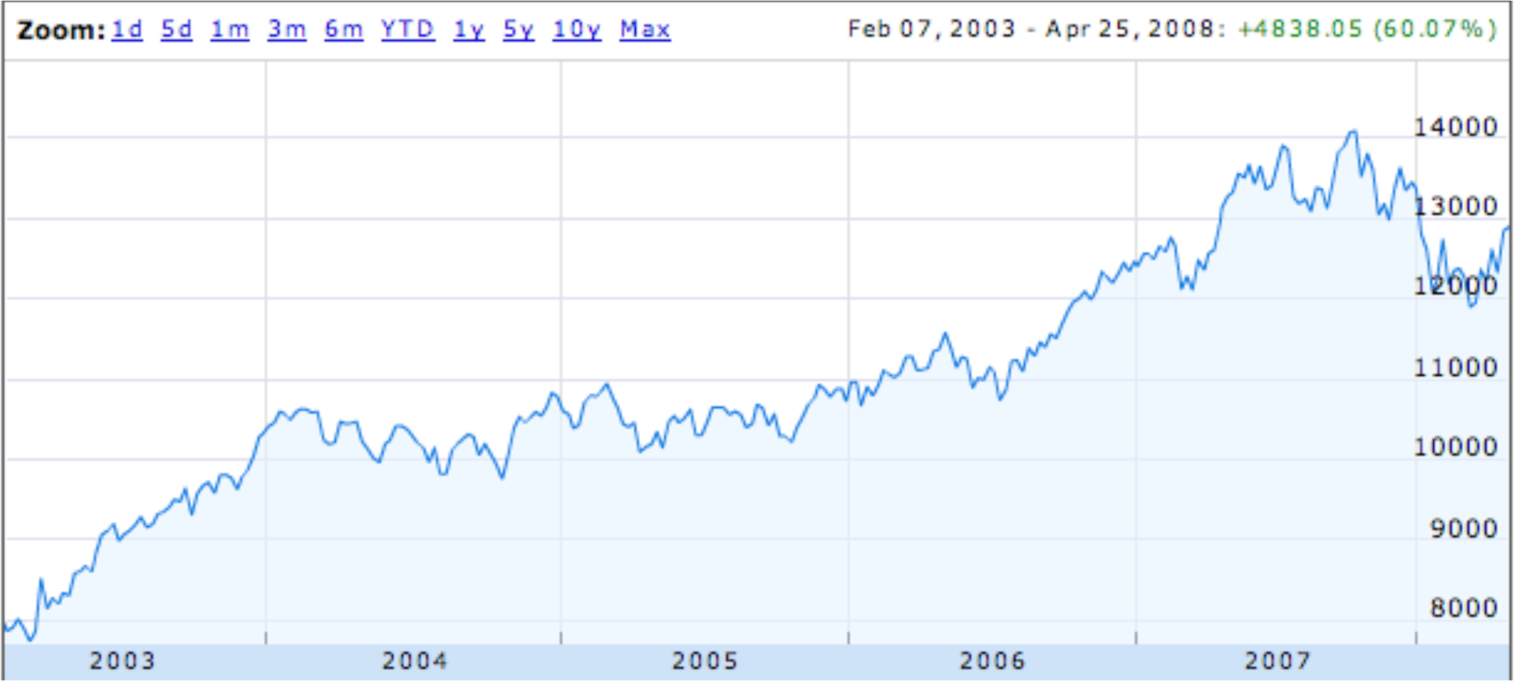
Dow Jones Trend
random steps with “up” bias?

Slide 5
Gambling: Fair Case
Suppose we’re playing a fair game:
Pr[win bet] = 1/2
Pr[hit $200] starting
with $100?
1/2
Pr[hit $600] starting
with $500?
5/6

Slide 6
Gambling: Fair Case
For fair game in general
What about an unfair game?

Slide 7
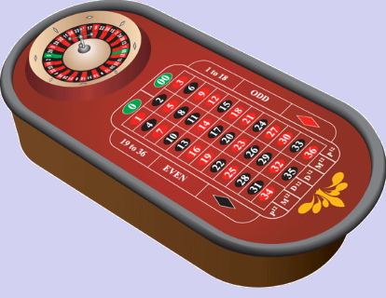
Gambling: Slightly Unfair
Betting black in US roulette
Pr[win bet] = 18/38 = 9/19 < 1/2

Slide 8
US Roulette
What is Pr[hit $500 + 100] starting with $500? (5/6 when fair)
< 1 / 37,000
What is Pr[reach $1M + 100] starting
with $1M? (≈ 1 when fair)
< 1 / 37,000
no matter how many $ at start!

Slide 9
Gambler’s Ruin
Parameters
p ::= Pr[win $1 bet]
n ::= initial capital
T ::= gambler’s target
What is Pr[hit target]?

Slide 10
Gambler’s Ruin
View as random walk on a line.
…
…
$0
$1
n-1
n
n+1
T-1
T
p
p ::=Pr[win a bet]
k
k+1
q ::= 1-p = Pr[lose a bet]
k-1
k
q
What is Pr[reach T before 0]?

Slide 11
General Approach
p
…
…
n-1
n
n+1
q
w_{n} ::= Pr{hit target | start at n}
= Pr{target | n+1} • Pr{win bet}
= w_{n+1} • p
+ Pr{target | n-1} • Pr{lose bet}
+ w_{n-1} • q

Slide 12
General Approach
p
…
…
n-1
n
n+1
q
w_{n} = pw_{n+1} + qw_{n-1}, so
w_{n+1} = (1/p)w_{n} - (q/p)w_{n-1}
we have a linear recurrence!

Slide 13
…otherwise Gambler is ruined
Claim:
Pr[ruin] = 1 – Pr[win]
so if we know one, we know
the other.

Slide 14
…otherwise Gambler is ruined
because Pr[play forever] = 0 :
with any stake
Pr[ends in < T bets] > ɛ
so
Pr[≥ kT bets] < (1-ɛ)^{k}

Slide 15
Condition on 1st bet
w_{n}::= Pr[hit $T from $n]
Pr[w_{n}| win 1st bet] = w_{n+1}
Pr[w_{n}| lose 1st bet] = w_{n-1}
w_{n}= w_{n+1}∙p + w_{n-1}∙q

Slide 16
A Linear Recurrence
w_{n+1} = (1/p)w_{n} - (q/p)w_{n-1}
w₀ = 0 (Gambler is broke)
w_{T} = 1 (Gambler at target)
Solve as usual and get:

Slide 17
Linear Recurrence
Twist: we don’t know w₁
for r ::= q/p ≠ 1.
But w_{T} = 1, so can solve for w₁. Then

Slide 18
Winning when Biased Against
intended profit
Suppose p < q, so r ::= q/p > 1.

Slide 19
Winning when Biased Against
w_{n} < (1/r)^{intended profit}
w_{n} bound does not depend on n!
1/r < 1, so w_{n} is exponentially
decreasing in intended profit!

Slide 20
Profit $100 in US Roulette
p = 18/38
q = 20/38
1/r = 9/10
Pr[profit $100] < (9/10)¹⁰⁰
< 1/37,648

Slide 21
Profit $200 in US Roulette
p = 18/38
q = 20/38
1/r = 9/10
Pr[profit $200] < (9/10)²⁰⁰
< (1/37,648)²
< 1/70,000,000

Slide 22
What About the Fair Case?
(r ::= q/p = 1)
Uh oh, dividing by 0.
Use l’Hôpital’s Rule
d(r^{n}-1)/dr
nr^{n-1}
lim_{r→1} = =
d(r^{T}-1)/dr
Tr^{T-1}

