Slide 1
Harmonic Sums
n^{th} Harmonic number
B_{n} = H_{n}/2

Slide 2
Mathematics for Computer Science MIT 6.042J/18.062J
Integral Method for Sums

Slide 3
Integral estimate for H_{n}
1
1
x+1
1
2
1
3
1
1
2
1
3
0 1 2 3 4 5 6 7 8

Slide 4
Integral estimate for H_{n}
H_{n} = area of rectangles
> area under 1/(x+1) =

Slide 5
Integral estimate for H_{n}

Slide 6
Integral estimate for H_{n}
ln (n+1) ≤ H_{n}

Slide 7
Book stacking
for overhang 3, need B_{n} ≥ 3
H_{n} ≥ 6
integral bound: ln(n+1) ≥ 6
so ok with n ≥ ⎡e⁶-1⎤ = 403 books
actually calculate H_{n}:
227 books are enough.

Slide 8
Book stacking
ln(n+1)→∞ as n→∞,
so overhang can be
as big as desired!

Slide 9
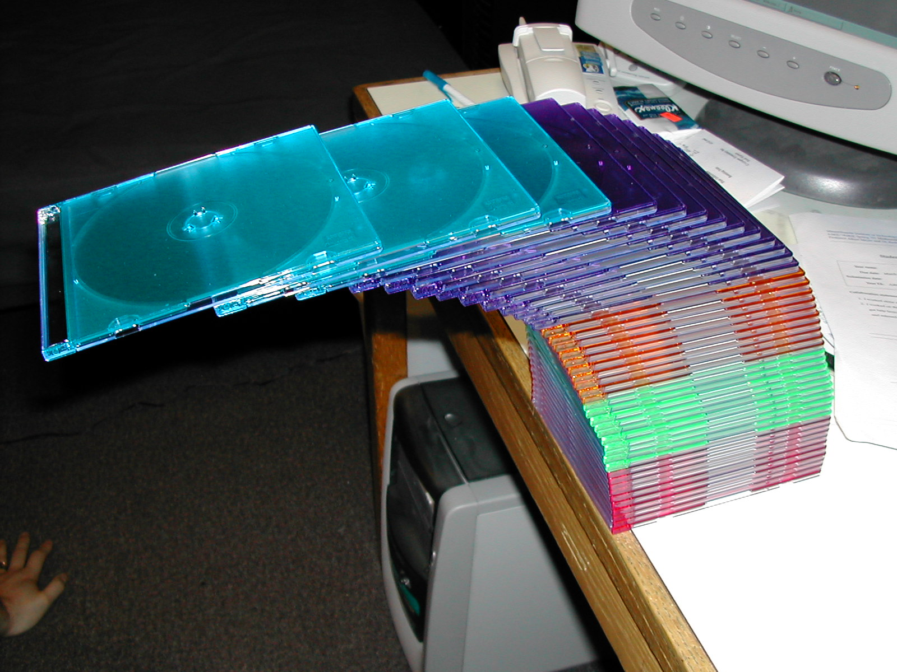
CD cases over the edge
43 cases high --top 4 cases completely off the table --1.8 or 1.9 case-lengths

Slide 10
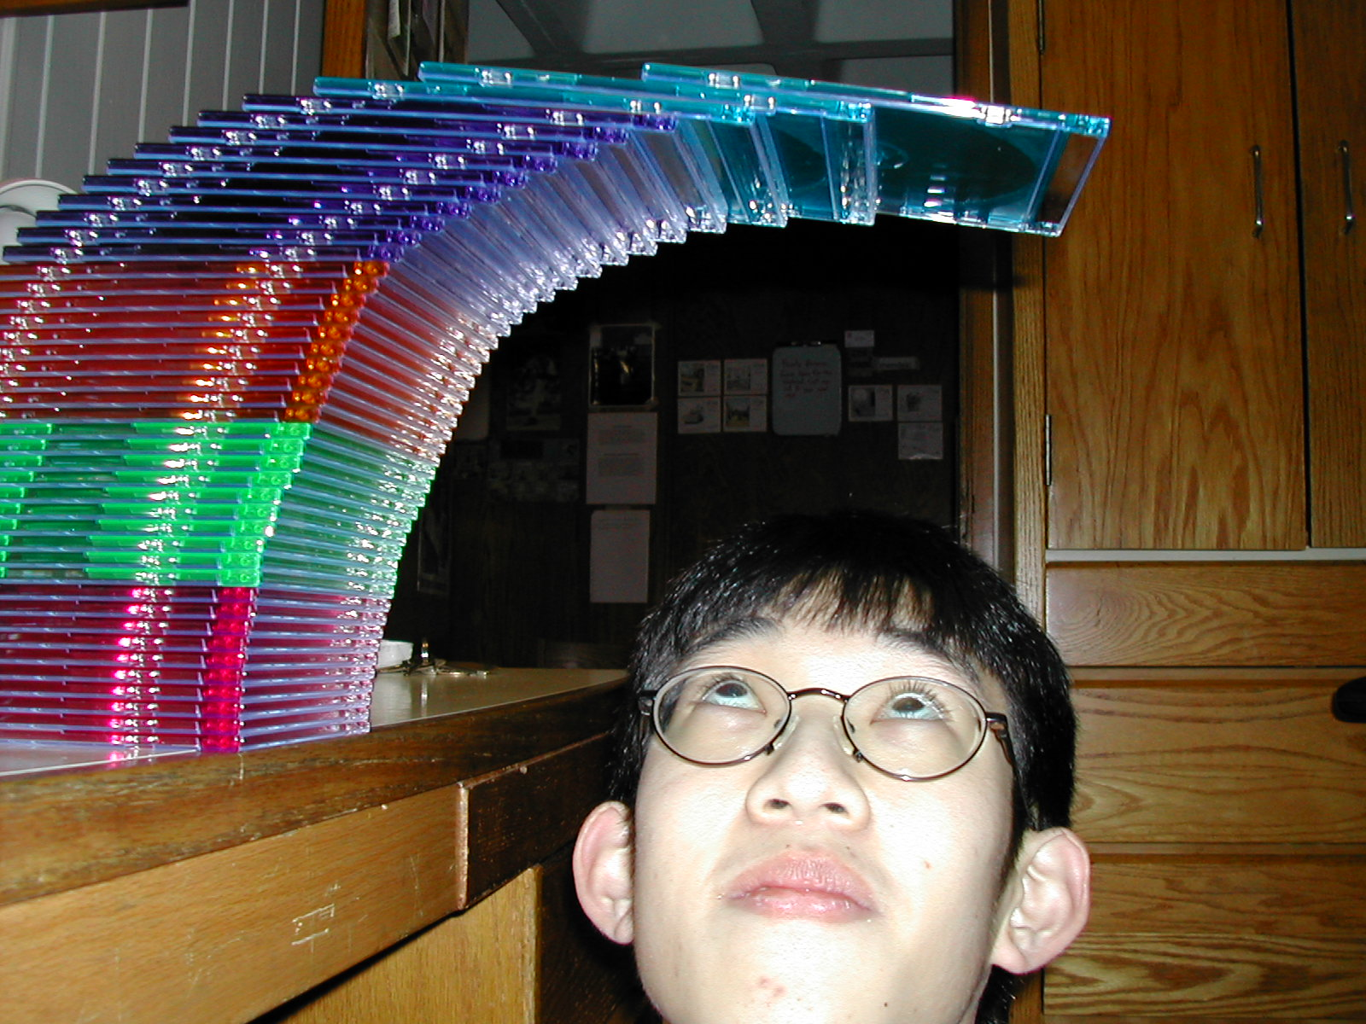
stack of 43 CD’s
see 6.042 Spring02 demo page for credits

Slide 11

don’t sneeze

Slide 12
Upper bound for H_{n}
1
1
2
1
3
1
1
2
1
3
0 1 2 3 4 5 6 7 8

Slide 13
Upper bound for H_{n}

Slide 14
Asymptotic bound for H_{n}
ln(n+1) < H_{n} < 1+ ln(n)
H_{n} ∼ ln(n)

Slide 15
Asymptotic Equivalence
Def: f(n) ∼ g(n)

Slide 16
Asymptotic Equivalence ~
Example: (n² + n) ~ n²
pf:

Slide 17
Integral Sum Bounds
Let be a weakly
decreasing function.

