Slide 1
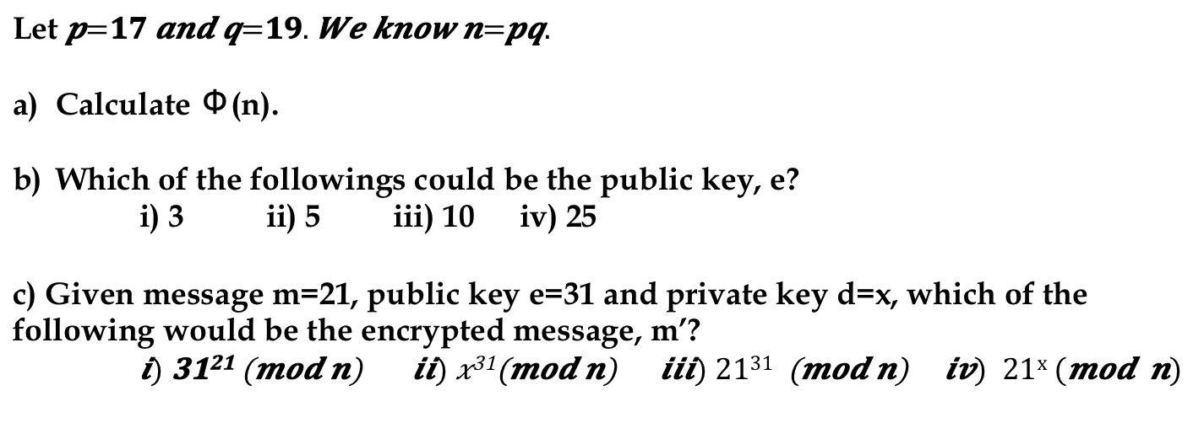
Micro quiz (Morning) RSA Cryptosystem
Let
Calculate Φ(n).
Which of the followings could be the public key, e?
i) 3 ii) 5 iii) 10 iv) 25
c) Given message m=21, public key e=31 and private key d=x, which of the following would be the encrypted message, m’?

Slide 2
Micro quiz (Afternoon) RSA Cryptosystem
Let p=17 and q=23. We know n=pq
Calculate Φ(n).
b) Given message m , public key (e,n), and private key (d,n), which of the following is the encrypted message?
i) m^{d} ii) rem(m^{d}, n) iii) m^{e} iv) rem(m^{e}, n)
c) d is the inverse of e mod Φ(n). Name the technique that can be used to compute d.

