Slide 1
Mathematics for Computer Science MIT 6.042J/18.062J
Simple Graphs:
Coloring

Slide 2
Flight Gates
flights need gates, but
times overlap.
how many gates needed?

Slide 3
Airline Schedule
time
122
145
67
257
306
99
Flights

Slide 4
Conflicts Among 3 Flights
Needs gate at same time
145
306
99

Slide 5
Model all Conflicts with a Graph
257
122
145
67
306
99

Slide 6
Color the vertices
Color vertices so that adjacent
vertices have different colors.
min # distinct colors needed =
min # gates needed

Slide 7
Coloring the Vertices
257
122
145
assign
gates:
67
306
257, 67
122,145
99
306
4 colors
4 gates
99

Slide 8
Better coloring
257
122
145
67
306
3 colors
3 gates
99

Slide 9
Final Exams
subjects conflict if student
takes both, so
need different time slots.
how short an exam period?

Slide 10
Model as a Graph
8.02
6.042
18.02
assign
times:
3.091
M 9am
M 1pm
T 9am
T 1pm
4 time slots
(best possible)
6.001

Slide 11
Conflicting Allocation Problems
# separate habitats to house different species of animals, some incompatible with others?
# different frequencies for radio stations that interfere with each other?
# different colors to color a map?

Slide 12
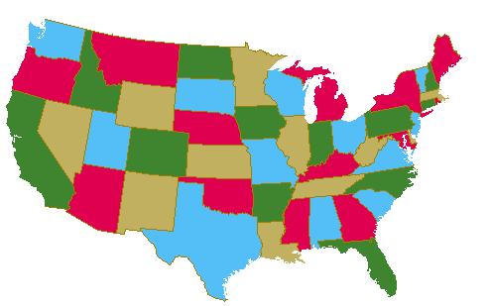
Map Coloring

Slide 13
Countries are the Vertices

Slide 14
Planar Four Coloring
any planar map is 4-colorable.
1850’s: false proof published
(was correct for 5 colors).
1970’s: proof with computer
1990’s: much improved

Slide 15
Chromatic Number
min #colors for G is
chromatic number
χ(G)

Slide 16
Chromatic Number
min #colors for G is
chromatic number, χ(G)
lemma:
χ(tree) = 2

Slide 17
Trees are 2-colorable
root
Pick any vertex as “root.”
if (unique) path from root is
even length:
odd length:

Slide 18
Simple Cycles
χ(C_{even}) = 2
χ(C_{odd}) = 3

Slide 19
Complete Graph K₅
χ(K_{n}) = n

Slide 20
The Wheel W_{n}
W₅
χ(W_{odd}) = 4
χ(W_{even}) = 3

Slide 21
Bounded Degree
all degrees ≤ k, implies
χ(G) ≤ k+1
very simple algorithm…

Slide 22
“Greedy” Coloring
…color vertices in any order. next vertex gets a color different from its neighbors.
≤ k neighbors, so
k+1 colors always work

Slide 23
slightly tricky coloring
can be colored
with 3 colors

Slide 24
slightly tricky coloring
can be colored
with 3 colors
cannot be colored
with 2 colors
proof?

Slide 25
coloring arbitrary graphs
2-colorable? --easy to check
3-colorable? --hard to check
(even if planar)
find χ(G)? --theoretically
no harder than 3-color, but
harder in practice

