Slide 1
Mathematics for Computer Science MIT 6.042J/18.062J
Stable
Matching

Slide 2
Stable Marriage
A Marriage Problem
1 2 3 4 5
Boys
Girls
A B C D E

Slide 3
Stable Marriage
Preferences
Boys Girls
1 : CBEAD A : 35214
2 : ABECD B : 52143
3 : DCBAE C : 43512
4 : ACDBE D : 12345
5 : ABDEC E : 23415

Slide 4
Stable Marriage
1: CBEAD
2 : ABECD
3 : DCBAE
4 : ACDBE
5 : ABDEC
Preferences
Try “greedy”
strategy for boys

Slide 5
Stable Marriage
Preferences
Marry Boy 1 with Girl C
(his 1st choice)
1: CBEAD
2 : ABECD
3 : DCBAE
4 : ACDBE
5 : ABDEC
1
C

Slide 6
Stable Marriage
Preferences
2 : ABE D
3 : D BAE
4 : A DBE
5 : ABDE

Slide 7
Stable Marriage
Preferences
2 : ABED
3 : DBAE
4 : ADBE
5 : ABDE

Slide 8
Stable Marriage
Next:
Preferences
Marry Boy 2 with Girl A
(his remaining 1st choice)
2 : ABED
3 : DBAE
4 : ADBE
5 : ABDE
2
A

Slide 9
Stable Marriage
Final “boy greedy” marriages
1 C
2 A
3 D
4 B
5 E

Slide 10
Stable Marriage
Trouble!
1
C
4
B

Slide 11
Stable Marriage
Boy 4 likes Girl C better than his wife.
1
C
4
B

Slide 12
Stable Marriage
and vice-versa
1
C
4
B

Slide 13
Stable Marriage
a rogue couple
1
C
4
B

Slide 14
Stable Marriage
Stable Marriage Problem:
Marry everyone without any rogue couples!

Slide 15
Stable Marriage
Let’s try it!

Slide 16
Stable Marriage
Preferences
Boys Girls
1 : CBEAD A : 35214
2 : ABECD B : 52143
3 : DCBAE C : 43512
4 : ACDBE D : 12345
5 : ABDEC E : 23415

Slide 17
Stable Marriage I.
3 A
5 B
4 C
1 D
2 E
all girls get 1st choice

Slide 18
Stable Marriage II
5 A
2 B
4 C
3 D
1 E
“boy optimal”

Slide 19
Stable Marriage
More than a puzzle:
College Admissions
(original Gale & Shapley paper, 1962)
Matching Hospitals & Residents.
Matching Clients & Servers

Slide 20
Stable Marriage
More than a puzzle:
College Admissions
(original Gale & Shapley paper, 1962)
Matching Hospitals & Residents.
Matching Dance Partners.

Slide 21
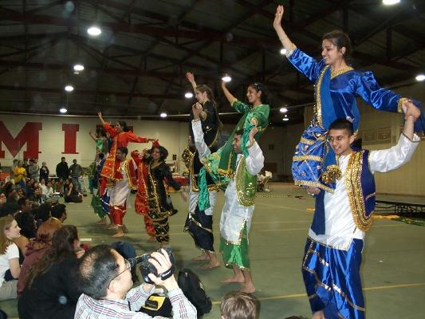
Stable Marriage

