Slide 1
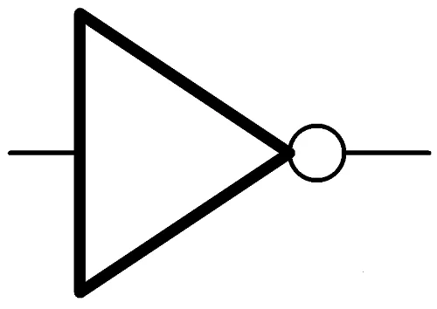
. . .
AND-circuit
NOT-gate

