Slide 1
Mathematics for Computer Science MIT 6.042J/18.062J
Uncountable
Sets

Slide 2
Infinite Sizes
NO!
Are all sets the same size?
Cantor’s Theorem
shows how to keep finding
bigger infinities.

Slide 3
Countable Sets
A is countable iff can list it: a₀,a₁,a₂,….
example:
::= {finite bit strings}
Claim: ::= {∞-bit strings}
is uncountable.

Slide 4
Diagonal Arguments
Suppose
 | 0 | 1 | 2 | 3 | . | . | . | n | n+1 | . | . | .
s₀ | 0 | 0 | 1 | 0 | . | . | . | 0 | 0 | . | . | .
s₁ | 0 | 1 | 1 | 0 | . | . | . | 0 | 1 | . | . | .
s₂ | 1 | 0 | 0 | 0 | . | . | . | 1 | 0 | . | . | .
s₃ | 1 | 0 | 1 | 1 | . | . | . | 1 | 1 | . | . | .
. | . | . |  |  | 1
. | . |  | . |  |  | 1
 | . |  |  | . |  |  | 0

Slide 5
Diagonal Arguments
Suppose
 | 0 | 1 | 2 | 3 | . | . | . | n | n+1 | . | . | .
s₀ | 0 | 0 | 1 | 0 | . | . | . | 0 | 0 | . | . | .
s₁ | 0 | 1 | 1 | 0 | . | . | . | 0 | 1 | . | . | .
s₂ | 1 | 0 | 0 | 0 | . | . | . | 1 | 0 | . | . | .
s₃ | 1 | 0 | 1 | 1 | . | . | . | 1 | 1 | . | . | .
. | . | . |  |  | 1
. | . |  | . |  |  | 1
 | . |  |  | . |  |  | 0
1
0
1
0
0
0
1

Slide 6
Diagonal Arguments
Suppose
⋯
1
0
1
0
0
0
1

Slide 7
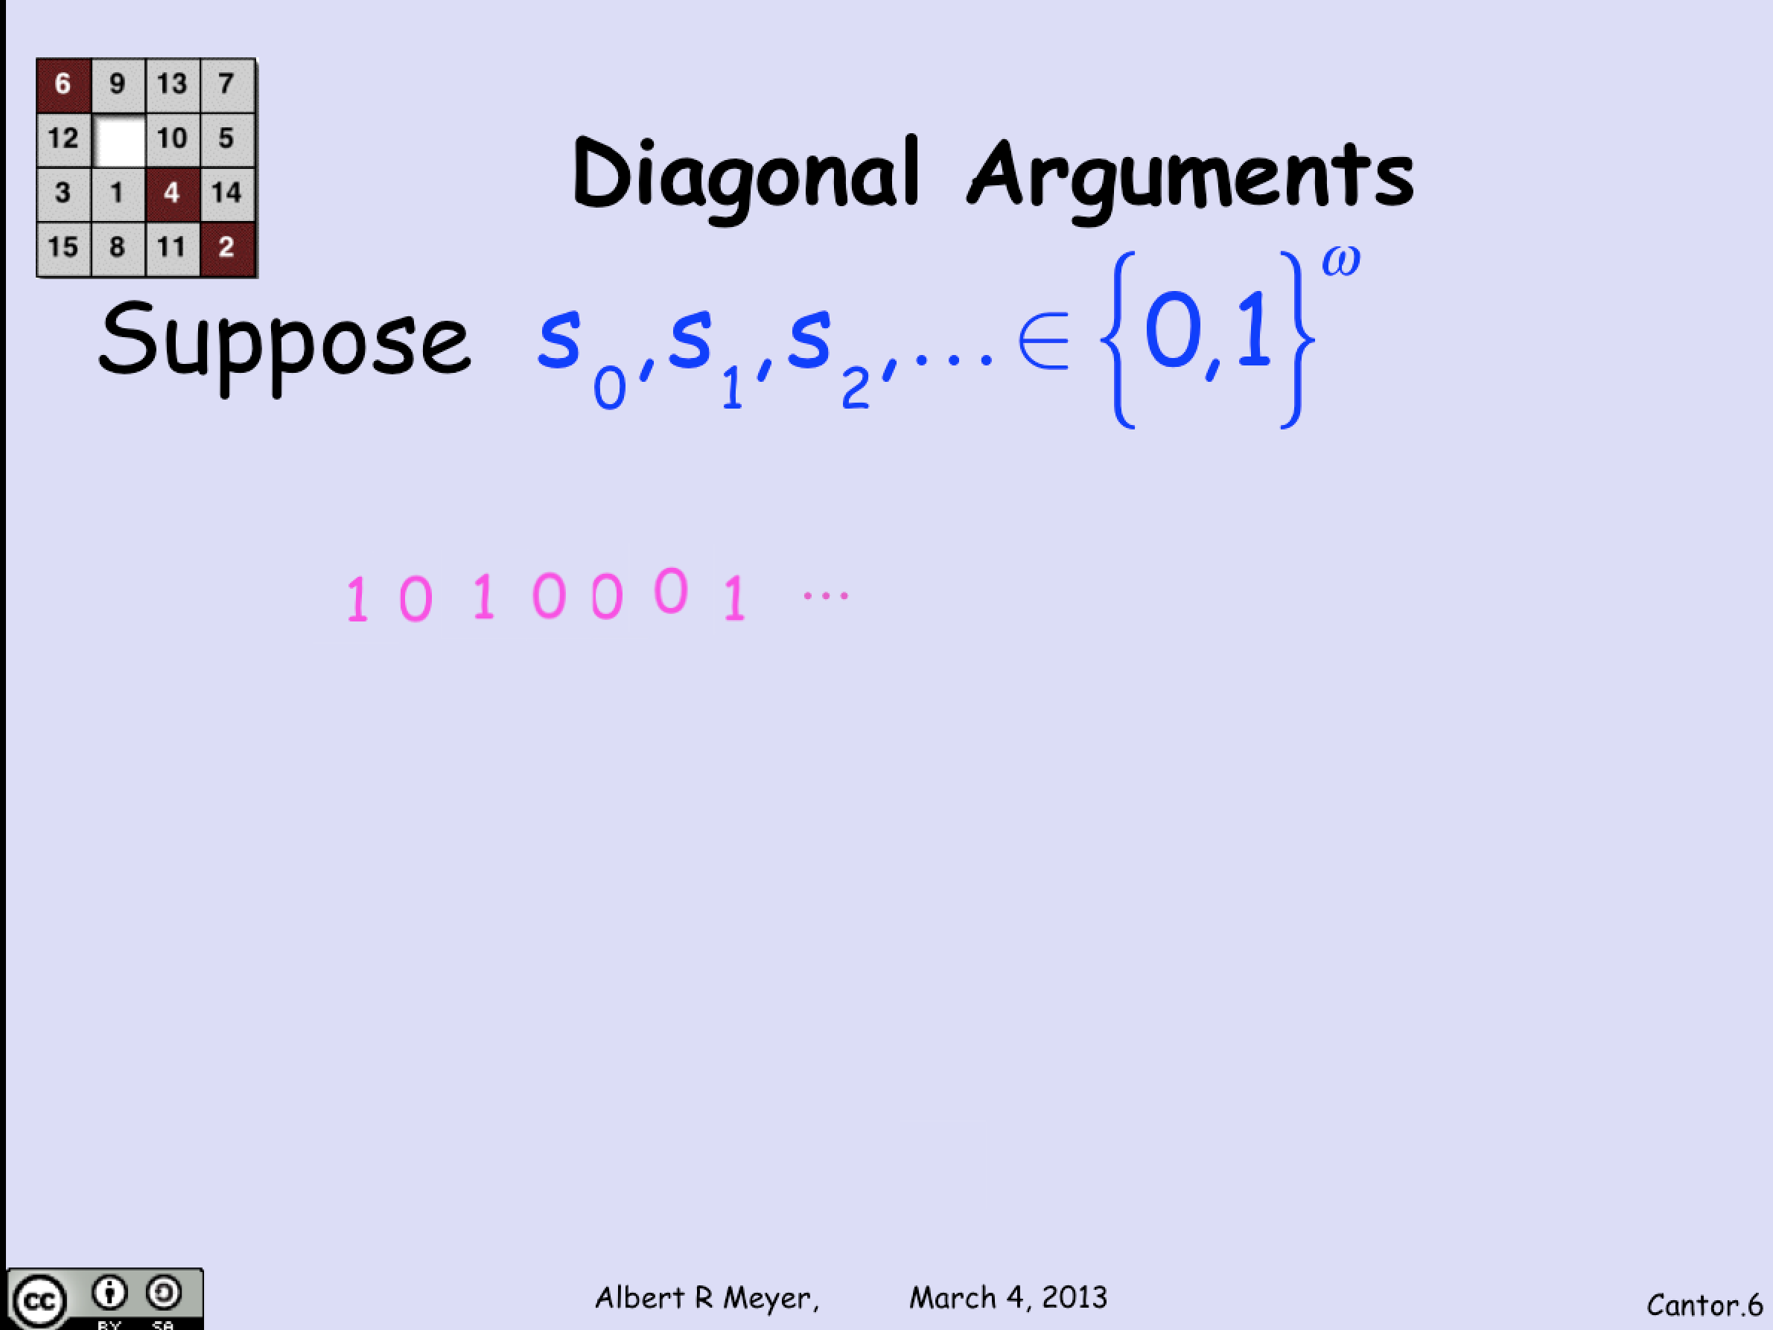

Slide 8
Diagonal Arguments
Suppose
⋯
1
…differs from every row!
0
1
So cannot be listed:
this diagonal sequence
will be missing
0
0
0
1

Slide 9
Diagonal Arguments
So differs from every row.

Slide 10
Diagonal Arguments
So differs from every row. That is,

Slide 11
Diagonal Arguments
So differs from every row. That is,
contradicting the claim that
every appears as a row.

Slide 12
is uncountable
So

Slide 13
Strictly Smaller
A strict B ::= NOT(A surj B)
A is “strictly smaller” than B

Slide 14
Strictly Smaller
Warning!
“Strictly smaller” is a metaphor

Slide 15
Strictly Smaller
Warning!
“Strictly smaller” is a metaphor meant to suggest properties of the highly technical relation
strict.

Slide 16
Strictly Smaller
Warning!
We do not assign “sizes” to infinite sets.
Informal reasoning about “strictly smaller” will be misleading for strict.

Slide 17
Cantor’s Theorem
A strict pow(A)
for every set, A
(finite or infinite)

Slide 18
Diagonal Arguments
Suppose
 | a | b | s | t | . | . | . | d | e | . | . | .
f(a) |  |  |  |  |  |  |  |  |  |  |  | .
f(b) |  |  |  |  |  |  |  |  |  |  |  | .
f(s) |  |  |  |  |  |  |  |  |  |  |  | .
f(t) |  |  |  |  |  |  |  |  |  |  |  | .
.

Slide 19
Diagonal Arguments
Suppose
 | a | b | s | t | c | . | . | d | e | . | . | .
f(a) | a |  | s | t |  |  |  |  | e |  |  | .
f(b) | a | b |  |  | c |  |  | d |  |  |  | .
f(s) |  | b |  | t |  |  |  |  |  |  |  | .
f(t) |  |  | s | t | c |  |  | d |  |  |  | .
f(c) |  | b | s |  |  |  |  | d | e
.
.

Slide 20
Diagonal Arguments
Suppose
 | a | b | s | t | c | . | . | d | e | . | . | .
f(a) | a |  | s | t |  |  |  |  | e |  |  | .
f(b) | a | b |  |  | c |  |  | d |  |  |  | .
f(s) |  | b | s | t |  |  |  |  |  |  |  | .
f(t) |  |  | s | t | c |  |  | d |  |  |  | .
f(c) |  | b | s |  | c |  |  | d | e
. |  |  |  |  |  | .
. |  |  |  |  |  |  | .

Slide 21
Diagonal Arguments
Suppose
D
 | a | b | s | t | c | . | . | d | e | . | . | .
f(a) |  |  | s | t |  |  |  |  | e |  |  | .
f(b) | a |  |  |  | c |  |  | d |  |  |  | .
f(s) |  | b | s | t |  |  |  |  |  |  |  | .
f(t) |  |  | s |  | c |  |  | d |  |  |  | .
f(c) |  | b | s |  | c |  |  | d | e
. |  |  |  |  |  | .
. |  |  |  |  |  |  | .

Slide 22
A strict Pow(A)
Pf: say have fcn f:A→pow(A).
Define a subset of A that is not in
the range of f: namely
D::= {a ∈A | a ∉ f(a)}
Now since it differs
from set f(a) at element a!

Slide 23
A strict Pow(A)
Pf: say have fcn f:A→pow(A).
a ∈D IFF a ∉ f(a)
for all a ∈A by def of D.
Suppose D ∈ range(f). That is
D = f(a_{d}) for some a_{d} ∈A

Slide 24
A strict Pow(A)
Pf: say have fcn f:A→pow(A).
a ∈f(a_{d}) IFF a ∉ f(a)
for all a ∈A by def of D, a_{d} .
Let a be a_{d}

Slide 25
A strict Pow(A)
Pf: say have fcn f:A→pow(A).
a_{d} ∈f(a_{d}) IFF a_{d} ∉ f(a_{d})
for all a ∈A by def of D, a_{d} .
Let a be a_{d}

Slide 26
A strict Pow(A)
Pf: say have fcn f:A→pow(A).
a_{d} ∈f(a_{d}) IFF a_{d} ∉ f(a_{d})
for all a ∈A by def of D, a_{d} .
Let a be a_{d}
: contradiction

Slide 27
A strict Pow(A)
Pf by contradiction:
Pf by contradiction: suppose
surj fcn f:A→pow(A). Let
W::= {a ∈A | a ∉ f(a)}, so
a ∈W iff a ∉ f(a).
f a surj, so W=f(a₀), some a₀ ∈A.
So, a ∈f(a₀) iff a ∉ f(a ).
₀
₀
₀
contradiction

Slide 28
A strict Pow(A)
So no f-arrow into D.
f is not a surjection.
QED

Slide 29
is uncountable
That is,

Slide 30
Proving Uncountability
We know: if C is countable
and C surj A then
A is countable
Corollary: if A is uncountable
and C surj A then
C is uncountable

Slide 31
Proving Uncountability
Lemma: If A is uncountable
and C surj A then
C is uncountable

Slide 32
Proving Uncountability
Corollary: A is countable iff
C surj A
for some countable C
Corollary: B is uncountable iff
B surj U
for some uncountable U

Slide 33
{0,1}^{ω} again
We know
and uncountable by
Cantor,

Slide 34
{0,1}^{ω} again
We know
and uncountable by
Cantor
, so {0,1}^{ω} uncountable.

Slide 35
Real Numbers Uncountable
map ±r to binary rep
7 1/3 = 111.010101…
maps to 111010101…

Slide 36
Real Numbers Uncountable
map ±r to binary rep
1/2 = .100000…
1/2 maps to 100000…

Slide 37
Real Numbers Uncountable
map ±r to binary rep
1/2 = .100000…
1/2 maps to 100000…
= .0111111…
-1/2 maps to 0111111…

