Slide 1
Mathematics for Computer Science
MIT 6.042J/18.062J
Sums
(Money & Books)
October 31, 2007

Slide 2
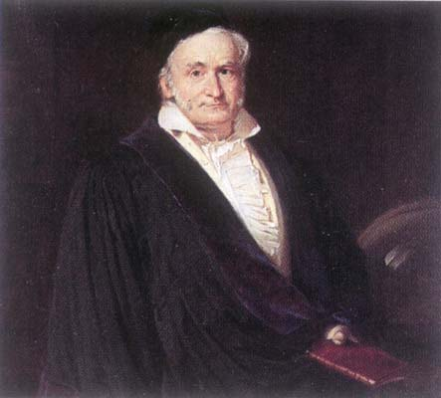
C. F. Gauss
Picture source: http://www-groups.dcs.st-and.ac.uk/~history/PictDisplay/Gauss.html
October 31, 2007

Slide 3
Sum for Children
89 + 102 + 115 + 128 + 141 +
154 + ··· +
193 + ··· +
232 + ··· +
323 + ··· +
414 + ··· + 453 + 466
October 31, 2007

Slide 4
Sum for Children
Nine-year old Gauss saw
30 numbers, each 13 greater than the previous one.
(So the story goes.)
October 31, 2007

Slide 5
Sum for Children
1st + 30th = 89 + 466 = 555
2nd + 29th =
(1st+13) + (30th-13) = 555
3rd + 28th =
(2nd+13) + (29th-13) = 555

October 31, 2007

Slide 6
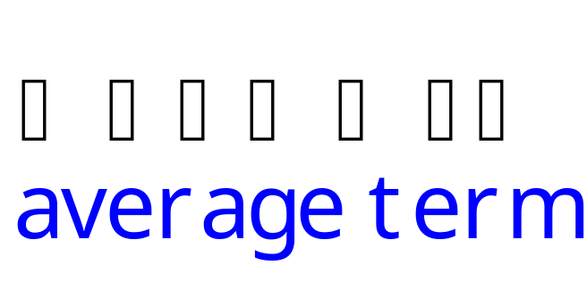
Sum for Children
Sum of k^{th} term and (31-k)^{th} term
is invariant! 15 pairs of terms, so
Total = 555 - 15
= (1st + last)¢(# terms/2)
= (1st + last)/2 ¢(# terms)
October 31, 2007

Slide 7
Sum for Children
example:
1 + 2 +☹+ (n-1) + n =
(1 + n)n
2
October 31, 2007

Slide 8
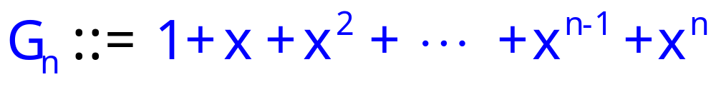
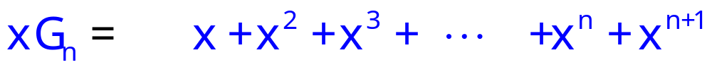
Geometric Sum
October 31, 2007

Slide 9
Geometric Sum
G_{n}−xG_{n}=
1 − x^{n+1}
October 31, 2007

Slide 10
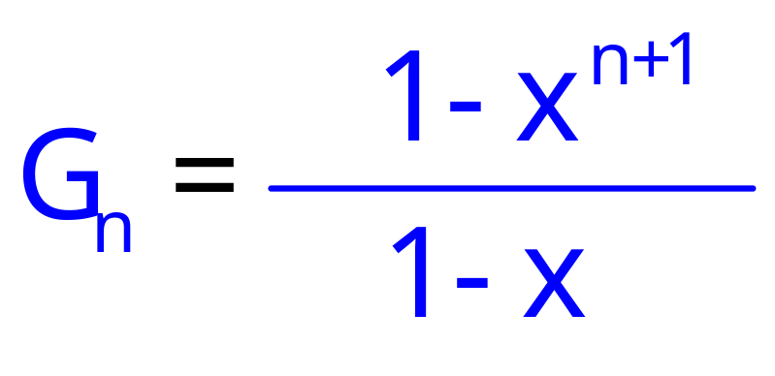
Geometric Sum
G_{n}−xG_{n}=
1 − x^{n+1}
October 31, 2007

Slide 11
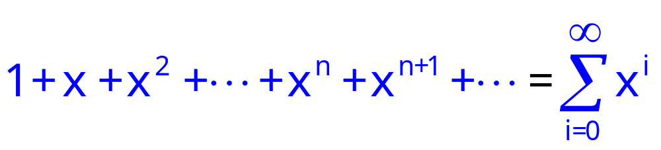
Geometric Sum
Consider infinite sum (series)
October 31, 2007

Slide 12
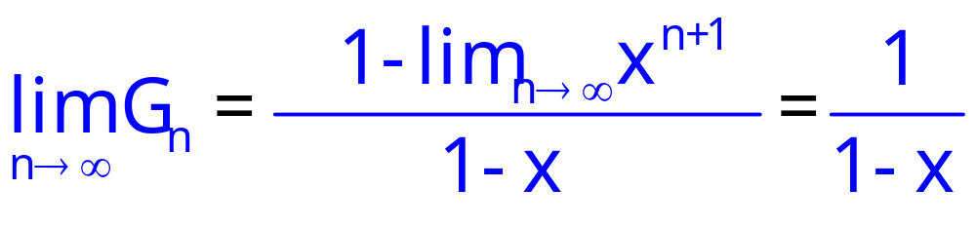
Infinite Geometric Series
October 31, 2007

Slide 13
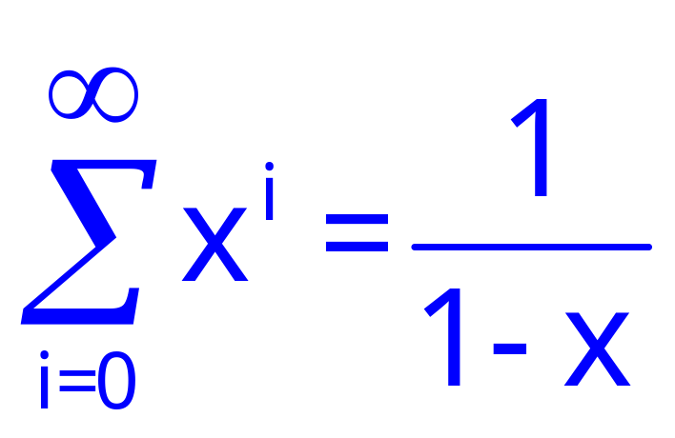
Infinite Geometric Series
for |x| < 1
October 31, 2007

Slide 14
The future value of $$
I will pay you $100 in 1 year,
if you will pay me $X now.
October 31, 2007

Slide 15
The future value of $$
bank will pay me 3% interest:
bankrate b ::= 1.03
-- bank increases my $ by
this factor in 1 year.
October 31, 2007

Slide 16
The future value of $$
If I deposit the $X now,
I will have $bX in 1 year,
so I break even iff bX = 100.
X=100r where r ::= 1/b.
So $100 in 1 year is worth
$100r = $97.09 today.
October 31, 2007

Slide 17
The future value of $$
$1 in 1 year is worth $0.9709 now.
$r last year is worth $1 today,
where r ::= 1/b.
So $n paid in 2 years is worth
$nr paid in 1 year, and is worth
$nr² today.
October 31, 2007

Slide 18
The future value of $$
$n paid k years from now
is worth $nr^{k} today
where r ::= 1/bankrate.
October 31, 2007

Slide 19
Annuities
I pay you $100/year for 10 years,
if you will pay me $Y now.
I break even iff you pay me
(value of $100 in 1 year) +
(value of $100 in 2 years) + ☹ +
(value of $100 in 10 years)
October 31, 2007

Slide 20
Annuities
I pay you $100/year for 10 years,
if you will pay me $Y now.
I break even iff you pay me
100r + 100r² + 100r³ +  + 100r¹⁰
= 100r(1 + r +  + r⁹)
= 100r(1-r¹⁰)/(1-r) = $853.02
October 31, 2007

Slide 21
Annuities
I pay you $100/year for 10 years,
if you will pay me $853.02 now.
QUICKIE: If bankrates unexpectedly
increase in the next few years,
  You come out ahead
  The deal stays fair
  I come out ahead
October 31, 2007

Slide 22
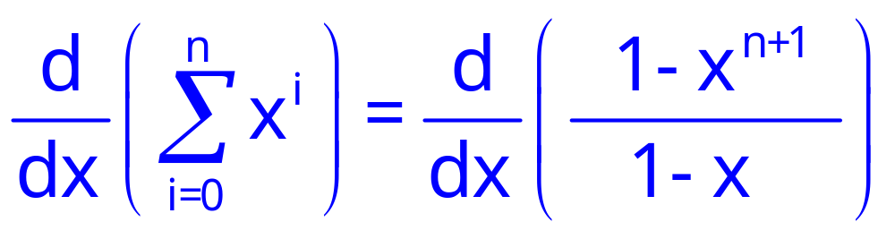
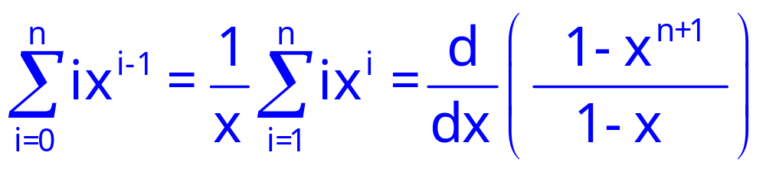
Manipulating Sums
October 31, 2007

Slide 23
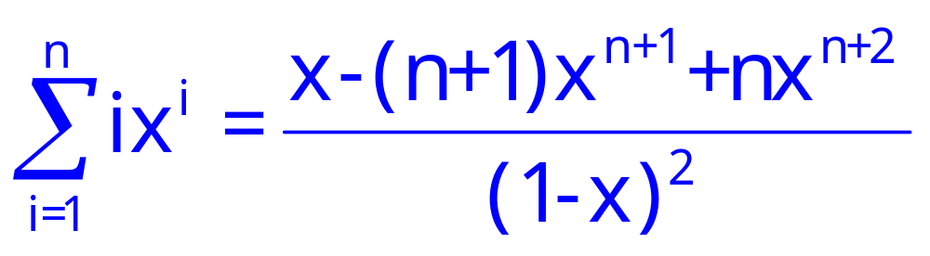
Manipulating Sums
October 31, 2007

Slide 24
Harmonic Sums, Integral Method
October 31, 2007

Slide 25
Book Stacking
table
Copyright © Albert R. Meyer, 2007. All rights reserved.
October 31, 2007

Slide 26
Book Stacking
How far out?
?
overhang
Copyright © Albert R. Meyer, 2007. All rights reserved.
October 31, 2007

Slide 27
Book Stacking
One book
book center
of mass
Copyright © Albert R. Meyer, 2007. All rights reserved.
October 31, 2007

Slide 28
Book Stacking
One book
book center
of mass
Copyright © Albert R. Meyer, 2007. All rights reserved.
October 31, 2007

Slide 29
Book Stacking
book center
of mass
One book
1
2
Copyright © Albert R. Meyer, 2007. All rights reserved.
October 31, 2007

Slide 30
n books
1
2
n
Copyright © Albert R. Meyer, 2007. All rights reserved.
October 31, 2007

Slide 31
n books
1
2
n
center
of mass
Copyright © Albert R. Meyer, 2007. All rights reserved.
October 31, 2007

Slide 32
n books
need
center of mass
over table
1
2
n
Copyright © Albert R. Meyer, 2007. All rights reserved.
October 31, 2007

Slide 33
n books
1
2
center of mass
of the whole stack
n
Copyright © Albert R. Meyer, 2007. All rights reserved.
October 31, 2007

Slide 34


n+1 books
1
2
center of mass
of all n+1 books
at table edge
center of mass of top n books at edge of book n+1
n
n+1
∆overhang
Copyright © Albert R. Meyer, 2007. All rights reserved.
October 31, 2007

Slide 35
Δoverhang ::=
horizontal distance from
n-book to (n+1)-book
centers of mass
October 31, 2007

Slide 36
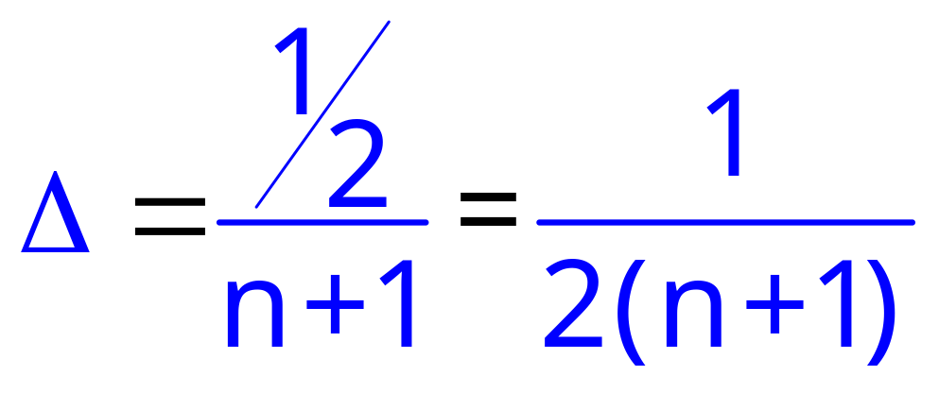
 overhang

n
1
1/2
October 31, 2007

Slide 37
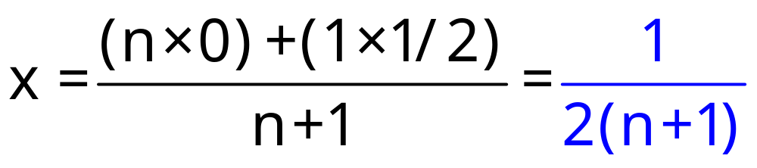
center of n-stack at x = 0.
center of n+1st book is at x = 1/2,
so center of n+1-stack is at
October 31, 2007

Slide 38
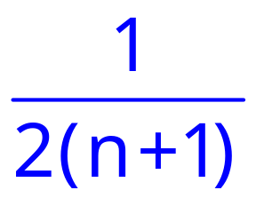
n+1 books
1
2
center of mass
of all n+1 books
center of mass of top n books
n
n+1
October 31, 2007

Slide 39

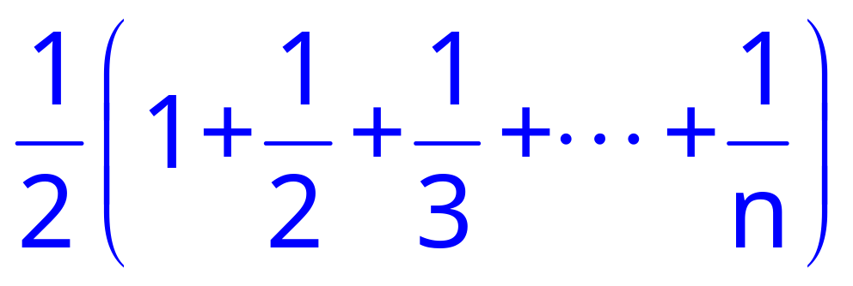
Book stacking summary
B_{n} ::= overhang of n books
B₁ = 1/2
B_{n+1} = B_{n} +
B_{n} =
October 31, 2007

Slide 40
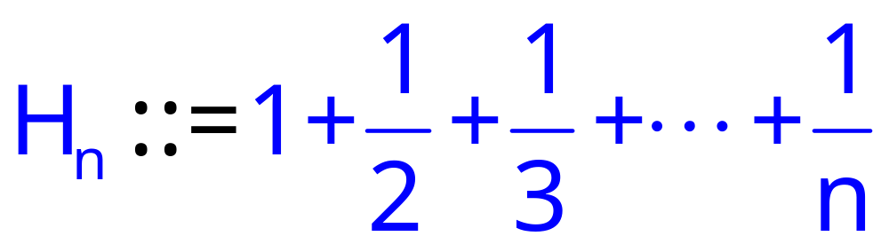
Harmonic Sums
n^{th} Harmonic number
B_{n} = H_{n}/2
October 31, 2007

Slide 41
Integral estimate for H_{n}
1
1
x+1
1
2
1
3
1
1
2
1
3
0 1 2 3 4 5 6 7 8
October 31, 2007

Slide 42
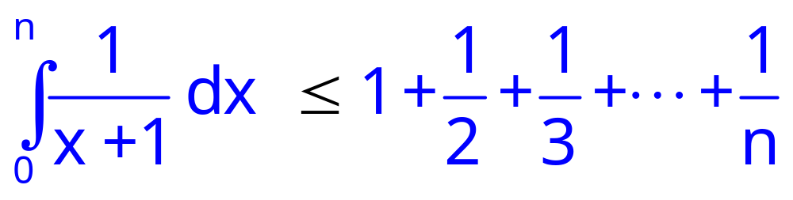
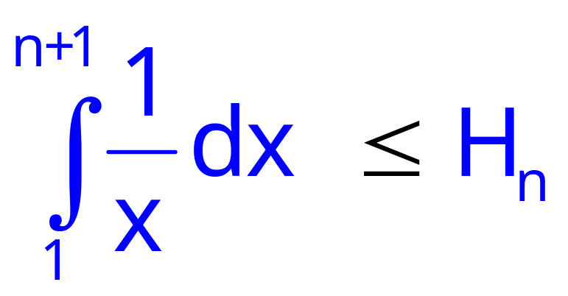
ln (n+1)  H_{n}
October 31, 2007

Slide 43
Book stacking
H_{n}!1 as n!1,
so overhang can be
as big as desired!
October 31, 2007

Slide 44
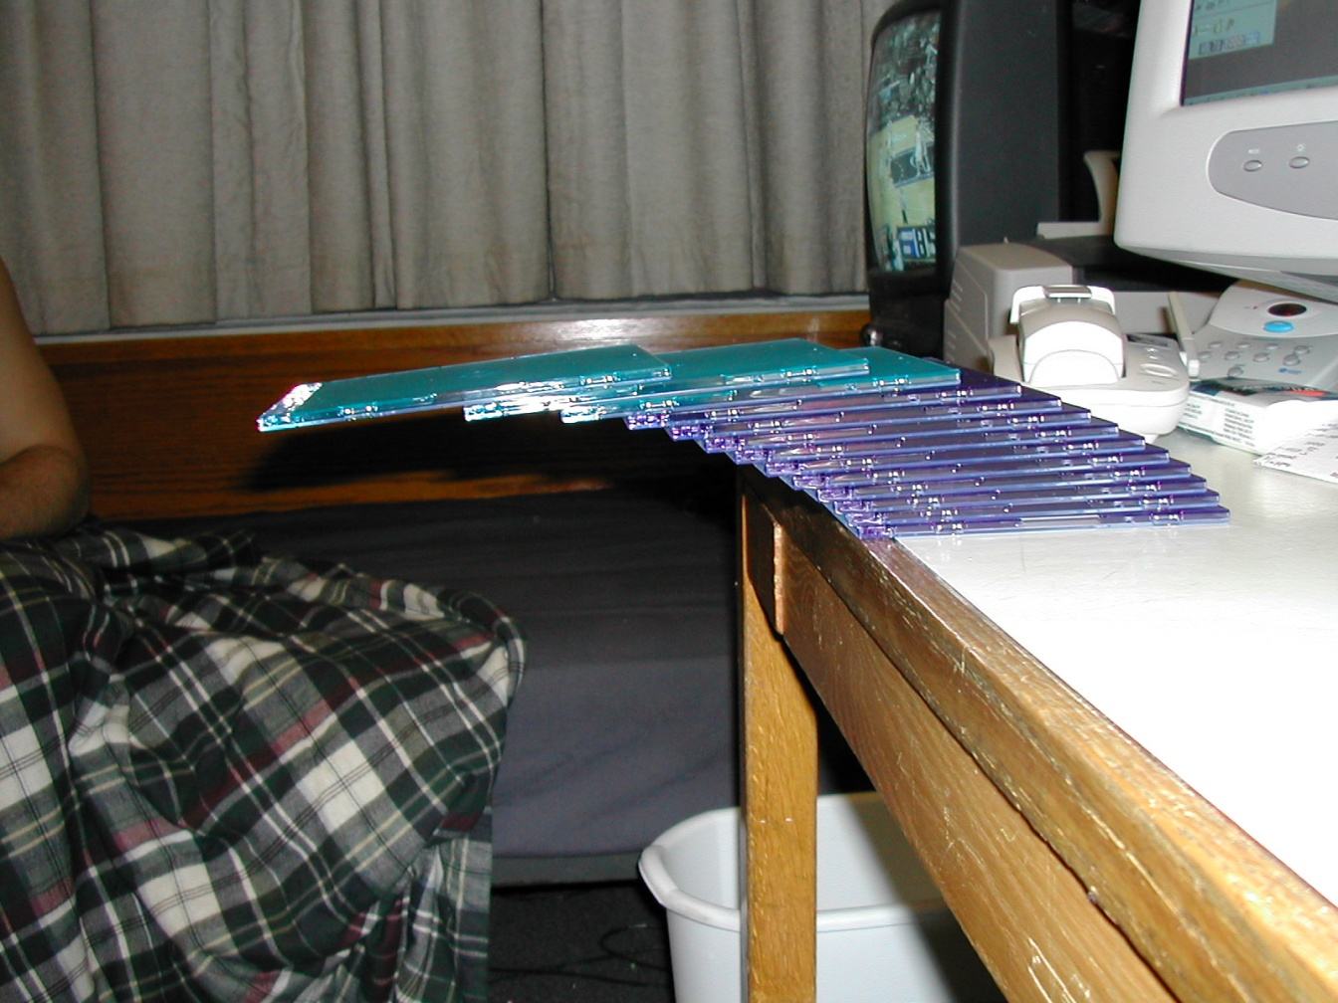
CD case past the edge
see 6.042 Spring02 demo page for credits
October 31, 2007

Slide 45
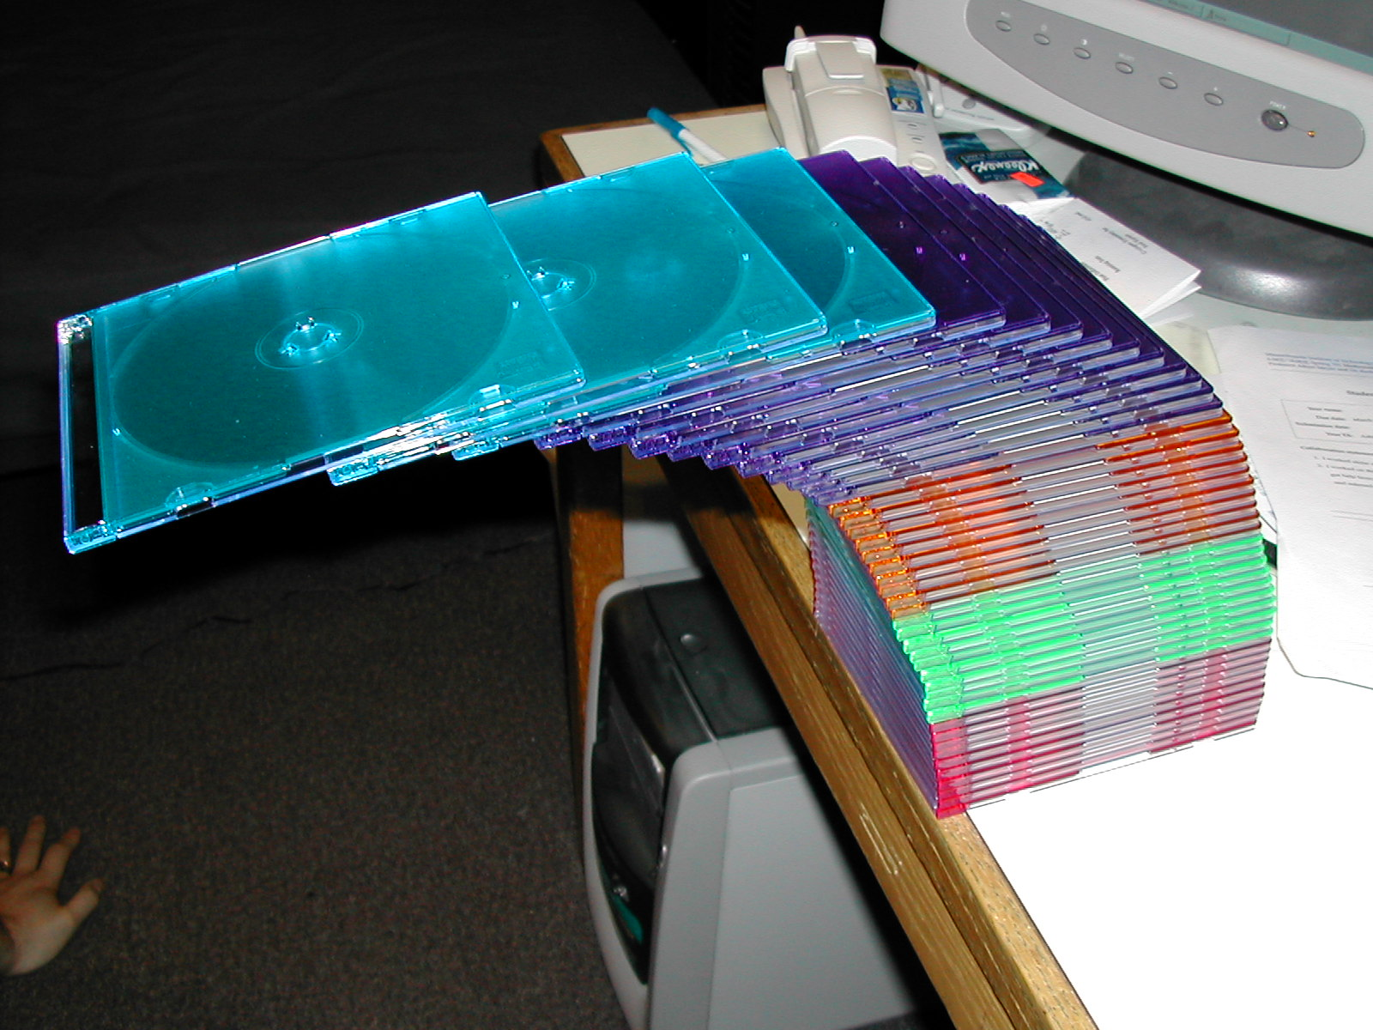
CD cases over the edge
43 cases high --top 4 cases completely off the table --1.8 or 1.9 case-lengths
October 31, 2007

Slide 46
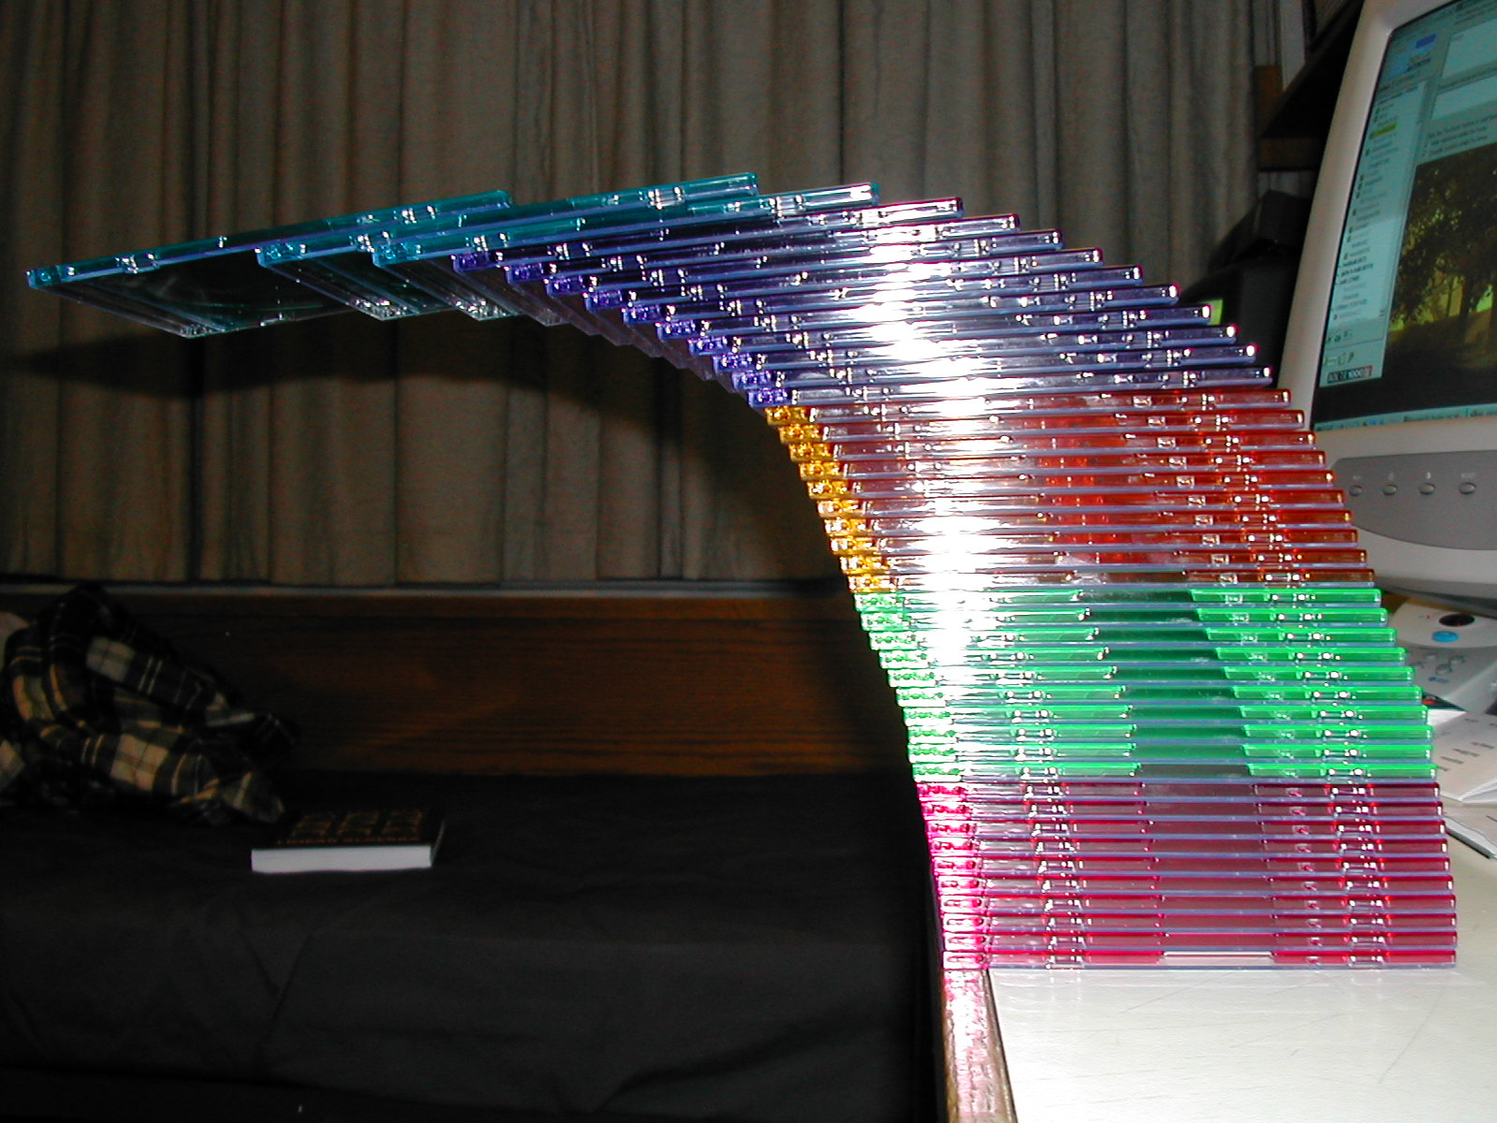
stack of 43 CD’s
October 31, 2007

Slide 47
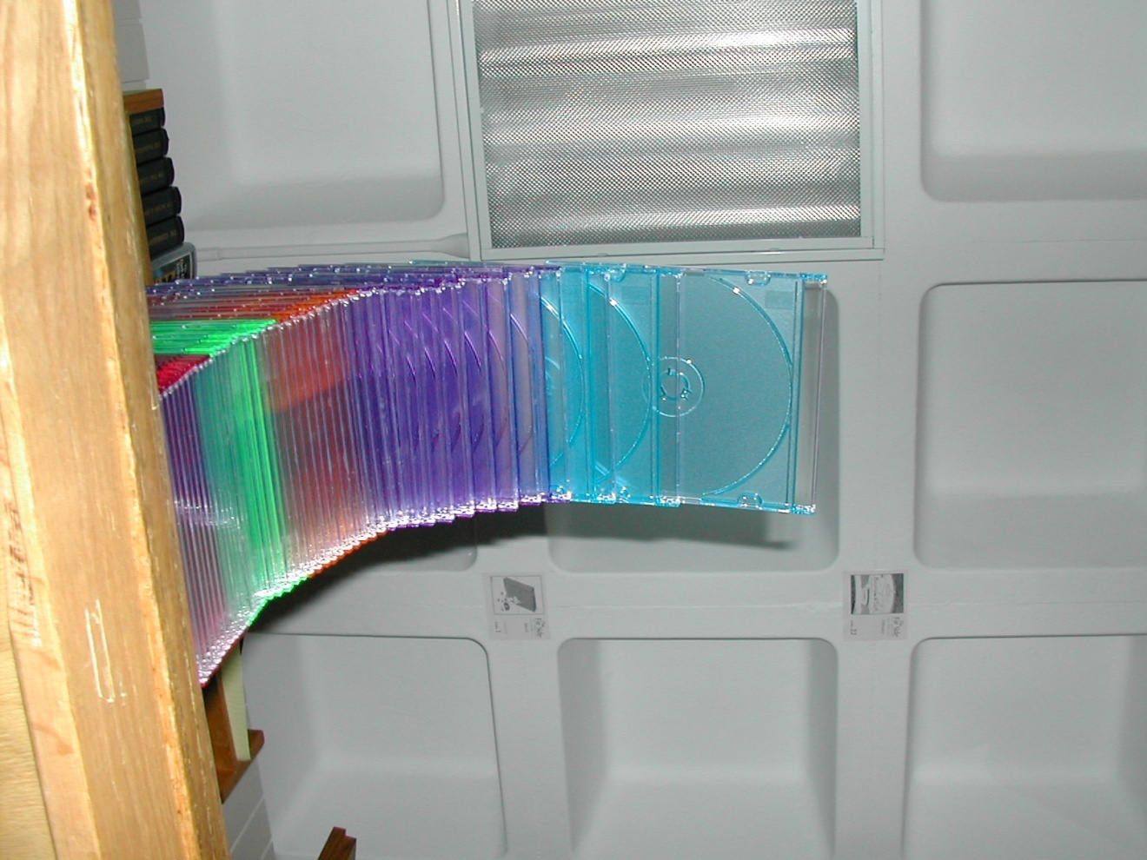
stack of 43 CD’s
October 31, 2007

Slide 48
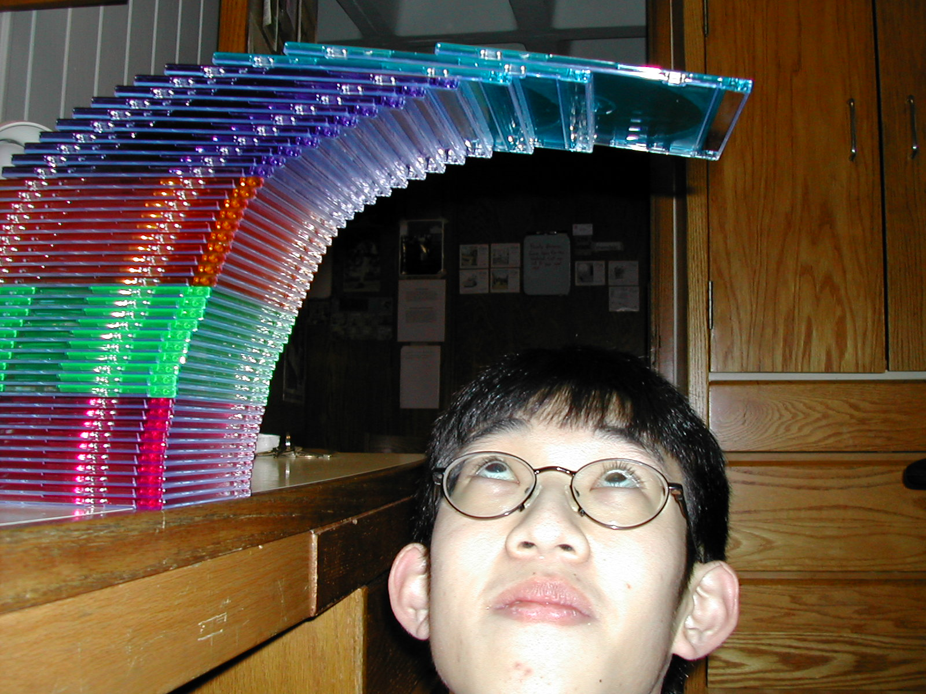
stack of 43 CD’s
see 6.042 Spring02 demo page for credits
October 31, 2007

Slide 49

don’t sneeze
October 31, 2007

Slide 50
Book stacking
for overhang 3, need B_{n} ¸ 3
H_{n}¸ 6
integral bound: ln(n+1) ¸ 6
so ok with n ¸ e⁶−1 = 403 books
actually calculate H_{n}:
227 books are enough.
October 31, 2007

Slide 51





Crossing a Desert
Gas
depot
truck
How big a desert can the truck cross?
October 31, 2007

Slide 52
1 Tank of Gas
1 tank
D₁::= max distance on 1 tank = 1
October 31, 2007

Slide 53
D_{n} ::=
max distance into the
desert using n tanks
of gas from the depot
October 31, 2007

Slide 54
n+1 Tanks of Gas
x
1 −2x
1−2x
n
1−2x
1−x
October 31, 2007

Slide 55
n+1 Tanks of Gas
x
So have:
(1−2x)n
+ (1−x)
grow depot at x
to be n tanks;
continue from
x with n tank
method.
October 31, 2007

Slide 56

depot at x
Set (1−2x)n + (1−x) = n.
Then using n tank strategy
from position x, gives
D_{n+1} = D_{n} + x
October 31, 2007

Slide 57
(1−2x)n + (1−x) = n
1
2n+1
x =
1
2n+1
D_{n+1} = D_{n} +
October 31, 2007

Slide 58
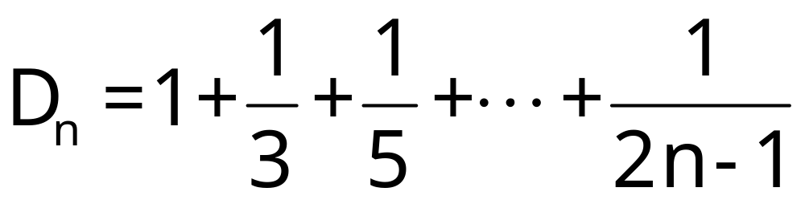
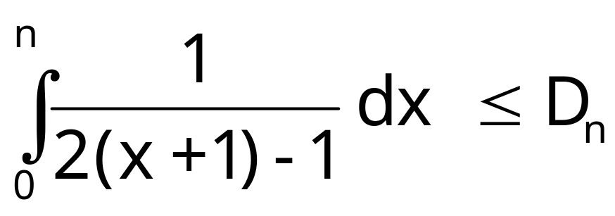
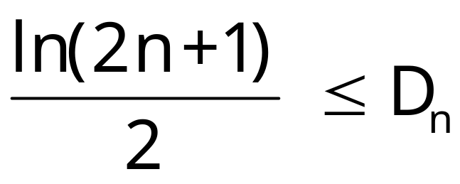
Can cross any desert!
October 31, 2007

Slide 59
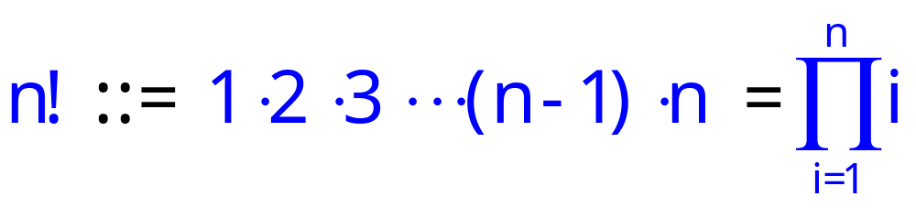
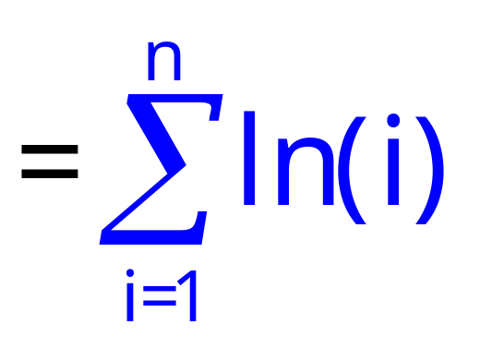
Closed form for n!
Factorial deﬁnes a product:
Turn product into a sum taking logs:
ln(n!) = ln( 1·2·3···(n – 1)·n ) =
ln 1 + ln 2 + · · · + ln(n – 1) + ln(n)
October 31, 2007

Slide 60
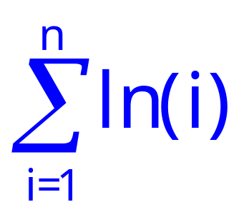
Closed form for n!
Integral Method to bound
ln n
ln(x)
…
ln(x+1)
ln 5
ln 4
ln 3
ln
n-1
ln n
ln 5
ln 2
ln 4
…
ln 3
ln 2
1
2
3
4
5
n–2
n–1
n
October 31, 2007
October 31, 2007
October 31, 2007

Slide 61
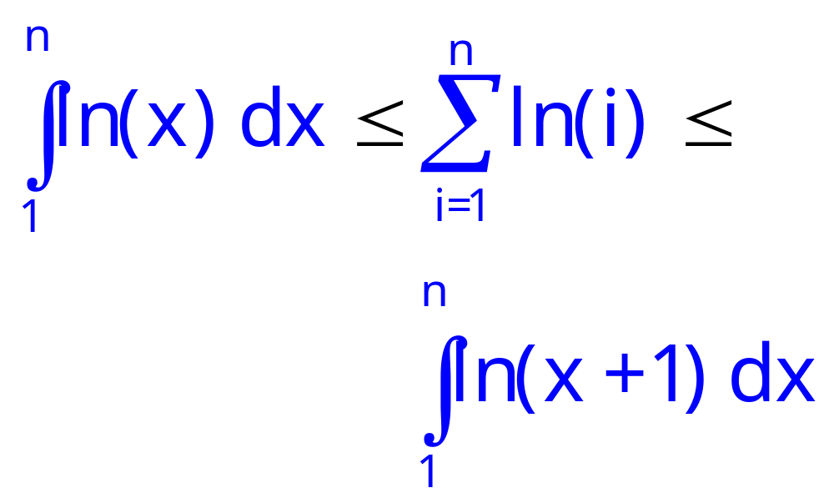
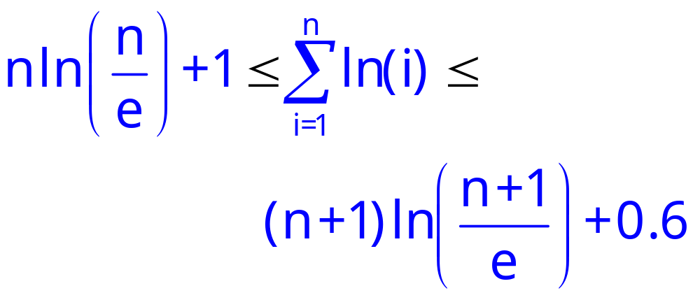
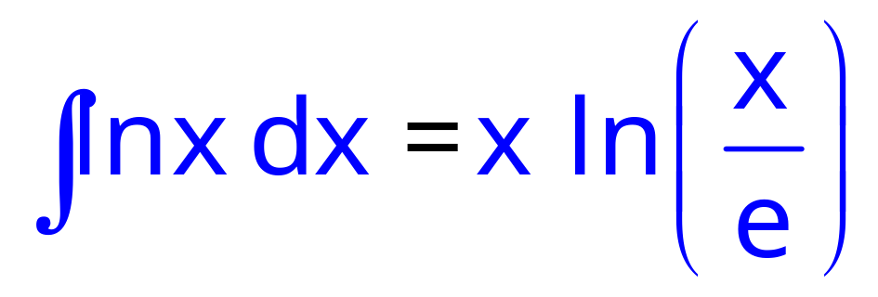
Closed form for n!
reminder:
October 31, 2007

Slide 62
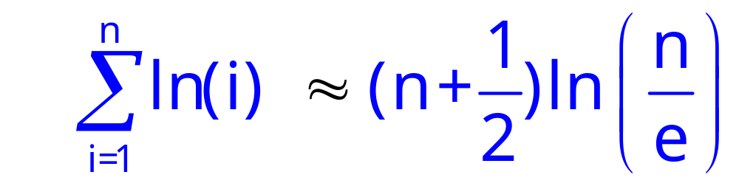
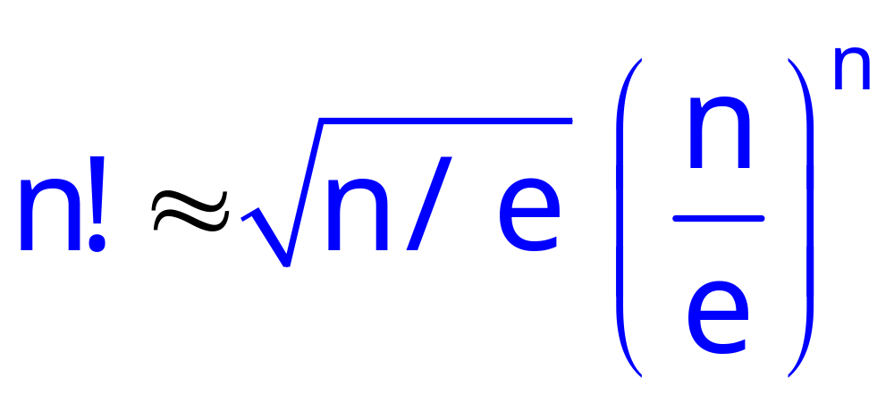
Closed form for n!
exponentiating:
October 31, 2007

Slide 63
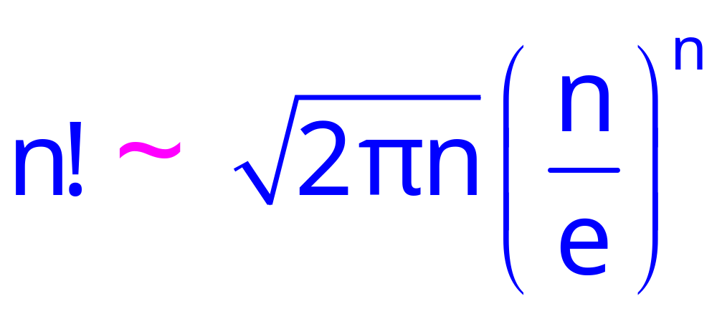
Stirling’s Formula
A precise approximation:
October 31, 2007

Slide 64
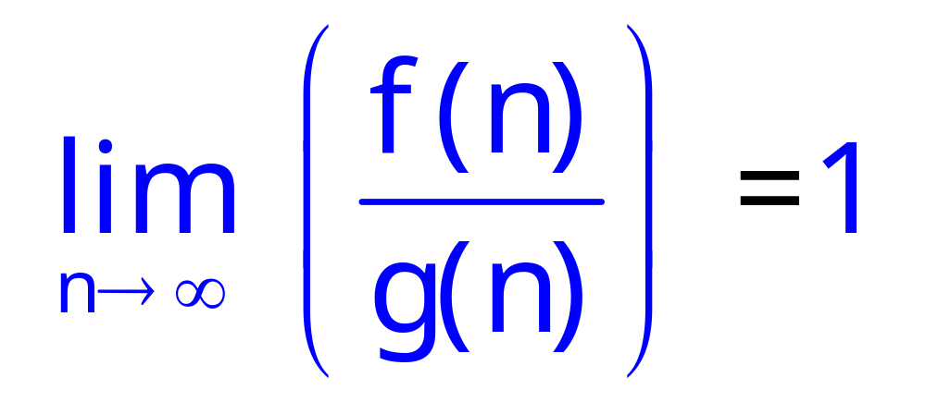
Asymptotic Equivalence
Def: f(n) ~ g(n)
October 31, 2007

