Slide 1
Mathematics for Computer Science
MIT 6.042J/18.062J
Sums &
Money

Slide 2
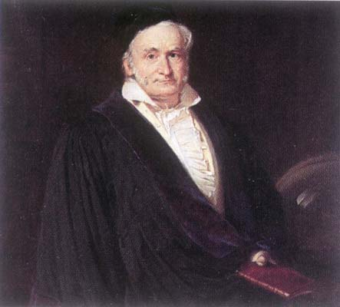
C. F. Gauss
Picture source: http://www-groups.dcs.st-and.ac.uk/~history/PictDisplay/Gauss.html

Slide 3
Sum for Children
89 + 102 + 115 + 128 + 141 +
154 + ··· +
193 + ··· +
232 + ··· +
323 + ··· +
414 + ··· + 453 + 466

Slide 4
Sum for Children
Nine-year old Gauss saw
30 numbers, each 13 greater than the previous one.
(So the story goes.)

Slide 5
Sum for Children
1st + 30th = 89 + 466 = 555
2nd + 29th =
(1st+13) + (30th−13) = 555
3rd + 28th =
(2nd+13) + (29th−13) = 555


Slide 6
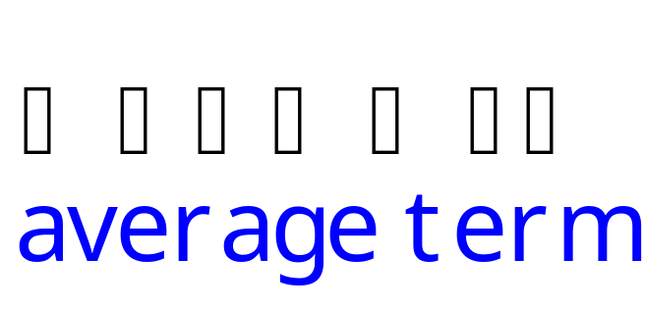
Sum for Children
Sum of k^{th} term and (31−k)^{th} term
is invariant! 15 pairs of terms, so
Total = 555 ⋅ 15
= (1st + last) ⋅ (# terms/2)
= (1st + last)/2 ⋅ (# terms)

Slide 7
Sum for Children
Example:
1 + 2 +  + (n−1) + n =
(1 + n)n
2

Slide 8
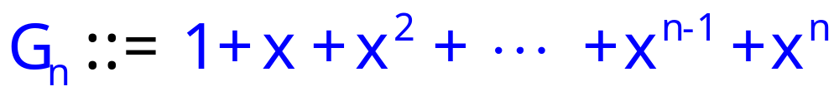
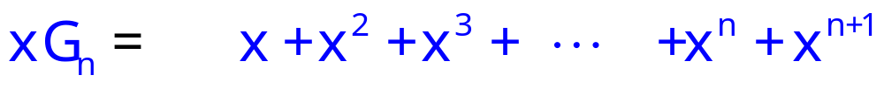
Geometric Series

Slide 9
Geometric Series
G_{n}−xG_{n}=
1 − x^{n+1}

Slide 10
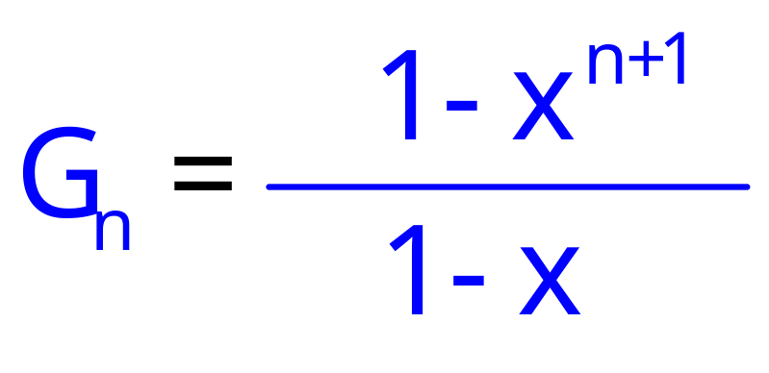
Geometric Series
G_{n}−xG_{n}=
1 − x^{n+1}

Slide 11
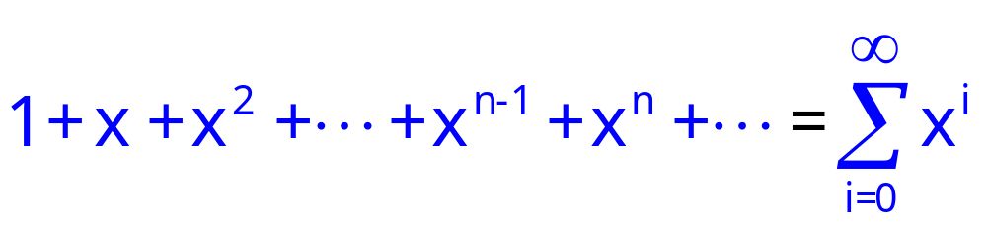
Geometric Series
Consider infinite sum (series)

Slide 12
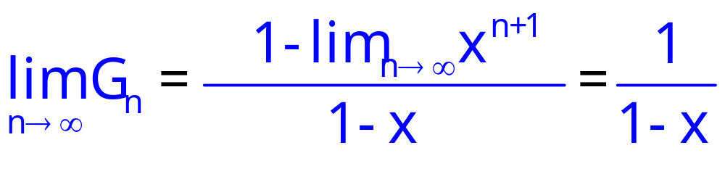
Infinite Geometric Series

Slide 13
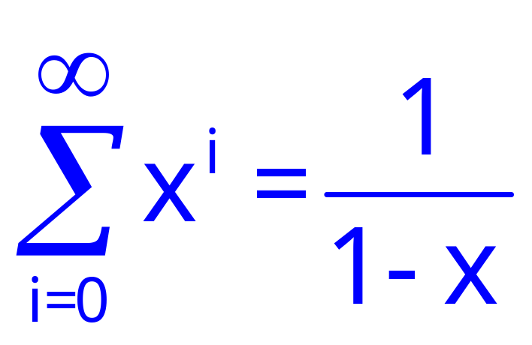
Infinite Geometric Series
for |x| < 1

Slide 14
Team Problem
Problem 1

Slide 15
The future value of $$
I will pay you $100 in 1 year,
if you will pay me $X now.

Slide 16
The future value of $$
My bank will pay me 3% interest.
define bankrate
b ::= 1.03
-- bank increases my $ by this factor in 1 year.

Slide 17
The future value of $$
If I deposit your $X now,
I will have $b⋅X in 1 year.
So I won’t lose money as long as
b⋅X ≥ 100.
X ≥ $100/1.03 ≈ $97.09

Slide 18
The future value of $$
$1 in 1 year is worth $0.9709 now.
$r last year is worth $1 today,
where r ::= 1/b.
So $n paid in 2 years is worth
$nr paid in 1 year, and is worth
$nr² today.

Slide 19
The future value of $$
$n paid k years from now
is worth $n∙r^{k} today
where r ::= 1/bankrate.

Slide 20
Annuities
I pay you $100/year for 10 years,
if you will pay me $Y now.
I can’t lose if you pay me
100r + 100r² + 100r³ +  + 100r¹⁰
= 100r(1+ r +  + r⁹)
= 100r(1−r¹⁰)/(1−r) = $853.02

Slide 21
Annuities
I pay you $100/year for 10 years,
if you will pay me $853.02.
QUICKIE: If bankrates unexpectedly
increase in the next few years,
  You come out ahead
  The deal stays fair
  I come out ahead

Slide 22
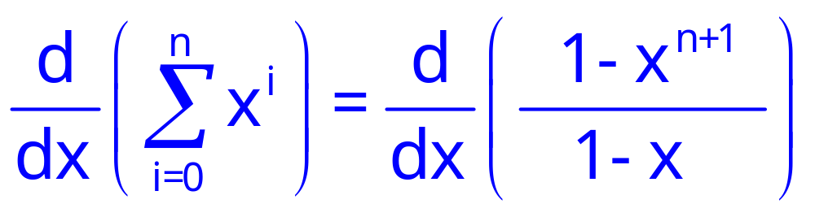
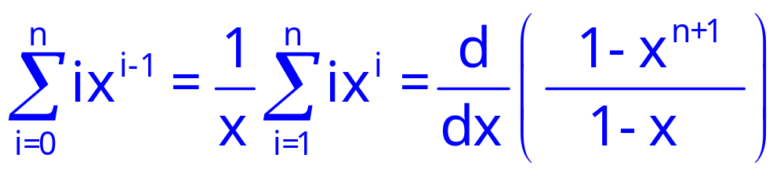
Manipulating Sums

Slide 23
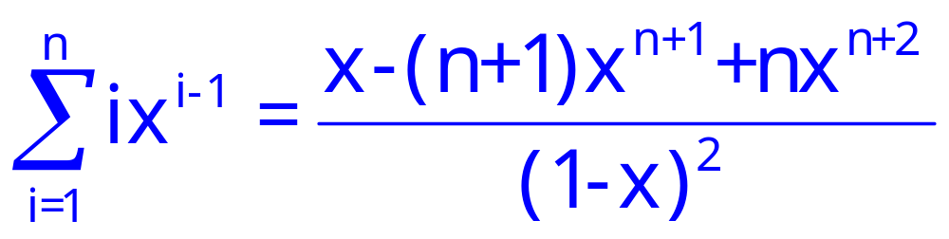
Manipulating Sums

Slide 24
Team Problems
Problems
2&3

