Slide 1
Games &Termination
Mathematics for Computer Science
MIT 6.042J/18.062J
Finite-Path Trees
Well-founded Orders

Slide 2
Tic-Tac-Toe
…
X
X
X

Slide 3
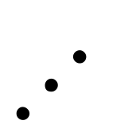
Tic-Tac-Toe
X
…
O
X
X
O
X
O

Slide 4
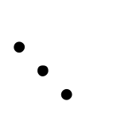
Tic-Tac-Toe
X
O
…
X
X
X
X
X
O
O
X
O

Slide 5

Tic-Tac-Toe Game Tree
…
…
…
…
Depth ≤ 9
win
lose

