Slide 1
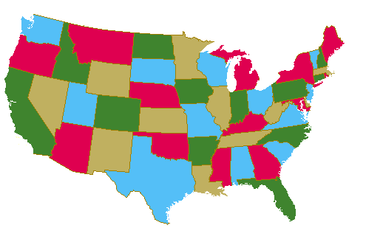
Notes:
A 4-colored Planar Map

Slide 2
Notes:
Maps are 2-Connected Planar Graphs

Slide 3
2
3
4
1
8
7
5
6
Notes:
Maps are 2-Connected Planar Graphs

Slide 4
V
VI
III
I
II
Notes:
Maps with 5 Faces

Slide 5
2
V
3
4
1
VI
III
I
8
7
II
5
6
Notes:
Maps Faces are Simple Cycles

Slide 6
Notes:
Planar Graphs May Have Cross-bars

Slide 7
f
b
a
c
e
g
d
Notes:
An Edge Appearing Twice on One Face

Slide 8
Notes:
Planar Graphs May Have Dongles

Slide 9
s
r
y
x
v
t
w
u
Notes:
Planar Graphs May Have Dongles

