Slide 1
Simple Graphs:
Connectedness,
Trees

Slide 2
Paths & Simple Paths
Lemma:
The shortest path between
two vertices is simple!
Proof: Suppose path from u to v crossed itself:
c
u
v

Slide 3
Paths & Simple Paths
Lemma:
The shortest path between
two vertices is simple!
Then path without c ···c is shorter:
c
u
v

Slide 4
Connected Graphs
A connected graph:
there is a path between
every two vertices.

Slide 5
Connected Components
Every graph consists of
separate connected
pieces (subgraphs) called
connected components

Slide 6
Connected Components
13
12
26
16
66
E17
E25
Med Center
10
8
East Campus
4
Inﬁnite corridor
3 connected components
The more connected components,
the more “broken up" the graph is.

Slide 7

Connected Components
The connected component
of vertex v :

Slide 8
Connected Components
So a graph is connected
iff it has only
1 connected component

Slide 9
Cycles
A cycle is a path that begins
and ends with same vertex
a
v
w
b
path: v ···b ···w ···w ···a ···v
also: a ···v ···b ···w ···w ···a

Slide 10
Cycles
A cycle is a path that begins
and ends with same vertex
a
v
w
b
also: a ···w ···w ···b ···v ···a

Slide 11
Simple Cycles
A simple cycle is a cycle that
doesn’t cross itself
v
w
path: v ···w ···v
also: w ···v ···w

Slide 12
Trees
A tree is a connected graph
with no cycles.

Slide 13
More Trees

Slide 14
Other Tree Definitions
A tree is a graph with a unique path between any 2 vertices.
A tree is a connected graph with n vertices and n – 1 edges.
A tree is an edge-minimal connected graph.

Slide 15
Be careful with these definitions
Is a tree is a graph with n
vertices and n – 1 edges?
NO:

Slide 16
Some trees with five vertices

Slide 17
Some trees with five vertices
Exercise: Prove that all trees with five vertices are isomorphic to one of these three.

Slide 18
Solution to Problem 0
sum of degrees = 2 • edges
5 vertex tree has 4 edges, so
  sum of degrees is 8
tree is connected, so each vertex
has degree at least 1
3 degrees left over: only possibilities are:
  4 1 1 1 1
  3 2 1 1 1
  2 2 2 1 1

Slide 19
Spanning Trees
A spanning tree: a subgraph
that is a tree on all the
vertices.

Slide 20
Spanning Trees

Slide 21
Spanning Trees
a spanning tree

Slide 22
Spanning Trees
another spanning tree
(can have many)

Slide 23
Spanning Trees
A spanning tree: a subgraph
that is a tree on all the
vertices.
Always exists: find minimum
edge-size, connected subgraph
on all the vertices.

Slide 24
CONNECTEDNESS
An edge is a cut edge if
removing it from the graph
disconnects two vertices.

Slide 25
Cut Edges

Slide 26
Cut Edges
B
B is a cut edge

Slide 27
Cut Edges
deleting B gives
two components

Slide 28
Cut Edges
A
A is not a cut edge

Slide 29
Cut Edges and Cycles
Lemma: An edge is a cut
edge iff it is not traversed
by a simple cycle.
Proof: Team problem.

Slide 30
Cut Edges
Fault-tolerant design:
  In a tree, every edge is a cut edge (bad)
  In a mesh, no edge is a cut edge (good)
  Tradeoff edges for failure tolerance

Slide 31
k-Connectedness
Def: k-connected iff
remains connected
when any k-1 edges
are deleted.

Slide 32
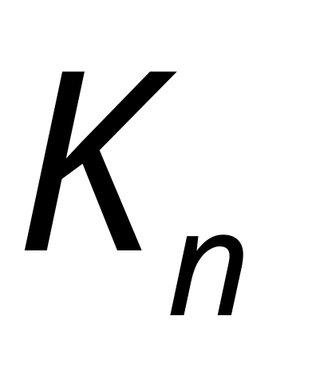
k-Connectedness
Example:
is (n-1)-connected

Slide 33
Team Problems
Problems 13

