Slide 1
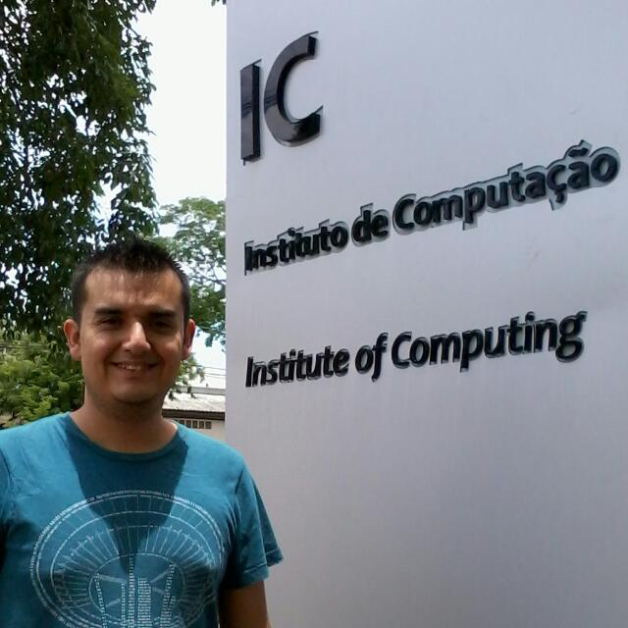
Cloudflare
Candidate Interview
Armando Faz Hernández
PhD Candidate
University of Campinas, Brazil
www.ic.unicamp.br/~armfazh
Position: Cryptography Engineering
Hiring Manager: Nick Sullivan

Slide 2
Background
RSA is currently supported by Cloudflare.
  RSA Signatures (PKCS 1)
  Encryption/Decryption (RSA-OEAP).
RSA public operations are fast.
  However, private operations are slow to compute.

Slide 3
Two-day Challenge
Can RSA run faster?
  Using Go
  Targeting 64-bit architectures
Mentoring: Vlad Krasnov

Slide 4
Improvement Ideas
Key idea: Modify Montgomery multiplication implementation
Replace CIOS algorithm by FIOS algorithm
  A better register scheduling
  Reduce the number of write memory operations
Replace CIOS algorithm by SOS algorithm
  Faster integer multiplication

Slide 5
Benchmark Results
CIOS → FIOS
15.8 %
14.8 %
-1.8 %

Slide 6
Benchmark Results
CIOS → SOS
18.5 %
12.7 %
-2.2 %

Slide 7
Summary
Fine tuning of Montgomery mult speedups RSA significantly.
There still other venues of optimization
  Dedicated code for squaring
  Protect look-up table accesses.
Code available in: http://github.com/armfazh/go
  Branch: opt2 (CIOS→ FIOS)
  Branch: fios (CIOS→ SOS)

