Slide 1
Singular Value decomposition
One of the most important Matrix Factorization

Slide 2
Overview:
About Simple\Interpretable Linear Algebra
Data Reduction technique that is the basis for many ML algorithms (Regression, PCA)
Pseudo-inverse of non square matrix system of equations, least squares, regression
Data-Driven Generalization of the fast Fourier transformation (FFT)
Applications:
The order of the Websites
Facebook:
Tagging a friend in a photo
Amazon, Netflix:
Google Search:
Recommender Systems

Slide 3

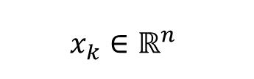
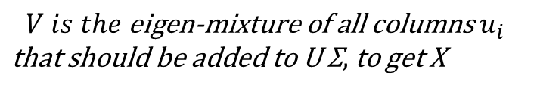
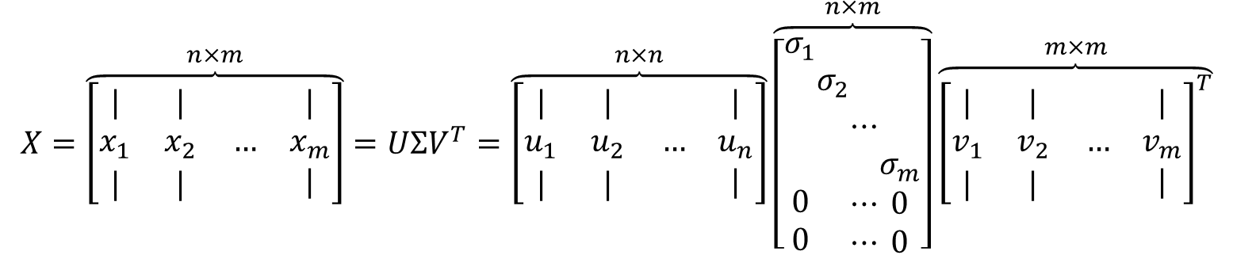
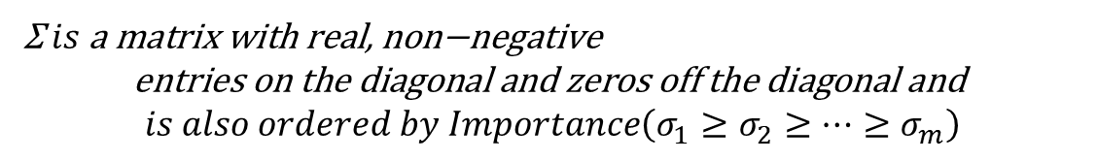
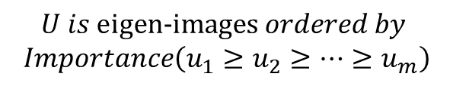
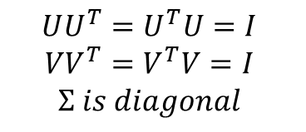
Definition of Singular value Decomposition
$$X=\overset{n×m}{\overbrace{\left[\begin{matrix}| & | & \\ x_{1} & x_{2} & … \\ | & | & \end{matrix} \begin{matrix}| \\ x_{m} \\ |\end{matrix}\right]}}=UΣV^{T}=\overset{n×n}{\overbrace{\left[\begin{matrix}| & | & \\ u_{1} & u_{2} & … \\ | & | & \end{matrix} \begin{matrix}| \\ u_{n} \\ |\end{matrix}\right]}}\overset{n×m}{\overbrace{\left[\begin{matrix}σ_{1} \\ \begin{aligned} \\ \\ \\ 0 \\ 0\end{aligned}\end{matrix}\begin{matrix} \\ \begin{aligned}σ_{2} \\ \\ \\ \\ \end{aligned}\end{matrix}\begin{matrix} \\ \begin{aligned} \\ ⋯ \\ \\ ⋯ \\ ⋯\end{aligned}\end{matrix}\begin{matrix} \\ \begin{aligned} \\ \\ σ_{m} \\ 0 \\ 0\end{aligned}\end{matrix}\right]}}\overset{m×m}{\overbrace{{\left[\begin{matrix}| & | & \\ v_{1} & v_{2} & … \\ | & | & \end{matrix} \begin{matrix}| \\ v_{m} \\ |\end{matrix}\right]}^{T}}}$$
$$x_{k}∈ℝ^{n}$$
$$UU^{T}=U^{T}U=I$$
$$VV^{T}=V^{T}V=I$$
$$Σ is diagonal$$
Image 2 nx1
$$U is \text{eigen}\text{−}\text{images} ordered by$$
$$Importance\left(u_{1}≥u_{2}≥⋯≥u_{m}\right)$$
$$V is the \text{eigen}\text{−}\text{mixture} \text{of} \text{all} \text{columns} u_{i}$$
$\text{that} \text{should} \text{be} \text{added} \text{to} \text{U}$ Σ$,$to get X
Image 1 nx1
Image m nx1
Σ$is \text{a} \text{matrix} \text{with} \text{real}\text{, }\text{non}\text{−}\text{negative}$
$$\text{entries} \text{on} \text{the} \text{diagonal} \text{and} \text{zeros} \text{off} \text{the} \text{diagonal} \text{and}$$
$$is also ordered by Importance\left(σ_{1}≥σ_{2}≥⋯≥σ_{m}\right)$$
The SVD is a unique matrix decomposition that exists for every complex valued matrix

Slide 4
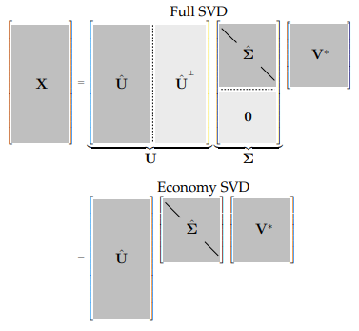

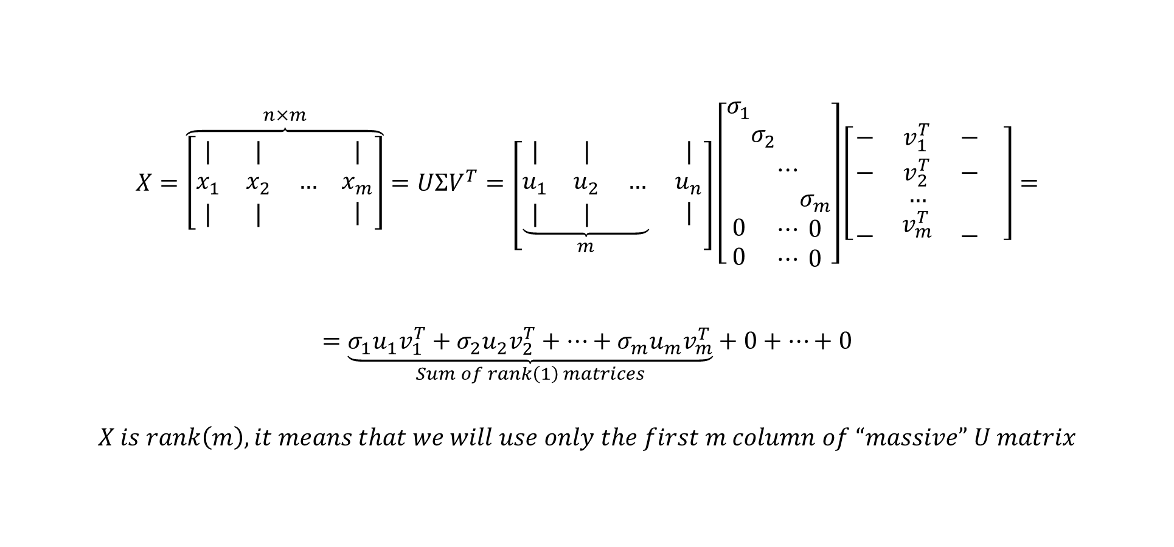
Singular value Decomposition
$$X=\overset{n×m}{\overbrace{\left[\begin{matrix}| & | & \\ x_{1} & x_{2} & … \\ | & | & \end{matrix} \begin{matrix}| \\ x_{m} \\ |\end{matrix}\right]}}=UΣV^{T}=\left[\underset{m}{\underbrace{\begin{matrix}| & | & \\ u_{1} & u_{2} & … \\ | & | & \end{matrix}}} \begin{matrix}| \\ u_{n} \\ |\end{matrix}\right]\left[\begin{matrix}σ_{1} \\ \begin{aligned} \\ \\ \\ 0 \\ 0\end{aligned}\end{matrix}\begin{matrix} \\ \begin{aligned}σ_{2} \\ \\ \\ \\ \end{aligned}\end{matrix}\begin{matrix} \\ \begin{aligned} \\ ⋯ \\ \\ ⋯ \\ ⋯\end{aligned}\end{matrix}\begin{matrix} \\ \begin{aligned} \\ \\ σ_{m} \\ 0 \\ 0\end{aligned}\end{matrix}\right]\left[\begin{matrix}− & v_{1}^{T} & − \\ − & v_{2}^{T} & − \\ \begin{aligned} \\ −\end{aligned} & \begin{aligned}… \\ v_{m}^{T}\end{aligned} & \begin{aligned} \\ −\end{aligned}\end{matrix} \right]=$$
$$=\underset{Sum of rank\left(1\right) matrices}{\underbrace{σ_{1}u_{1}v_{1}^{T}+σ_{2}u_{2}v_{2}^{T}+⋯+σ_{m}u_{m}v_{m}^{T}}}+0+⋯+0$$
$$X is rank\left(m\right), it means that we will use only the first m column of “massive” U matrix$$
$$rank(m)$$
$$That is we can use Economy SVD, where X=\hat{U}\hat{Σ}V^{T}$$

Slide 5

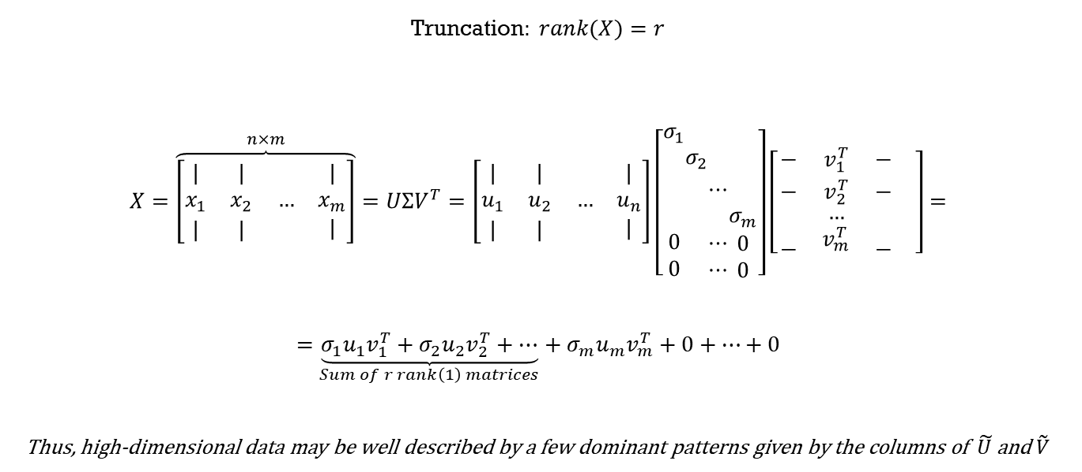

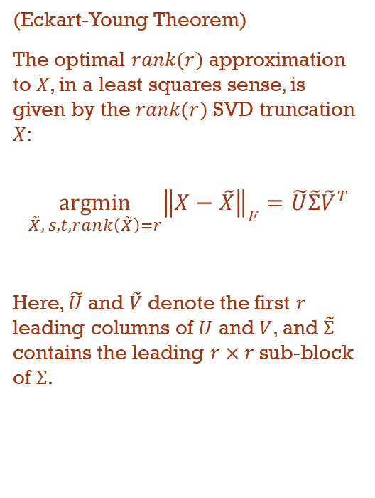
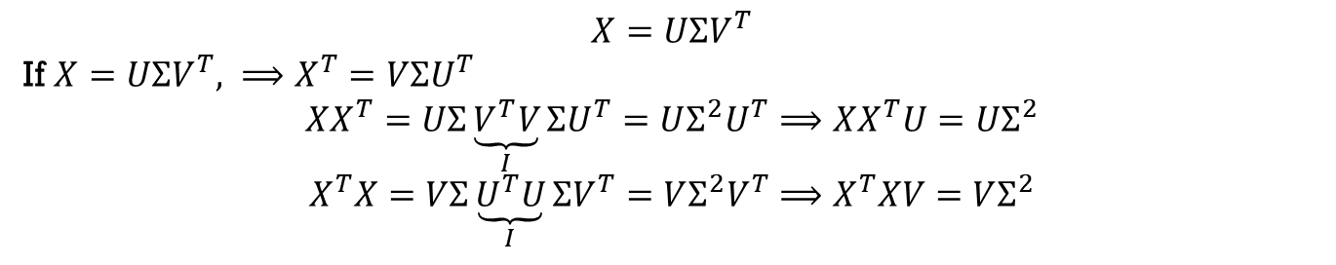

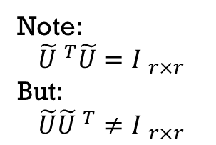
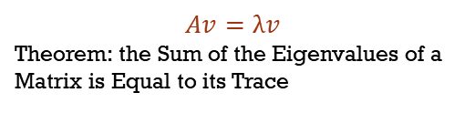
Singular value Decomposition: Matrix approximation
Truncation$: rank(X)=r$
$$X=\overset{n×m}{\overbrace{\left[\begin{matrix}| & | & \\ x_{1} & x_{2} & … \\ | & | & \end{matrix} \begin{matrix}| \\ x_{m} \\ |\end{matrix}\right]}}=UΣV^{T}=\left[\begin{matrix}| & | & \\ u_{1} & u_{2} & … \\ | & | & \end{matrix} \begin{matrix}| \\ u_{n} \\ |\end{matrix}\right]\left[\begin{matrix}σ_{1} \\ \begin{aligned} \\ \\ \\ 0 \\ 0\end{aligned}\end{matrix}\begin{matrix} \\ \begin{aligned}σ_{2} \\ \\ \\ \\ \end{aligned}\end{matrix}\begin{matrix} \\ \begin{aligned} \\ ⋯ \\ \\ ⋯ \\ ⋯\end{aligned}\end{matrix}\begin{matrix} \\ \begin{aligned} \\ \\ σ_{m} \\ 0 \\ 0\end{aligned}\end{matrix}\right]\left[\begin{matrix}− & v_{1}^{T} & − \\ − & v_{2}^{T} & − \\ \begin{aligned} \\ −\end{aligned} & \begin{aligned}… \\ v_{m}^{T}\end{aligned} & \begin{aligned} \\ −\end{aligned}\end{matrix} \right]=$$
$$=\underset{Sum of r rank\left(1\right) matrices}{\underbrace{σ_{1}u_{1}v_{1}^{T}+σ_{2}u_{2}v_{2}^{T}+⋯}}+σ_{m}u_{m}v_{m}^{T}+0+⋯+0$$
Thus, high-dimensional data may be well described by a few dominant patterns given by the columns of $\tilde{U}$ and $\tilde{V}$
(Eckart-Young Theorem)
The optimal $rank(r)$ approximation to $X$, in a least squares sense, is given by the $rank(r)$ SVD truncation $X$:
$$\underset{\tilde{X}, s,t, rank\left(\tilde{X}\right)=r}{argmin}{{\left\|X−\tilde{X}\right\|}_{F}}=\tilde{U}\tilde{Σ}{\tilde{V}}^{T}$$
Here, $\tilde{U}$ and $\tilde{V}$ denote the first $r$ leading columns of $U$ and $V$, and $\tilde{Σ}$ contains the leading $r×r$sub-block of $Σ$.
Note:
$${\tilde{U} }^{T}\tilde{U}={I }_{r×r}$$
But:
$$\tilde{U}{\tilde{U} }^{T}≠{I }_{r×r}$$
Interpretation as dominant correlations:
$$X=UΣV^{T}$$
If $X=UΣV^{T}, ⟹X^{T}=VΣU^{T}$
$$XX^{T}=UΣ\underset{I}{\underbrace{V^{T}V}}ΣU^{T}=UΣ^{2}U^{T}⟹XX^{T}U=UΣ^{2}$$
$$X^{T}X=VΣ\underset{I}{\underbrace{U^{T}U}}ΣV^{T}=VΣ^{2}V^{T}⟹X^{T}XV=VΣ^{2}$$
$$Eigenvectors$$
$$XV=UΣ$$
$$Eigenvalues$$
$$Av=λv$$
Theorem: the Sum of the Eigenvalues of a Matrix is Equal to its Trace
$$Eigenvectors$$

Slide 6
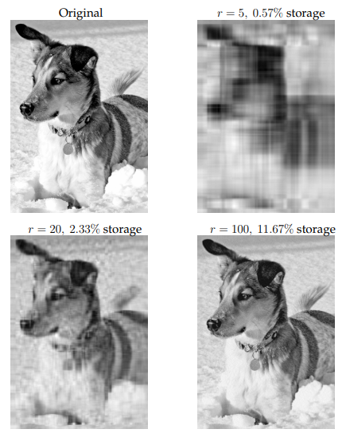
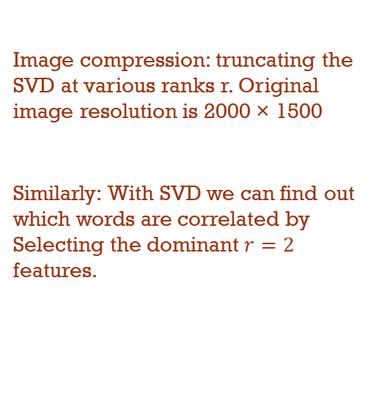
Example
Image compression: truncating the SVD at various ranks r. Original image resolution is 2000 × 1500
Similarly: With SVD we can find out which words are correlated by Selecting the dominant $r=2$ features.

Slide 7
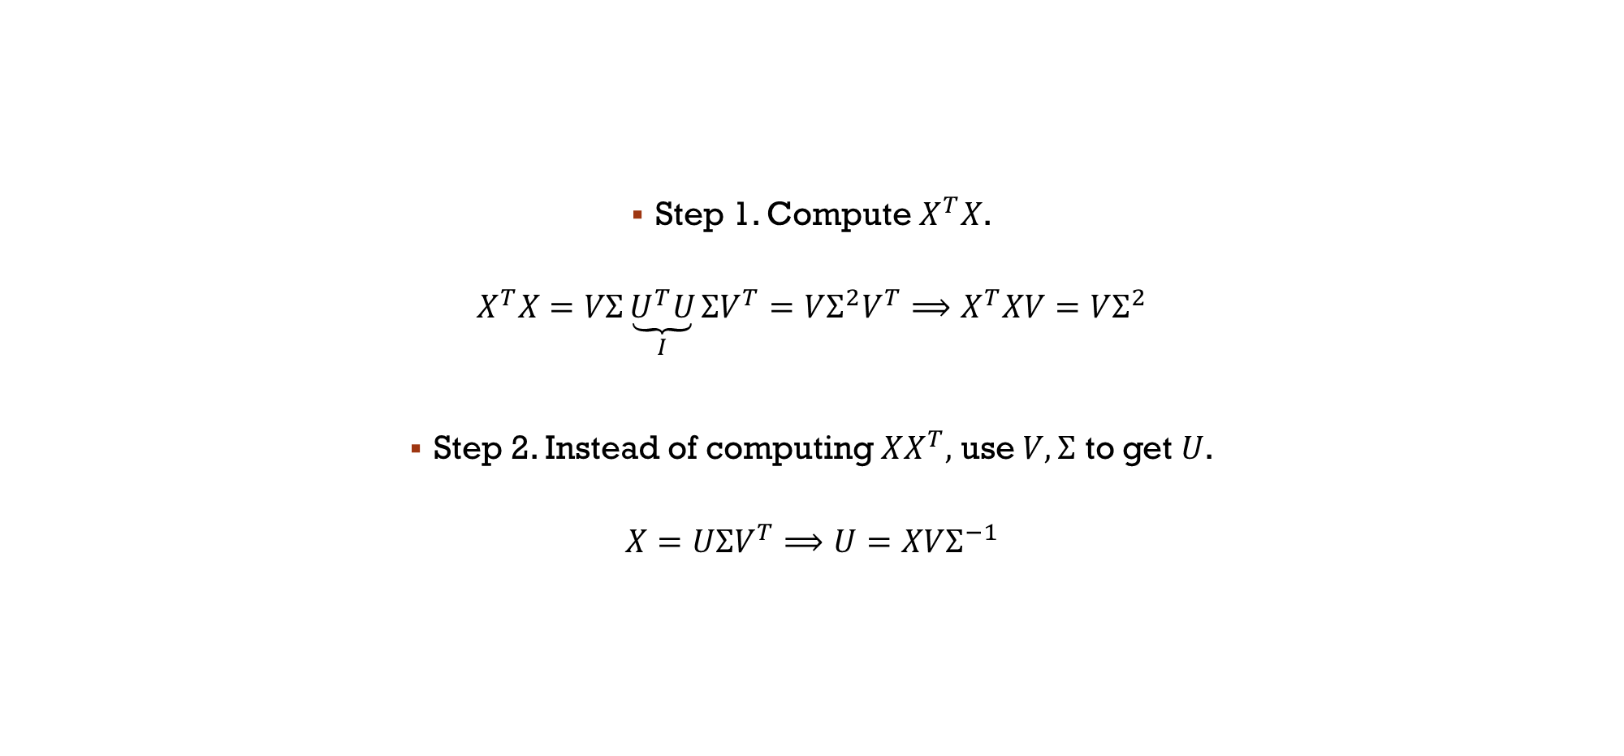
Computing SVD with Method of snapshots
Step 1. Compute $X^{T}X$.
$$X^{T}X=VΣ\underset{I}{\underbrace{U^{T}U}}ΣV^{T}=VΣ^{2}V^{T}⟹X^{T}XV=VΣ^{2}$$
Step 2. Instead of computing $XX^{T},$ use $V,Σ$ to get $U$.
$$X=UΣV^{T}⟹U=XVΣ^{−1}$$

Slide 8
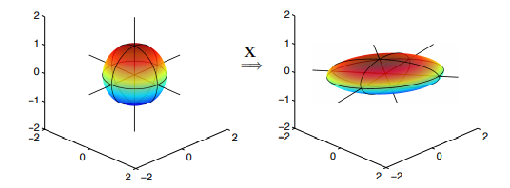


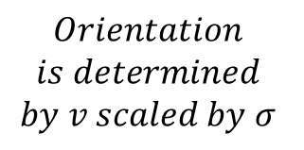



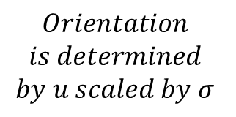






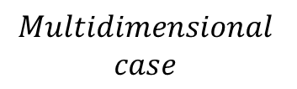



unitary transformations and Geometric interpretation
$$Orientation$$
$$is determined$$
$$by u scaled by σ$$
$$ℝ^{m}$$
$$ℝ^{n}$$
$$v_{1}$$
$${σ_{1}u}_{1}$$
$$v_{2}$$
$$Xv$$
$${σ_{2}u}_{2}$$
$$Multidimensional$$
$$case$$
$$ℝ^{n}$$
$$Orientation$$
$$is determined$$
$$by v scaled by σ$$
$$ℝ^{m}$$
$${σ_{1}v}_{1}$$
$$v_{1}$$
$${σ_{2}v}_{2}$$
$$v_{2}$$
$$uX$$

Slide 9
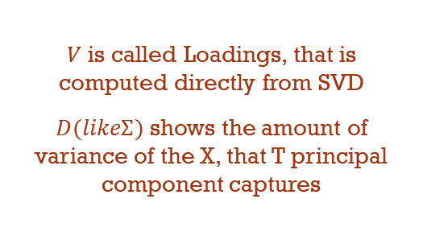
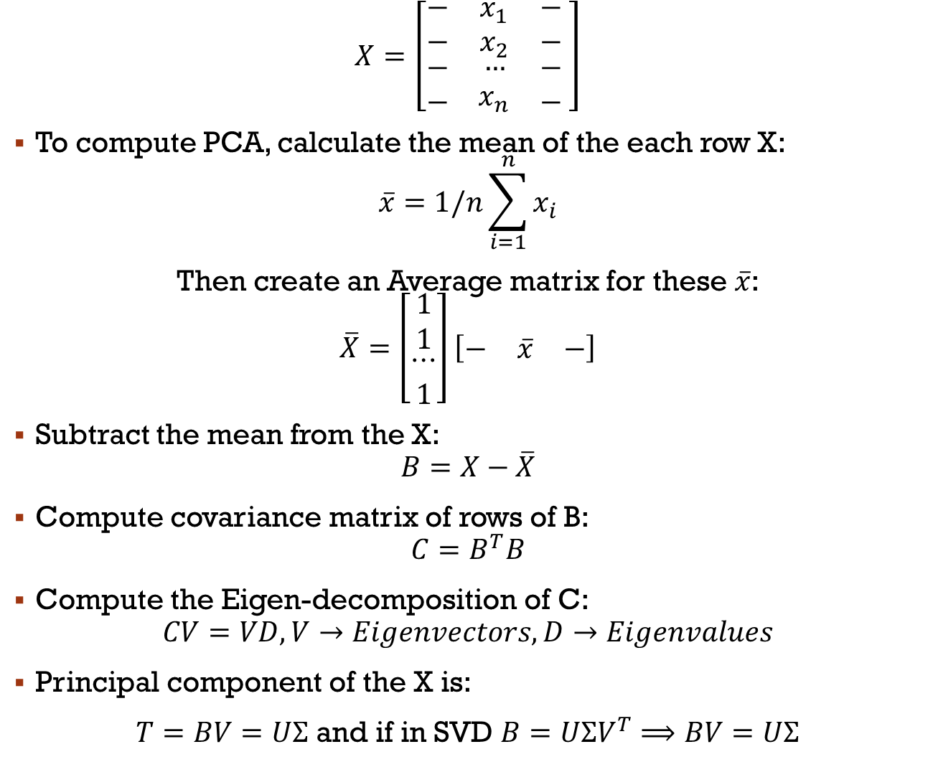
PCA:
OVERview and computation
$$X=\left[\begin{matrix}− & x_{1} & − \\ − & x_{2} & − \\ \begin{aligned}− \\ −\end{aligned} & \begin{aligned}… \\ x_{n}\end{aligned} & \begin{aligned}− \\ −\end{aligned}\end{matrix} \right]$$
To compute PCA, calculate the mean of the each row X:
$$\overline{x}=1/n\sum_{i=1}^{n}{x_{i}}$$
Then create an Average matrix for these $\overline{x}$:
$$\overline{X}=\left[\begin{matrix}1 \\ 1 \\ \begin{aligned}⋯ \\ 1\end{aligned}\end{matrix}\right]\left[\begin{matrix}− & \overline{x} & −\end{matrix}\right]$$
Subtract the mean from the X:
$$B=X−\overline{X}$$
Compute covariance matrix of rows of B:
$$C=B^{T}B$$
Compute the Eigen-decomposition of C:
$$CV=VD, V→Eigenvectors,D→Eigenvalues$$
Principal component of the X is:
$T=BV=UΣ$ and if in SVD $B=UΣV^{T}⟹BV=UΣ$
One of the most popular data reduction tool
Many Extensions and Modifications
Statistical interpretation of SVD
Hierarchical coordinate system
$V$ is called Loadings, that is computed directly from SVD
$D(likeΣ)$ shows the amount of variance of the X, that T principal component captures

Slide 10
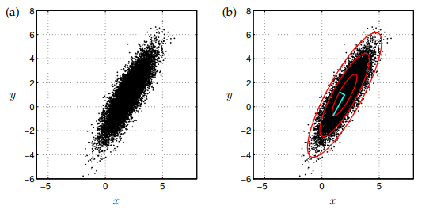
PCA: How it works
Our dataset distribution is 0 Centered and we hope(assume) it is Gaussian.
Red ellipsoid rings are the 1StD, 2StD and 3StD
The Vectors shows the direction of a feature that has the most variances (each Vector has its direction)

Slide 11
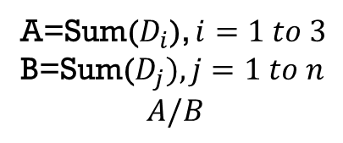
That’s it!
A=Sum($D_{i}$), $i=1 to 3$
B=Sum($D_{j}), j=1 to n$
$$A/B$$
Thanks

