Slide 1

Having fun with ZIP
Armijn Hemel, MSc - 2024-05-21

Slide 2
One slide summary
ZIP specifications are sometimes unclear and ambigious
not every implementation implements the specs the same
input sanitation is a problem

Slide 3
Why do I care about ZIP?
I am making a firmware analysis tool: Binary Analysis Next Generation (BANG): https://github.com/armijnhemel/binaryanalysis-ng/
many firmware files are delivered as ZIP files
some of these firmware files cannot be correctly unpacked by standard tools, or useful data is not unpacked:
  vendors change standard ZIP structures (Dahua)
  vendors add extra data in non-standard places (Google)
  etc.

Slide 4
ZIP file history
the ZIP file format was invented in the late 1980s as a result of the SEA vs PKWARE lawsuit
highly recommended background material: “BBS: The Documentary” (episode 8)
specifications allow reimplementations (but it is not an actual open standard) and are updated every couple of years

Slide 5
ZIP use
many file formats use or are based on ZIP.
Some examples:
  Microsoft Office + LibreOffice files
  Java archives (JAR, WAR, EAR, ...)
  Android package archives (APK)

Slide 6
ZIP implementations on *nix
there are plenty of (independent) ZIP (re)implementations on Linux:
  unzip
  p7zip (originally for 7z, but can also unpack ZIP and other compression formats)
  minizip/minizip-ng
  Python/Java/C# libraries
  BANG (wraps around Python libraries, with additional parsing with Kaitai Struct)
  and more

Slide 7
ZIP file format (1)
ZIP is not a compression format. Instead, it is an archive format:
  individual files in archive can be compressed with different compression algorithms
  a ZIP archive is a concatenation of files, with a lookup table (called “central directory”) at the end of the archive providing quick access to files using offsets (with some additional metadata here and there)

Slide 8
ZIP file format (2)
files (including directories) are stored together with a “local file header”
the local file header contains metadata and is followed by data (except directories or empty files), possibly encrypted
(optionally) data is followed by extra metadata (“data descriptors”), for example in ZIP files created using streaming
The central directory has a corresponding entry for each file, with (nearly) the same data metadata as the local file header and data descriptor.

Slide 9
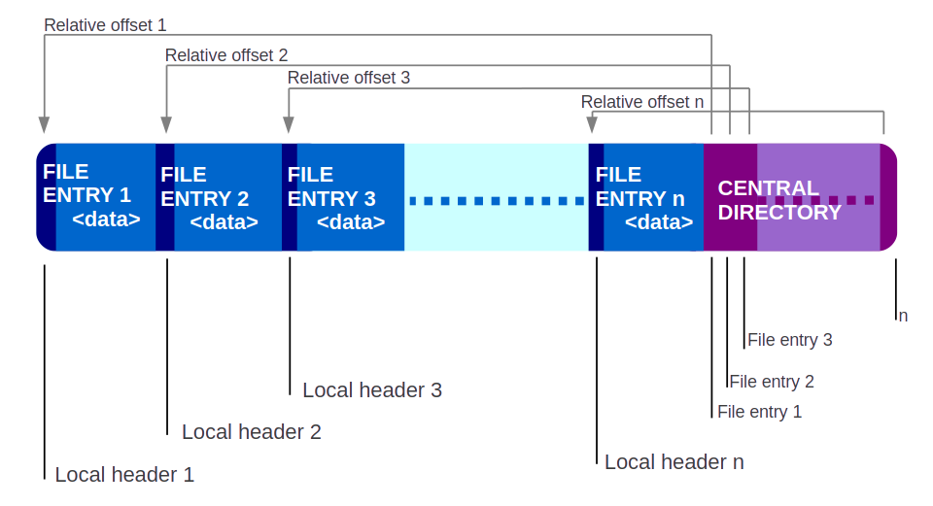
ZIP file format (3)

Slide 10
Local file header
the local file header contains metadata, such as:
  file name length + file name
  compressed + uncompressed size (could be -1 for example when streaming)
  CRC32
  type of compression (store, deflate, bzip2, LZMA, XZ, zstd, etc.)
  various bit flags
  extra fields with custom data

Slide 11
Central directory
the central directory contains almost the same information as the local file directory, with slight differences:
  possibly different compressed/uncompressed size value (think: streaming)
and then some more information not in the local file header. Most interesting:
  file comment

Slide 12
More ZIP headers
the ZIP documentation specifies more ZIP headers, used for different kinds of metadata:
  end of central directory header - header indicating the end of the archive: contains a pointer to the start of the central directory, plus optional archive comment
  data descriptor - header following the data, indicating the actual size of the data. This is used in streaming data.
  ZIP64 related headers

Slide 13
Typical workflow for unpacking
open the file
search the data for the “end of central directory” header (EOCD)
find the offset to the “central directory” from the EOCD
extract metadata for each file from the central directory, including offsets and size
extract individual files from the archive

Slide 14
Quiz: unpacking concatenated files
Imagine two ZIP files A and B concatenated together creating A+B
when unpacking A+B, which ZIP file is unpacked:
  A
  B
  A and B
  none
  yellow

Slide 15
Answer: it depends on the tool!
unzip, Python ZIP library and some others unpack B
p7zip unpacks A
BANG unpacks A and B

Slide 16
Why does this happen?
most tools seek to the end of the file and then search backwards for a valid EOCD and finds B, completely missing A. Not good.
p7zip (probably) searches forward to the first (corresponding) EOCD and finds A and ignores any trailing data. Much better.
BANG searches forward to first find A, then continues to find B. Probably best.

Slide 17
Implications
A+B is not a valid ZIP file according to the specifications but many programs will still process it (in some way).
prepended data (in front of a valid ZIP) has been used in malware delivery
What else could go wrong?

Slide 18
Deep dive into the ZIP specification
a deep dive into the ZIP specification revealed several unclarities related to:
  deprecation of features (how?)
  names & paths
  which data to use in case of duplicates (remember: local file header and central directory have duplicated fields)

Slide 19
Deprecation of features (1)
ZIP defines a “version needed to extract” that ZIP programs can use as a check to see if the functionality is supported.
this is a per file field, not per archive!
specifications:
  This value is based on the specific format features a ZIP program MUST support to be able to extract the file. If multiple features are applied to a file, the minimum version MUST be set to the feature having the highest value. New features or feature changes affecting the published format specification will be implemented using higher version numbers than the last published value to avoid conflict.

Slide 20
Deprecation of features (2)
the functionalities and minimum versions for “version needed to extract” are specified in section 4.4.3.2
most implementations don't support all features but cherrypick. This makes it useless (p7zip therefore ignores it)
incomplete: one new feature (zstd compression) hasn't even been given a number!

Slide 21
Directory names (1)
I have files where directory names have no / at the end and unzip refuses to unpack the file
The specification says:
  4.4.17.1 The name of the file, with optional relative path. The path stored MUST NOT contain a drive or device letter, or a leading slash.
Question: should directories stored always end with a / ? Is that the “optional relative path”?

Slide 22
Directory names (2)
comment from unzip:
  /* Add trailing / to the directory name */
.NET, Python and likely others also require directories to always have a /
p7zip doesn't care

Slide 23
File names
the specifications don't mention anything about duplicate file names
how these are processed is implementation specific

Slide 24
Local file header vs central directory
a lot of data is duplicated between the local file header and the central directory. The specifications aren't clear which data should be leading.
most implementations choose to completely ignore the local file directory (and sometimes also the central directory).

Slide 25
Implementations ignore specs
comments are not properly implemented in every implementation
specification says:
  D.1 The ZIP format has historically supported only the original IBM PC character encoding set, commonly referred to as IBM Code Page 437.
  D.2 If general purpose bit 11 is unset, the file name and comment SHOULD conform to the original ZIP character encoding.
Python: “The comment associated with the ZIP file as a bytes object.” and “Comment for the individual archive member as a bytes object.”

Slide 26
Hmmm.
the specifications are unclear and implementations are not reading them in the same way
there must be opportunities for malice!
Let's play!

Slide 27
Experiment: hiding malware in ZIP files
as an experiment a student from OS3.nl (Nick Mastorakis) and I worked on fooling malware scanners with modified ZIP files:
  “hide” malware in ZIP files
  upload to VirusTotal to scan with 60+ malware scanners
13 scenarios, 2 malware samples were used of different size: a regular one and a small one to hide in ZIP fields

Slide 28
VirusTotal
VirusTotal is an online service where files can be scanned by multiple malware scanners
drawbacks:
  results aren't always reproducible due to updates to VirusTotal
  VirusTotal might sometimes not show all results to thwart malware developers wanting to proof their malware
Still, there were some interesting results!

Slide 29
Caveats
malware scanners should not be used as the only line of defense
there are many other mechanisms to get malware onto a machine
getting malware onto a machine is just one piece of the malware puzzle: unpacking and executing is the other

Slide 30
Scenario 1: baseline
uncompressed malware (Agent Tesla variant)
  recognized by 59 out of 71 scanners
some scanners were not successful as the malware itself wasn't recognized. Logical conclusion: 59 scanners is the upper bound (for reasons outlined before this wasn't always the case)

Slide 31
Scenario 2: regular ZIP
compress the file using a regular ZIP compression program (“zip” on Linux) in the simplest format possible.
58 out of 62 scanners successfully found the malware
note: for each scan a different number of scanners was reported. This makes comparing results sometimes a bit tricky.

Slide 32
Scenario 3: use different ZIP programs
same as previous, but use p7zip and minizip-ng for compression
52 out of 64 scanners found the malware
note: slightly fewer scanners found it but not very significant

Slide 33
Scenario 4: use different compression
bzip2: 45 out of 65
LZMA: 41 out of 63
zstd: 5 out of 61
interesting! zstd is a recent addition to the ZIP standard, but very few malware scanners can unpack files compressed with it
results were similar when using different ZIP implementations

Slide 34
Scenario 5: change the “version to extract” field
the “version to extract” field is present in both the local file header and central directory
changing that to invalid versions might cause scanners to not unpack (see earlier)
but this is not the case: 51 out of 65.

Slide 35
Scenario 6: concatenating ZIP and malware
two subscenarios:
  malware + ZIP: 53 out of 71
  ZIP + malware: 4 out of 62
This is interesting. It seems most scanners ignore trailing data?

Slide 36
Scenario 7: concatenate two ZIP files
two subscenarios:
  harmless ZIP + malware ZIP: 39 out of 64
  malware ZIP + harmless ZIP: 33 out of 64
some scanners would only scan the first file, others only the second file. Some scanners didn't find anything, others found both.

Slide 37
Scenario 8: use comments to hide data
for this scenario a different smaller malware was used that would fit in 65,536 bytes
two subscenarios:
  use the archive .ZIP file comment (end of central directory): 13 out of 62
  use a file comment (central directory): 1 out of 61
file comments seem to be ignored by most scanners!

Slide 38
Scenario 9: use a custom “extra field”
a custom “extra field” was created, containing the malware. 4 bytes are used for the “extra field header” so that leaves 65,532 bytes for malware. This was done for both the local file header and central directory.
shocking: 0 out of 61 were successful
no scanners scan data in “extra field” fields!

Slide 39
Scenario 10: store malware between two local files
put malware in between two local file headers, adapt the central directory so that the file can still be unpacked regularly
basically: this is similar to Google does with Android Signing Blocks in APK files
2 out of 61
many scanners do not seem to scan data between the individual files

Slide 40
Scenario 11: hide files
Specifications say:
  4.3.2 Each file placed into a ZIP file MUST be preceded by a "local file header" record for that file. Each "local file header" MUST be accompanied by a corresponding "central directory header" record within the central directory section of the ZIP file.
create a ZIP file with 3 files, file nr 2 being malware and remove the entry for nr 2 from the central directory (this is similar to what a format called “Search Optimized ZIP” does)
8 out of 60
it seems that most scanners treat the central directory as complete.
result is interesting compared to scenario 10: adding a local file header makes more scanners find the malware?

Slide 41
Scenario 12: hide malware in the name field
the ZIP specification allows for absurd long names (65,536 bytes) which most file systems don't like
construct a file name as follows:
  regular file name + NULL byte + malware
0 out of 59 scanners
the file name field isn't scanned by malware scanners

Slide 42
Scenario 13: change compression method
changing the compression method in the local file header and/or central directory, without actually changing the compression.
first create a ZIP file with deflate compression, then:
  change compression method to zstd in local file header: 19 out of 63
  change compression method to zstd in central directory: 2 out of 61
interesting: possibly some scanners look at the local file header and bail out early?

Slide 43
Possible scenarios
digital signature field
files created using a streaming approach
ZIP64 extensible data sector (might allow much bigger malware to be stored)
very old, mostly unsupported, compression (shrunk, reduced, implode)
strong encryption fields
using multiple fields to store parts of malware

Slide 44
We need a better ZIP implementation
ZIP isn't a great file format but it isn't going away.
for forensics/malware research we really need better tools that will allow:
  easy access to every piece of data in a ZIP file
  linting of ZIP files
  proper visualisation
proposals for funding to create better tools is currently under review

Slide 45
Wrapping up + thank you
catch me in the hallway to ask me more!
big thanks to NLnet Foundation for funding my journey deep deep into the land of ZIP
try BANG! https://github.com/armijnhemel/binaryanalysis-ng/

