Slide 1
Build Tracing
Armijn Hemel, MSc
Tjaldur Software Governance Solutions

Slide 2
About me
computer science at Utrecht University (NL)
  created first prototype of NixOS distribution, based on Nix package manager
former board member at NLUUG & NixOS Foundation
former core team gpl-violations.org
creator of (open source licensed) tools for binary analysis/software composition analysis & build analysis
license compliance audits, defending against GPL trolls, M&A work, and so on

Slide 3
Possible views on software
there are three possible views to look at software:
  source code: what license/author/copyright do files or packages have?
  build time: how were programs built and with which source code?
  run time: how do programs combine/interact at run time?

Slide 4
Source code view on software
the source code view has been the focus of SBOMs:
  package level license
  file level license
  author/copyright
  dependencies
  etc.
but it doesn't give us the full picture of how software is built, installed and used and can lead to confusion.

Slide 5
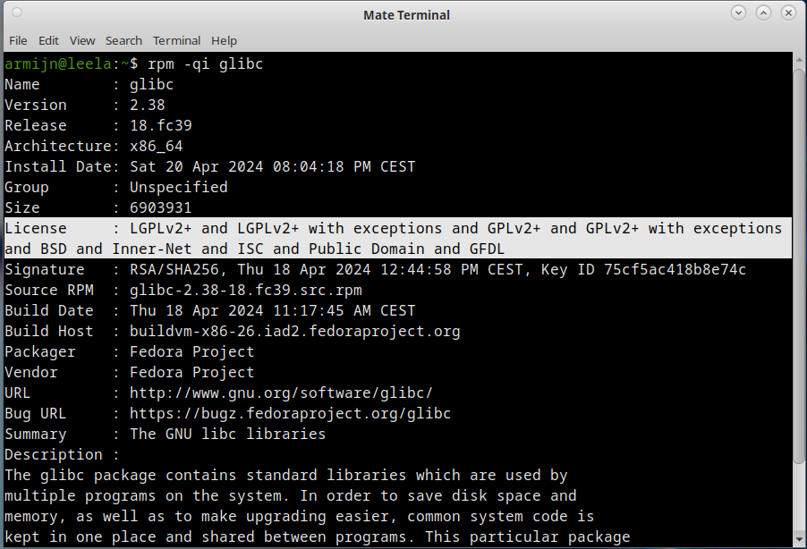
Example: glibc

Slide 6

GPL code in a library?!!?!11!?

Slide 7
What's going on?
in glibc there are pure GPL-2.0 licensed files, but these are individual tools not part of the library part of glibc. Tool example: “ldconfig”
in many packages you can find files that are not part of what is installed on a machine/device:
  build files (GNU autotools, custom scripts, etc.)
  translation files
these might only be used during build time and not be shipped in an installable package, or in a separate package, or not included in a build.

Slide 8
Build time view
the source code view is correct, but it misses some information, namely “what source went into a particular binary?”
knowing for each binary which source code files were used, allows you to:
  zoom in on license/security issues
  reduce problem space and triage more effectively
note: SPDX actually has a “build profile” but it is not granular enough for information related to individual binaries

Slide 9
How to find out what went into a specific binary?
two ways:
  fingerprinting - only needs a binary, but is not very accurate
  build tracing - very accurate, but needs access to source code and the build process (you need to be able to rebuild)

Slide 10
Fingerprinting
extract symbols (function names, strings) and map to a database of same information extracted from known source code
risk of missing files that were used (example: static ELF linking means far fewer symbols available for fingerprinting)
makes no sense if you have source code and can rebuild!
I make (open source licensed) tools for binary analysis fingerprinting. Binary Analysis Next Generation (BANG) https://github.com/armijnhemel/binaryanalysis-ng/

Slide 11
Tracing a build
instrument the unmodified build (with strace or BPF) and record which files are being opened, created, renamed, and so on, and create a build graph to track which files were used to create a binary.
This works really well:
  ASE2014 conference: “Tracing Software Build Processes to Uncover License Compliance Inconsistencies”
  Authors - Sander van der Burg, Eelco Dolstra, Shane McIntosh, Julius Davies, Daniel M. German, Armijn Hemel

Slide 12
Example: FFmpeg
FFmpeg has switches to include/exclude GPL licensed code
by just looking at the source code it is very hard to find out what will be used (build script parsing is not the way)
by tracking the files that are opened in the build you can very easily see which files are used
we used build tracing to uncover license inconsistencies in FFmpeg (which were then fixed by FFmpeg). These were very hard to spot otherwise.

Slide 13
Example projects using tracing
some projects using (a form of) tracing
  Eclipse Adoptium
  TraceCode
  https://github.com/armijnhemel/tracing_software_packages
  build-recorder: https://github.com/eellak/build-recorder
  ESSTRA: https://github.com/sony/esstra/

Slide 14
Build tracing project
I am making proper tools (work in progress, still early days) to make this all a bit easier:
https://github.com/armijnhemel/tracing_software_packages
this work is funded through NGI Zero Core, a fund established by NLnet with financial support from the European Commission's Next Generation Internet program.

Slide 15
Run time view
the run time view could include:
  all run time dependencies
  configuration
personally I think that this is impossible to capture in SBOMs for run time environments:
  dynamic ELF loading, dynamic Java class loading, WebAssembly, JavaScript, etc.
Nix closures/expressions probably capture more information!
  please talk to me to learn more

Slide 16
Build tracing specifics: how it works (1)
these instructions are for Linux
  standard Linux tools (strace), with a bit of custom glue (open source licensed)
  no BPF
only a subset of system calls are traced:
  file related (open, close, stat + friends)
  process related (vfork, clone + friends)
  file descriptor related (dup, pipe, tee + friends)

Slide 17
Build tracing specifics: how it works (2)
trace output is written to a file per PID
files are parsed to create a build graph:
  which process creates which other process?
  inputs and outputs
a build graph can be traversed to answer the question:
  which process created which binary and which inputs were involved?
let's look at some example trace files

Slide 18
Build tracing specifics: how it works (3)
making sure your code is complete and corresponding:
  copy files that were opened/stat'ed
  rebuild
  compare the binaries
let's look at another example (Linux kernel 6.11)
  original number of files
  copied number of files

Slide 19
Some statistics
Trace files can get BIG and there are MANY:
  Linux kernel 6.11 build trace files are ~1.4 GiB (or 3 GiB when tracing all system calls)
  ~25,000 trace files
PID wrapping can be an issue, but should not be a problem on modern systems (max PID: 4M+)
tracing makes a build slower

Slide 20
What to do and not to do when tracing
don't trace every build: ideally you should only have to trace a build once
only retrace when code changes significantly
rebuild to see if you are “complete and corresponding”
do not base your license analysis only on the copied files (there could be license references somewhere else), but use it to have a better understanding of what you are actually building

Slide 21
Tracing software packages project
https://github.com/armijnhemel/tracing_software_packages
currently:
  tracing a build and writing files
  copying files
planned:
  graph traversal
  data backends (scancode, vulnerablecode)
welcome to contribute (code, funding)

Slide 22
Conclusion
Build tracing can be a very effective way to get more granular information
If you need more information: armijn@tjaldur.nl
https://github.com/armijnhemel/tracing_software_packages
this work is funded through NGI Zero Core, a fund established by NLnet with financial support from the European Commission's Next Generation Internet program.

