Slide 1
PCPG — Predictive Coding Policy Gradients
On-policy policy gradients in JAX/Flax + a predictive-coding-trained policy (jpc)
Code overview · June 2026 · branch feature/cleanba-bandit

Slide 2
Repository layout
src/backprop_algorithms/ REINFORCE, PPO, Cleanba PPO, TRPO (+ shared common.py)
src/pc_algorithms/ PC-REINFORCE (predictive coding via jpc)
src/networks/ MLP / NatureCNN, action distributions, policy interface
src/env/ Procgen wrapper + 2-armed bandit (same VecEnv API)
configs/ YAML experiment configs (default.yaml, bandit.yaml)
scripts/ run_train.py, run_eval.py, run_bandit_comparison.py
results/ committed artifacts: plots, per-update logs, CSVs
•
• One convention everywhere: each algorithm file has an inline Config class + main()
– scripts/run_train.py maps YAML keys onto Config and dispatches by agent.algorithm
– Both envs expose the same interface: reset(), step(), action_space.n, normalize_obs()

Slide 3
What we took from where
Component | Source | What we changed
REINFORCE, PPO, TRPO | PolicyGradientsJax (Matt00n), MIT | Procgen + bandit env factory, init-bias knob, SGD option, bug fixes
networks/ (MLP, CNN, distributions) | PolicyGradientsJax | near-exact copy; distrax migration planned
Cleanba PPO | Cleanba / CleanRL (vwxyzjn) | single-file re-implementation on our env API (not the distributed actor-learner)
PC training (inference + local updates) | jpc (thebuckleylab) | used as a library: make_mlp, make_pc_step; we add the RL wrapper
Bandit env, adversarial init, comparison | ours | —

Slide 4
Algorithms in the repo
Algorithm | Gradient type | Update rule
REINFORCE | vanilla PG (backprop) | log-prob × advantage, SGD or Adam
PPO / Cleanba PPO | first-order surrogate (backprop) | clipped ratio, GAE, minibatch epochs, Adam(eps=1e-5)
TRPO | natural PG (backprop) | Fisher-preconditioned step via conjugate gradient + KL line search
PC-REINFORCE | predictive coding (no backprop) | advantage-weighted output targets → jpc inference relaxation → local PC updates
PCPG | predictive coding | work in progress — the point of the project

Slide 5
Testbed: 2-armed bandit with an adversarial start
• Simplest RL problem: 1 state, 2 actions, 1-step episodes; arm means (1.0, 0.9), deterministic
• Softmax policy initialized at π(optimal arm) ≈ 1.8% (logit bias [0, 4])
• Why this separates the algorithm families:
– vanilla PG gradient on the logit gap = π(1−π)·Δr ≈ 0.002 → plateau of ~1/π updates, any step size
– natural PG divides by the Fisher π(1−π) → constant logit progress per update
– Mei et al. 2020: softmax PG O(1/t) with plateau constants; NPG converges linearly
• Deterministic rewards keep the gap purely geometric — no estimation-noise excuses

Slide 6
PC-REINFORCE: policy gradients without backprop
• Policy = predictive coding network (jpc.make_mlp, equinox): 1 → 32 → 2
• Per update:
– rollout 2000 one-step episodes, advantages A = r − mean(r)
– output targets y = logits + α·A·(onehot(a) − π) → PC output error = REINFORCE gradient
– jpc.make_pc_step: relax activities to equilibrium (diffrax ODE), then local PC weight updates
• No end-to-end backprop through the policy — all updates are local
• Hypothesis: PC inference acts as an implicit (partial) preconditioner of the learning signal

Slide 7
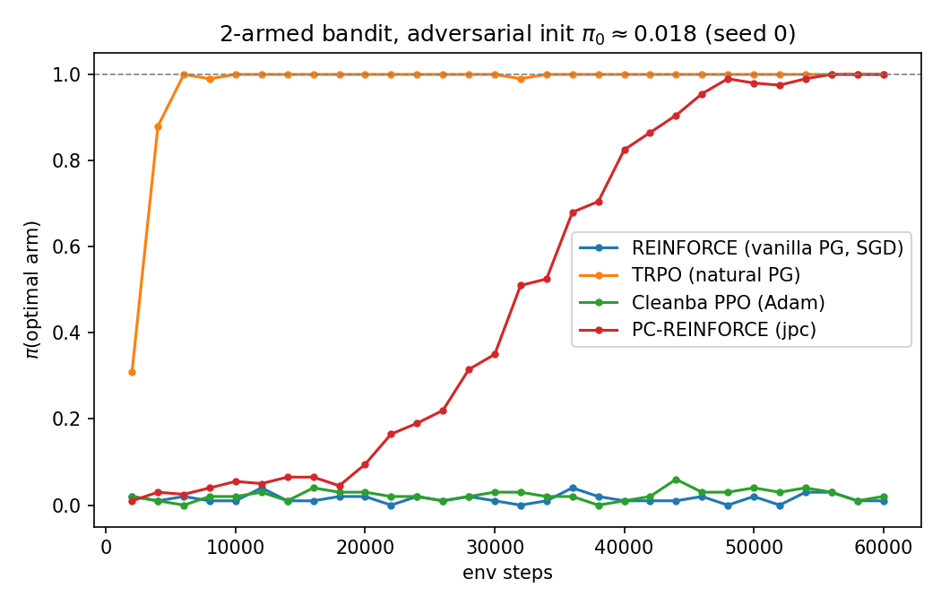
Results: PC sits between vanilla PG and natural PG
Algorithm | final π(opt) | avg π(opt)
TRPO (natural PG) | 1.000 | 0.972
PC-REINFORCE (jpc) | 1.000 | 0.487
Cleanba PPO (Adam) | 0.020 | 0.023
REINFORCE (SGD) | 0.010 | 0.015
TRPO escapes in ~3 updates; PC-REINFORCE climbs steadily and converges by ~50k steps; REINFORCE and PPO never leave the plateau. Reproduced on seeds 0 and 7.

Slide 8
Hyperparameters (bandit comparison)
 | REINFORCE | TRPO | Cleanba PPO | PC-REINFORCE
samples / update | 2000 (1 env) | 2000 (8×250) | 2000 (8×250) | 2000 (8×250)
optimizer | SGD 0.5 | value: Adam 1e-2 | Adam 2.5e-4, eps 1e-5 | Adam 1e-2 (PC params)
key knobs | entropy 0 | target KL 0.01, CG 10 iters, 8 minibatches | clip 0.1, 4 epochs × 4 minibatches, GAE λ 0.95 | target scale 1.0, max_t1 20
policy net | linear (1→2) | linear (1→2) | linear (1→2) | MLP 1→32→2 (PCN)
shared | 60k steps · γ 0.99 · adversarial logit bias [0, 4] · 200 stochastic eval episodes/update

Slide 9
Reproduce + environment
pip install -e . # incl. jpc from GitHub
python scripts/run_bandit_comparison.py --seed 0 # 4-way + plot + logs
python scripts/run_train.py --config configs/bandit.yaml
python scripts/run_train.py --config configs/default.yaml # Procgen
•
• Outputs land in results/bandit_seed{seed}/: figure, per-algo logs, pi_optimal.csv, summary.txt
• Version pins that matter: JAX 0.4.38 + Flax 0.10.2 + Optax 0.2.4
– jpc requires JAX 0.4.38–0.5.2; newer JAX removed device_put_replicated used by the pmap code
• Next: PCPG — replace the REINFORCE wrapper with a PC-native policy gradient; distrax distributions

