Slide 1
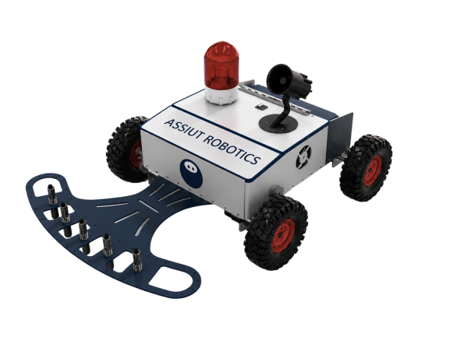
ASSIUT ROBOTICS
MINESWEEPER
BY
ASSIUT ROBOTICS TEAM

Slide 2
MECHANICAL
SECTION
2.ELECTRICAL
SECTION

Slide 3
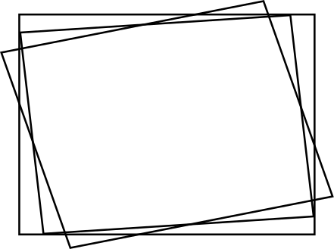
ELECTRICAL SYSTEM OVERVIEW
Our robot uses a dual-controller architecture consisting of:
Raspberry Pi 4 (8GB) for high-level processing.
Arduino Mega for low-level hardware control.
The Raspberry Pi is responsible for:
Computer Vision
Localization
Mine Mapping
Running ROS 2
The Arduino is responsible for:
Motor Control
Reading Sensors
Executing real-time hardware tasks
Both controllers communicate through Serial Communication, ensuring fast and reliable data exchange between processing and control units.

Slide 4
Hardware Components
The robot contains several electronic components working together:
Raspberry Pi 4
Arduino Mega
DC Motors
Motor Drivers
Wheel Encoders
IMU Sensor
Metal Detector Circuit
Proximity Sensors
HD Camera
Warning LED
Buzzer
Each component has a specific role that contributes to autonomous navigation and mine detection.
MAIN ELECTRONIC COMPONENTS

Slide 5
SENSORS AND CONTROL
Sensors Integration
The electrical system combines multiple sensors to improve robot performance.
Wheel Encoders measure traveled distance.
IMU provides robot orientation and heading.
Metal Detector identifies buried mines.
Proximity Sensors detect surface mines.
HD Camera recognizes arena coordinates.
Whenever a mine is detected:
Warning LED turns ON.
Buzzer sounds automatically.
Detection data is sent to the controller for processing
ر

Slide 6
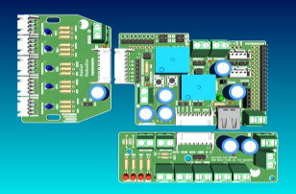
PCB DESIGN
Custom PCB Design
TO SIMPLIFY WIRING AND IMPROVE MAINTENANCE, THE ELECTRONICS ARE DIVIDED INTO THREE CUSTOM PCB MODULES.
1. Metal Detector Module
Metal Detector
Five Proximity Sensors
Status LEDs
2.LIFT MECHANISM MODULE
CONTROLS:
ELECTROMagnets
DC Motor
Limit Switches
3. Centralized Module
MOUNTED DIRECTLY ON THE ARDUINO MEGA AS A SHIELD.
RESPONSIBLE FOR:
POWER DISTRIBUTION
SENSOR Connections
COMMUNIcation with Raspberry Pi
This modular design reduces cable complexity and makes troubleshooting easier

Slide 7

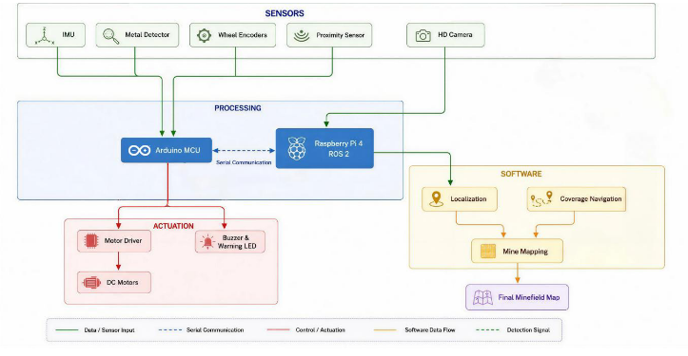
Software Architecture
The robot is controlled using ROS 2.
DeDICATED ROS NODES MANAGE:
VISION PROCESSING
LOCALIZATION
MINE DETECTION
NAVIGATION
MINEFIELD MAPPING
THE ROBOT MOVES AUTONOMOUSLY USING A LAWNMOWER (ZIGZAG) COVERAGE STRATEGY, SCANNING THE ENTIRE FIELD WHILE GENERATING THE MINE MAP AUTOMATICALLY.
SOFTWARE & CONTROL ARCHITECTURE

Slide 8
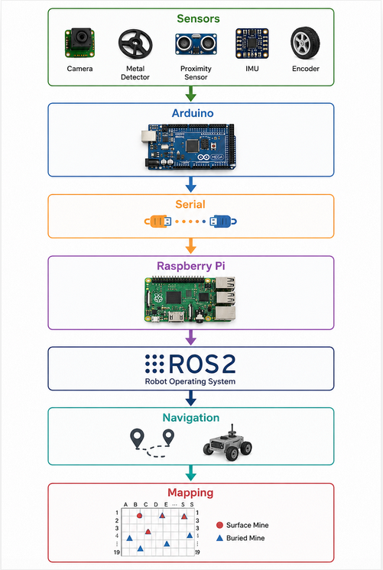

SYSTEM WORKFLOW
This workflow illustrates how sensor data flows through the controllers and software to produce autonomous robot movement and mapping.

Slide 9
THANK YOU

