Slide 1
An OWL Ontology for the Generic Statistical Information Model (GSIM): Design and Implementation
Monica Scannapieco¹, A. Dreyer², G. Duffes²,
D. Gillman³, L. Tosco¹
1: Istat - Italian National Institute of Statistics
2: INSEE - National Institute of Statistics and Economic Studies
3: BLS – U.S. Bureau of Labour Statistics

Slide 2



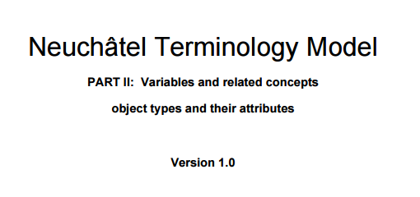

NSIs and Data Models
Since more than two decades National Statistical Institutes (NSIs) have been investing on (meta)data models
DDI (Document Data Initiative) (1995)
Neuchâtel model (2004)
SDMX (Statistical Data and Metadata Exchange) (2004)
Common Metadata Framework (2011)
GSIM (Generic Statistical Information Model) (2013)
Data Documentation Initiative
Generic Statistical Information Model

Slide 3

GSIM (Generic Statistical Information Model)
GSIM is a reference framework for statistical information promoted by UNECE and endorsed by statistical organizations
Four top-level groups
Captures the designs and plans of statistical programs (e.g. Statistical Need, Business Processes)
Catalogues the information that comes in and out of a statistical organization via Exchange Channels (e.g. Information Provider, Protocol)
Defines the meaning of data, providing an understanding of what the data are measuring (e.g. Classification, Variable)
Describes and defines the terms used in relation to structures for organizing data (e.g. Data Structure, Data Set)

Slide 4
GSIM and GSBPM
GSBPM (Generic Statistical Business Process Model) defines the statistical production processes for which GSIM objects are inputs or outputs
Input
GSIM Information Object(s)
GSBPM
Output
Transformed (or new) GSIM Information Object(s)

Slide 5
Purpose of the Work - 1
Proposal of an OWL ontology for GSIM
Linked data standards to express machine-actionable, formal and interoperable models
Use case 1: querying of metadata and data
Ability to easily make (meta)data queries, e.g.:
Given a “gsim:business process” X, which are the “gsim:process steps” that X “gsim:has”?
Given a “gsim:variable” X, which are the “gsim: codelists” on which X “gsim: is based on”?

Slide 6
Purpose of the Work - 2
Use case 2: interoperability between GSIM and GSBPM ontologies
For a given “gsbpm:statistical production activity” Y , which is the set of “gsim:business service” “gsim:used by” “gsim:businessprocess” X (equivalent to Y)?
Ability to integrate different metadata systems (in Istat the Unitary Metadata Systems and the Repository of Generalized Software)
Coherence checks btw different models (more later on that!)

Slide 7
Approaches for generating the GSIM-OWL Ontology
Approach 1
Approach 2
GSIM UML specification
GSIM UML Models
GSIM OWL
Design&
Implementation
Export in XMI
Ad-hoc XSL Transformations
GSIM OWL Output 1
GSIM OWL Output 2
Notes:
7
Most common

Slide 8
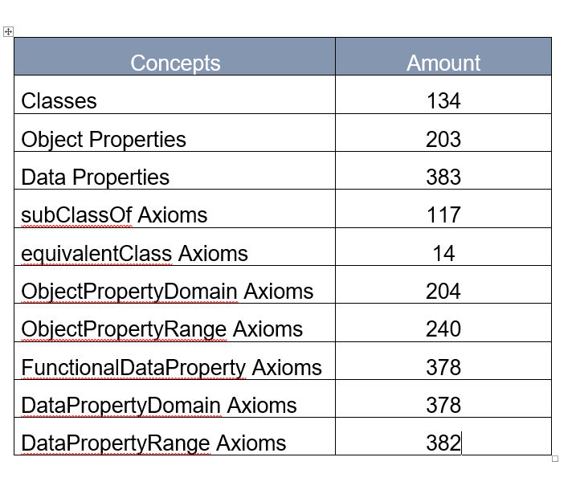
Resulting Ontology
General Characteristics
Notes:
8
Most common

Slide 9
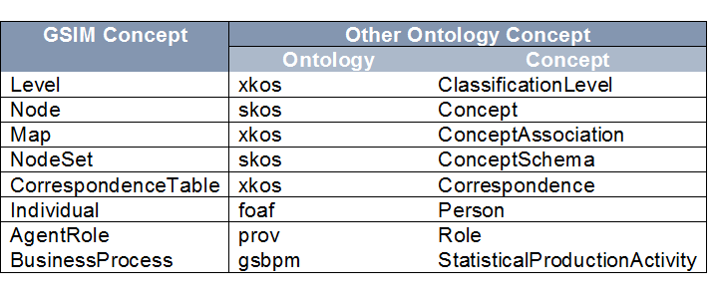
Resulting Ontology
Equivalence between concepts of GSIM and concepts of other ontologies
Notes:
9
Most common

Slide 10
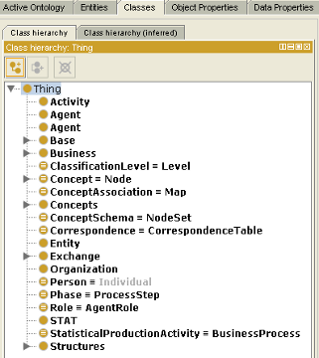
Design & Implementation Issues - 1
Most correspondences straightforward
UML classes have been mapped into OWL Classes
Five Classes for GSIM Base, Business, Concepts, Exchange, Structure
Sub-classes for each concept belonging to the topic
Notes:
10
Most common

Slide 11
Design & Implementation Issues - 2
UML attributes and relationships:
RDF distinguishes betwen data and object properties (and annotation)
UML attributes mapped to Datatype properties
UML relationships into Object properties
Not always a direct correspondence between UML and OWL respective elements
Notes:
11
Most common

Slide 12
Design & Implementation Issues - 3
Abstract class in UML does not have a direct correspondence with any OWL class
Additional statements on Classes, ObjectProperties, and DataProperties (e.g. objectIntersectionOf, disjointClasses) allow representing the domain of interest
Issue of names: in UML the name of a property is a tag while in RDF it must uniquely identify the property
Notes:
12
Most common

Slide 13
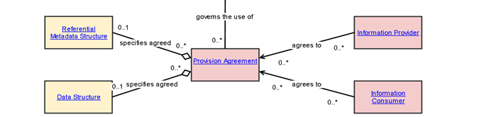
Design & Implementation Issues - 4
Information Provider and Information Consumer, use the same relation “agrees to” in their relationships with the concept Provision Agreement
“agrees to” must become two different properties in the ontology otherwise, it is implicitly assumed an intersection of the domains, which is not true in general
Notes:
13
Most common

Slide 14
Possible Solution - 1
Is the original attribute/relationship name unique?
NO
YES
Is the original with source and destination unique?
One property
NO
YES
is the cardinality restriction on range unique?
One property
NO
YES
Build for each triple a property name including the names of property range and domain.
One property with a union domain

Slide 15
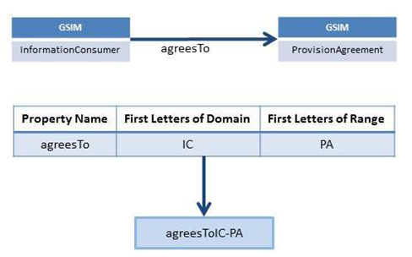
Possible Solution - 2
Creation of specific properties with a name convention

Slide 16
Detailed Implementation Approach 2
From UML to XML (XMI) to simplified XML
From XML to RDF
for classes and packages
From XML to RDF for properties
Export the UML description from EA to a file in the XMI 2.1 format
XSL Transformation to extract relevant content to a simplified XML
XSL transformation to produce RDF/XML
One to one mapping RDF Concepts for classes
All classes of a package sub-classes of a class representing the package (Structure, Business, etc.).
UML attributes and relationships are both represented by, and transformed into, RDF properties
In most cases one to-one mapping
Algorithm for issue of the names
Github link for XSL Transformations: https://github.com/FranckCo/GSIM-SPAP

Slide 17
Conclusions - 1
OWL as an enriched way to represent the GSIM model
E.g. issue of property names
The work ahead must be put in the perspective of the international collaborations going on
Common Statistical Production Architecture (CSPA) is an effort to standardize statistical production (OWL ontology for CSPA - see SemStats paper)
CSPA, production systems are built up from small modules that can be shared
Notes:
17
Most common

Slide 18
Conclusions - 2
GSBPM ontology already proposed (SemStats 2015)
GSBPM will guide the development of which CSPA modules must be built, and GSIM will guide which metadata are inputs and outputs to each process
Correctness and completeness
A Business function is “performed” by :
only a business process (GSIM is right!)
only a business service (CSPA is right!)
by both of them (GSIM and CSPA are incomplete)
Notes:
18
Most common

