Slide 1
I have a dream about classifications...
SemStats 2016, 18/10/2016
Danny Delcambre, Agne Bikauskaite, Jan Planovsky
Eurostat

Slide 2
3 dimensions of innovation and modernisation work of Eurostat
Dimension | Stakeholders | Initiatives / Projects
(1) European Commission | ESTAT + DGs | IT rationalisation Data4Policy StatDCAT-AP
(2) European Statistical System (ESS) | ESTAT + 28 MSs + 4 EFTA countries | ESS Vision 2020 DIGICOM
(3) Global | ESTAT, UNECE, OECD, UNSD, ... | HLG-MOS⁽¹⁾ Modernstat
⁽¹⁾ High-Level Group for the Modernisation of Official Statistics
Notes:
Introduction of Eurostat as an important player in the modernisation initiatives - context of EC, ESS and Global
idea but that my proposal could improve the foundations of a common architecture for metadata - put the proposal in the general framework of the modernisation exercise led by UNECE

Slide 3
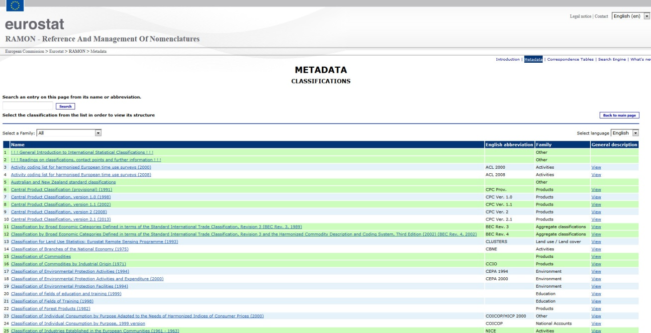
Importance of statistical classifications
foundations of statistical work
beginning: heterogeneity, too many specificities
late 1990s: progress in information technologies – automation of data processing => urgent need for convergence
Internet: broad public availability of classifications and other metadata (RAMON)

Slide 4
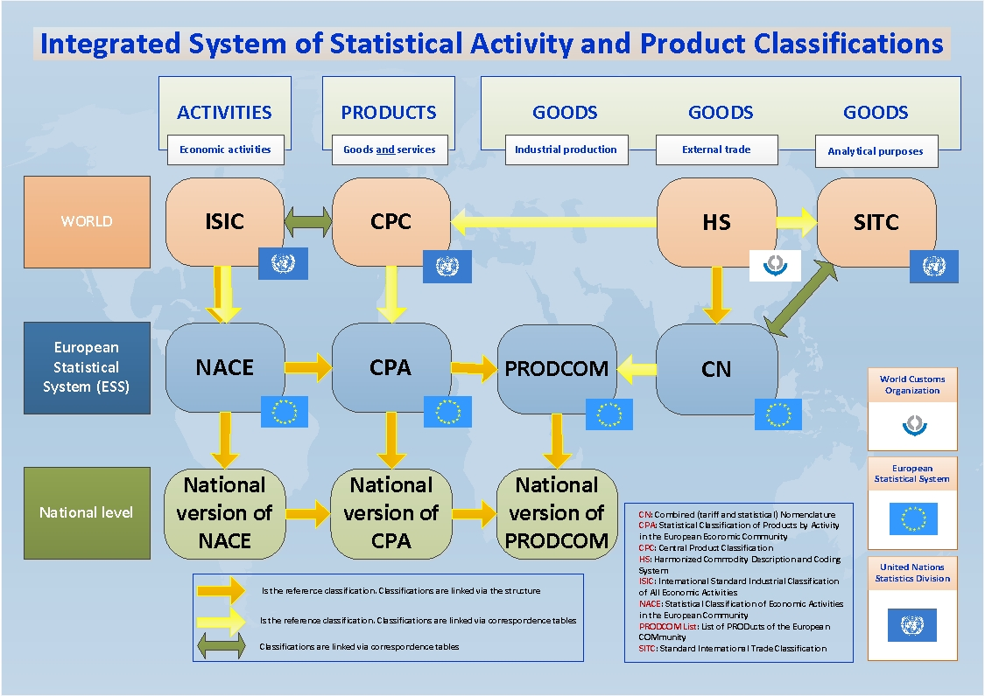
Integrated system of classifications (horizontal view)
Notes:
This is the result of a lot of discussions, many years of collaboration, nice tangible result – underline linkage between ALL classifications in the system
– snapshot of the system at a specific point in time; then we can add vertical dimension
This is only a partial representation of the system of integrated classifications; many other classifications can be added to this picture (e.g. Classification by Broad Economic Categories, COICOP, etc.)

Slide 5
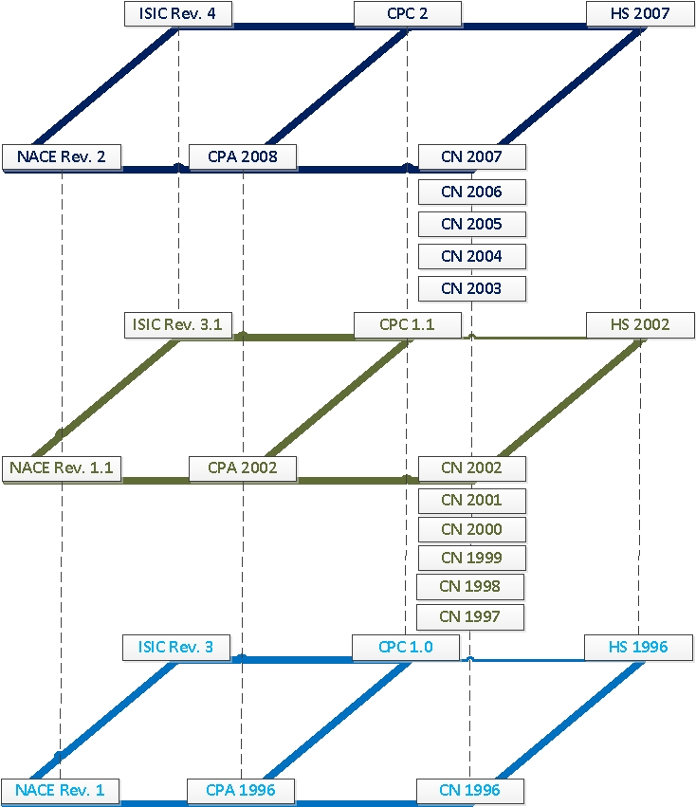
Integrated system of classifications (vertical view)
(partial) illustration of historical evolution
links between revisions
useful to researchers, analysts, students to explore time series
Notes:
Again, this is a partial view; not all classifications are shown in this picture

Slide 6
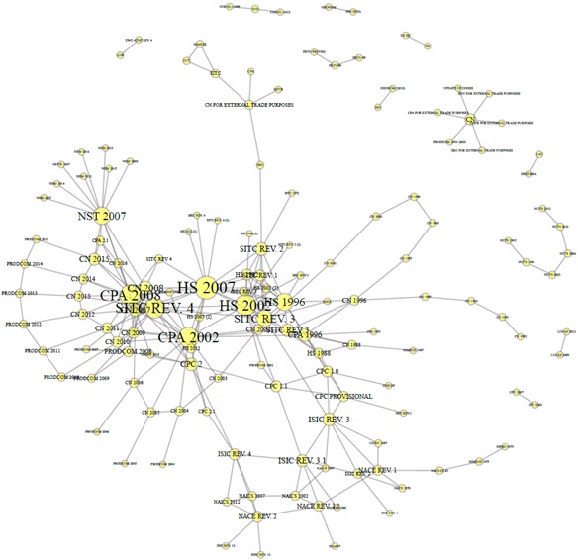
Integrated system of classifications (combined view)
Linked Classifications –basic prototype
Notes:
This is to show complexity – manually constructed; the entities not linked are easy to identify
Produced with R, based on the classifications stored in RAMON. The satellite classifications are classifications outside the system (e.g. health classifications)
Special thanks to our colleague Luca Gramaglia

Slide 7





RDF Triple Store
RAMON
User interface
Notes:
In order to provide a proof of concept of the idea illustrated in the paper, Eurostat built a small demo visualisation application.
A set of classifications stored in Eurostat's RAMON database were translated in RDF (using the SKOS ontology) and uploaded in a triple store.
A small visualisation tool was then built. It retrieves the data from the triple store via SPARQL queries.

Slide 8
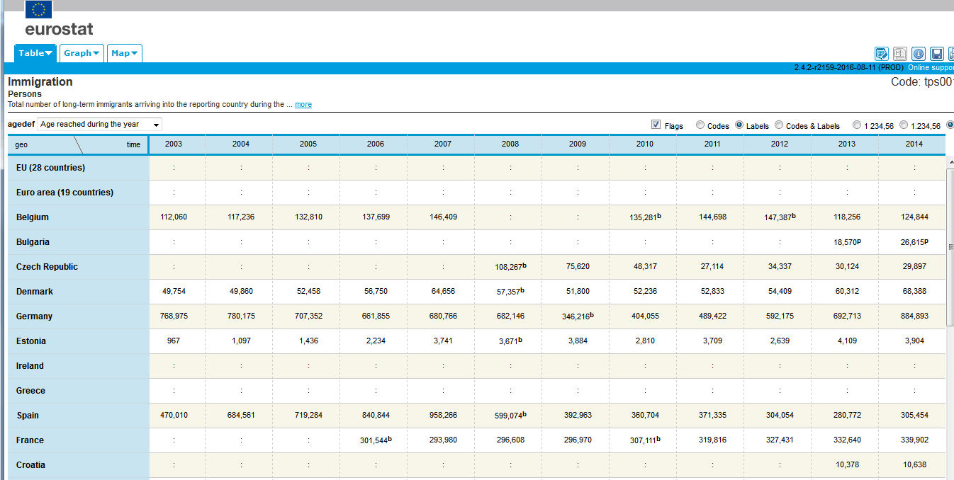

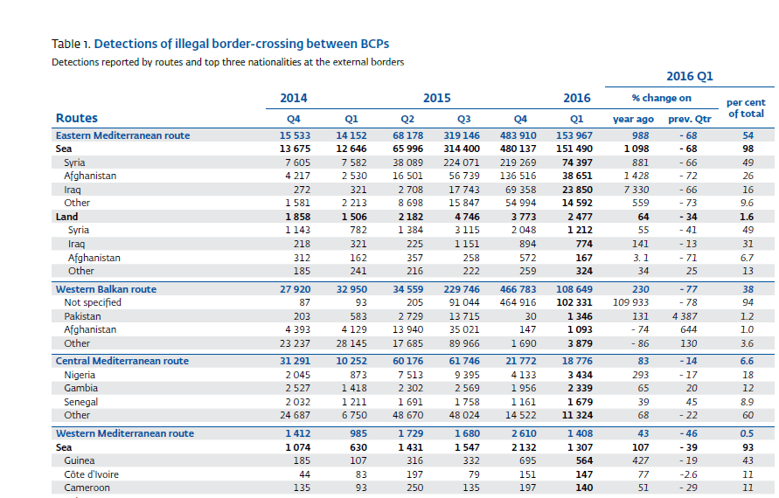

Linking open data (1)
EU produces a lot of open data
But they are not so much linked yet
Notes:
This is an example of migration data from two different sources – Eurostat and Frontex.
Data are presented in different formats, different time periods are covered, different metadata are used.
It would be nice to link them to build a complex picture - value added of linking data.

Slide 9
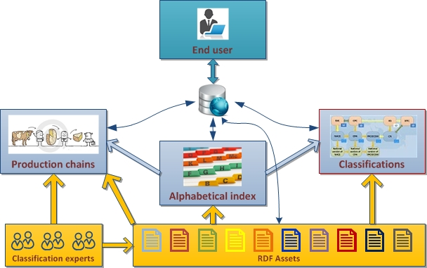
Linking open data (2)
Existing inputs:
alphabetical indexes
classifications
correspondence tables
Missing link to produce leverage effect:
RDF assets as enablers for linking data
governance and network of experts
Notes:
Alpha index – list of activities, goods and services together;
yellow box – classification experts and other information providers to be coordinated in order to populate RDF triple stores based on common standards (e.g. XSKOS: Extension for Statistical Classifications: http://ceur-ws.org/Vol-1549/article-03.pdf; https://github.com/linked-statistics/xkos; https://www.unece.org/fileadmin/DAM/stats/documents/ece/ces/ge.40/2013/WP10.pdf); appropriate governance will be needed (preferably under UN auspices).
Have organisations producing RDF files – impetus is needed.
(leverage effect - value added)

Slide 10
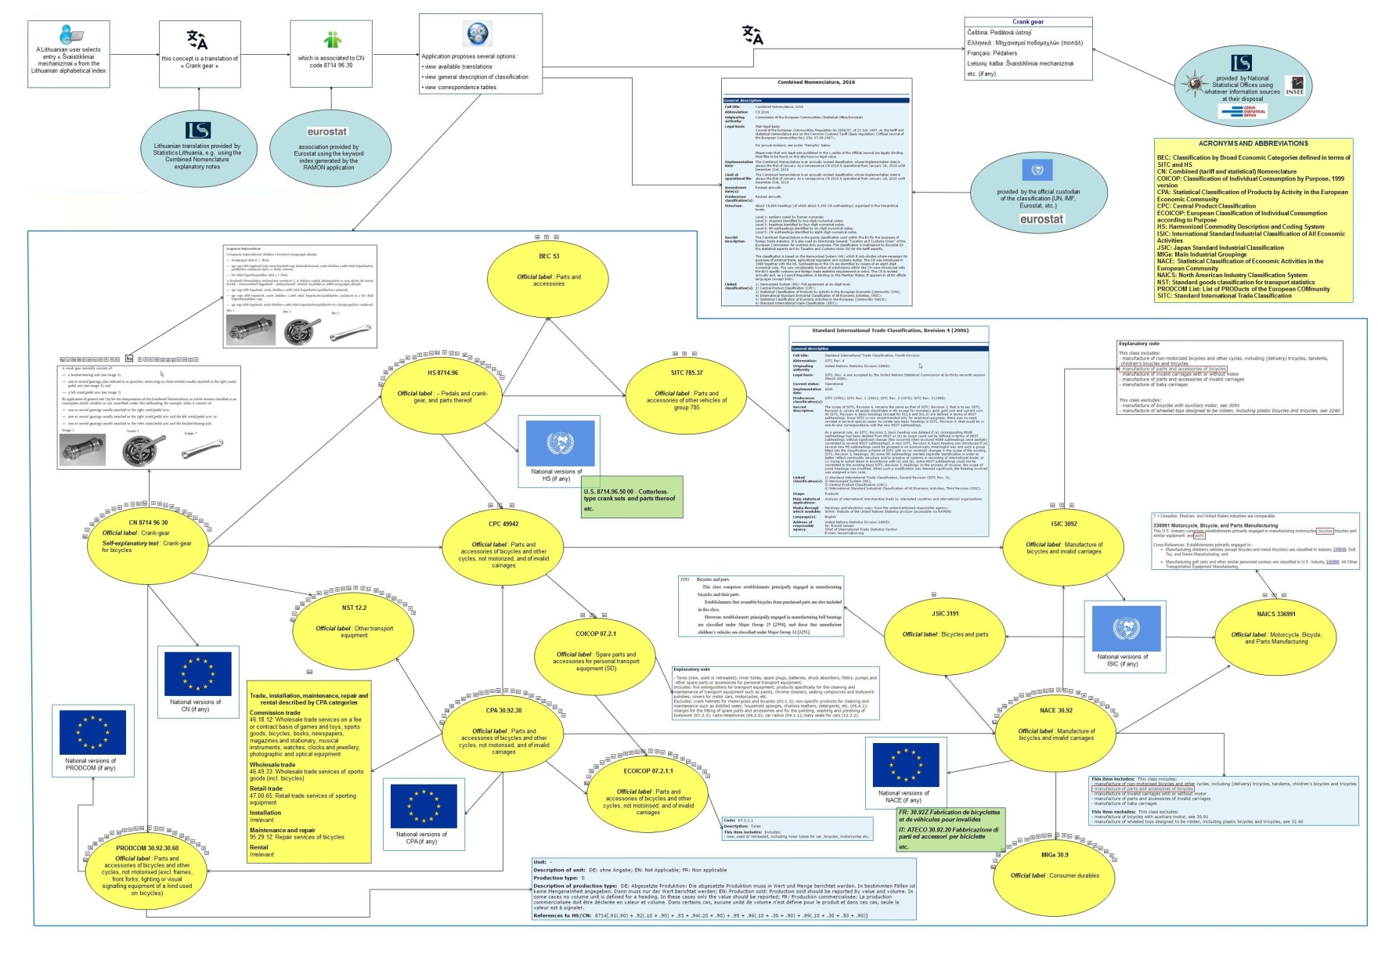
Linking Data (use case)
Notes:
Demonstration of concrete use case: A Lithuanian user needs to know where "crank gears" are classified in the COICOP classification (follow paper instructions)
http://ec.europa.eu/eurostat/ramon/documents/poster.jpg
Explanatory notes of CN
http://eur-lex.europa.eu/legal-content/EN/TXT/PDF/?uri=OJ:C:2015:076:FULL&from=EN (see page 368)
advantage: linkages between parts of the integrated system; - navigation between different elements of the system - usable by different clients

Slide 11
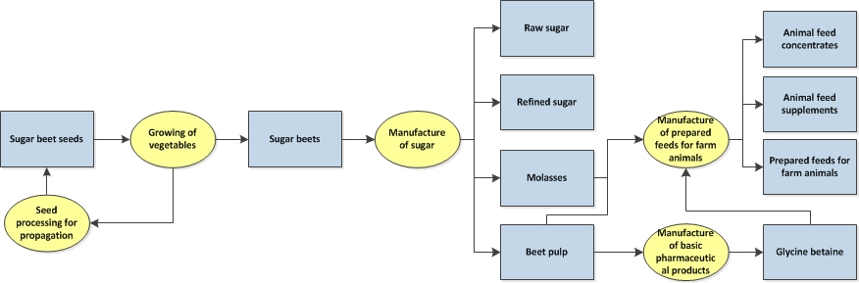
Production chain model
Notes:
Optional slide - A possible by-product of alpha-index; it could be used in the context of classification revisions (e.g. when the way a good is produced is not well known);
This "Production chain" proposal is an attempt to retain as much as possible of the expertise in the public domain (because classification experts retire, leave the statistical sphere, etc.).
The philosophy of this proposal is to try and show, for each physical product listed in the alphabetical index, its production chain, based on the traditional input → process → output model.
However, if this is the only use case considered for this project, the investment would be too high for the benefit; therefore, if you see other possible use cases, please say so…

Slide 12
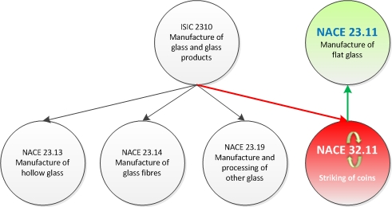
Error detection in correspondence tables
Notes:
But visualization and easy navigation would not be the only uses of this tool;
indeed it could also be used to identify mistakes in correspondence tables as in the example below based on ISIC - NACE correspondence table.

Slide 13
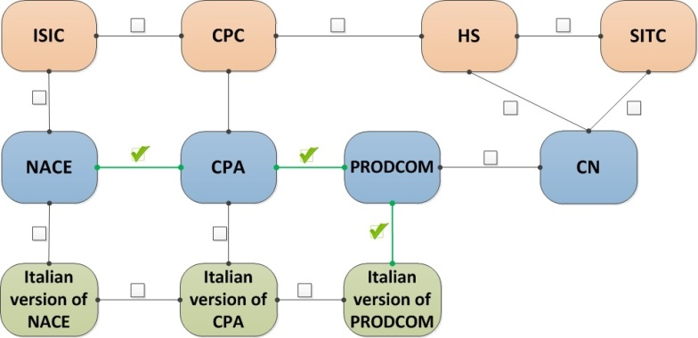
Ad hoc generation of correspondence tables
Notes:
Simplified picture – the user has freedom to choose the path to get to the final product (in this example: a concordance between NACE and the Italian version of PRODCOM)
The user will select the path he wants to use to go from the source classification to the target classification based on existing official correspondence tables between the classifications which are part of the system.
The application will then fetch the requested correspondence tables as RDF files, put them together and manipulate the information (e.g. remove duplicates) so as to provide the user with the requested information. The result of such manipulations will prove a very useful input e.g. for economic analyses of data sets based on classifications of different natures.
It can also prove useful for detecting divergences between different systems of classifications: e.g., comparing [NACE]-[CPA]-[PRODCOM]-[Italian version of PRODCOM] to [NACE]-[Italian version of NACE]-[Italian version of CPA]-[Italian version of PRODCOM] might highlight differences in correspondence tables, and hence help improve the consistency of the whole system (correspondence tables often have thousands of lines and interpretation of the contents of the categories can also influence the construction of the concordances).

Slide 14
This is not the end of the game...
This presentation is based mainly on a use case for classifications and correspondence tables
Linking RDF assets could also apply, mutatis mutandis, to all other types of metadata:
concepts
methodological manuals
general descriptive metadata (e.g. IMF SDDS: Special Data Dissemination Standard, Eurostat SIMS: Single Integrated Metadata Structure)
questionnaires
IT tools
Linked data could be the trigger to have a much more organized way of working, generating substantial economies of scale
Notes:
mutatis mutandis - (used when comparing two or more cases or situations) making necessary alterations while not affecting the main point at issue.
"what is true of undergraduate teaching in England is equally true, mutatis mutandis, of American graduate schools"

Slide 15
The way forward
There is a clear need for centralized reference places where users can find all the information they are looking for
the number of visitors on RAMON is a clear evidence for that
however, changes in priorities and development of existing or new statistical activities will soon make it impossible to continue maintaining it properly
new ways should therefore be envisaged to guarantee the perennity of such tools
solution lies in LOD and global collaboration between experts
If IOs make their metadata resources available as LOD, it will be possible to build powerful and tailor-made applications that will suit the needs of users
Notes:
perennity - trvalost

Slide 16
Leverage effect of centralization
Centralizing all metadata and making them available in easily reusable formats would have many advantages:
have one reference place for all metadata information
when a new survey is launched, the existence of such a central repository would refrain from creating yet new classifications, concepts, etc.
the identification of diverging concepts could be a trigger for the concerned organizations to try and reduce these divergences
the identification of very similar concepts could be a trigger to try and have identical concepts
one piece of information made available as linked data does not have to be duplicated internally, thus saving resources
expertise is not concentrated in the IOs - it is also well present in national organizations with linked data, these national experts could be much more involved
involvement of national experts and organizations could improve the multilingual character of the information disseminated (similar to Wikipedia approach)
the secretariat for such a system should be at global level (i.e. UN), thus inspiring trust and fostering standardization

Slide 17
Thank you for your attention
Contact: Danny.Delcambre@ec.europa.eu

