Slide 1
StatDCAT-AP
A Common Layer for the Exchange of Statistical Metadata in Open Data Portals
Makx Dekkers, Stefanos Kotoglou, Chris Nelson,
Norbert Hohn, Marco Pellegrino, Vassilios Peristeras
Semstats 2016, October 18
Notes:
6 authors:
3 standards experts, involved in several worldwide initiatives (e.g. ISO, SDMX, RDF, DCAT, data quality vocabulary)
3 officials from EU institutions (Publication Office, Eurostat, DIGIT)

Slide 2

What StatDCAT-AP is
Current status
Using StatDCAT-AP
StatDCAT-AP and SDMX
Future steps
Notes:
Menu of the presentation

Slide 3
The challenge: data silos
The data landscape consists of many data silos:
Statistical data, geospatial data, legal data, research data, archival data, etc.
Many of these silos build portals with metadata:
http://ec.europa.eu/eurostat/data/database, http://stats.oecd.org (stats)
http://inspire-geoportal.ec.europa.eu/ (geo)
https://www.openaire.eu/ (research)
These portals serve their goal for specific audiences, and the data set could be in a variety of formats, not necessarily RDF
The metadata describing these datasets may be curated according to a variety of standards (DDI, SDMX, ISO 11179 etc.)
But: No easy way to discover data across domains
Notes:
When you look for data, you immediately realise that there are many "silos", several standards and formats, a variety of metadata frameworks.
No easy way of discovering data

Slide 4
A cross-domain standard
Bringing together metadata from a multitude of domains in one 'general data portal' to expose domain-specific data
Using a cross-domain description standard that is able to capture a core set of characteristics across domains:
DCAT Application Profile for data portals in Europe
Extending cross-domain standard with additional features of domain-specific data: GeoDCAT-AP, StatDCAT-AP
Enabling creation of high-level index for the purpose of discovery across domains
NB: Local systems and domain-specific portals continue to use specific standards: approach based on the export of metadata according to a cross-domain standard
Notes:
This is what DCAT and StatDCAT try to achieve.
Bringing together metadata from a multitude of domains in one 'general data portal'
Using a cross-domain standard that is able to capture a core set of characteristics across domains
Extending this cross-domain standard with additional features of domain-specific data
Enabling the creation of a high-level index for the purpose of data discovery
Important to stress:
DCAT-AP and StatDCAT-AP do not aim to replace local or domain-specific standards, but instead facilitate the export into a more general standard.

Slide 5

What is StatDCAT-AP
Application Profile of the DCAT W3C Recommendation for the exchange of descriptions of datasets between (open) data portals
DCAT-AP was developed for specific use in Europe, among others to support the European Data Portal
StatDCAT-AP: extension of DCAT-AP enabling cross-portal search for statistical data sets
Extend DCAT-AP by adding:
Metadata elements from statistical standards (e.g. SDMX)
Recommendations for use of specific controlled vocabularies
Notes:
WHAT DOES AP MEAN ?
Wikipedia: In computer information sciences, an application profile consists of a set of metadata elements, policies, and guidelines defined for a particular application.
In the StatDCAT-AP specification: Application Profile is a specification that re-uses terms from one or more base standards, adding more specificity by identifying mandatory, recommended and optional elements to be used for a particular application, as well as recommendations for controlled vocabularies to be used.
DCAT-AP is a general specification for data portals in Europe based on a W3C Recommendation, with StatDCAT-AP adding specific aspects for statistical datasets.
Focus on use cases:
Improving discovery of statistical data sets in open data portals
Facilitating integration of statistical data sets with open data from other domains

Slide 6
What StatDCAT-AP is
Current status
Using StatDCAT-AP
StatDCAT-AP and SDMX
Future steps

Slide 7
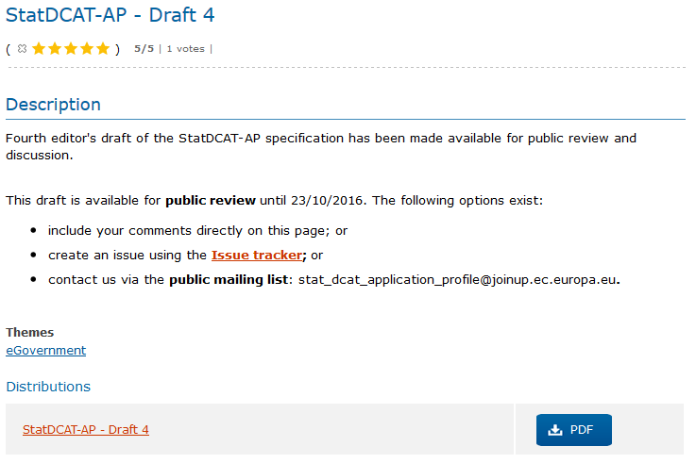
Current status: public review
Final draft of specification is available on Joinup:
https://joinup.ec.europa.eu/node/152858
Extended deadline 31 October 2016

Slide 8
StatDCAT-AP Working Group
Chair: Eurostat and EU Publications Office
Stakeholders
The ISA and ISA² Programme of the European Commission, other Directorates General (DGs) of the European Commission, other European Union institutions, representatives of national institutes and international agencies, experts, representatives of consumers such as Digital Agenda Scoreboard, representatives of the European Data Portal.
Meetings
Five meetings took place in 2016, including one face to face meeting. The next meeting will take place on 14 November 2016.
Presentations and minutes-discussions from the meetings are available on Joinup at https://joinup.ec.europa.eu/node/152858.
Notes:
There is a working group covering a wide range of stakeholders and working through conference calls and meetings aiming for consensus.
Open to more participation. The WG will review the comments received during the public review, in November.

Slide 9
What StatDCAT-AP is
Current status
Using StatDCAT-AP
StatDCAT-AP and SDMX
Future steps

Slide 10
Using StatDCAT-AP in practice
Many statistical datasets are of interest to the general data portals and their users. Using StatDCAT-AP helps general data portals to provide enhanced services for collections of statistical data.
Statistical data providers (e.g. organisations, Member States) can increase the discoverability of their statistical datasets by including descriptions of the datasets in data portals.
Statistical data users (e.g. national statistic officers) can explore, find, identify and select statistical datasets coming from different portals.
StatDCAT-AP facilitates a better integration of existing statistical data portals with the open data portals, improving the discoverability of statistical datasets.
Notes:
Focus on:
enabling enhanced services,
increasing discoverability,
allowing to explore, find, identify and select datasets
and
facilitating a better integration of statistical datasets in general data portals.

Slide 11
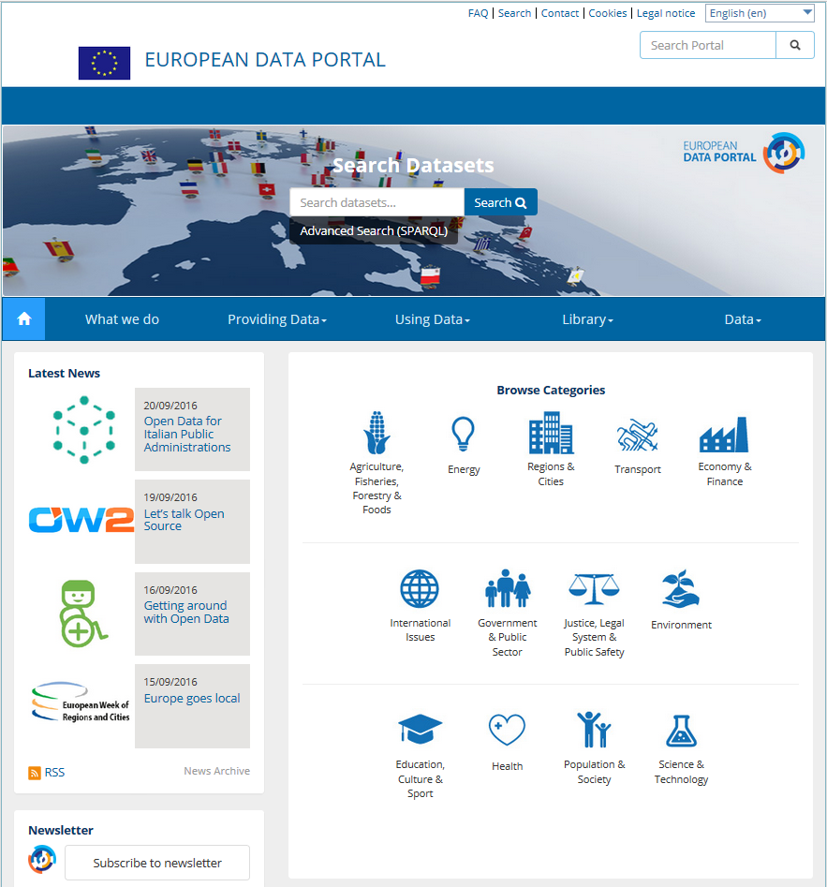
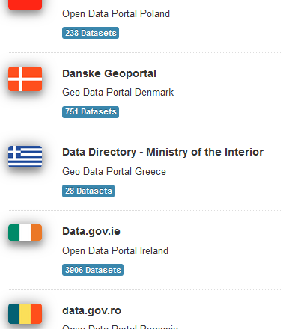
The European context
The European Data Portal
Developed for European Commission DG CNECT
Harvesting metadata from national data portals
http://www.europeandataportal.eu
Notes:
In Europe, the European Data Portal harvests the metadata of Public Sector Information available on public data portals across European countries. Information regarding the provision of data and the benefits of re-using data is also included.
(When we say “data”, in the statistical community, we are referring to numeric data of a very specific type: statistics! The LOD definition is much broader!)
Within the Portal, a section is dedicated to "searching datasets": here the metadata categories follow DCAT and have been mapped against the Eurovoc Thesaurus.

Slide 12

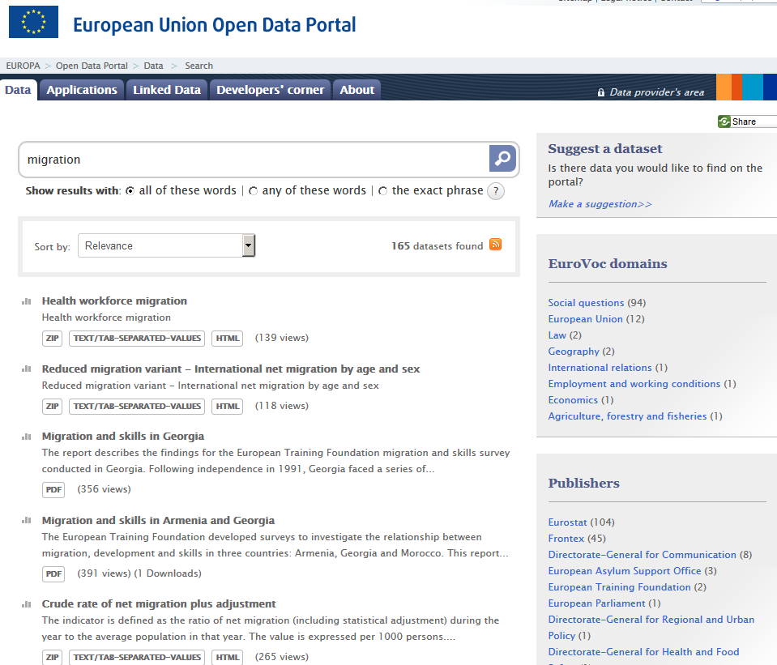
VIDEO
Notes:
The EU Open Data Portal is a single point of access to the data from EU institutions.
For example, the user can find data on migration coming from Eurostat, other European Commission DGs, the EU agencies working on this topic (like FRONTEX or Asylum Support Office)
But let's now give the floor to the authors of the paper, with a video-presentation that they have produced to guide us through StatDCAT-AP.

Slide 13
What StatDCAT-AP is
Current status
Using StatDCAT-AP
StatDCAT-AP and SDMX
Future steps

Slide 14
Future steps
Publication of final version after comments received during public review (end of 2016)
Full support of StatDCAT-AP from EU and European Open Data Portals
Piloting
Building experiences
Revising standard taking into account lessons learnt, quality aspects,…
Notes:
Next steps:
Publication of final version after public review: end of 2016
Full support of StatDCAT-AP from EU and European Open Data Portals (Eurostat dissemination chain, target 2018)
Piloting metadata extraction from SDMX and other metadata repositories, building experiences
Revising the standard taking into account lessons learnt, quality aspects,…

Slide 15
Future work: Quality
Quality aspects are very important for datasets in general and statistical datasets in particular
Due to time and resource constraints, current version of StatDCAT-AP does not fully address the issue
Short-term: provide mechanism to link to existing quality information in StatDCAT-AP, version 1
Longer-term: consider integrated quality framework as basis for extensions to StatDCAT-AP, version 2
Notes:
Quality aspects are very important, for statistical datasets in particular
Due to time and resource constraints, the current version does not fully address the issue and just provide an annotation mechanism
Next step is to consider an integrated quality framework for extending StatDCAT-AP into a version 2

Slide 16
Quality, longer-term: SIMS
Eurostat's Single Integrated Metadata Structure includes specific quality aspects:
e.g. Accessibility and clarity; Quality management; Relevance; Accuracy and reliability; Timeliness and punctuality; Coherence and comparability
This set of aspects can form the basis for future extensions to StatDCAT-AP, or even to DCAT-AP
Notes:
Eurostat's Single Integrated Metadata Structure (SIMS) includes specific quality aspects harmonised at EU level, e.g. Accessibility and clarity; Quality management; Relevance; Accuracy and reliability; Timeliness and punctuality; Coherence and comparability.
This set of aspects can form the basis for future extensions to StatDCAT-AP, or even to DCAT-AP, possibly based on the RDF data quality vocabulary (currently under discussion as a W3C Working Group Note, 30 August 2016)

Slide 17
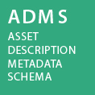
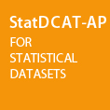
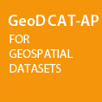
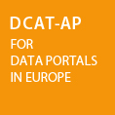






Get involved
Joinup: https://joinup.ec.europa.eu/asset/stat_dcat_application_profile/description
Visit ISA initiatives
mail@makxdekkers.com
stefanos.kotoglou@be.pwc.com
chris.nelson@metadatatechnology.com
marco.pellegrino@ec.europa.eu
norbert.hohn@publications.europa.eu
vassilios.peristeras@ec.europa.eu

Slide 18
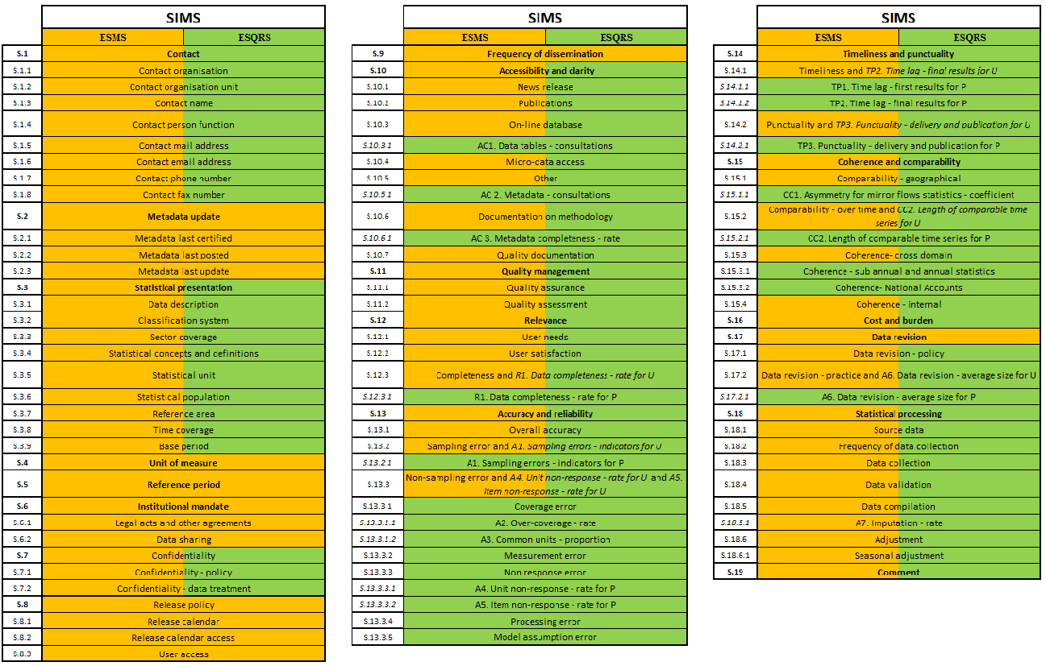
The “Single Integrated Metadata Structure” (SIMS) of the European Statistical System

Slide 19
VIDEO
Notes:
The EU Open Data Portal is a single point of access to the data from EU institutions.
For example, the user can find data on migration coming from Eurostat, other European Commission DGs, the EU agencies working on this topic (like FRONTEX or Asylum Support Office)
But let's now give the floor to the authors of the paper, with a video-presentation that they have produced to guide us through StatDCAT-AP.

Slide 20

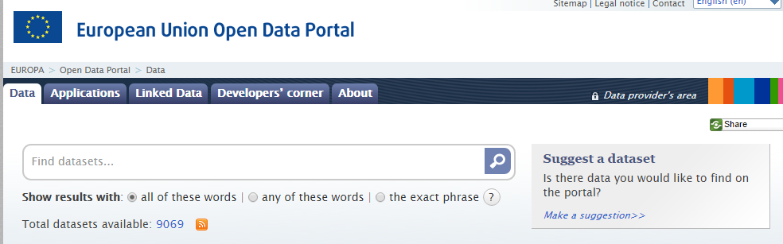
Notes:
EU Open Data Portal is a single point of access to the data from EU institutions.
For example the user can find data on migration coming from Eurostat, other European Commission DGs, the EU agencies working on this topic like FRONTEX or Asylum Support Office

Slide 21
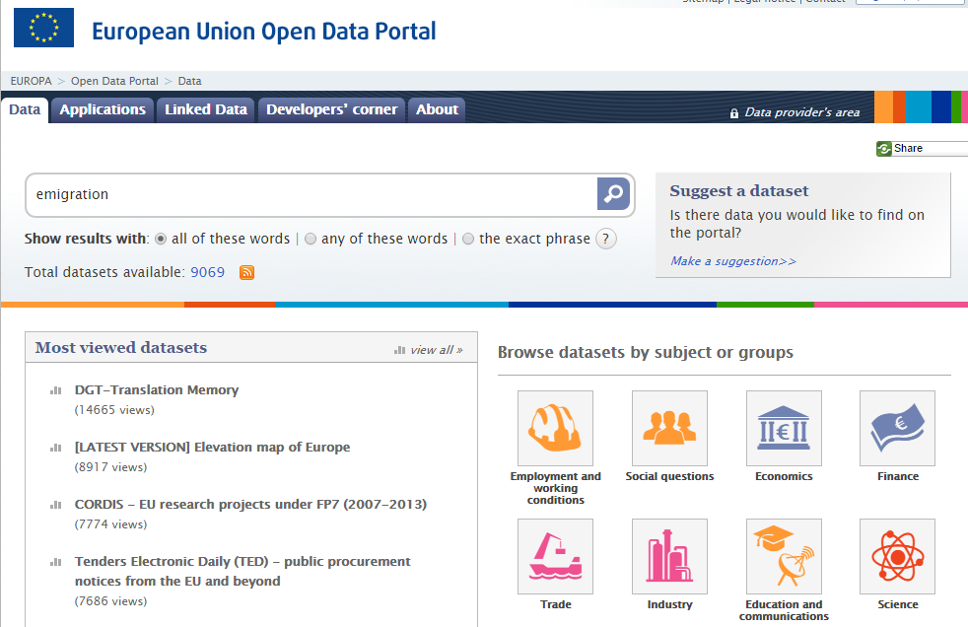

Slide 22

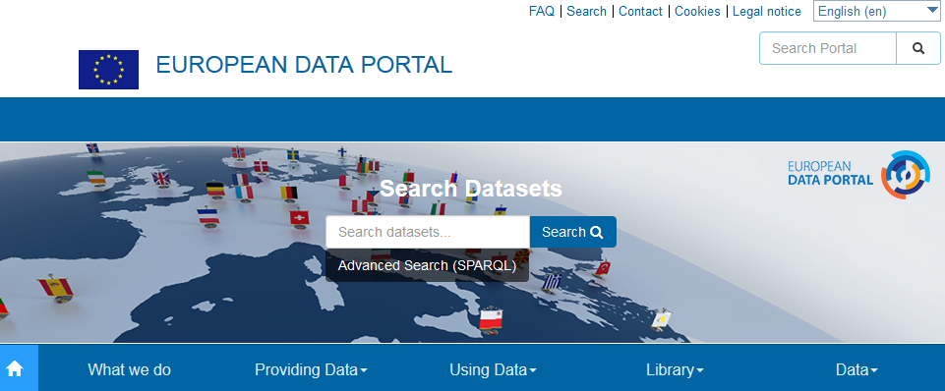
EU Open Data Portal vs European Data Portal
Datasets of national public institutions (regions, ministries, etc..)
Datasets of the EU institutions, agencies and other bodies (Parliament, Commission, ESTAT, JRC, Council, EEA..)
71 catalogues (data portals and geo portals)
583,727 datasets
Reuse apps
Quality checker
Trainings
Studies
Notes:
Datasets of national public institutions (regions, ministries, etc..)
National open data portals (managed by each State)

Slide 23
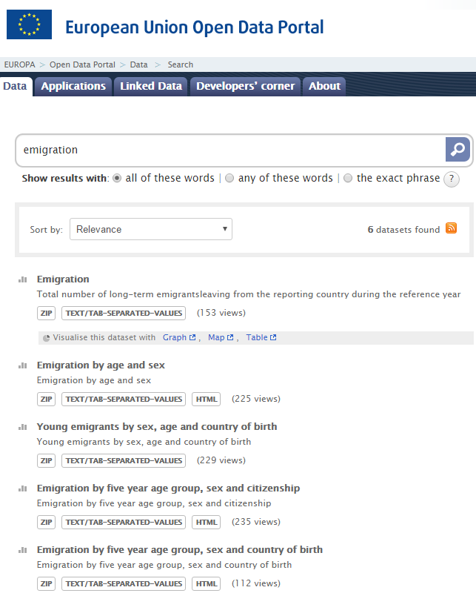
Notes:
EU Open Data Portal is a single point of access to the data from EU institutions.
For example the user can find data on migration coming from Eurostat, other European Commission DGs, the EU agencies working on this topic like FRONTEX or Asylum Support Office

Slide 24
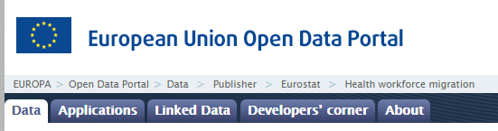
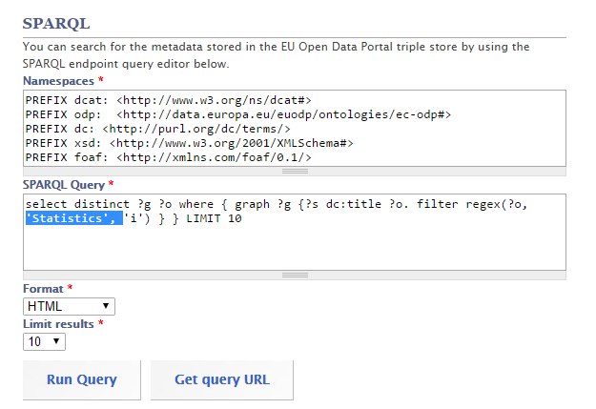

Slide 25
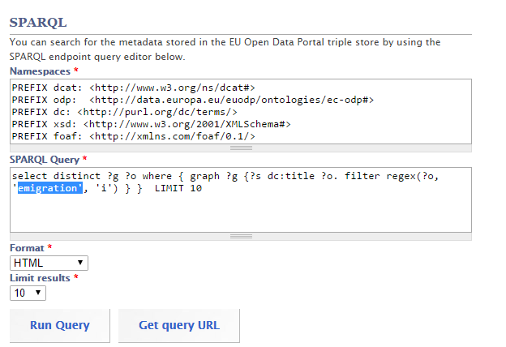
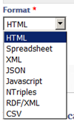
Linked Open Data
http://data.europa.eu/euodp/en/linked-data
Notes:
The metadata on migration can be also retrieved from RDF triple store using SPARQL query
SELECT distinct ?graphURL ?title
WHERE{ graph ?graphURL {?s dc:title ?title. filter REGEX(?title, 'migration', 'i') } }
LIMIT 100
The result can be obtained in various formats: html, spreadsheet, xml, json, javascript, ntriples, RDF/XML, CSV

Slide 26
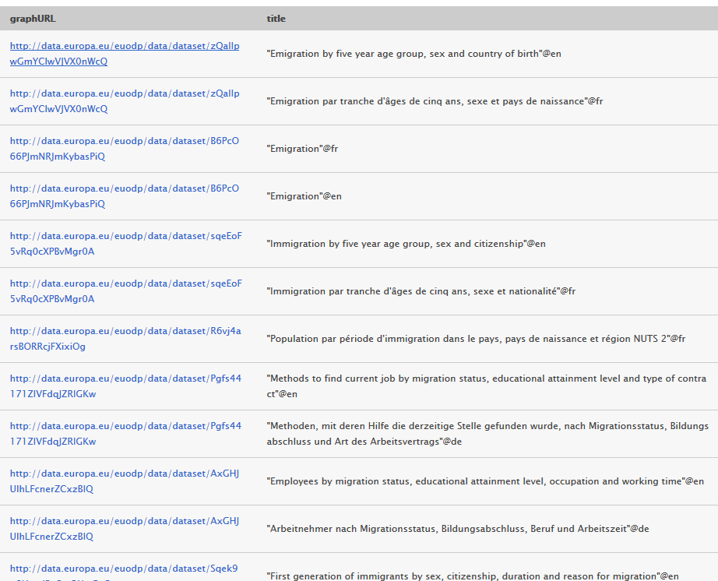
Notes:
An example of the result in html format.
When the user clicks on the URL he can see more metadata on this dataset

Slide 27
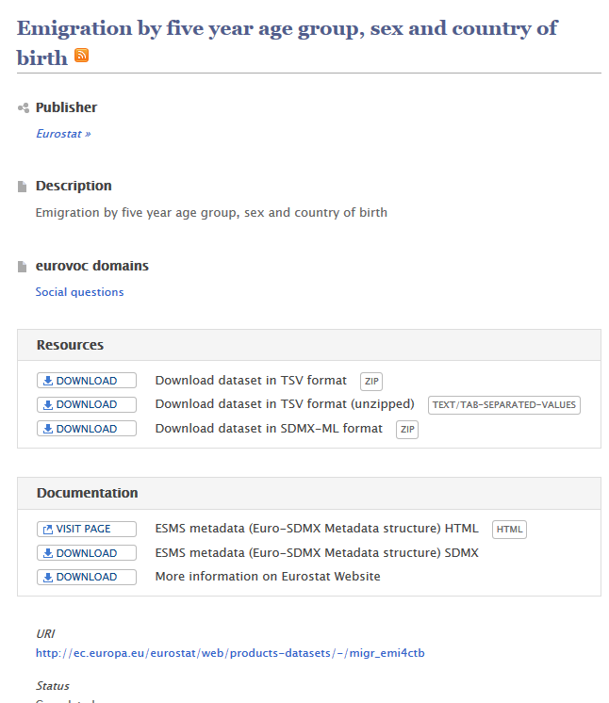
Notes:
The user can download the files with data or go to the source: EUROSTAT

Slide 28
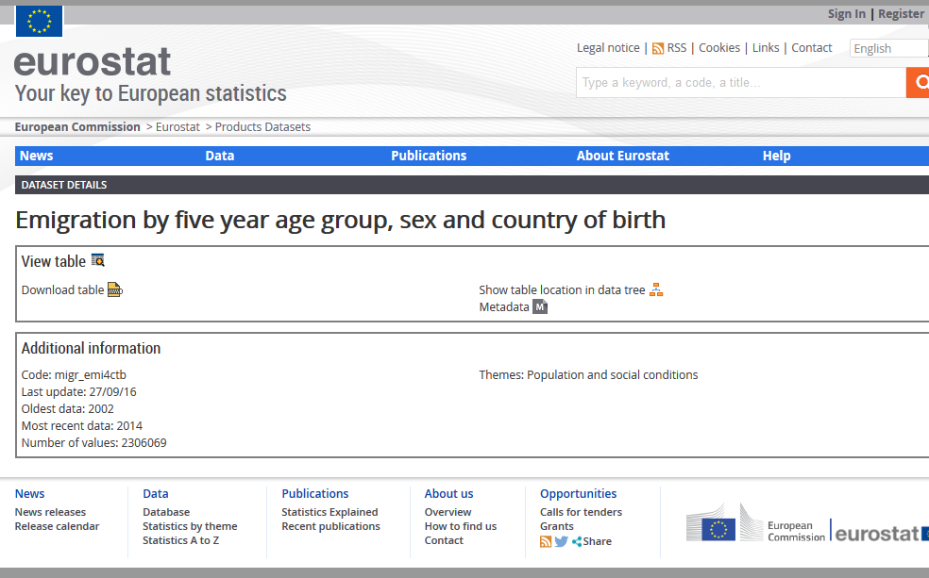

Slide 29
DCAT main entities
Catalogue
Dataset
Distribution
Dataset
Distribution
Dataset
Distribution
Dataset
Distribution
A catalogue contains one or more datasets
A dataset has one or more distributions

Slide 30
5 star-schema of Linked Open Data
★ | Make your stuff available on the Web (whatever format) under an open license
★★ | Make it available as structured data (e.g., Excel instead of image scan of a table)
★★★ | Use non-proprietary formats (e.g., CSV instead of Excel)
★★★★ | Use URIs to denote things, so that people can point at your stuff
★★★★★ | Link your data to other data to provide context

Slide 31
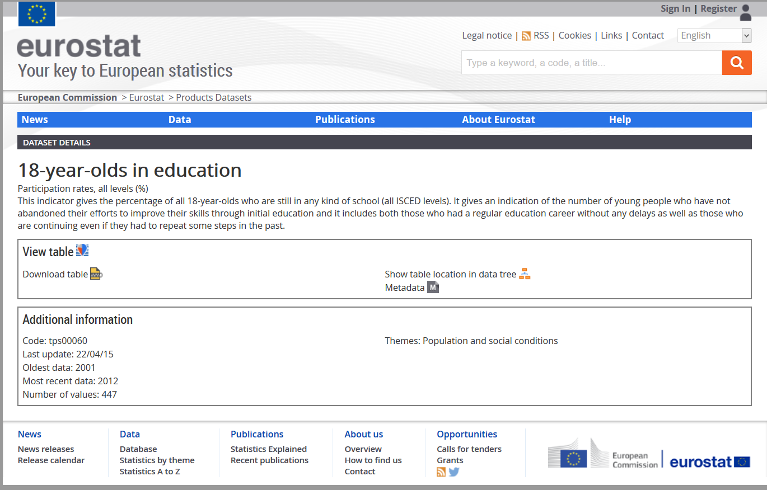

Slide 32
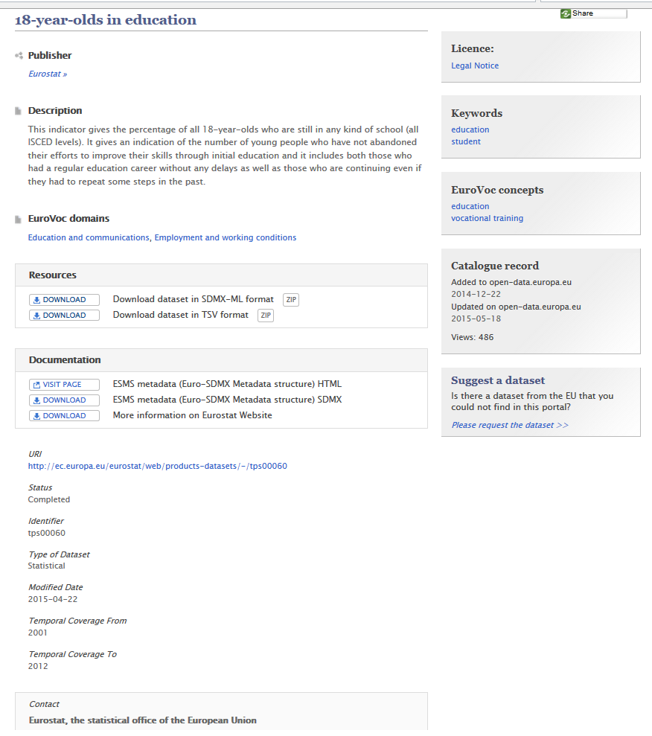
Dct:title
Dct:publisher
Dct:description
Dcat:keyword
Dcat:keyword
Dcat:theme
Dcat:distribution
dqv:hasQuality Annotation
Dct:identifier
Dct:modified
Dct:temporal
Dct:temporal
Dcat:contactPoint

Slide 33
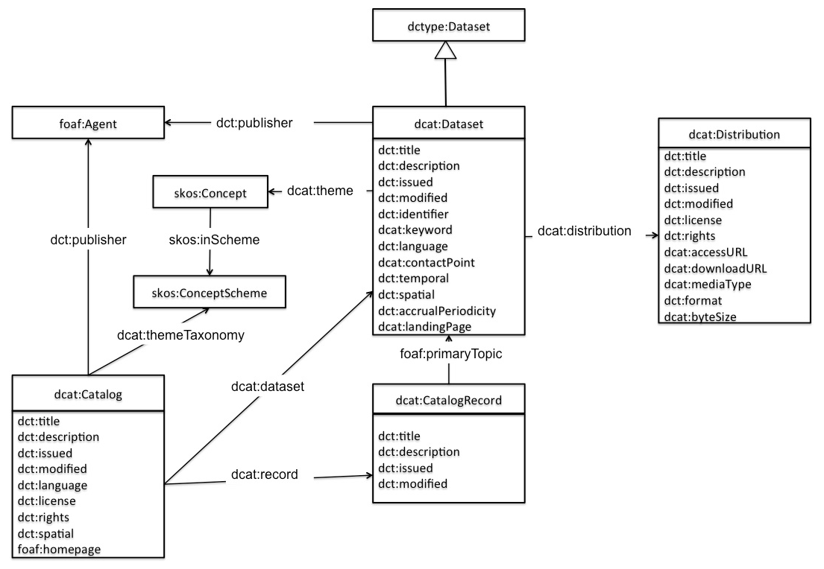
DCAT-AP (core) model
Metadata about the dataset
Metadata specific to the data sources

Slide 34
Dataset
Mandatory | Recommended | Optional
dct:description dct:title | dcat:contactPoint dcat:distribution dcat:keyword dct:publisher dcat:theme | adms:identifier adms:sample adms:versionNotes dcat:landingPage dct:accessRights dct:accrualPeriodicity dct:conformsTo dct:hasVersion dct:isVersionOf dct:identifier dct:issued dct:language dct:modified dct:provenance dct:relation dct:source dct:spatial dct:temporal dct:type foaf:page owl:versionInfo
dqv:hasQualityAnnotation
stat:attribute
stat:dimension
stat:numSeries
stat:unitMeasure
StatDCAT-AP to add optional properties:

Slide 35
Dimensions
Country of birth, sex, 5 year age groups
Notes:
The user can download the files with data or go to the source: EUROSTAT

Slide 36
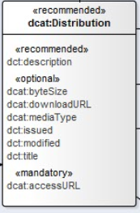
Distribution
Mandatory | Recommended | Optional
dcat:accessURL | dct:description dct:format dct:license | adms:status dcat:byteSize dcat:downloadURL dcat:mediaType dct:conformsTo dct:issued dct:language dct:modified dct:rights dct:title foaf:page spdx:checksum
StatDCAT-AP to add optional property:
dct:type

Slide 37
What StatDCAT-AP is
Current status
Using StatDCAT-AP
StatDCAT-AP and SDMX
Future steps

Slide 38

Use case: StatDCAT-AP ‘users’
Consumer
DCAT-AP
Search / discovery of data existence
Definition of StatDCAT-AP
producer
SDMX
SDMX/StatDCAT
Evaluation of STAT DCAT-AP
Process-oriented
producer
Ad-hoc
csv

Slide 39
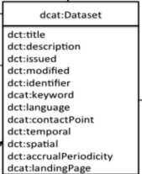
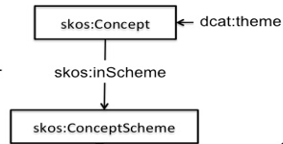
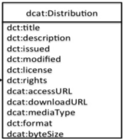

SDMX Information Model: Schematic View
Concepts and Coding Schemes used to Publish Data Sets
Codes
Concepts
Codelists
Topics
Concept Schemes
Data Structure Definition
Category Scheme
Data Flow
Categories
Data Sources and Indexed Content
Publishers
Data Provider Scheme
Registered Data Source
Provision Agreement
(Actual) Content Constraint
Data Providers
Notes:
This is a schematic view of the constructs in the SDMX Information Model that can be used to aid data discovery
In the SDMX Information Model the construct that is the target of the search is the Dataflow. The Dataflow is a conceptual data set. It links to the data structure and the data provider(s), and is, essentially, a specification of data that can be collected or disseminated.
The actual existence of data for either collection or dissemination is determined by the Registered Data Source which identifies the location of the data set and how it can be accessed.
Data can be discovered either via a topic scheme (e.g. statistical themes – these can be hierarchical), by data provider (i.e. the publisher), or via the Concepts or the Codes used in the data structure.

Slide 40
Publishing StatDCAT-AP from SDMX: Requirements
Ability to
Combine metadata from a variety of sources
SDMX registry
Excel or CSV files
Metadata Repository
Validate the metadata
Mandatory/Conditional
Representation (URL, text, code)
Multiple or single occurrence
Hierarchy
Output StatDCAT-AP RDF
Submit Catalogue metadata to the portal
Notes:
Focus on use cases:
Improving discovery of statistical data sets in open data portals
Facilitating integration of statistical data sets with open data from other domains

Slide 41
StatDCAT-AP A New Dawn in Statistical Data Discovery

