Slide 1
Containment and Complementarity Relationships in Multidimensional Linked Open Data
Marios Meimaris and George Papastefanatos
Institute for the Management of Information Systems
Research Center “Athena”
{m.meimaris, gpapas}@imis.athena-innovation.gr

Slide 2
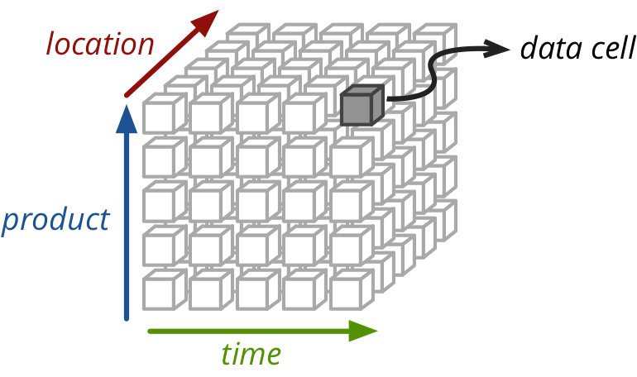
Multidimensional data
Schema
Dimensions
Measures
Attributes
Code lists
Data
Observations
Notes:
Rough description of a cube. Made of the schema part and the data part.
Code lists are hierarchies (e.g. flat). Hierarchies are key to relating points in a multidimensional and multi-source data space.

Slide 3
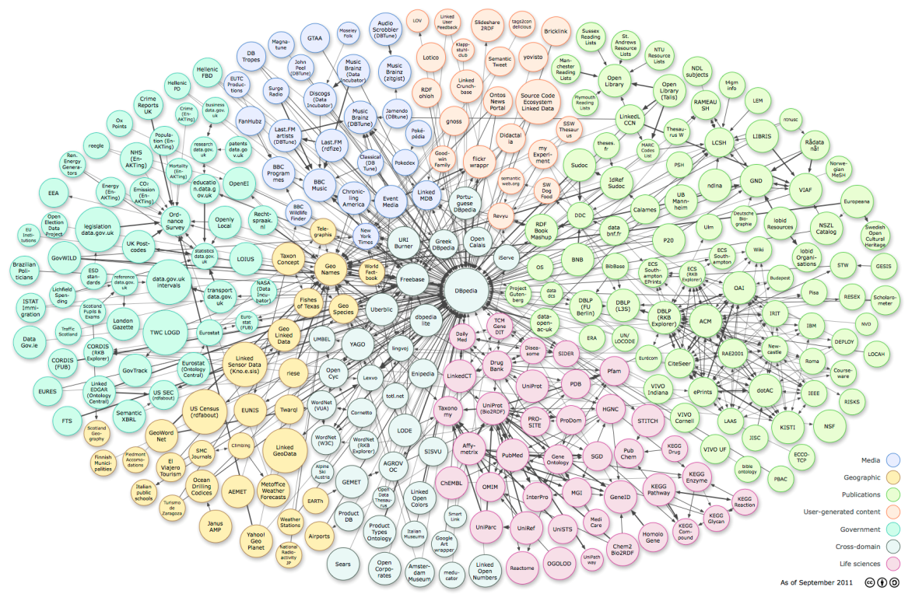
Multidimensional Linked Data
Origin of different source datasets
LD recommendations and Best Practices provide common grounds across remote sources
RDF Data cube¹ provides a common meta-schema
Re-use of:
Dimension properties
Measure properties
Code lists
Hierarchies
In case of no re-use, mapping/alignment is needed
1. http://www.w3.org/TR/vocab-data-cube/
Notes:
Linked data as a common set of techniques
Specialized vocabularies such as Data Cube.
Prevalent use of hierarchies and coded lists. Values of such sets are not necessarily brought to life to serve this purpose. Instead, they might come from * or be linked to * sources such as open data hubs and knowledge aggregators (e.g. dbpedia, freebase yago).
Reuse, on purpose or unknowingly (hardly the case, in reality mapping/entity resoution, but this tis future work)

Slide 4
Problem tackled
Relating points in multidimensional data spaces semantically
Bulk detection and computation of containment and complementarity relationships between observations
in the same dataset or
in different datasets
Observation relationships are useful for:
performing OLAP analytics over multidimensional, multi-dataset data spaces
computing similarities/distances between observations
Suggestion mechanisms for relevant statistics
Exploratory analysis and discovery
Notes:
Semantically, i.e. in different ways with different meaning and translation.
These relationships are dataset independent because they are applied on the instance level. The incoming datasets just pinpoint the data points.

Slide 5
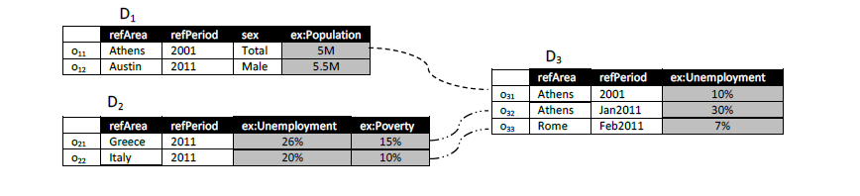
Observations are related
We identify two (non-exhaustive) types of relationships:
Observation containment
Observation complementarity

Slide 6
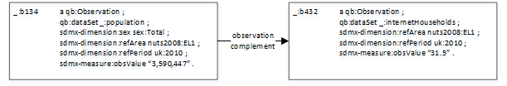
Observation Complementarity
Two observations complement each other when they provide different information for the same point in the data space
P_{k}: the set of dimension properties for observation I
p_{i}: a single dimension property
h_{l}^{m} : the value of property m for observation l
c_{jroot}: the top (root) concept for all hierarchies
Notes:
-Same context: definitions such as entity complement, schema complement, finding related tables, web table association etc.

Slide 7
Observation Containment
An observation contains another observation when it is a partial or full generalization of the latter w.r.t to their shared dimension values
Full containment vs Partial containment
Full containment means that a contained/containing observation can be directly rolled-up/drilled-down to the containing/contained observation,
Partial containment means that both contained and containing observation must be rolled-up on their disjoint dimensions to complement each other
full
partial

Slide 8


Containment example
location | time | sex | Population
Italy | 2012 | Total | 59,478,000
Riva del Garda | 2012 | Male | 15,100
Trentino | 2012 | Female | 248,400
… | … | … | …
obs1
obs2
obs3
full
partial
Hierarchy is reflexive (i.e. a value is a parent of itself)

Slide 9
Computation
Build the feature space
Group by dimension / measure
Extract containment per dimension / measure
Compute overall containment scores and classify as full or partial
Compute complementarity scores

Slide 10
Occurrence Matrix
1. Build the feature space into an occurrence matrix
Each dimension value is a feature
Encoded is the hierarchy of features (1 for occurrence and all parents, 0 otherwise)
 | refArea |  |  |  |  |  |  |  |  |  | refPeriod |  |  |  |  | sex
 | WLD | EUR | AM | GR | IT | Ath | Rom | US | TX | Aus | ALL | 2001 | 2011 | Jan11 | Feb11 | M | F | T
obs₁₁ | 1 | 1 | 0 | 1 | 0 | 1 | 0 | 0 | 0 | 0 | 1 | 1 | 0 | 0 | 0 | 0 | 0 | 1
obs₁₂ | 1 | 0 | 1 | 0 | 0 | 0 | 0 | 1 | 1 | 1 | 1 | 0 | 1 | 0 | 0 | 1 | 0 | 1
obs₂₁ | 1 | 1 | 0 | 1 | 0 | 0 | 0 | 0 | 0 | 0 | 1 | 0 | 1 | 0 | 0 | 0 | 0 | 1
obs₂₂ | 1 | 1 | 0 | 0 | 1 | 0 | 0 | 0 | 0 | 0 | 1 | 0 | 0 | 1 | 1 | 0 | 0 | 1
obs₃₁ | 1 | 1 | 0 | 1 | 0 | 1 | 0 | 0 | 0 | 0 | 1 | 1 | 0 | 0 | 0 | 0 | 0 | 1
obs₃₂ | 1 | 1 | 0 | 1 | 0 | 1 | 0 | 0 | 0 | 0 | 1 | 0 | 1 | 1 | 0 | 0 | 0 | 1
obs₃₃ | 1 | 1 | 0 | 0 | 1 | 0 | 1 | 0 | 0 | 0 | 1 | 0 | 1 | 0 | 1 | 0 | 0 | 1

Slide 11
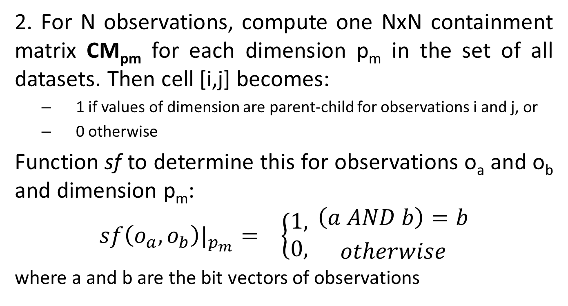
Containment Matrices
2. For N observations, compute one NxN containment matrix CM_{pm} for each dimension p_{m} in the set of all datasets. Then cell [i,j] becomes:
1 if values of dimension are parent-child for observations i and j, or
0 otherwise
Function sf to determine this for observations o_{a} and o_{b} and dimension p_{m}:
$$sf\left(o_{a},o_{b}\right)|_{p_{m}}= \left\{\begin{aligned}1, \\ 0, \end{aligned}\right.{\left(a AND b\right)=b \atop otherwise}$$
where a and b are the bit vectors of observations

Slide 12
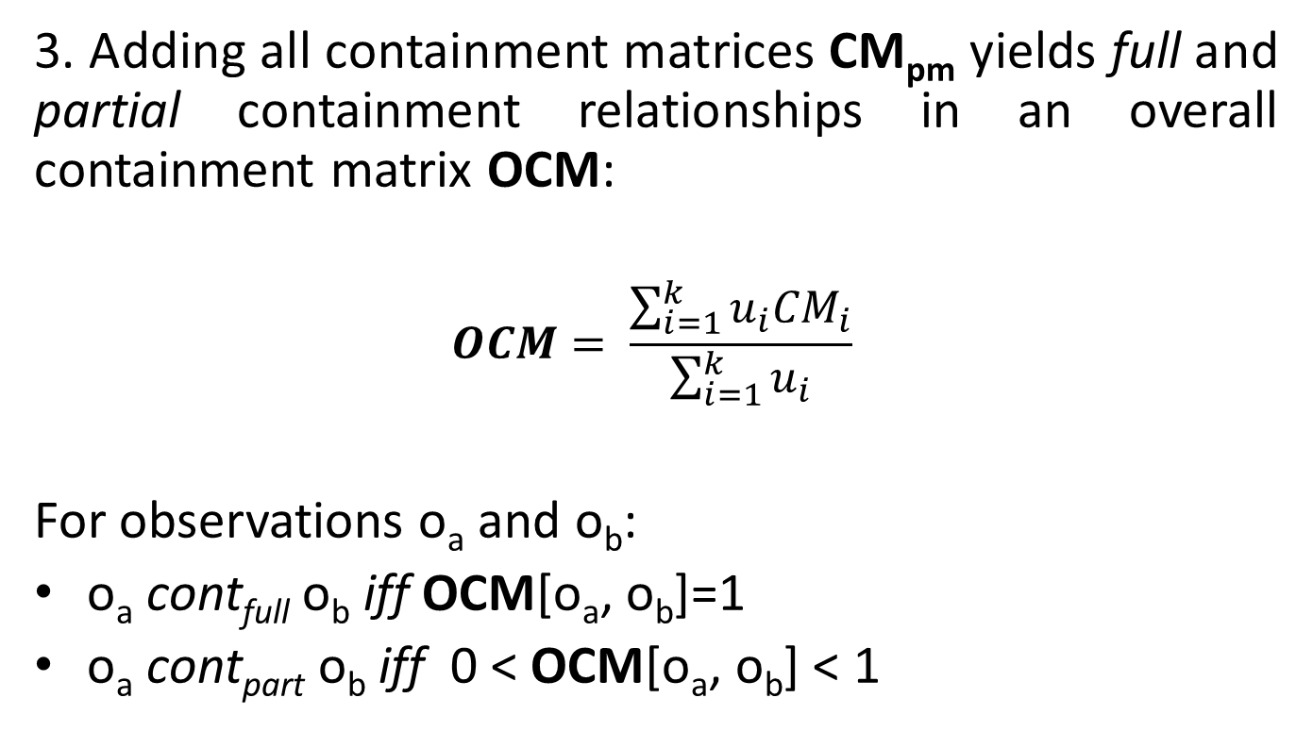
Containment relationships
3. Adding all containment matrices CM_{pm} yields full and partial containment relationships in an overall containment matrix OCM:
$$OCM= \frac{\sum_{i=1}^{k}{u_{i}{CM}_{i}}}{\sum_{i=1}^{k}{u_{i}}}$$
For observations o_{a} and o_{b}:
o_{a} cont_{full} o_{b} iff OCM[o_{a}, o_{b}]=1
o_{a} cont_{part} o_{b} iff 0 < OCM[o_{a}, o_{b}] < 1
Notes:
If it adds up to 1, it means that all dimension values are children, if it adds up to less than one (but still larger than 0) then it is partially contained.

Slide 13
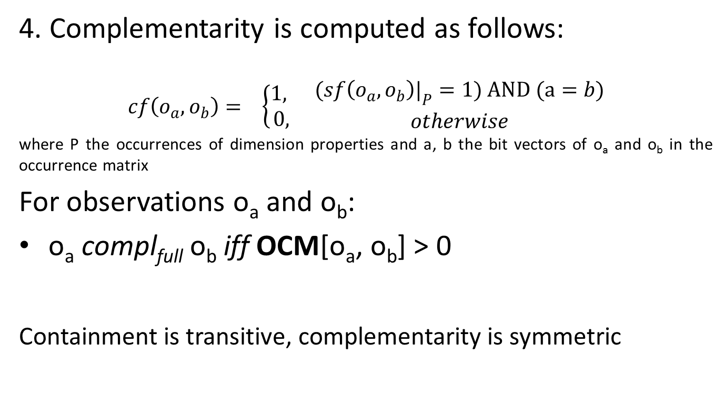
Complementarity relationships
4. Complementarity is computed as follows:
$$cf\left(o_{a},o_{b}\right)= \left\{\begin{aligned}1, \\ 0, \end{aligned}\right. {(sf\left(o_{a},o_{b}\right)|_{P}=1) AND (a=b) \atop otherwise}$$
where P the occurrences of dimension properties and a, b the bit vectors of o_{a} and o_{b} in the occurrence matrix
For observations o_{a} and o_{b}:
o_{a} compl_{full} o_{b} iff OCM[o_{a}, o_{b}] > 0
Containment is transitive, complementarity is symmetric
Notes:
We want the dimension properties to match (same schema for dimensions). If there are excess dimensions we smooth them out by aggregating them to the root concept value (parent of all by default). Also, exactly the same values for these dimensions.

Slide 14
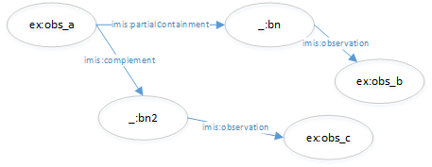
Data Cube Extension
Notes:
The extension can either capture generic links with the type of the relationship, or be annotated with more data (e.g. complement on which measure etc).

Slide 15
Experimental Evaluation
Datasets:
Population (Eurostat, Worldbank)
Internet households (Eurostat)
Poverty (Eurostat, Worldbank)
6 dimension properties
3 measure properties
#of obs. | refArea | refPeriod | sex | unit | age | poverty | internet | population
D₁ (539) | 85 regions,20 countries | 2004-2011 | N/A | Yes | Yes | Yes | N/A | N/A
D₂ (1693) | 293 regions, 33 countries | 2003-2010 | N/A | Yes | N/A | Yes | N/A | N/A
D₃ (629) | 42 regions, 3 countries | 2009-2013 | M, F, Total | Yes | N/A | N/A | N/A | Yes
D₄ (316) | 65 regions,7 countries | 2009-2013 | N/A | N/A | N/A | N/A | Yes | N/A

Slide 16
Results - Discussion
Most new relationships are partial containments (~27% of possible relationships)
Complementarity is the strictest relationship (0.03% of the total possible observation pairs)
Relatedness of complementarity to partial/full containment
~1.3 million new links between observations
 | D₁ | D₂ | D₃ | D₄
D₁ | 647 (0.31%) full 34.3k (16.32%) partial N/A compl | N/A full N/A partial N/A compl | N/A full N/A partial N/A compl | N/A full N/A partial N/A compl
D₂ | 605 (0.02%) full 605k (14.83%) partial 1238 (0.04%) compl | 3370 (0.14%) full 378k (14.83%) partial N/A (complement | N/A full N/A partial 204 (0.004%) compl | N/A full N/A partial N/A compl
D₃ | N/A full N/A partial N/A compl | N/A full N/A partial N/A compl | 1k (0.26%) full 261k (65.9%) partial N/A compl | N/A full N/A partial N/A compl
D₄ | N/A full N/A partial 328 (0.05%) compl | N/A full N/A partial 218 (0.005%) compl | N/A full N/A partial 592 (0.07%) compl | 437 (0.17%) full 22.2k (22.3%) partial N/A compl

Slide 17
Future Work
Suggestion mechanisms based on computed relationships, conduct user studies to evaluate
Faster and more efficient computations (now O(N²) )
Better feature extraction
Dimensionality reduction
Extracting latent datasets based on containment and complementarity relationships
Notes:
These relationships can point to useful suggestions etc.

Slide 18












Support
DIACHRON
Managing the Evolution and Preservation of the Data Web
KRIPIS: SODAMAP Project
linked-statistics.gr

