Slide 1



From Flat Lists to Taxonomies: Bottom-up Concept Scheme Generation in Linked Statistical Data
Albert Meroño-Peñuela
@albertmeronyo
SemStats @ ISWC 19-10-2014

Slide 2
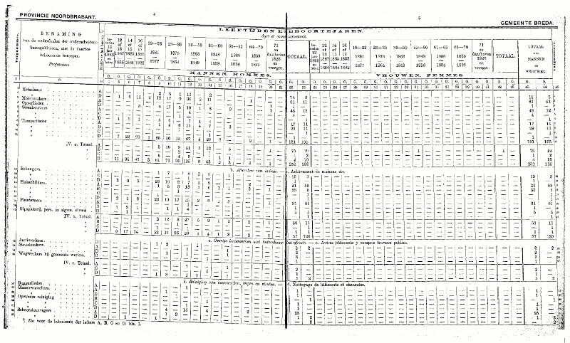
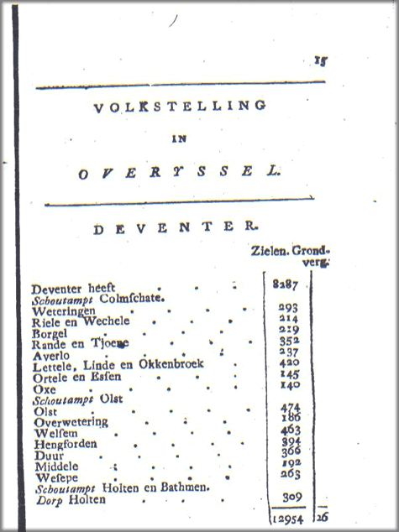
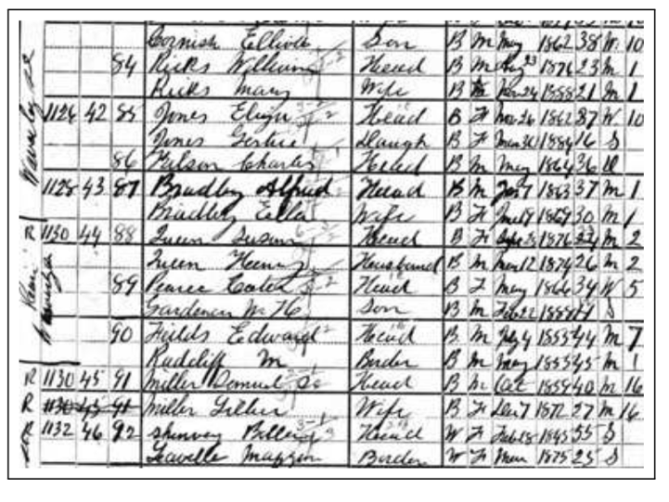
Motivation
Dutch Historical Censuses (1795-1971)
[Public Historical Statistical Data]
http://lod.cedar-project.nl/cedar/
Notes:
We’ve been

Slide 3
Dimension Reusability
cedar:BRT_1889_02_T1-S0-K17-h a qb:Observation ;
cedar:population "12"^^xml:integer ;
maritalstatus:maritalStatus
maritalstatus:single ;
cedarterms:occupationPosition cedarterms:job-D ;
sdmx-dimension:sex sdmx-code:sex-F ;
cedarterms:occupation hisco:88030 ;
sdmx-dimension:refArea gg:11150 ;
cedarterms:belief cedar:118 ;
cedarterms:houseType cedar:Klooster ;
prov:wasDerivedFrom
cedar:BRT_1889_08_T1-S0-K17 ;
prov:wasGeneratedBy
cedar:BRT_1889_08_T1-S0-K17-activity .

Slide 4
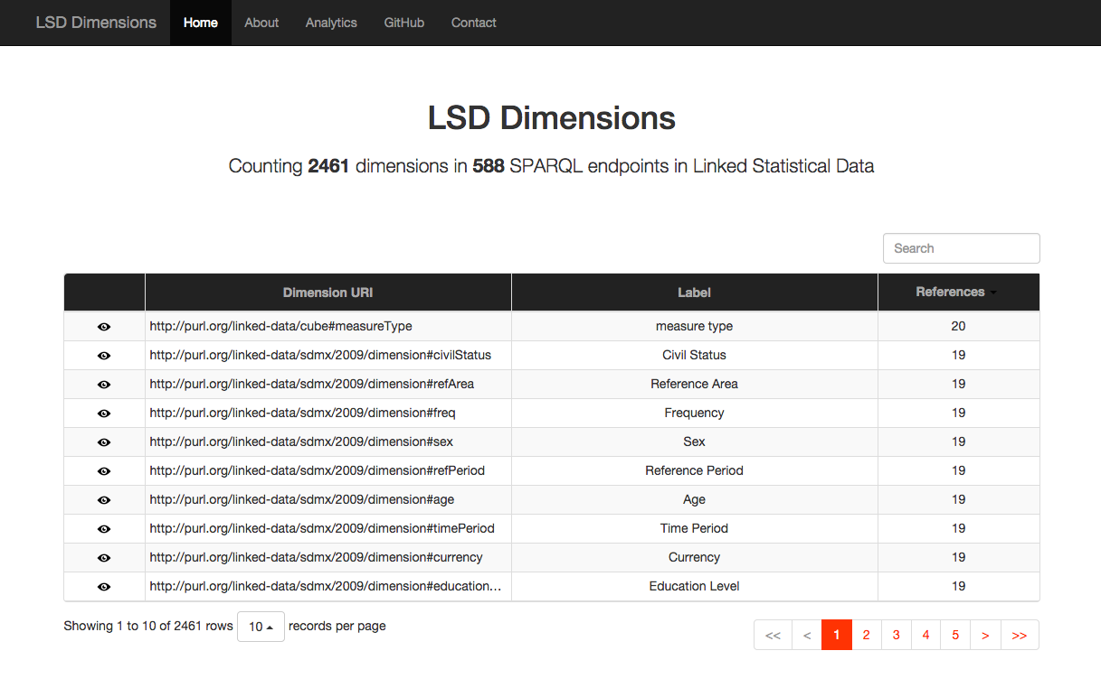
LSD Dimensions
http://lsd-dimensions.org/
https://github.com/albertmeronyo/LSD-Dimensions
Hourly JSON-LD dumps

Slide 5
What if dimensions aren’t out there?
Need to build them
Input: flat lists of non-standard values
Output: standard concept scheme
Knowledge intensive problem

Slide 6
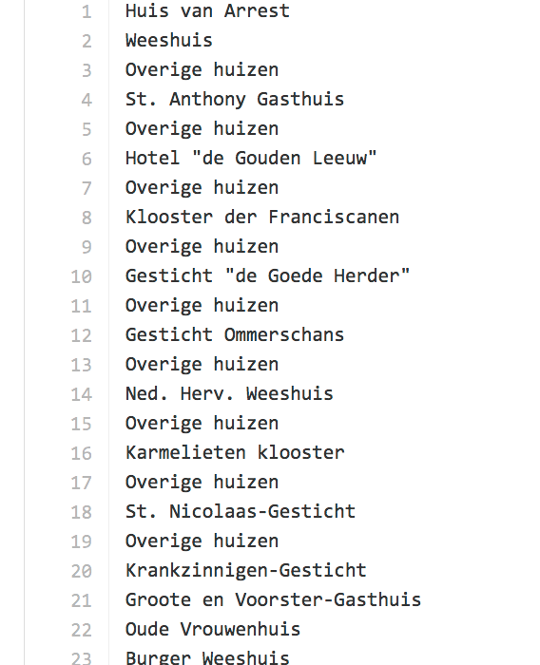
Dutch Historical Building Types

Slide 7
TabCluster: data-driven concept scheme generation
https://github.com/CEDAR-project/TabCluster
Leverages lexical and semantic term properties
Lexical Hierarchical Clustering
ScyPy python implementation
Similarity transitivity
Clustering threshold & other parameters
Semantic Tagging of Clusters (WordNet & DBPedia) w/ skos:Concept
Term frequency-based
Less common broader concept category

Slide 8
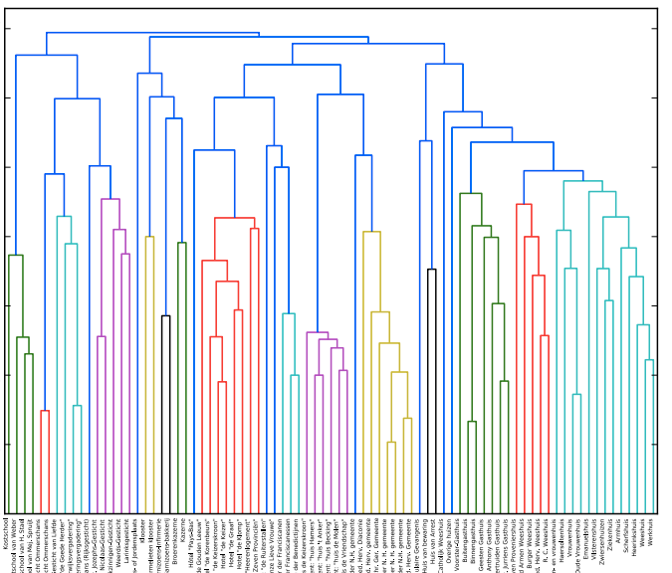
Output & Evaluation
Notes:
We serialize this into skos, Turtle
We map the new standard values with the original ones in the data (advantage of data-driven, these mappings are for free)

Slide 9
Thank you
Questions, suggestions, comments most welcome
@albertmeronyo
https://github.com/CEDAR-project/TabCluster
http://lsd-dimensions.org/

