Slide 1
Multiscale Exploration of Spatial Statistical Datasets A Linked Data Mashup Approach
Ba-Lam Do, Tuan-Dat Trinh, Peter Wetz, Elmar Kiesling,
Amin Anjomshoaa, A Min Tjoa
Linked Data Lab, Vienna University of Technology
http://ldlab.ifs.tuwien.ac.at/

Slide 2
Problem Statement
Number of statistical datasets is growing rapidly
Exploration tools analyze only individual data sources and have an unexciting scenario
Input: Sparql endpoint
Output: Visualization of its datasets
Not open for reusability and difficult to extend provided functionality
Notes:
Today, in line with the increasing adoption of Open Data policies, the amount of data in general and statistical data in particular published by governments and organizations on the web is growing rapidly.
It plays an increasingly important role in public policy formation and acts as a facilitator for informed decision-making in the private sector.
Therefore, efficient data exploration and data integration approaches retrieve a large interest of end users.
Unfortunately, there are three problems.
Firstly, many exploration tools analyze only individual data sources. Therefore, end user can not integrate data from different data sources.
Secondly, these tools have the same scenario which is really unexciting.
- They receive the input is the address of SPARQL endpoint. Since then, they analyze the endpoint and provide the visualizations of its datasets.
Therefore, first of all, end users need to know the endpoint to provide to the exploration tool. Next, these tools don’t focus to the interest of end users. All end users receive the same result which can be a large list of datasets and they need to browse each dataset to find the interesting data.
Finally, these tools are not open for reusability and difficult to extend provided functionality.

Slide 3
Objectives
Exciting scenario:
Input: address(es)/location(s)
Output: datasets of multiple sources relating to the input
Open mashup platform
Support data integration from different datasets
Openness and reusability
Notes:
So, the question is how to enable users to consume statistical data in endpoints in a convenient way? We solved three problems by the way as the following
Firstly, we provide an exciting scenario for end users. They can provide one address, one location or many ones. It means that we take care the interest of end users and provide the different results based on the interests of different end users.
Secondly, we will analyze existing data sources to return datasets from multiple sources which relate to the input. So, we are on the way of data integration
Finally, we need an open mashup platform which supports data integration from different datasets, as well as, it is openness and reusability. Every developer are welcomed to contribute to the platform which allows end users to analyze the data sources in more details or in different contexts. For example to compare the locations in the input with the top 10 locations in one dataset.

Slide 4







List of endpoints
6000 locations
60k locations
Use Google Geocoding API
https://developers.google.com/maps/documentation/geocoding/
Notes:
At present, we have a list of 15 endpoints which use Data Cube Vocabulary. From this list, we detected more than 60k different locations. To solve the problem which the locations which can be described in different languages, are same we use Google Geocoding API.
This API can retrieve the name of one location and return the information of this location, containing the type (for example Country, Province, City), the official name in English. With the different names of the same location, Google return the same result. Therefore, we build a metadata which describes that one dataset contain which locations.
However, Google has a limitation. With free users, they can send 2500 requests per day. Therefore, at present I also have a small metadata from three endpoints from Open Government Wien, Ireland, and Digital Agenda for Europe with 6000 locations.

Slide 5
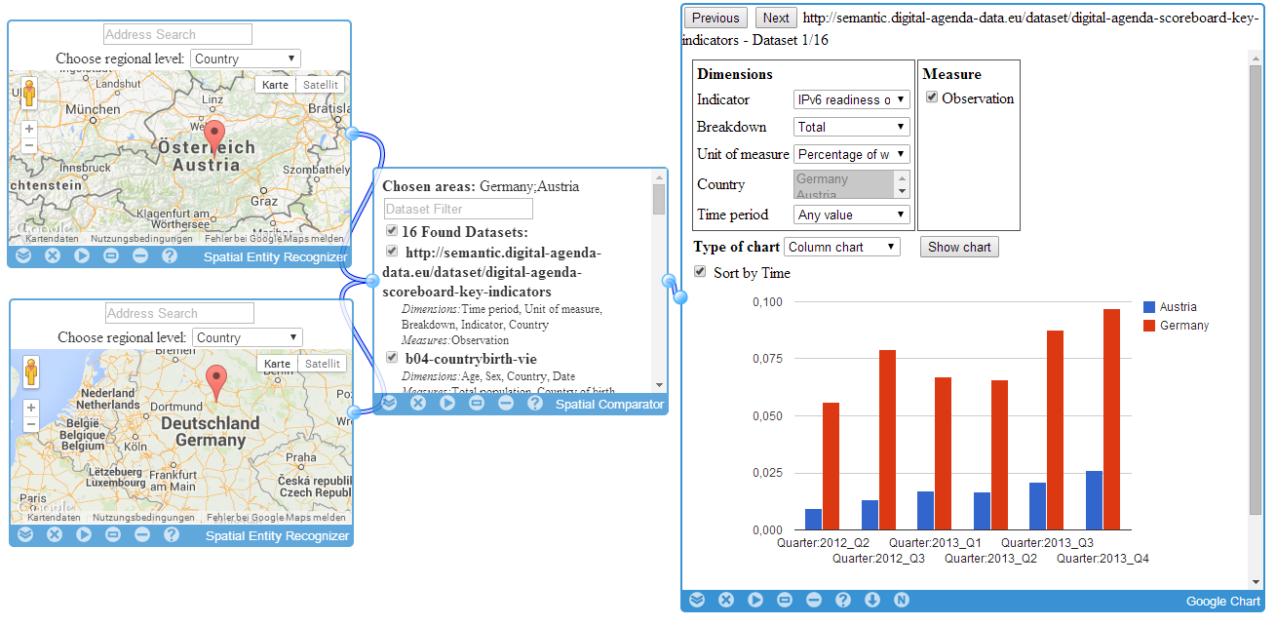
Example
http://linkedwidgets.org/MashupPlatform.html?id=MashupSpatialDataComparator
Notes:
We implemented an linked widget platform which uses widget to retrieve the data input, process the data and make the visualization. I want to show an example.
We have two Recognizer widgets. Each widget allows end user to input one address or click a point in the map. End users can choose the level for this address: Country, Province, City…
The Comparator widget retrieves data from two Recognizer widgets. It uses Google Api to detect the areas: Germany and Austria
Next it queries our metatdata to find datasets which contain both of these areas.
End users can input some keywords to filter the list. We will match the keyword with the dimensions, measures in each datasets.
The last widget will show the visualization of each dataset. User can change the option of dimensions, measure, charts.

Slide 6
Thank you very much for your attention!
Contact:
Ba-Lam Do
Linked Data Lab
Institute of Software Technology and Interactive Systems
Vienna University of Technology, Austria
http://ldlab.ifs.tuwien.ac.at
lam@ifs.tuwien.ac.at
Notes:
That is all of my presentation. Thank you very much for your attention

Slide 7
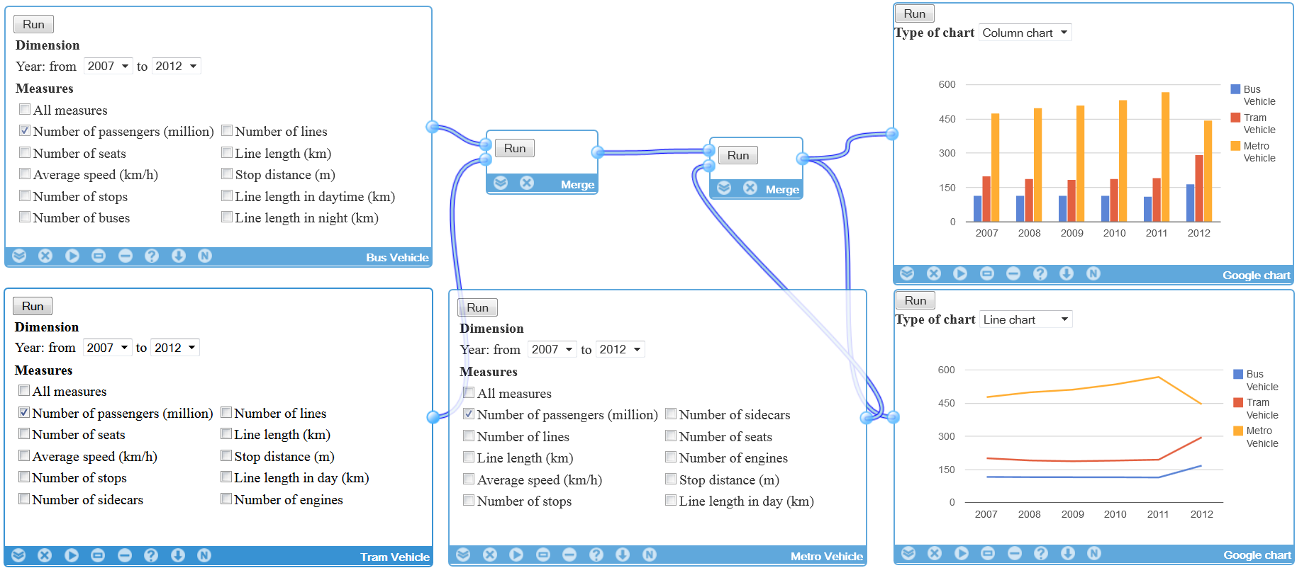
Compare Bus, Tram, and Metro

Slide 8
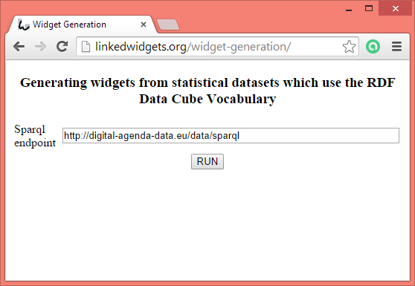

How to create widget

Slide 9
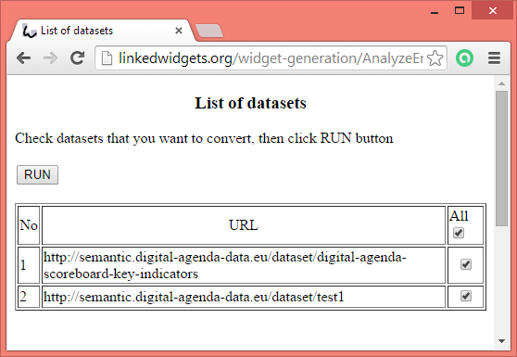
How to create widget

Slide 10
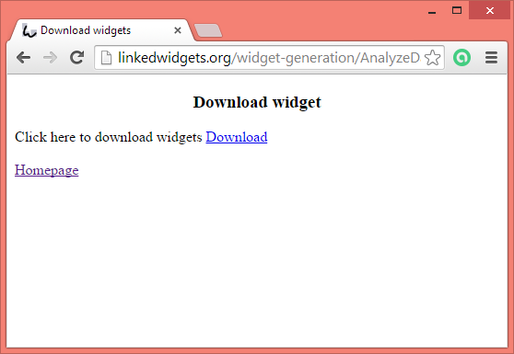
How to create widget

