Slide 1
Publishing Official Classifications in Linked Open Data
Giorgia Lodi**, Antonio Maccioni**, Monica Scannapieco*, Mauro Scanu*, Laura Tosco*
* Istituto Nazionale di Statistica – Istat
** Agenzia per l’Italia Digitale – AgID

Slide 2
Motivations
End of 2012 the Agency for Digital Italy (AgID) published the first version of National Guidelines on the use of LOD as the paradigm for enabling semantic interoperability between Public Administrations
Among the key datasets, AgID identified official classifications as cross-domain data to be published in LOD

Slide 3
Aims of the Project
The Italian National Institute of Statistics - Istat & AgID launched a joint project:
To model Official Classifications (Ateco 2007 -Classification of Economic Activity and COFOG - (Classification of the Functions of Government) in LOD using standard ontologies (SKOS, XKOS, ADMS,…)
To certify data by provenance using the PROV framework, i.e. document the (i) overall process of creation of a classification and (ii) the creation and publication of the LOD version
publication on a SPARQL endpoint hosted by AgID: http://spcdata.digitpa.gov.it
Notes:
Joint UNECE-Eurostat-OECD Work Session on Statistical Metadata (METIS)
The DDI Alliance is a self-sustaining membership organization that develops and promotes the DDI specification and associated tools, education, and outreach programs.
The SDMX sponsoring institutions are the Bank for International Settlements, the European Central Bank, Eurostat (the statistical office of the European Union), the International Monetary Fund (IMF), the Organisation for Economic Co-operation and Development (OECD), the United Nations Statistics Division and the World Bank.

Slide 4
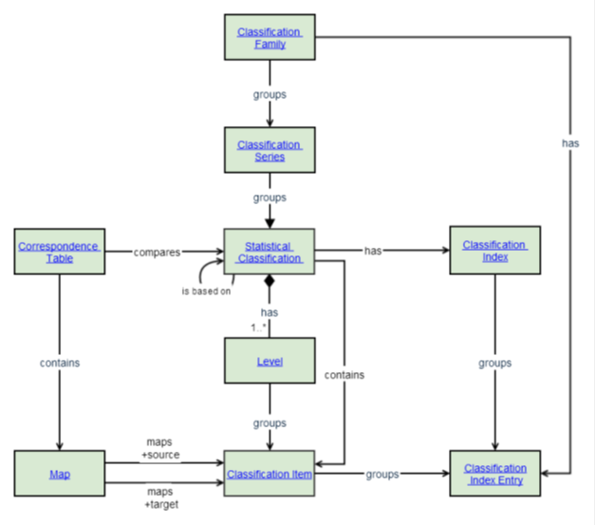
Statistical Official Classifications
Statistical Official Classifications allow to:
Reuse them in different production processes
Promote harmonization
Important models:
Neuchâtel Terminology Model Classification (2004)
Generic Statistical Information Model (GSIM) (2013)
GSIM: UML- schema

Slide 5
ATECO 2007
Classificazione delle Attività Economiche (ATECO)
Version 2007
Italian counterpart of NACE classification (http://epp.eurostat.ec.europa.eu/portal/page/portal/nacerev2/introduction)
Consisting of the following levels:
ATECO | NACE
Sezioni | Sections
Divisioni | Divisions
Gruppi | Groups
Classi | Classes
Categorie | -
Sottocategorie | -

Slide 6
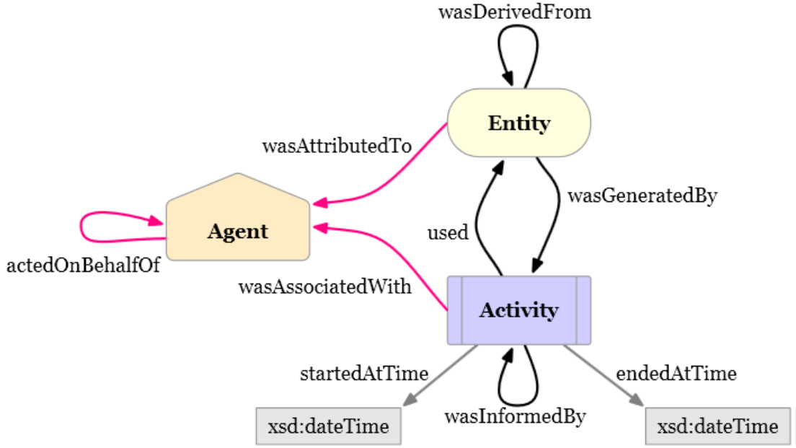
PROV Ontology
W3C recommendation, OWL2 ontology
Provides a set of classes, properties, and restrictions to represent provenance information
Publishing, together with data, who is the responsible of the data - person/institution/ administration that manages/creates/ manipulates the data
Certifying data - data are certified if they are published by their responsible
Provenance of data in terms of information regarding entities and processes involved in the production and publication of data

Slide 7
XKOS Ontology
XKOS - eXtended Knowledge Organization System
Data Documentation Initiative (DDI)
Extension of SKOS - Simple Knowledge Organization System
Manages statistical classifications
Implements requirements laid out in ISO standards (ISO 704:2000 revised 2009 and ISO 1087-1:2000)
Represent statistical classifications with their structure, textual properties, and relations between classications

Slide 8
XKOS and SKOS
SKOS vocabulary: loosely defined notions of ‘broader than’, ‘narrower than, and ‘related to’ relationships.
Statistical classifications - XKOS:
Formally defined hierarchical relations, which are referred to as generic (generic-specific) and partitive (whole-part).
Levels that correspond to increasingly detailed views of the field covered
Use of associations that are more specific than the generic ‘related to’. Causal, sequential, and temporal relations defined.
XKOS uses SKOS classes and related properties (codes, labels, etc.) to represent:
Classification items (skos:Concept)
Classification Scheme (skos:ConceptScheme)
Classification (skos:Concept)
skos:inScheme
skos:member
skos:broader
skos:narrower
skos:Collection
skos:Concept
…
XKOS adds properties to describe the links between these objects i.e.:
xkos:belongsTo
xkos:follows
xkos:supercedes
xkos:classifiedUnder
xkos:ClassificationLevel
xkos:depth
xkos:organizedBy
xkos:levels
xkos:ClassificationLevel
xkos:Correspondence
xkos:madeOf
………
skos:classification scheme may be attached to a classification using
xkos:belongsTo

Slide 9
LinkedATECO 2007
Available at AgID SPARQL endpoint:
http://spcdata.digitpa.gov.it/
Uses different ontologies and vocabularies
Realization steps:
Provenance Modeling
Classification Modeling
Classification Distribution
Implementation

Slide 10
Provenance Modeling
Notes:
10
Most common

Slide 11
Classification Modeling
Notes:
11
Most common

Slide 12
Classification Distribution
ADMS(Asset Description Metadata Schema): describe semantic assets, defined as highly reusable metadata
DCAT (Data Catalogue Vocabulary) to insert the classification as dataset of our data catalogue and to decouple the abstract entity notion of dataset from its actual implementation
Notes:
12
Most common

Slide 13
Implementation
Data Import:
CSV file from http://sistemaclassicazioni.istat.it/class/sistemaclassicazioni/index.php to a relational data base
Pre-processing:
e.g. adding new attributes with composed existing fields
Data Mapping
D2RQ framework
Publishing resulting RDF data
D2RQ framework

Slide 14
Conclusions
Contribution of the work:
Technical: modeling aspects of OS classification by making use of ontologies that are specific of the statistical domain, like XKOS, as well as of more general purpose ontologies, like PROV.
Methodological: data interoperability is made possible by twofold efforts
Shared formats and models, i.e., technological standards like RDF framework and ontologies like XKOS
Content harmonization, i.e., common domain-specific information concepts.
OS classifications in LOD as a first step towards content harmonization

