Slide 1
Publishing the 15th Italian
Population and Housing Census in
Linked Open Data
Monica Scannapieco, R. M. Aracri, S. De Francisci,
A. Pagano, L. Tosco, L. Valentino
Istituto Nazionale di Statistica – Istat

Slide 2
NSIs & LOD
NSIs produce data
Data dissemination is a fundamental phase
Different models are adopted by NSIs to represent data:
DDI (Document Data Initiative) (1995)
Neuchâtel model (2004)
SDMX (Statistical Data and Metadata Exchange) (2004)
GSIM (Generic Statistical Information Model) (2013)
Need to broaden the dissemination to non-statistical users
Data dissemination in LOD format !
Among NSIs who published data in LOD format:
Istat (Italy), INSEE (France), ABS (Australia), EL.Stat (Greece), CSO (Ireland)

Slide 3
Istat SDMX-based Data Dissemination - 1
NSI-DATA
.txt
DB
SDMX
Query
Gesmes
file
User from Statistical Business Domain
Content Negotiation
Excel
NSI SDMX Web Service
Users not only from Statistical Business Domain
RDF
data

Slide 4






Istat LOD-based Dissemination - 2
NSI-DATA
Basic user
RDF
data
Advanced user
Machine To Machine

Slide 5
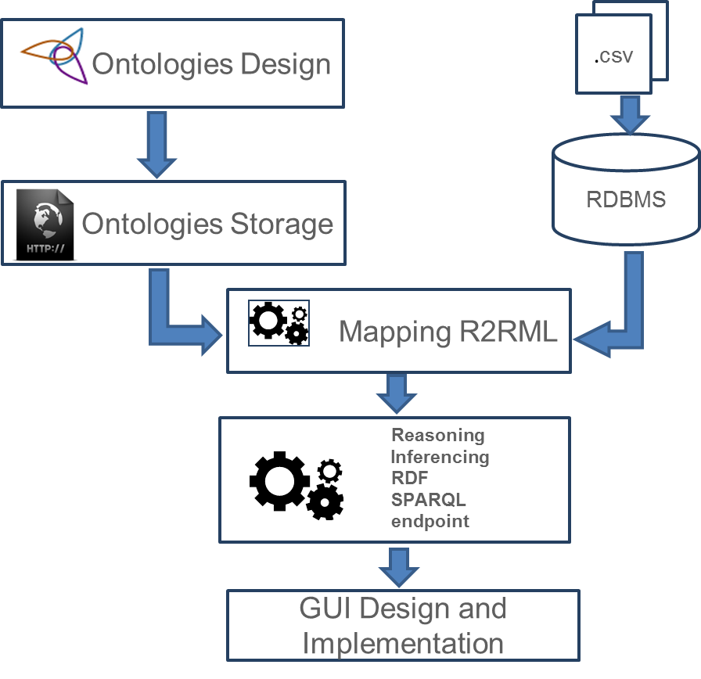
The CensLOD Project: Main Phases & Workflow
The project consists of three main phases:
Domain analysis and Ontology definition
Triples generation
LOD publishing
Project Workflow
Notes:
5
Most common

Slide 6
Phase 1: Domain Analysis
Territory dataset :describing the Italian territorial features from both administrative and geographical perspectives
Censpop dataset: describing the population and housing Census indicators, at the territorial level of Census section
Published in the past as CSV files or as XLS files (http://www.istat.it/it/archivio/104317 )
COD_PRO | COD_COM | PRO_COM | SEZ2001 | SEZIONE | P1 | P2 | P3 | P4 | P5 | P6 | P7
5 | 1 | 5001 | 50010000005 | 5 | 9 | 6 | 3 | 3 | 4 | 0 | 2
5 | 5 | 5005 | 50050000343 | 343 | 34 | 17 | 17 | 12 | 15 | 2 | 5
5 | 118 | 5118 | 51180000013 | 13 | 13 | 7 | 6 | 5 | 5 | 1 | 1
5 | 120 | 5120 | 51200000001 | 1 | 292 | 141 | 151 | 104 | 133 | 7 | 45
5 | 121 | 5121 | 51210000037 | 37 | 23 | 11 | 12 | 10 | 8 | 0 | 4
Data size
402.903 Census Sections
74.482 Localities
2.200 Census Areas
3.631 Geomorphological entities
And others classes …
43 indicators for each entity (currently loaded):
Resident Population – Males
Resident Population – age > 74 years
Foreigners and stateless persons resident in Italy – Males
…
Notes:
6
Most common

Slide 7
Phase 1: Ontologies Definition
Two distinct Ontologies:
Territorial Ontology
Census Data Ontology (population & housing)
OWL Ontologies
Use of Meta Ontologies:
SKOS and XKOS: skos:Concept, …
ADMS: adms:AssetRepository, …
Data Cube Vocabulary: qb:DataSet, qb:Observation, …
PROV: prov:wasGeneratedBy, …
GeoNames: gn:name, gn:countryCode, gn:parentCountry, …
Notes:
7
Most common

Slide 8
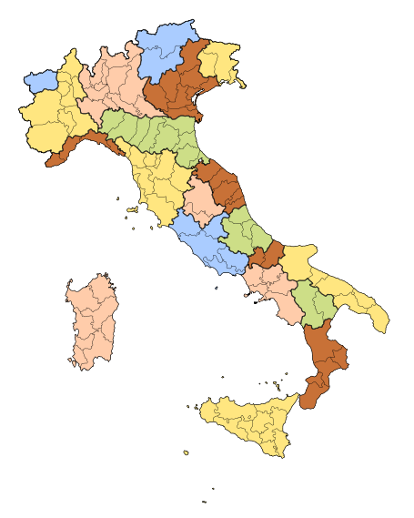
Territorial Ontology
Description of principal classes of the domain:
95 entities
Regions
Province
Locations
…..
200 roles:
appartiene ACDDASC (links municipality with its sub-municipalities components)
equivalentTo (links entity with the relative Geonames entity)
…..
Notes:
8
Most common

Slide 9
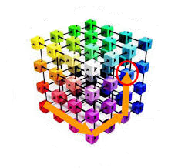
Census Data Ontology
Use of RDF Data Cube Vocabulary that allows to publish multi-dimensional data
Dimensions:
Sex
Age classes
Citizenship
Territory (territory defined in the Territorial Ontology)
Construction Period
Number of floors
…..
Measures:
Number of residents
Foreigners and stateless resident in Italy
Number of Housing
…..
Dimensions:
Sex
Age
Marital status
Dimensions:
Construct period
Intended use
Number of floors
Measure
Resident Population
Measure
Number of dwellings
Notes:
9
Most common

Slide 10
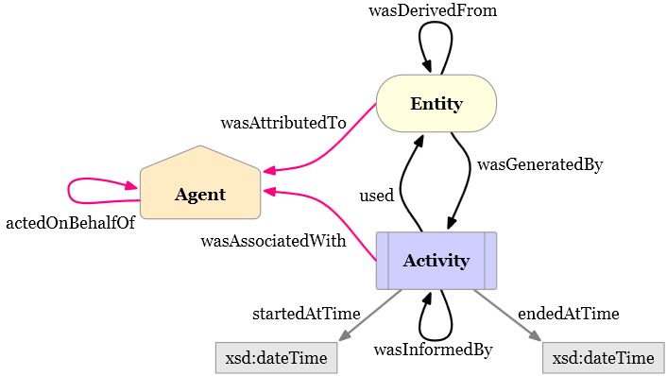
Certifying Istat Data
Istat data are the results of established methodological procedures:
Official Statistics has a precise meaning in terms of quality and trust of the statistical information product
We used the W3C PROV Ontology as a structured description of the provenance of the data
Where data come from
Official data sources according to European and National regulation
Domain standard conformance (e.g., variant and version of a statistical classification)
…
Notes:
10
Most common

Slide 11

Phase 2: Triples Generation
Triples generation by mapping CSV source file into triples using R2RML language (http://www.w3.org/TR/r2rml/)
Mapping rules manually written
Triplestore
Mapping R2RML
Ontologies Design
RDBMS
.csv
Notes:
11
Most common

Slide 12
Mapping Example
Mapping rules to obtain all the contested zones showing two properties:
nomeAreaSpeciale
contestatoDa
Example R2RML mapping
@prefix rr: <http://www.w3.org/ns/r2rml#>.
@prefix ex: <http://example.com/ns#>.
@prefix ter: <http://rdf.istat.it/ter/> .
<#TriplesMapZonaInContestazione>
rr:logicalTable [ rr:tableName "ZONE_IN_CONTESTAZIONE" ];
rr:subjectMap [
rr:template "http://dati.istat.it/ter/ZonainContestazione/{COD_ZONA_C}";
rr:class ter:ZonaInContestazione;
rr:class ter:AreaSpeciale;
];
rr:predicateObjectMap [
rr:predicate ter:contestatoDa;
rr:objectMap [ rr:column "PRO_COM" ];
];
.
rr:predicateObjectMap [
rr:predicate ter:nomeAreaSpeciale;
rr:objectMap [ rr:column “NOME_AS" ];
];
Mapping result
Contested zone #5, named ‘Regione Folla’, that is a AreaSpeciale and is contested between two municipalities identified by ‘96001’ and ‘2066’
Result (Turtle)
<http://dati.istat.it/ter/ZonainContestazione/5>
a ter:ZonaInContestazione , ter:AreaSpeciale ;
ter:contestatoDa "96001" , "2066" ;
ter:nomeAreaSpeciale "Regione Folla" .
Notes:
12
Most common

Slide 13
Phase 2: Triples Generation
OWL2 Profiles syntactic subsets of OWL 2 - each is more restrictive than OWL DL
OWL 2 EL
polynomial time algorithms
particularly suitable for applications
very large ontologies are needed
expressive power can be traded for performance guarantees
OWL 2 QL
conjunctive queries to be answered in LogSpace (more precisely, AC0) using standard relational database technology
particularly suitable for applications
relatively lightweight ontologies are used to organize large numbers of individuals
it is useful or necessary to access the data directly via relational queries (e.g., SQL)
OWL 2 RL
implementation of polynomial time reasoning algorithms using rule-extended database technologies operating directly on RDF triples
particularly suitable for applications
relatively lightweight ontologies are used to organize large numbers of individuals
it is useful or necessary to operate directly on data in the form of RDF triples
Notes:
13
Most common

Slide 14
Phase 2: Triples Generation
OWL with IF Semantic [1]
Usage of Oracle Spatial and Graph
Vocabularies & rulebase (for inferencing) supported
1. RDF++
-all RDFS vocabulary constructs
-owl:InverseFunctionalProperty
-owl:sameAs
2. OWLSIF
-all RDFS vocabulary constructs -owl:FunctionalProperty
-owl:InverseFunctionalProperty -owl:SymmetricProperty
-owl:TransitiveProperty -owl:sameAs
-owl:inverseOf -owl:equivalentClass
-owl:equivalentProperty -owl:hasValue
-owl:someValuesFrom -owl:allValuesFrom
3. OWL Prime
-rdfs:subClassOf -rdfs:subPropertyOf
-rdfs:domain -rdfs:range
-owl:FunctionalProperty -owl:InverseFunctionalProperty
-owl:SymmetricProperty -owl:TransitiveProperty
-owl:sameAs owl:inverseOf
-owl:equivalentClass -owl:equivalentProperty
-owl:hasValue -owl:someValuesFrom
-owl:allValuesFrom -owl:differentFrom
-owl:disjointWith -owl:complementOf
Supported semantics for these value restrictions are only intensional (IF semantics).
4. OWL 2RL & 5. OWL2 EL
As described in
http://www.w3.org/TR/owl2-profiles/#OWL_2_RL
http://www.w3.org/TR/owl2-profiles/#OWL_2_EL
[1] Completeness, decidability and complexity of entailment for RDF Schema and a semantic extension involving the OWL vocabulary,
by H.J. Horst, Journal of Web Semantics 3, 2 (2005), 79–115
Notes:
14
Most common

Slide 15
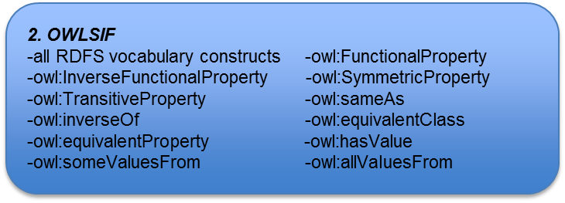
Phase 2: Triples Generation
Inference rulebase chosen
OWLSIF
Optimizations applied
Triples materialization
Considerable reduction of response time
Definition of “ad hoc” inference rules
Storage of frequent queries
OWL with IF Semantic
Notes:
15
Most common

Slide 16
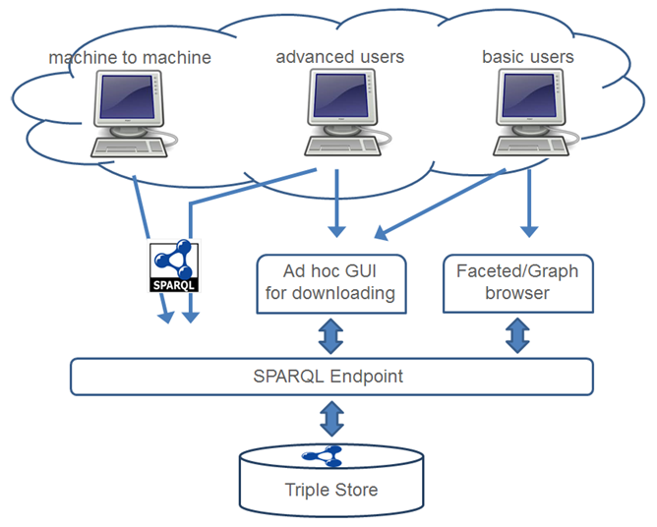
Phase 3: LOD Publishing
Three access points to cover the requirements of the different possible users:
SPARQL endpoint
Advanced users
Machine-to-machine communications
Linked Data Interface (Faceted/Graph browser)
Basic users
Ad-hoc GUI for datasets downloading
Basic users
Notes:
16
Most common

Slide 17
Technological Environment
GUI
Pubby
Ad-Hoc Design & Development
Graph Browser & HTML/LOD Interface
GUI for queries
Application
Joseki API
SPARQL Endpoint
Oracle
Reasoning Engine
Oracle (R2RML)
Mapping to RDF Engine
Data
Storage
Oracle
Triple Store
Technological Stack
Functional Stack

Slide 18
Performances
Million of triples
Notes:
18
Most common

Slide 19
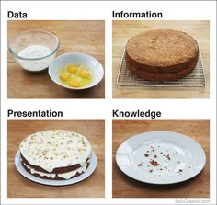
Concluding Remarks
Cens-LOD is the first production process that deploys Istat data on an Istat SPARQL Endpoint
2014: Publication of CensPop and Territory
2015: Addresses
LOD-based data dissemination will allow:
Machine-to-machine data provisioning by Istat (currently only SDMX datasets)
Widening the range of Istat data users
Improving efficiency of data exchange flows with Italian administrations
…and much more ☺: like having the knowledge «Eaten»
By Mark Johnstone
Notes:
19
Most common

