Slide 1
Representing Verifiable Statistical Computations as linked data
Jose Emilio Labra Gayo
WESO Research group
University of Oviedo
Spain
labra@uniovi.es
Hania Farham
The Web Foundation
London
hania@webfoundation.org
Juan Castro Fernández
WESO Research Group
University of Oviedo
Spain
juan@weso.es
Jose María Álvarez Rodríguez
Dept. Computer Science
Carlos III University
Spain
josemaria.alvarez@uc3m.es

Slide 2
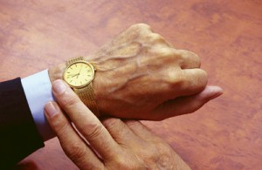
This talk in one slide
Describe the WebIndex Project
Represents an statistical index
Data Model based
Computation and validation process
Visualization

Slide 3
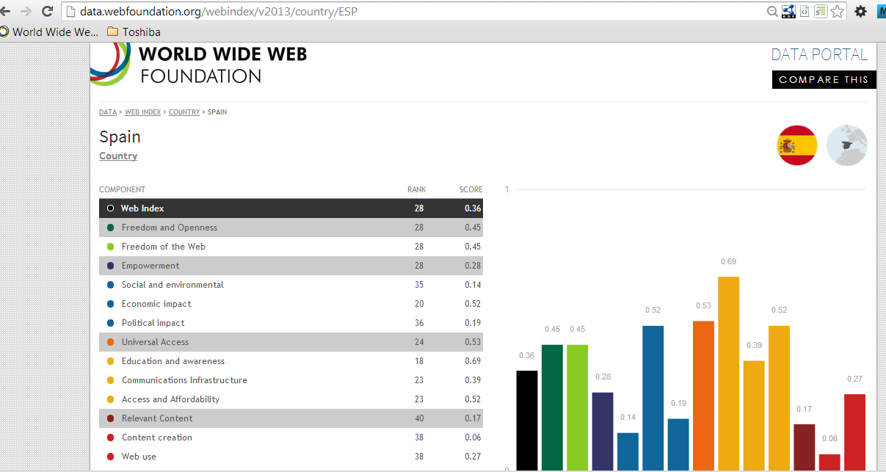
Web Index
Measure WWW's contribution to development and human rights by country
Developed by the Web Foundation
Web page:
http://thewebindex.org
Linked data portal:
http://data.webfoundation.org/webindex/2013

Slide 4
Technical details
Index made from
81 countries, 5 years (2007-12
116 indicators:
84 Primary (questionnaires)
32 Secondary (external sources)
Linked data portal
Modeled on top of RDF Data Cube
Linked data: DBPedia, Organizations, etc.

Slide 5
Different versions
2012. Visualizations & linked data portal
RDF representation based on RDF Data Cube
Internal validation
No representation of computations
2013. Include data about computations
Goal: External agents can verify data & computations
2014. Currently in development

Slide 6

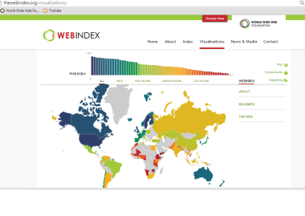
Webindex workflow
Conversion
Excel → RDF
Computation
Enrichment
Data
(Excel)
RDF
Datastore
Visualizations
Linked data portal

Slide 7
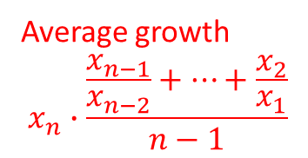
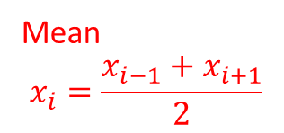
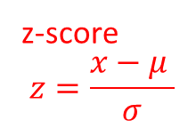
Computation process (1)
Simplified with one indicator, 3 years and 4 countries
Raw Data (Indicator A)
Impute Data
Country | 2009 | 2010 | 2011
Spain | 4 | 5 | 3
Finland | 4 |  | 6
Armenia | 1
Chile | 6 | 8
Country | 2009 | 2010 | 2011
Spain | 4 | 5 | 3
Finland | 4 | 5 | 6
Armenia | 1 | 1 | 1
Chile | 6 | 8 | 10.6
Mean
$$x_{i}=\frac{x_{i−1}+x_{i+1}}{2}$$
Country | 2009 | 2010 | 2011
Spain | 4 | 5 | 3
Finland | 4 |  | 6
Armenia | 1
Chile | 6 | 8
Country | 2009 | 2010 | 2011
Spain | 4 | 5 | 3
Finland | 4 | 5 | 6
Armenia | 1 | 1 | 1
Chile | 6 | 8 | 10.6
Country | 2009 | 2010 | 2011
Spain | 4 | 5 | 3
Finland | 4 |  | 6
Armenia | 1
Chile | 6 | 8
Country | 2009 | 2010 | 2011
Spain | 4 | 5 | 3
Finland | 4 | 5 | 6
Armenia | 1 | 1 | 1
Chile | 6 | 8 | 10.6
Average growth
$$x_{n}∙\frac{\frac{x_{n−1}}{x_{n−2}}+⋯+\frac{x_{2}}{x_{1}}}{n−1}$$
Filter Data
Normalize Data (z-scores)
Country | 2009 | 2010 | 2011
Spain | 4 | 5 | 3
Finland | 4 | 5 | 6
Armenia | 1 | 1 | 1
Chile | 6 | 8 | 10.6
Country | 2009 | 2010 | 2011
Spain | -0.57 | -0.57 | -0.92
Finland | -0.57 | -0.57 | -0.14
Chile | 1.15 | 1.15 | 1.06
z-score
$$z=\frac{x−μ }{σ}$$
Country | 2009 | 2010 | 2011
Spain | 4 | 5 | 3
Finland | 4 | 5 | 6
Armenia | 1 | 1 | 1
Chile | 6 | 8 | 10.6
Country | 2009 | 2010 | 2011
Spain | 4 | 5 | 3
Finland | 4 | 5 | 6
Armenia | 1 | 1 | 1
Chile | 6 | 8 | 10.6
Country | 2009 | 2010 | 2011
Spain | -0.57 | -0.57 | -0.92
Finland | -0.57 | -0.57 | -0.14
Chile | 1.15 | 1.15 | 1.06
Country | 2009 | 2010 | 2011
Spain | -0.57 | -0.57 | -0.92
Finland | -0.57 | -0.57 | -0.14
Chile | 1.15 | 1.15 | 1.06
More details can be found here: http://thewebindex.org/about/methodology/computation/

Slide 8

Computation Process (2)
Simplified with one indicator, 3 years and 4 countries
Normalize Data (z-scores)
Adjust data
Country | 2009 | 2010 | 2011
Spain | -0.57 | -0.57 | -0.92
Finland | -0.57 | -0.57 | -0.14
Chile | 1.15 | 1.15 | 1.06
Country | 2009 | 2010 | 2011
Spain | -0.57 | -0.57 | -0.92
Finland | -0.57 | -0.57 | -0.14
Chile | 1.15 | 1.15 | 1.06
Country | 2009 | 2010 | 2011
Spain | -0.57 | -0.57 | -0.92
Finland | -0.57 | -0.57 | -0.14
Chile | 1.15 | 1.15 | 1.06
Country | A | B | C | D | ...
Spain | 8 | 7 | 9.1 | 7.1 | ...
Finland | 7 | 8 | 7.1 | 8 | ...
Chile | 8 | 9 | 7.6 | 6 | ...
$$x_{i}=x_{i}+δ$$
Group indicators
Rankings
Country | Readiness | Impact | Web | Composite
Spain | 5.7 | 3.5 | 5.1 | 4.5
Finland | 5.5 | 3.9 | 7.1 | 4.9
Chile | 6.7 | 4.5 | 7.6 | 5.1
Country | Readiness | Impact | Web | Composite
Spain | 2 | 3 | 3 | 3
Finland | 3 | 2 | 2 | 2
Chile | 1 | 1 | 1 | 1
More details can be found here: http://thewebindex.org/about/methodology/computation/

Slide 9
WebIndex data model
Model based on RDF Data Cube
Main entity = Observation
Observations have values by years
Observations refer to indicators and countries
Observation
Indicator
% Broadband subscribers
Years
Countries
ITU_B | 2011 | 2012 | 2013 | ...
Germany | 20.34 | 35.46 | 37.12 | ...
Spain | 19.12 | 23.78 | 25.45 | ...
France | 20.12 | 21.34 | 28.34 | ...
... | ... | ... | ... | ...
ITU_B | 2011 | 2012 | 2013 | ...
Germany | 20.34 | 35.46 | 37.12 | ...
Spain | 19.12 | 23.78 | 25.45 | ...
France | 20.12 | 21.34 | 28.34 | ...
... | ... | ... | ... | ...
ITU_B | 2010 | 2011 | 2012 | ...
Germany | 20.34 | 35.46 | 37.12 | ...
Spain | 19.12 | 23.78 | 25.45 | ...
France | 20.12 | 21.34 | 28.34 | ...
... | ... | ... | ... | ...
DataSets are published by Organizations
Datasets contain several slices
Slices group observations
Indicators are provided by Organizations
Examples
ITU = International Telecommunication Union
UN = United Nations
WB = World bank
...
DataSet
Slice

Slide 10
Data model*
dc:publisher
DataSet
rdf:type = qb:DataSet
qb:structure : wf:DSD
rdfs:label : xsd:String
Slice
rdf:type = qb:Slice
qb:sliceStructure: wf:sliceByArea
Organization
rdf:type = org:Organization
rdfs:label: xsd:String
foaf:homepage: IRI
qb:slice
1..n
qb:observation
qb:observation
wf:provider
1..n
Country
rdf:type = wf:Country
wf:iso2 : xsd:string
wf:iso3 : xsd:string
rdfs:label : xsd:String
Observation
rdf:type = qb:Observation
cex:value: xsd:float
dc:issued: xsd:dateTime
rdfs:label: xsd:String
cex:ref-year: xsd:gYear
Indicator
rdf:type = cex:Primary
| cex:Secondary
rdfs:label: xsd:string
rdfs:comment: xsd:string
skos:notation: xsd:String
cex:ref-area
cex:indicator
cex:computation
Computation
rdf:type = cex:Computation
*Simplified

Slide 11
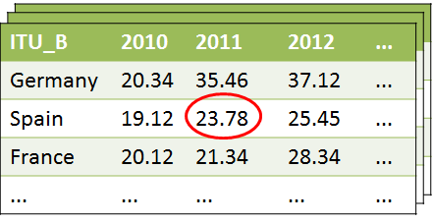
Excel → RDF (Turtle)
indicator:ITU_B
a wf:SecondaryIndicator ;
rdfs:label "Broadband subscribers %"
.
dataset:DITU a qb:DataSet ;
rdfs:label "ITU Dataset" ;
dc:publisher org:ITU ;
qb:slice slice:ITU10B ,
slice:ITU11B,
. ...
...
slice:ITU11B a qb:Slice ;
qb:sliceStructure wf:sliceByYear ;
qb:observation obs:obs8165,
obs:obs8166,
...
...
org:ITU a org:Organization ;
rdfs:label "ITU" ;
foaf:homepage <http://www.itu.int/>
.
country:Spain a wf:Country ;
wf:iso2 "ES" ; wf:iso3 "ESP" ;
rdfs:label "Spain"
.
interrelated
linked
data
obs:obs8165 a qb:Observation ;
rdfs:label "ITU B in ESP, 2011" ;
cex:indicator indicator:ITU_B ;
qb:dataSet dataset:DITU ;
cex:value "23.78"^^xsd:float ;
cex:ref-year 2011 ;
cex:ref-area country:Spain ;
dc:issued "2013-05-30"^^xsd:date ;
cex:computation cex:raw ;
...
.

Slide 12



Computation process
1. First computation
Statistics experts using Excel
2. Second computation (WESO team)
1st. approach: SPARQL Update queries
Can reuse the validation queries
Declarative approach
Problem: Efficiency & debugging
2nd. approach: Special purpose program
Performs computations and adds metadata
wiCompute
http://www.github.com/weso/wiCompute

Slide 13
Computation representation
Computex Vocabulary
Describes statistical computation procedures
Compatible with RDF Data Cube
Some terms:
cex:Concept | Entities that are beind indexed
cex:Indicator | Dimension whose values add information to the index
cex:Computation | Represents the different computation types It can be: cex:Raw, cex:Mean, cex:Increment, cex:Copy, cex:Z-Score, cex:Ranking, cex:AverageGrowth, cex:WeightedMean
cex:WeightSchema | Weight schema for a list of indicators

Slide 14


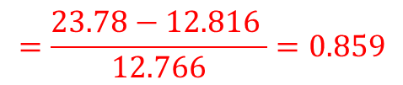
Example of a computed observation
obs:c39049 a qb:Observation ;
rdfs:label "ITU B in ESP, 2011, Normalized" ;
cex:indicator indicator:ITU_B ;
qb:dataSet dataset:computed366 ;
cex:value "0.859"^^xsd:double ;
cex:ref-year 2011 ;
cex:ref-area country:Spain ;
cex:computation wi-comp:comp39050 ;
...
.
Normalization using z-score
$$z=\frac{x−μ }{σ}$$
$$=\frac{23.78−\text{12.816} }{12.766}=0.859$$
wi-comp:39050 a cex:Normalize ;
cex:stdDesv "12.766"^^xsd:double ;
cex:mean "12.816"^^xsd:double ;
cex:slice wi-slice:sliceITUB_2011 ;
cex:observation obs:obs8165 ;
.
ok!
wi-slice:sliceITU_B_2011 a qb:Slice ;
qb:observation obs:8471,
obs:8434, ...;
.
obs:obs8165 a qb:Observation ;
cex:value "23.78"^^xsd:double ;
...
.
URI of computed observation:
http://data.webfoundation.org/webindex/v2013/observation/computed_2011_1386752461095_39049

Slide 15
Verifying linked data contents
Once the linked data has been published
How can an external agent verify it?
2 approaches:
SPARQL Queries
Shape expressions

Slide 16
SPARQL validation
CONSTRUCT queries like:
CONSTRUCT {
[ a cex:Error ; cex:errorParam # ... omitted
cex:msg "Observation has two different values" . ]
} WHERE {
?obs a qb:Observation .
?obs cex:value ?value1 .
?obs cex:value ?value2 .
FILTER ( ?value1 != ?value2 )
}
Detects if one observation has more than 1 value

Slide 17
SPARQL validation
More advanced queries like:
CONSTRUCT {
[ a cex:Error ; cex:errorParam # ...omitted
cex:msg "Mean value does not match" ] .
} WHERE {
?obs a qb:Observation ;
cex:computation ?comp ;
cex:value ?val .
?comp a cex:Mean .
{ SELECT (AVG(?value) as ?mean) ?comp WHERE {
?comp cex:observation ?obs1 .
?obs1 cex:value ?value ;
} GROUP BY ?comp
}
FILTER (abs(?mean - ?val) > 0.0001)
}
Detects if an observation whose computation is declared as the mean is really the mean

Slide 18
Shape Expressions validation
Shape expressions declare the shape of RDF data
Human readable and machine processable
Shape Expressions for team communication
Developers know which triples must generate/consume
<Observation> {
rdf:type (qb:Observation)
, cex:value xsd:float ?
, dc:issued xsd:dateTime
, rdfs:label xsd:string ?
, qb:dataSet @<DataSet>
, cex:ref-area @<Country>
, cex:indicator @<Indicator>
, cex:ref-year xsd:gYear
, cex:computation @<Computation>
}
Documentation http://weso.github.io/wiDoc

Slide 19

Visualization
Visualization tool: Wesby, Inspired by Pubby
Enables easy customization by templates
Different templates are chosen based on rdf:type
Data load on demand
SPARQL queries
Responsive design and mobile friendly

Slide 20
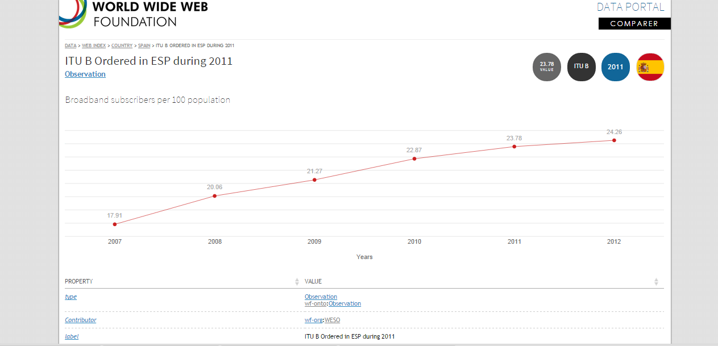
Visualization
Example: Template for Observations
http://data.webfoundation.org/webindex/v2013/observation/obs8003

Slide 21
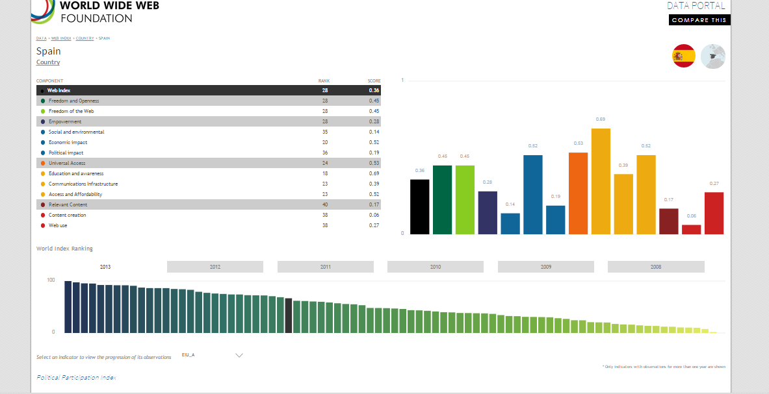
Visualization
Example: Template for Countries
http://data.webfoundation.org/webindex/v2013/country/ESP

Slide 22
Conclusions
WebIndex:
Linked data portal (medium size ≈ 3,5 mill triples)
It adds data about computation
Computations represented as linked data
We explored some possibilities for validation
SPARQL validation: very expressive, declarative
Shape Expressions: more readable
Visualization by templates

Slide 23
Future work
Computex vocabulary was a first attempt
Further work to employ it in similar projects
Visualization of computations
Define wesby templates to visualize computations
Question: Was it worth the effort?
Producer/consumers balance
We produced data that can be externally verified
However, we still don't have consumers who need it

Slide 24
End of presentation
More info:
WESO Research group
http://www.weso.es

