Slide 1

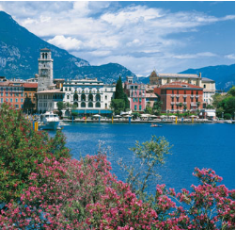

Smart Statistics:
Data Analytics Services
Based on Open Data Platforms
Emanuele Baldacci
Italian National Institute of Statistics (Istat)
Head of Department for Integration, Quality, Research and Production Networks Development (DIQR)
Riva del Garda, Italy, October 19th 2014
Notes:
11

Slide 2
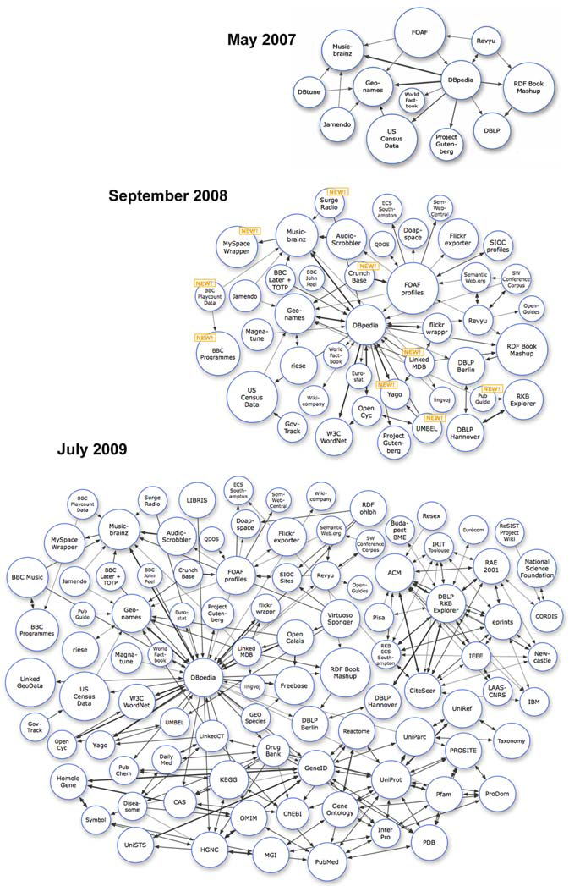
Outline
Times are changing
European and international initiatives
Modernisation strategy
Putting users in the driver’s seat
Linked Open Data (LOD) in official statistics
Future Challenges
Emanuele Baldacci – Riva del Garda, Italy, October 19th 2014

Slide 3

“Times they are-a-changing”:
drivers, threats and opportunities
Budget constraints
IT trends and growth of prosumers
Scaled up demand for decision-oriented information
Competitive pressures: data commoditisation
Increasing quality concerns (e.g. fiscal data, timeliness)
Emanuele Baldacci – Riva del Garda, Italy, October 19th 2014

Slide 4
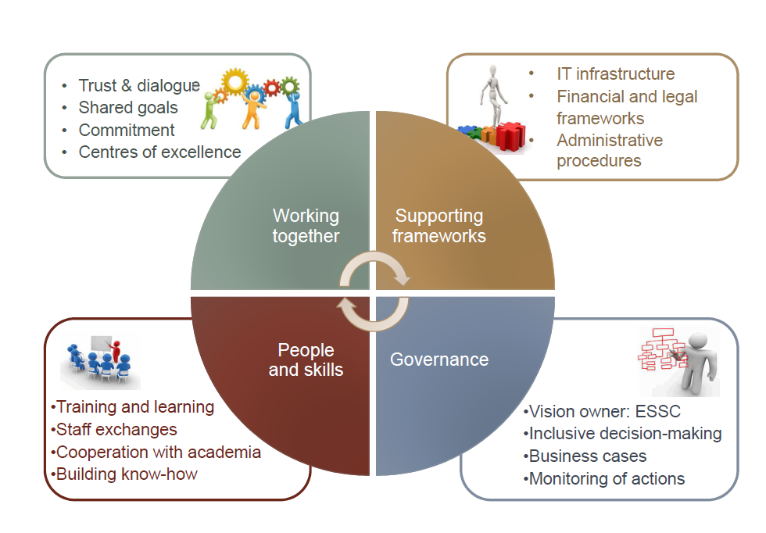
ESS Vision 2020: main challenges and key areas of intervention
Main Challenges
Data revolution
New metrics
Price of statistics
Future of Europe
Key areas
Identifying user needs and cooperation with stakeholders
Enhancing quality of European statistics
Harnessing new data sources, including Big Data for integrated data collection and processing
Developing efficient and robust statistical processes based on process industrialisation
Developing ESS common dissemination and communication systems
Emanuele Baldacci – Riva del Garda, Italy, October 19th 2014

Slide 5

Web-COSI
It is a two-year project (1/2014 -12/2015)
funded by the EC-DG CONNECT, FP7
Work Programme 2013, based on a Consortium led by Istat with the partnership of OECD and two NGOs: Lunaria and i-genius
It uses Web 2.0 technologies to foster the engagement of citizens and society at large in the area of new measures of societal progress and well-being
It implements Web 2.0 applications for collecting, producing and visualising locally generated information and data, empowering the usage of crowd sourced data
It contributes to a better integration and complementarity of official and non-official statistics, increasing trust in collectively generated statistics
Emanuele Baldacci – Riva del Garda, Italy, October 19th 2014

Slide 6
Modernisation Strategy
Ensuring cost-efficiency
Responding to increasing and changing user needs
Reusing services and infrastructure
Supporting paperless government
Enhancing data accessibility and re-usability
Investing on innovation culture
Using innovative and effective communication tools
Common innovation goals:
Emanuele Baldacci – Riva del Garda, Italy, October 19th 2014

Slide 7
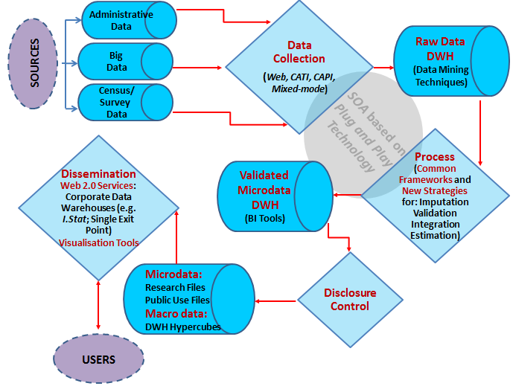
Stat2015 stylised framework
NSI commitments towards common Business Architecture (BA) to industrialise and standardise the statistical production process
Service-Oriented Architecture (SOA) based on plug-and-play technology to ensure also interoperability between different systems
Shared standard IT tools and methods
Support data sharing and Open data
Explore digital and big data
Emanuele Baldacci – Riva del Garda, Italy, October 19th 2014

Slide 8
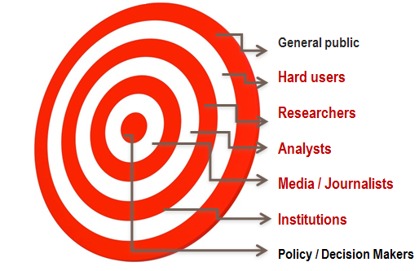
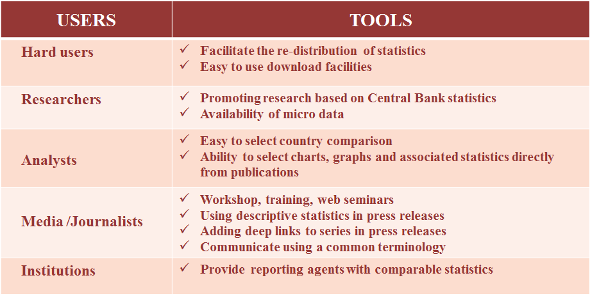
Putting users in the driver’s seat
From “naked” data to tailored services and tools
From plain dissemination to Web 2.0 statistics (e.g. collaborative platforms, visualisation tools)
From data description to analytics based on Linked Open Data
Towards Open Data real time machine (impacts assessment and simulation)
Emanuele Baldacci – Riva del Garda, Italy, October 19th 2014

Slide 9
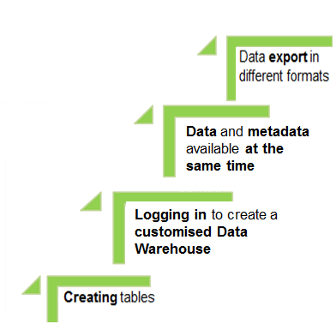
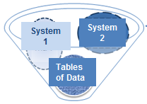

I.Stat – The macrodata dissemination system
Implementation of a Single Dissemination System where:
all Istat data are uploaded;
there is constant interaction with users;
a continuous process of improvement exists
Data are available by thematic area
and not by
statistical production process
Availability of a set of functions to improve data surfing
Emanuele Baldacci – Riva del Garda, Italy, October 19th 2014

Slide 10
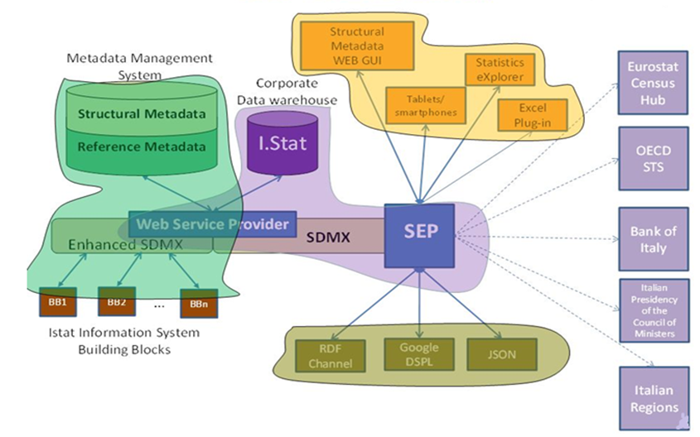
Single Exit Point – machine to machine
www.istat.it
SUM
Emanuele Baldacci – Riva del Garda, Italy, October 19th 2014
Notes:
10

Slide 11

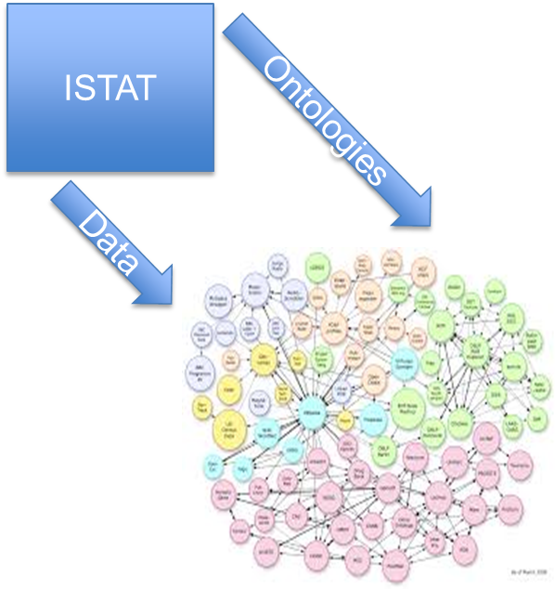
Linked Open Data (LOD) in official statistics:
a turning point
LOD-centred business strategies: adding value through integration
Definition of common ontologies to drive internal data and metadata integration
Ontologies
Statistical ontologies (together with data) as a critical link for LOD Cloud (e.g. classifications)
Emanuele Baldacci – Riva del Garda, Italy, October 19th 2014

Slide 12
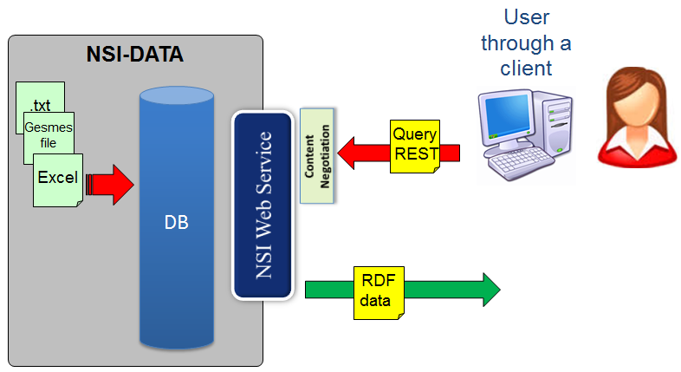
SDMX-based Dissemination
Project - Istat and Eurostat
(Grant SDMX)
Emanuele Baldacci – Riva del Garda, Italy, October 19th 2014

Slide 13
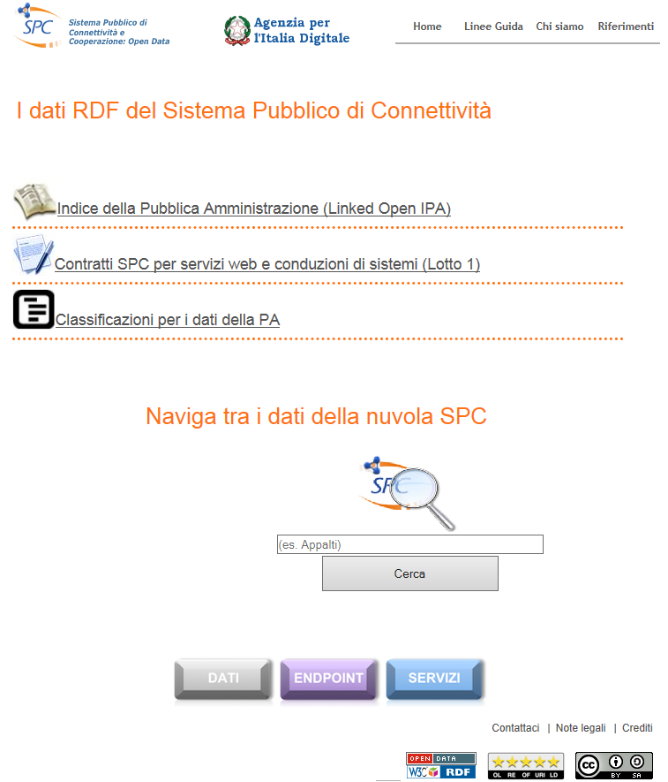
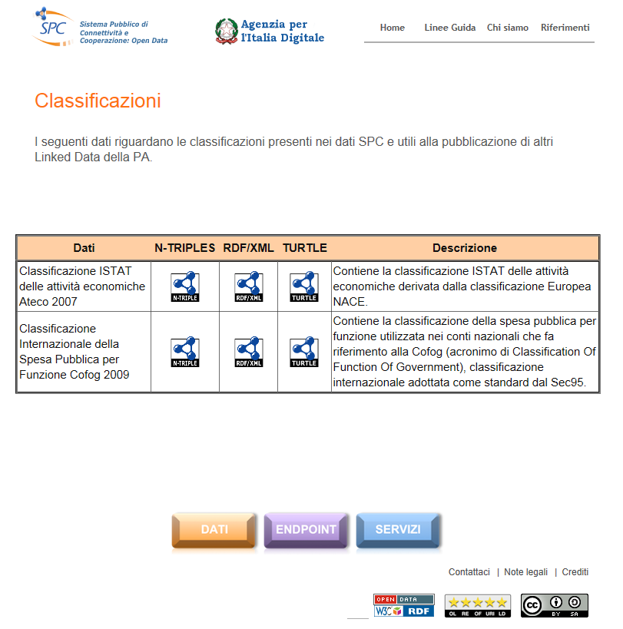
Project - Istat and Agid
Shared design solutions to produce LOD
Guidelines to illustrate LOD governance
Some Istat Classifications available in LOD on Agid website
Emanuele Baldacci – Riva del Garda, Italy, October 19th 2014

Slide 14
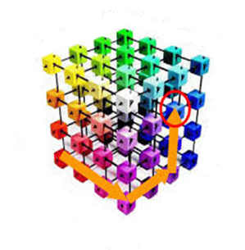
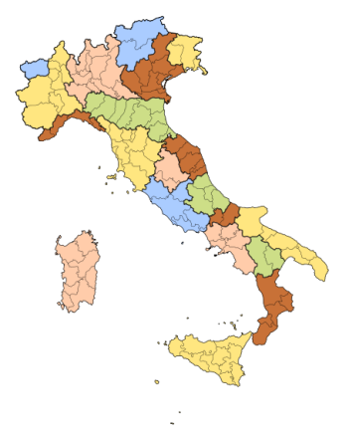
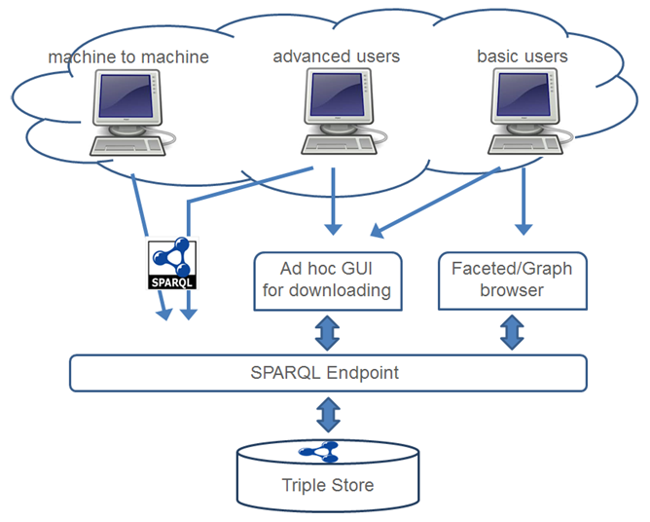
Istat LOD portal (I)
Three access points to cover the requirements of the different possible users:
SPARQL endpoint
Advanced users
Machine-to-machine communications
Linked Data Interface (Faceted/Graph browser)
Basic users
Ad hoc GUI for datasets downloading
Basic users
Territorial Data
Italian Population and Housing Census
Emanuele Baldacci – Riva del Garda, Italy, October 19th 2014

Slide 15






Istat LOD portal (II)
NSI-DATA
Non-expert user
RDF
data
Expert user
Machine To Machine
Emanuele Baldacci – Riva del Garda, Italy, October 19th 2014

Slide 16
Linked Open Data (LOD) in official statistics:
How?
Organisation - Partnerships with private sector: beyond monopoly vs. competition
Communication - Demand management and tailoring based on needs: new market assessment tools
Statistics - Linking official statistics with other data
IT - Rich data service portals
Communication Issues
IT Issues
Statistical Issues
Organisational Issues
Emanuele Baldacci – Riva del Garda, Italy, October 19th 2014

Slide 17

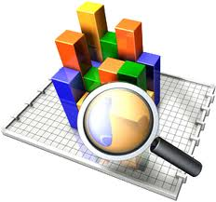
Research Agenda for NSIs (I)
Making statistical standards LOD-AWARE: e.g. Generic Statistical Information Model (GSIM)
Modelled and Implemented by
SDMX
DDI
+
RDF
Methods for LOD analytics:
Interactiveness
Discovery
Personalisation
Emanuele Baldacci – Riva del Garda, Italy, October 19th 2014

Slide 18
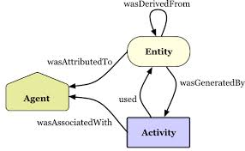

Research Agenda for NSIs (II)
New quality frameworks:
Provenance, both as publishers and as users of LOD
IT infrastructure and tools
New skills: LOD scientists, LOD designers, LOD builders
Emanuele Baldacci – Riva del Garda, Italy, October 19th 2014

Slide 19
Future Challenges for NSIs
Legislation, i.e. with respect to the access and use of data
Privacy, i.e. managing public trust and acceptance of data re-use and its link to other sources
Continuing to ensure data quality/integrity and suitability of statistical methods within this innovative framework
Finding new skills
Increasing statistical culture among users
Fostering international collaboration
Engaging stakeholders in decisions
Building partnerships with private sector
Emanuele Baldacci – Riva del Garda, Italy, October 19th 2014

Slide 20
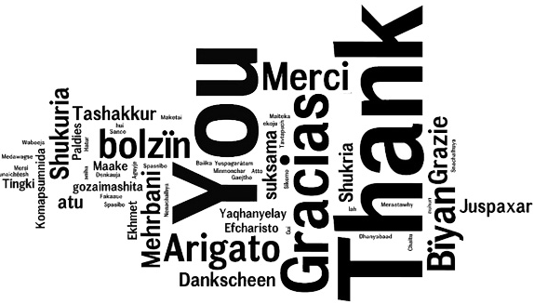

Thank you for your attention
Contacts:
baldacci@istat.it
www.istat.it
Emanuele Baldacci – Riva del Garda, Italy, October 19th 2014
Notes:
20
20

