Slide 1
Australian Bureau of Statistics
Implementation of Semantic Web Technology
Presenter: Michael Mecham,
Australian Bureau of Statistics (ABS)

Slide 2
Concepts, Sources & Methods (CSM) Ontology Project
An ABS R&D project conducted in 2010/11
Collaboration between
Macroeconomics and Integration Group (MIG)
statisticians / business customers
Technology Services Division
Developers
Michael Mecham
Arupa Sarkar
Business Sponsor
Peter Meadows

Slide 3
Overview
Business need
Our solution
Proposed future directions

Slide 4
Why document Concepts, Sources & Methods (CSM)?
Principle 2. To retain trust in official statistics, the statistical agencies need to decide according to strictly professional considerations, including scientific principles and professional ethics, on the methods and procedures for the collection, processing, storage and presentation of statistical data.
Principle 3. To facilitate a correct interpretation of the data, the statistical agencies are to present information according to scientific standards on the sources, methods and procedures of the statistics.
Source: Fundamental Principles of Official Statistics, United Nations
Notes:
These two principles are from the set of 10 Fundamental Principles of Official Statistics published by the UN.
In summary, producers of official statistics need to have well defined sources from which the inputs to the statistics we produce are drawn. We also need to have well defined and sound methods for transforming those inputs to conceptually sound, consistent and useable statistics that we disseminate.
Not only do our sources and methods needs to be sound, they must be transparent to those who rely on the statistics we produce. This is why CSMs must not only provide the basis for the work of statisticians within the ABS when producing the statistics but the CSMs themselves must also be published.

Slide 5
What we were modelling
Very high level definitions:
Concepts underpinning statistics
Sources of data for surveys
Methods = how to

Slide 6
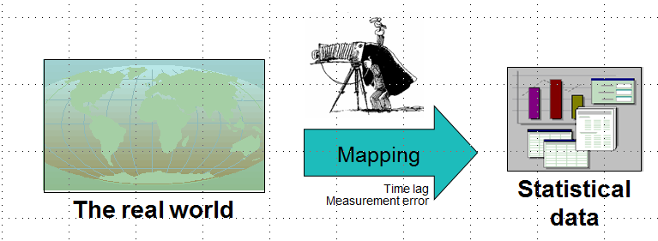
“Concepts” and CSM
A statistical framework can be considered a conceptual model of a domain within the real world (eg “the economy”) for which statistical data can be collected and compiled on a well defined and consistent basis.
The System of National Accounts (SNA) is an internationally agreed statistical framework.
Not all concepts associated with Australian National Accounts data compiled by the ABS will align precisely with the theoretical ideal set out by SNA. The description of Concepts within CSM allows sets of concepts to be understood in relation to each other.
Notes:
It is very clear from the UN principles that sources and methods need to be described – but what do we mean when referring to “Concepts” as the “C” within CSM?
Methods and Sources in the ontology are also “concepts”, but the “C” in CSM refers to documenting Statistical Concepts found within Statistical [Concept] Frameworks that define a statistical model of a “real world” domain.
Conceptual frameworks underpin the official statistics that are produced.
Users of the statistics need to know how the statistics that are actually disseminated relate to relevant conceptual frameworks
to support their analysis and application of the statistics, and
to allow them – on an informed basis - to compare, and integrate, the current statistics with statistics from other sources (including national accounts statistics published previously by the ABS)

Slide 7
Business needs
Key needs:
Accessibility
Usability
Maintainability
Extendibility

Slide 8
What we did
Creation of prototype to model Concepts, Sources and Methods of macroeconomic statistics:
First candidate survey: Australian System of National Accounts
Made available using a semantic file format (RDF)
Use of a familiar open source wiki-style web interface
We created separate instances of the CSM ontology:
Pragmatic reasons;
Environment 1 - Authoring (dynamic)
Environment 2 - Viewing (static)

Slide 9
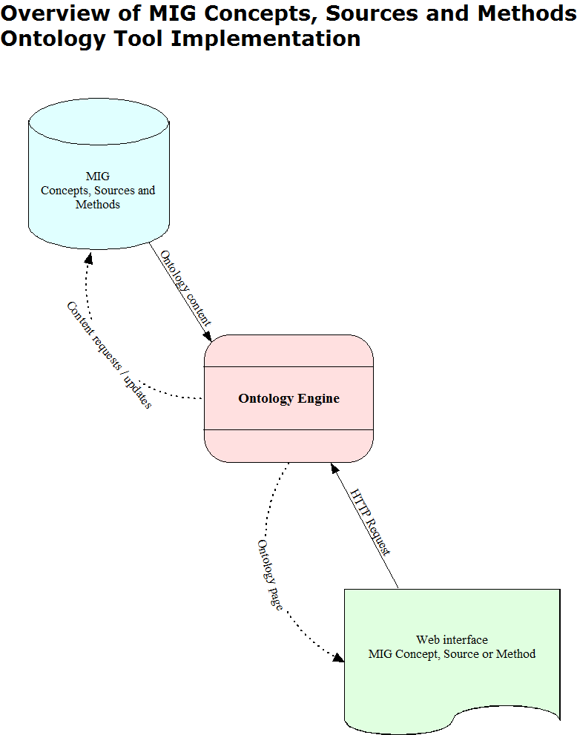
High level implementation design

Slide 10
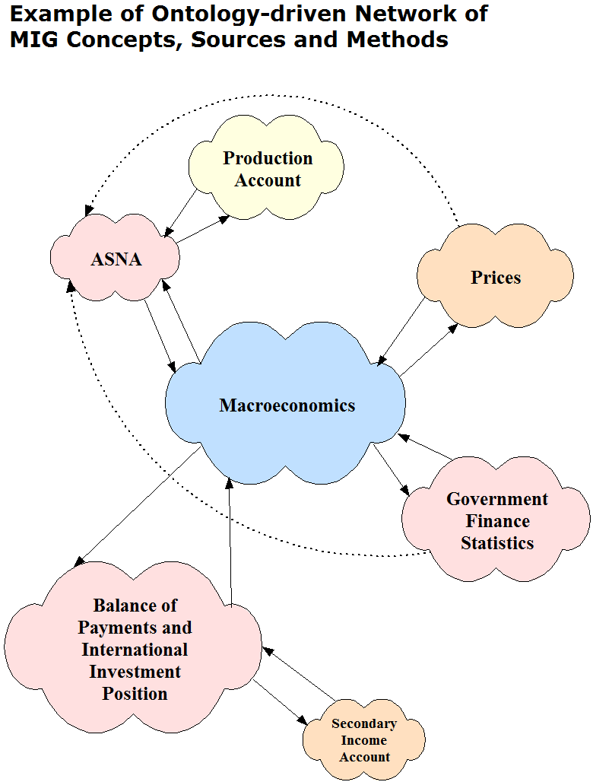
High level Macro Economic ontology

Slide 11
Our Semantic Solution
Needed a structure to network the perceivable ideals underpinning a survey:
It is conceptual - “Concepts”
It’s inputs may be varied - “Sources”
It has a methodology – “Methods”

Slide 12
Our Semantic Solution
Perceivable was key, therefore CSM could be modelled:
Developed model using the open source Ontology editor, Protégé → OWL/RDF
Our CSM Ontology modelling akin to Object Oriented modelling
Our goal was to produce a fully traversable network of CSM nodes for a web-based Wiki interface

Slide 13
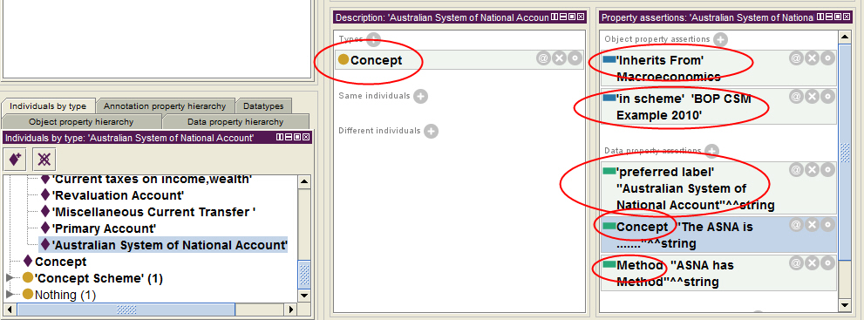
Our Semantic Solution
Brief technical view :
High level design showing CSM linkages to support the goal of a traversable network of nodes

Slide 14
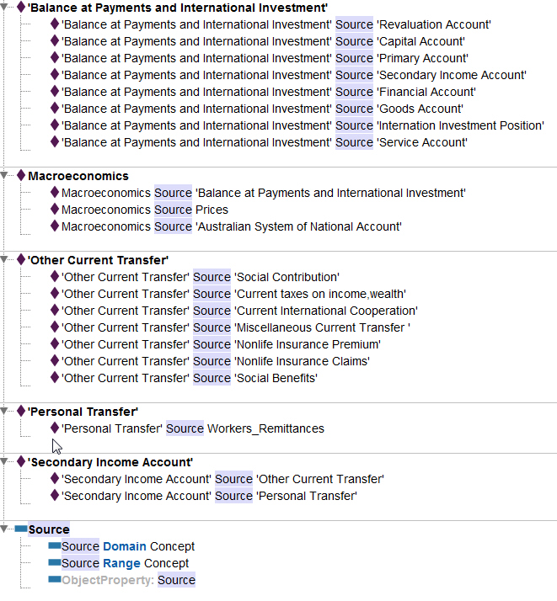
Our Semantic Solution
Brief technical view :
Source hierarchy

Slide 15
Our Semantic Solution
Wiki interface:
Semantic MediaWiki plugin consuming RDF
Benefit: high degree of end-user familiarity
Deployment issues
ABS intranet
Subset available on ABS website

Slide 16
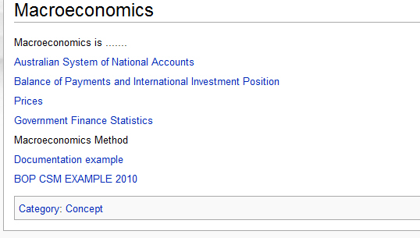
Our Semantic Solution
Wiki interface example views:
Let’s traverse some of the ASNA structure

Slide 17
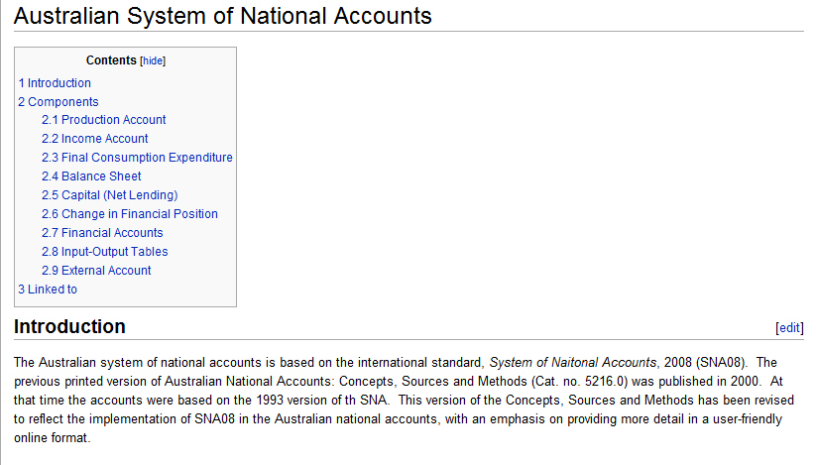
Our Semantic Solution
Wiki interface example views:
Looks familiar? Great!

Slide 18
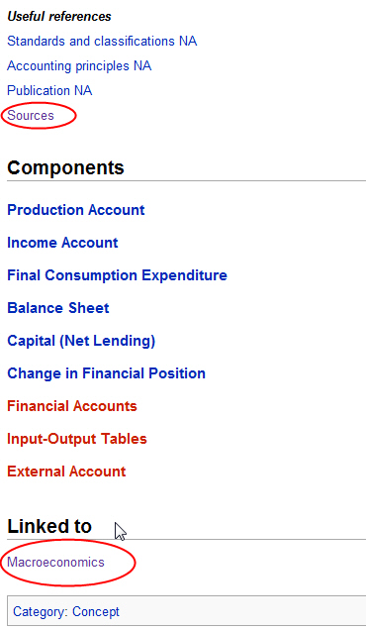
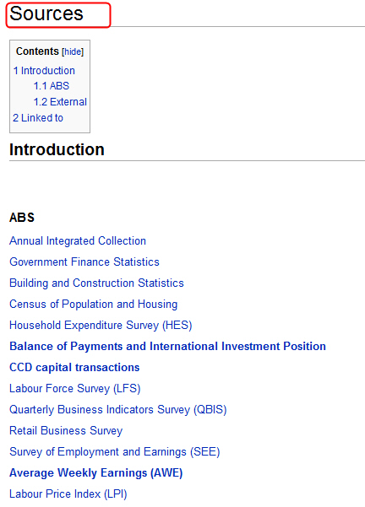
Our Semantic Solution
Wiki interface example views:
Scroll to the bottom, there’s something special…

Slide 19
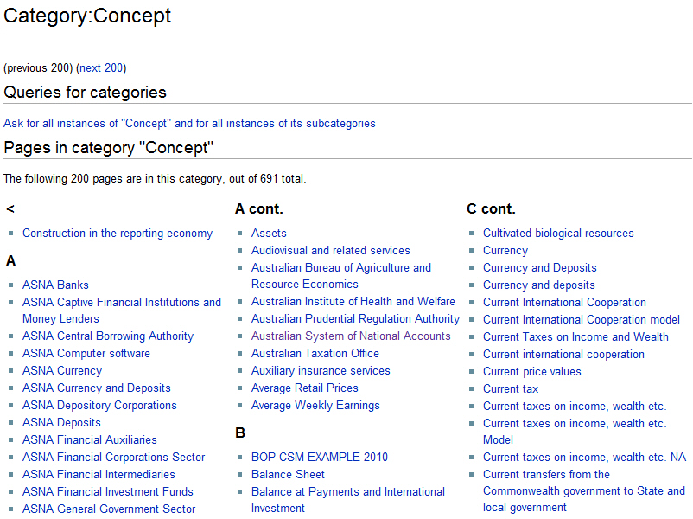
Our Semantic Solution
Wiki interface example views:
Here is where the real power of a CSM Ontology is realised

Slide 20
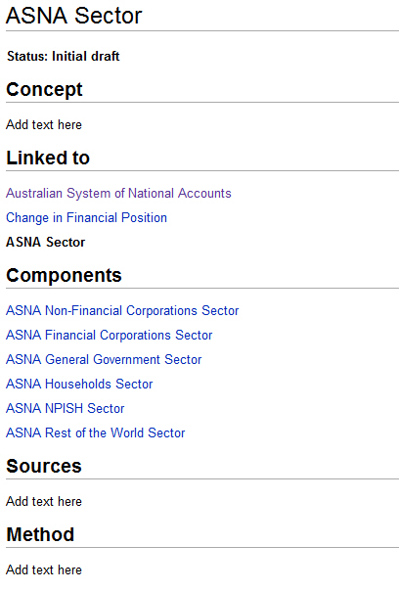
Our Semantic Solution
Wiki interface example views:
Aggregation and linking of ASNA CSM, exciting!

Slide 21
Ideas for future direction
Integration of functionality to highlight contribution of individual components of higher level Major Economic Indicators
Hierarchical graph (e.g. tree structure)
Integration of functionality enabling contribution to ABS CSM from the public
Supporting ABS research: automation of updating of relevant CSM content (e.g. newsfeeds, external agency datasets….)

Slide 22
Proposal for future capability
Authoring space for external website.
Should be seamless environment for ABS staff.
Secure Online Discussion Communities
ABS Website
Concepts, Sources & Methods
ABS Intranet
Concepts, Sources & Methods
Document
Editing,
Provider
Contact
Economic
Intelligence
Research
News Feeds

Slide 23
Fostering International Comparability
Statistical Frameworks such as SNA are designed to be consistent and shared and applied internationally
National Accounts data is intended to be comparable around the world
Shouldn’t CSMs be expressed in a readily comparable form?
International collaboration, harnessing ontologies and other semantic web technologies, could help make this a reality?

Slide 24
Conclusion
Significant organisational lessons in terms of potentially improved transparency of survey methodologies
Shared lessons from this foray represent significant potential future value to statistical agencies
As one of ABS’ first attempts in the ontology realm, a positive and successful outcome

