Slide 1
Design and generation of Linked Clinical Data Cube
Laurent Lefort and Hugo Leroux
1st Workshop on Semantic Statistics, 22 October 2013
CSIRO Computational Informatics

Slide 2


Australian Imaging Biomarkers and Lifestyle data Problem – Solution – Remaining challenges
Data collected for the AIBL study
(aibl.csiro.au)
For the early detection of Alzheimer’s Disease
Protocol aligned with Alzheimer’s Disease Neuroimaging Initiative (ADNI)
Plus nutrition, lifestyle
Microdata collected via electronic data capture tool (OpenClinica)
To be consumed by researchers
1) discovery + data quality assessment (fix)
2) production of publishable results
Original format (export format): CDISC ODM
Clinical Data Interchange Standards Consortium
Operational Data Model
Notes:
This talk has three parts:
- The problem we are trying to solve and why Sem Stats vocabularies are relevant
- What we have done and learned so far
What’s next
aibl.csiro.au
-

Slide 3
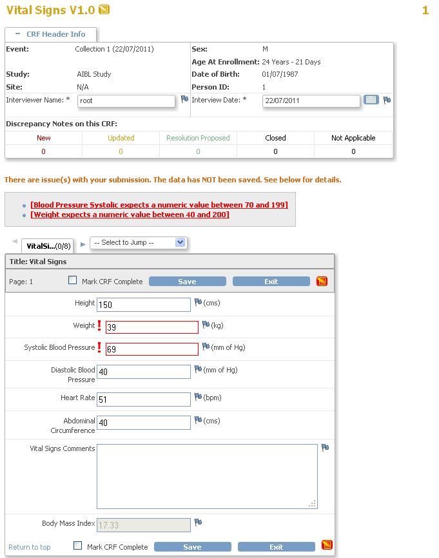
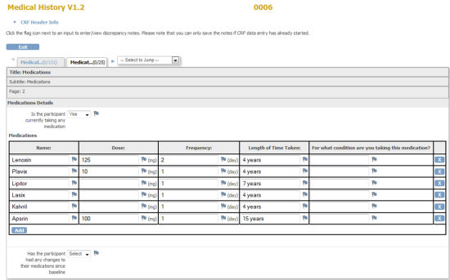
AIBL Protocol and e-data capture
36 Months
54 Months
72 Months
Baseline
…
Screening
18 Months
Vital Signs
Blood
Neuropsychological t.
Demographics
Medications
PiB PET scan and MRI for ¼
Diagnostic Summary
Diet and lifestyle Q.
Notes:
AIBL
BP, HR, weight, height, abdominal girth
80 ml blood
2 hours neuropsychological testing
HADS and GDS
Medication list
Diet and lifestyle questionnaires
PiB PET scan and MRI for ¼
Diagnostic panel evaluation
DA file review
Repeat every 18 months

Slide 4
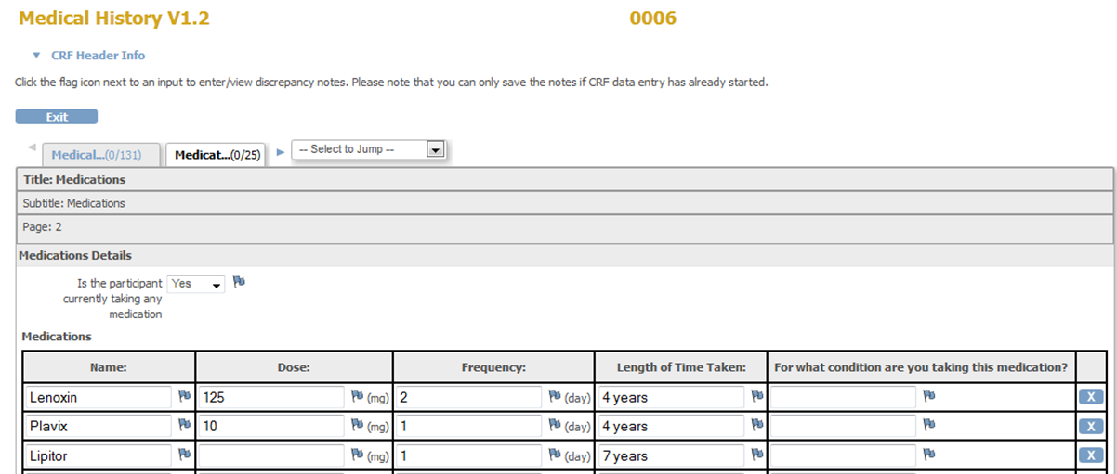
Examples of forms (OpenClinica)

Slide 5

CDISC ODM XML Schema
ODM
METADATA
*Study
* MetadataVersion
* Study Event Def
Form
*Form Def
DATA
* ItemGroup Def
* Item Def
Data types
*Clinical Data
*Subject Data
* Study Event Data
Same OID
*Form Data
* ItemGroup Data
* Item Data
Data values

Slide 6
Current use of AIBL data Problem – Solution – Remaining challenges
Conversion in tabular format (Excel or CSV)
Browser-based exploration tool
Additional processing via Excel or R or …
(different toolset for AIBL and ADNI)

Slide 7
Primary motivation: add new dimensions
{ts} observation
Main
Time (scale = second)
{cs}
Subject
Date (scale = day)
{dataset}
Study Event
(scale = phase)
before,after,at
Month (scale = month)
Node
Product
AMT Trade
Product id
main
cm
Medication
AMT Med.
Product id
scheduled before,after,at
Theme
SNOMED
Substance id
{ds}
Sub-theme
vs
Variable
WHO CC ATC DDD
{v}
{atc}
(5) Subst
(4) Chem
(1) ATC top group
(anatomical)
(3) Pharma
(2) Therap

Slide 8
Is this a Semantic Stats problem? Problem – Solution – Remaining challenges
Yes!
Transition from monolithic tree structure to multi-dimensional data cube → RDF Data Cube Vocabulary (and associated SDMX best practices for slicing it)
Complex study structure plus user-defined data types → DDI-RDF Discovery (and associated DDI Best practices)

Slide 9
RDF Data cube http://purl.org/linked-data/cube
RDF Data Cube (qb): a method to organise linked data in slices
A vocabulary published by the W3C Government Linked Data (GLD) Working Group (Working Draft)
Also the method used to publish statistics data and environmental data in Europe e.g. for Bathing Water Quality in UK http://www.epimorphics.com/web/projects/bathing-water-quality
Advantages
Allows multiple views on the same data (similar to OLAP)
Generic approach which supports the links to domain-specific definitions
Useable:
In any browser via Linked Data API (HTML output)
In JavaScript via Linked Data API (JSON output)
In R via SPARQL
Notes:
Working Draft http://www.w3.org/TR/vocab-data-cube/

Slide 10
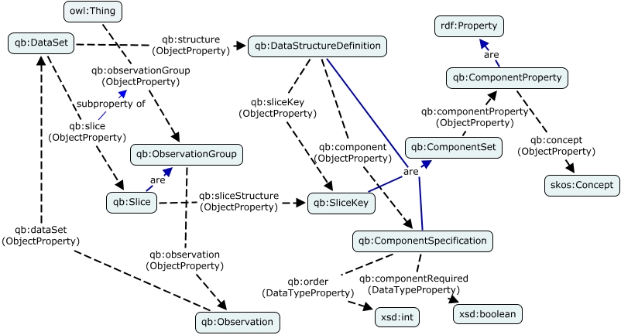
QB (Candidate Rec. version)

Slide 11
DDI-RDF Discovery
DDI-RDF Discovery Vocabulary (disco): a metadata vocabulary for documenting research and survey data
Derived from the Data Documentation Initiative standards
DDI and W3C people
two Dagstuhl Seminars
Designed as a complement to existing vocabularies developed by W3C community (Dublin Core, SKOS, XKOS, DCAT (data catalogue), RDF Data Cube
Work in progress
At least half of it not discussed in this talk - Dataset statistics
Useful if we want to attach statistical data to slices …

Slide 12
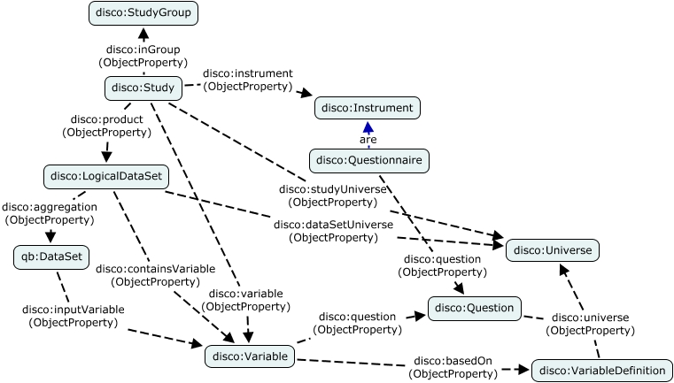
Disco (study description)

Slide 13
QB, Disco and ODM
ODM
disco:LogicalDataset
Clinical Data
qb:Dataset
Study
Subject Data
Metadata
qb:Slice
Study Event Def
Study Event Data
qb:Slice
Form Data
disco:Universe
Form Def
ItemGroup
Data
ItemGroup Def
qb:Observation
Item
Data
Item
Def
disco:Variable
Disco:VariableDefinition

Slide 14
Is this a Semantic Stats problem? Problem – Solution – Remaining challenges
But …
We have more than one data cube …
25 after elimination of privacy-sensitive data: patient details, doctor details, …

Slide 15
Study
Clinical
Screening (Telephone)
Main cube
Blood
CSF
MCI Patient
Vital Signs
AD Patient
Medical History
Personal Info
Assessment Progress
Family History
Medication
Lifestyle
1655
variables
Demographics
Cognitive
Actigraph
Neuropsychiatric Inventory Examination
Physical Activity
Neuropsychological Battery
Food frequencies
Imaging
Food intakes
PET-PIB
Memory Complaint Questionnaire
Food nutrients
MRI
Alcoholic nutrients
Short IQ Code
Dexa

Slide 16
Is this a Semantic Stats problem? Problem – Solution – Remaining challenges
Solution: Nested Data Cubes
Based on big table defining which variables go in which cubes

Slide 17
Core AIBL
Cube
Product -> Study Phase ->
Universe ->
(Date) -> (Time)
Solution: Nested data cubes
1,2
Specialised
Medication Cube
Time Series
Id-> Phase -> Variable -> (Date. Time)
5
7b
7b
6
Slice
Participant <- Node
ATC DDD levels
5 <- 4 <- 3 <- 2 <- 1
Cross-section
A
3,4
Core obs.(links to special. obs)
9
Specialised Vital Signs
Cube
7a
Id-> Phase
-> (Date. Time)
8b
C
Medication obs.
B
Vital Sign obs.
8a

Slide 18
Is this a Semantic Stats problem? Problem – Solution – Remaining challenges
Solution: Nested Data Cubes based on RDF Data Cube vocabulary
Maximum compatibility required to be able to reuse tooling developed according to W3C specification
Plus URI scheme

Slide 19
Nested Data Cubes with QB
qb:dataSet
Main
qb:slice
SERIES
Phase
qb:observation
Dated
Observation
SECTIONS
Observation
Subject
:mainObservation
SLICES
Sub-theme
ObservationGroup
qb:observationGroup
ObservationGroup
:specialisedObservation
qb:dataSet
Specialised
qb:slice
SERIES
Sub-theme
qb:observation
SECTIONS
Observation
Observation
Sub-Theme

Slide 20
Main cube | URI scheme
Product series (pr) | ROOT/{dataset}/ts/pr/{pr}
Phase series (ph) | ROOT/{dataset}/ts/pr/{pr}/ph/{ph}
Dated series (dt) | ROOT/{dataset}/ts/pr/{pr}/ph/{ph}/dt/{dt}
Product section (pr) | ROOT/{dataset}/cs/pr/{pr}
Node section (nd) | ROOT/{dataset}/cs/pr/{pr}/nd/{nd}
Gender section (gd) | ROOT/{dataset}/cs/pr/{pr}/gd/{gd}
Subject section (su) | ROOT/{dataset}/cs/pr/{pr}/nd/{nd}/su/{su}
Product slices (pr) | ROOT/{dataset}/ds/pr/{pr}
Theme slices (th) | ROOT/{dataset}/ds/pr/{pr}/th/{th}
Sub-theme slices (st) | ROOT/{dataset}/ds/pr/{pr}/th/{th}/st/{st}
Observation groups | ROOT/{dataset}/pr/{pr}/ph/{ph}/su/{su}

Slide 21
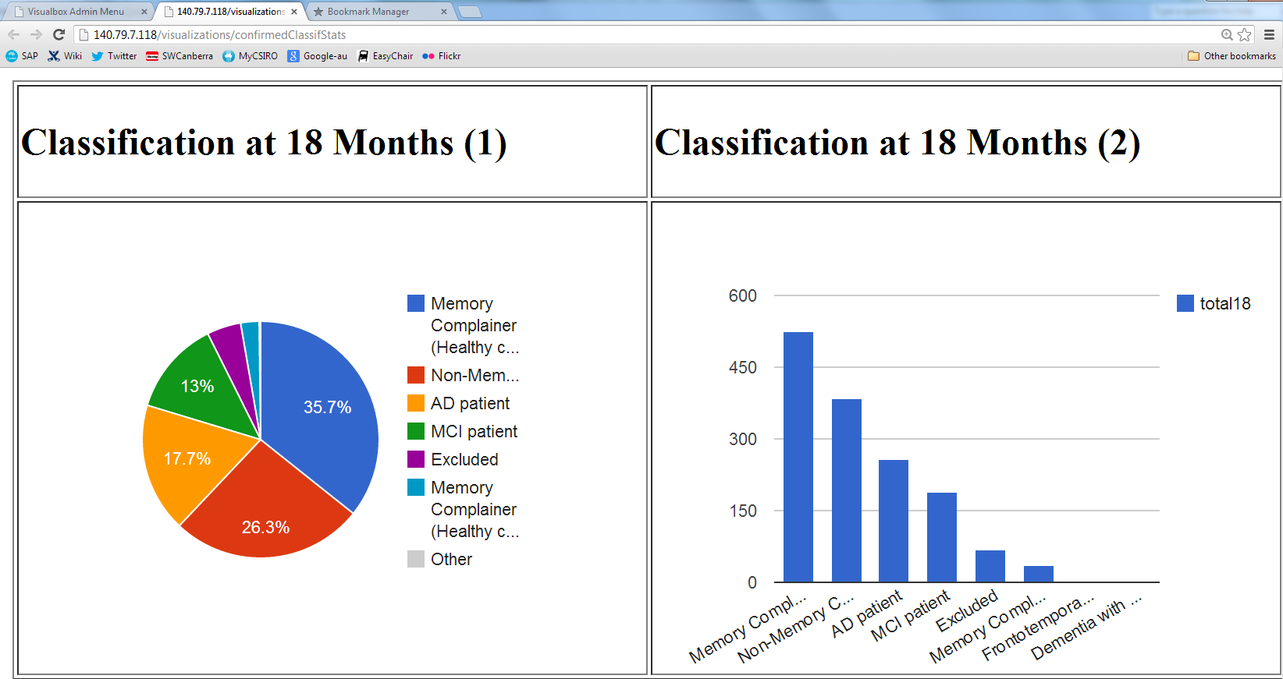
Access via SPARQL (+ Visual Box)

Slide 22
Holes Problem – Solution – Remaining challenges
Survey-originated data more likely to have missing data
Rule-based forms: if X … then display box to enter the value of Y
Cases where the patient is no longer available for the study (deceased patient or “lost”patient)
Question (specs writer): how can you handle datasets with holes?
QB example: issue with some IC constraints (see paper)
Question (tools developers): can you handle datasets with holes (and help the user to avoid them and understand them)?

Slide 23
Sensitive data Problem – Solution – Remaining challenges
Need to answer privacy issue with data like AIBL
Proposal: add different identifiers for each specialised data cube with links at the slice level?
To allow browsing /exploration of one data cube at a time with lighter research approval regime (to give enough information for specialist working on data quality issues and for researchers to decide if they need to apply to be granted full access).
Question: implementation /access control and performance constraints for queries accessing multiple cubes

Slide 24
Conclusions Problem – Solution – Remaining challenges
Benefits of semantic statistics vocabularies
Adoption of SDMX best practices (SDMX guidelines for DSDs Statistical Data and Metadata Exchange 2012)
Modularity
Approach reusable for other domains
Ongoing work on vocabulary mappings (Medications)
Adoption by Pharma community (FDA/PhUSE)?

Slide 25
Thank you
CSIRO COMPUTATIONAL INFORMATICS
Laurent Lefort Ontologist
t +61 2 9123 4567
e laurent.lefort@csiro.au
CSIRO Computational Informatics

