Slide 1
Strategic opportunities through applying semantic technologies to modernising official statistics
Dr Siu-Ming Tam
SemStats 2013
22 October 2013
Notes:
http://www.datalift.org/en/event/semstats2013

Slide 2
Welcome to SemStats 2013!
The goal of the SemStats workshop is to explore and strengthen the relationship between the Semantic Web and statistical communities…
…to provide better access to the data held by statistical offices.
…and to assist in local and global Modernisation of Statistical Production and Services
Notes:
The goal of this workshop as advertised on the web site - exploring and strengthening the relationship between the semantic web and statistical communities - is very important. I look forward very much to today’s engagement.
In order to “explore and strengthen the relationship” between the two communities, each needs to have a basic understanding of the other community – what are its goals, its values, what challenges is it facing, what strategic directions is it pursuing
Most of the participants today are experts in regard to Semantic Web, leaders of the associated community and fully aware of its strategic directions.
My background is in the statistical community. I would like to open this workshop by briefly sharing with you a little more about the goals and values of this community, the challenges we are facing and how we are responding to these challenges.
Introducing the values associated with the statistical community, and challenges faced us, may help those participants from the semantic web community identify new areas where there can be fruitful engagement between the two communities today, and possibly areas for ongoing collaboration.
<next>
The outcome proposed on the website would be excellent for the Linked Open Data community, and would assist producers of statistics in fulfilling our mission.
I would like to invite participants in this workshop, however, to consider more broadly the extent to which the semantic web community may be able to assist the statistical community with the challenges we face, and our responses to these challenges
<next>

Slide 3
Statistics
Statistics is the science of learning from data, and of measuring, controlling, and communicating uncertainty – American Statistical Association
Origin of the term Statistics
Statistics 1.0
Statistics 2.0
Notes:
Italicised text - Definition used by ASA (American Statistical Association)

Slide 4
Change brings uncertainty….
Statistics help government, business and the community understand and shape change
Evidence based decision making
But what happens when statisticians face change?
In technology
In meeting increasing and users expectations
In scientific methods for producing statistics
In budgets!

Slide 5
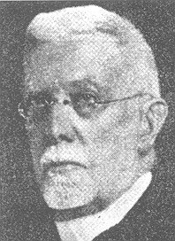
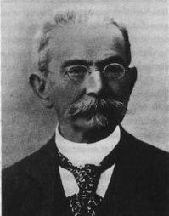
Georg von Mayr in response to Anders Kaier’s
On the Method of Representative
Enumerations Serving as a Type of the Entire Population of a State (ISI 1895)
Kaier
Von Mayr
“...I regard as most dangerous the point of view found in his work. I understand that representative samples can have some value, but it is a value restricted to the domain already illuminated by full coverage. One cannot replace by calculation the real observation of facts. A sample provides statistics for the units actually observed, but not true statistics for the entire terrain.
It is especially dangerous to propose representative sampling in the midst of an assembly of statisticians. Perhaps for legislative or administrative goals sampling may have uses - but one must never forget that it cannot replace a complete survey. It is necessary to add that there is among us these days a current in the mind of mathematicians that would, in many ways, have us calculate rather than observe. We must remain firm and say: no calculation when observation can be made.”
Notes:
Perhaps a curmudgeonly response from von Mayr and similar in spirit to the response I believe Ken Foreman received from the Commonwealth Statistician of the day when use sampling was being considered within the ABS. I believe it was something along the lines of “I have spent my whole career attempting to eliminate error from our statistics and here you are proposing to introduce more of it.” Others present may be able to render the quote more accurately.
But von Mayr’s concern was in part that no sample could adequately represent the detailed heterogeneity of real populations and today we might interpret that as the recognition that accurate small domain estimates are going to be difficult to produce.
Kiaer himself would stop the use of representative sampling by the Norwegian CBS in the early 1900’s. Why? The parliamentary commission on disability statistics.

Slide 6
100+ years later…
Sample surveys for statistical units (persons, businesses) are now “orthodox”
…. but face to face interviews are expensive (and have other limits, e.g. timeliness, provide load)
Can we use Web surveys?
Can we use administrative registers instead?
Can we sample big data?
Can we integrate data from multiple sources to form a well rounded perspective?
Notes:
Over the past 100 years we have assembled an impressive understanding and selection of sample survey methods!
The emphasised words come from the ASA definition of statistics.

Slide 7

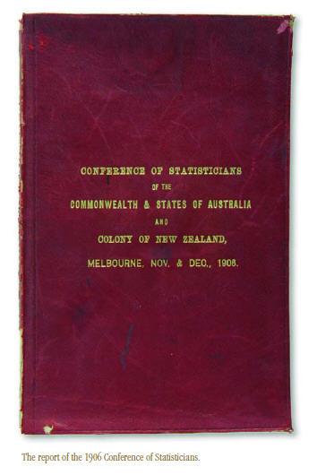


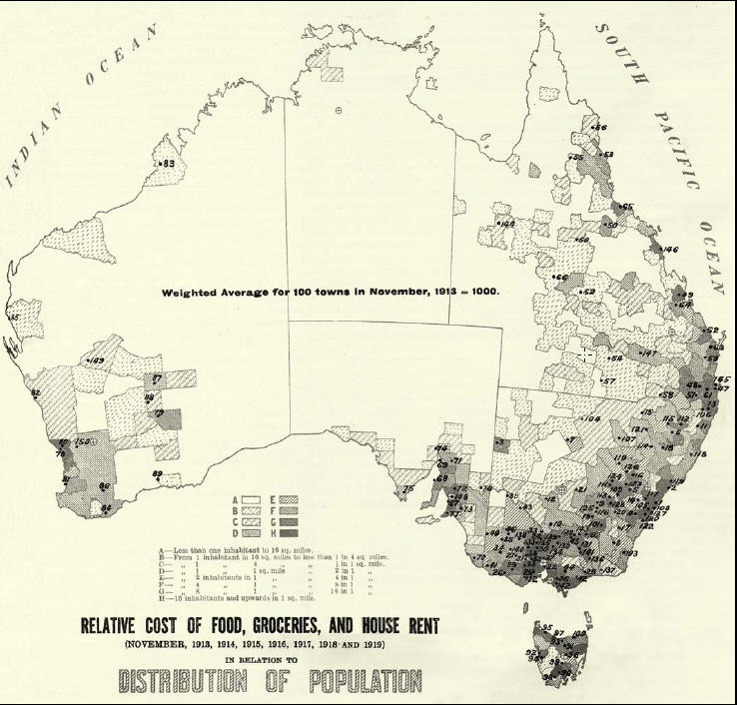

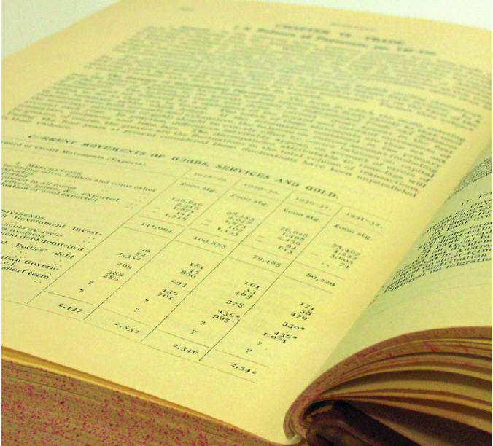

From paper based products
Notes:
In the past, statistics are often disseminated in paper based format.

Slide 8




To electronic products

Slide 9
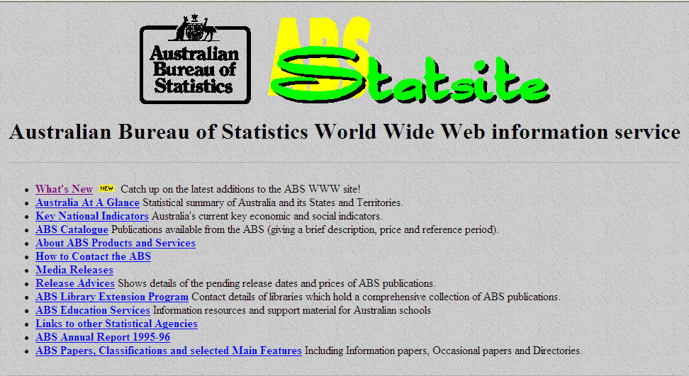
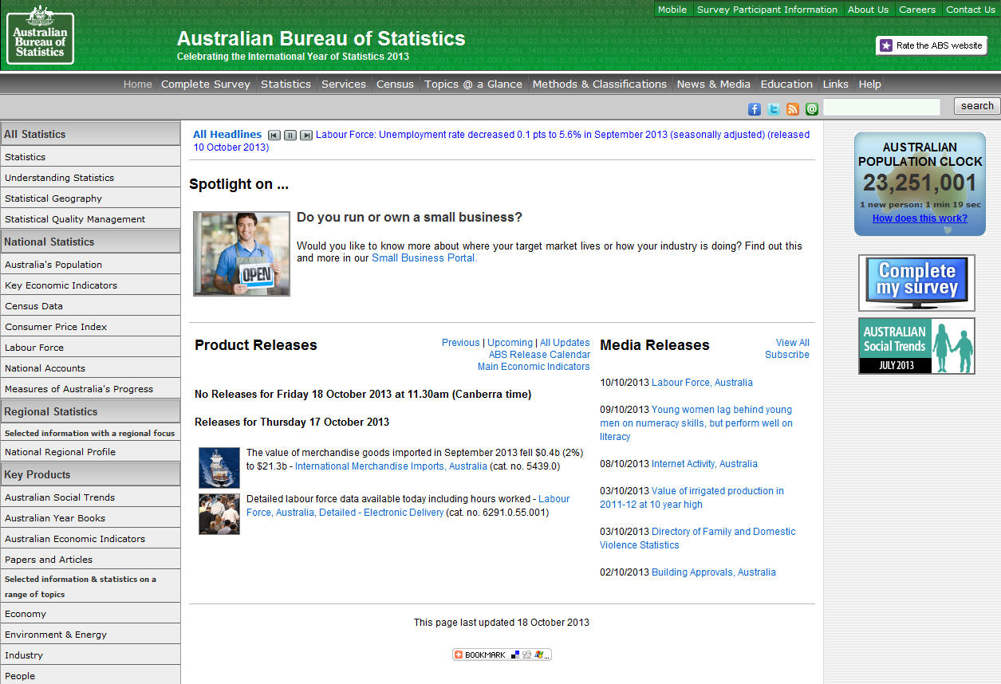
To web-based products
Notes:
Now has evolved to disseminates statistics in web based products. And there is a trend to move from the one way communication (NSO publishes and users consume – pushing the contents to users) towards two way communication (user input parameter and pull relevant information from NSO)

Slide 10
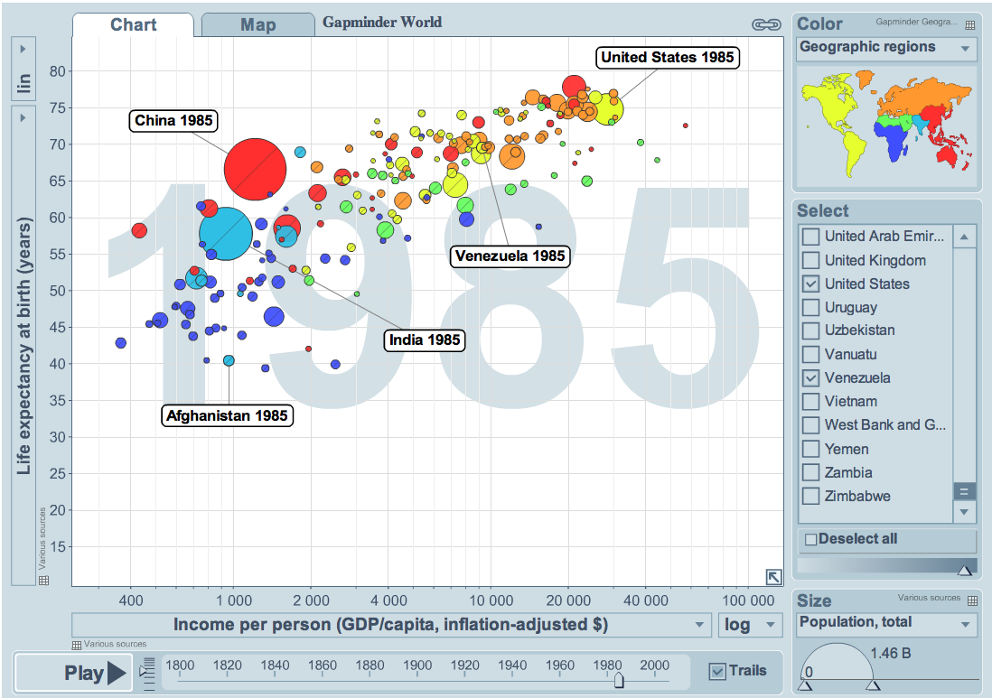
Gapminder World by Hans Rosling
Notes:
Interactive way of presenting Statistics (Web 2.0)
Hans Rosling’s Gapminder World provides an interactive way of visualising statistics in 3 dimensions. Data can be sliced and diced according to users preferences and the result is graphically displayed instantaneously. The screen shot shows an example implementation of Gapminder World that can dynamically shows life expectancy and GDP per capita by country since 1800.
Note to speaker: Mouse click on the picture will display the Gapminder World online version on Gapminder website for live demo. Please click on the slide header to navigate to the next screen.
Offline version of Gapminder can be downloaded from
http://www.gapminder.org/downloads/

Slide 11
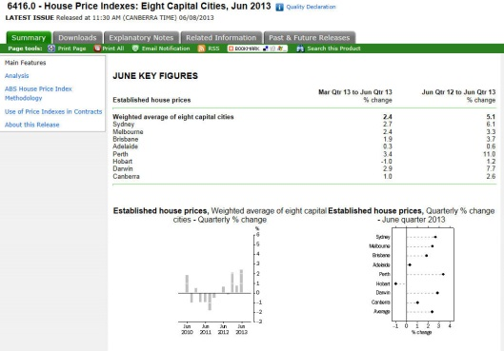
Australian House Price Indexes - Static
Notes:
This is an example of an ABS product presented using web 1.0 technology which only allows one way communication – displaying explanation text, charts and tables on a web page but contents are static.
In the subsequent slide, the same product is presented using web 2.0 technology which allows interactivity with users.

Slide 12
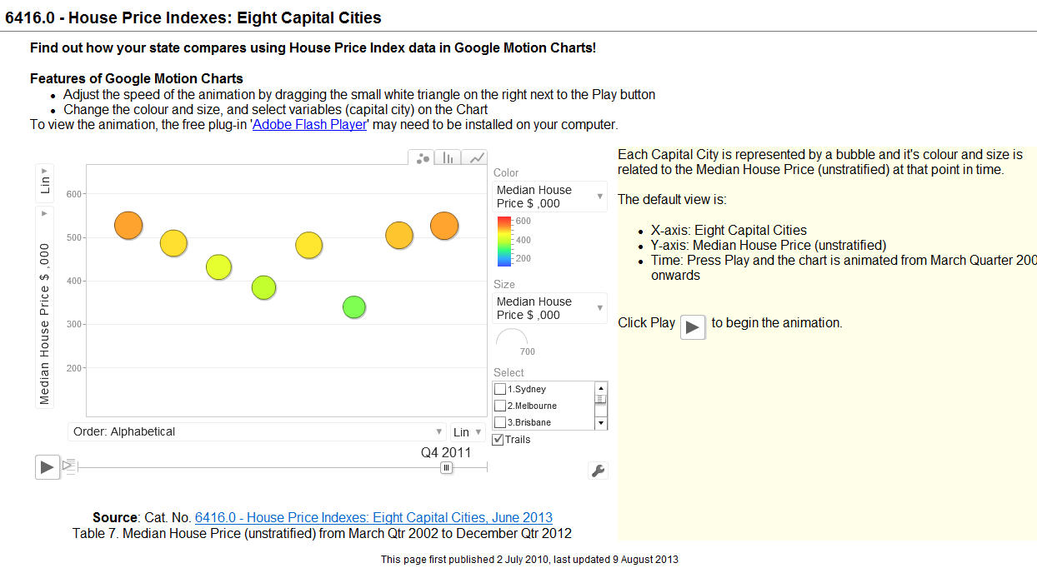
Australian House Price Indexes - Interactive
Notes:
The same ABS product is presented using web 2.0 technology (Google Motion Chart in particular).
Note to speaker: Mouse click on the picture will trigger display of ABS House Price Indexes on the ABS web site for demo. Please click on the slide heading to navigate to the next slide.

Slide 13
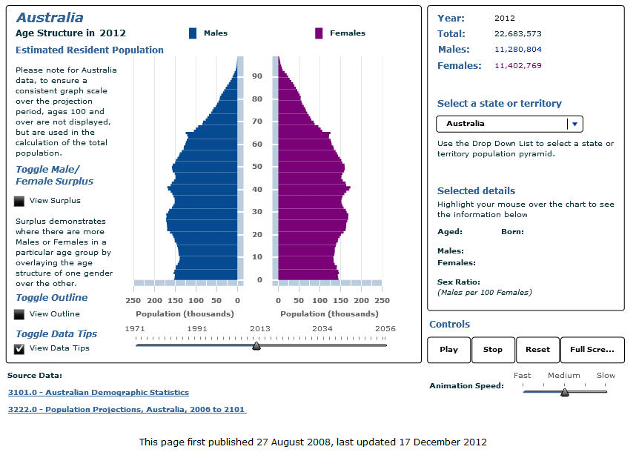
Australian Population Pyramid
Notes:
Apart from Google Motion Chart, ABS also use other technology to present statistics in an interactive way. Australian Population Pyramid is an example.
Note to speaker: Mouse click on the picture will display ABS Australian Population Pyramid on the ABS website for demo. Please click on the slide title to navigate to the next slide.

Slide 14
Official Statistics
Official statistics provide an indispensable element in the information system of a democratic society, serving the government, the economy and the public with data about the economic, demographic, social and environmental situation – UN Fundamental Principle
Notes:
One point of this slide – there are some “constraints” on how official statistics can respond to the challenges, but there is also an obligation to respond to these challenges based on UN principles (eg to maintain “practical utility”). Also, “not negotiables” in regard to official statistics (eg transparency, repeatability, reliability) should be taken into account in discussions/suggestions later in the day. Not every exciting new data technique and source could be used for official statistics without first understanding its soundness from a statistical perspective.
“Official Statistics” need objective, rigorous and transparent methods together with clear explanations that support informed use.
Official Statistics are exciting, but also carry a lot of responsibility, because they are fundamental to the functioning of a democratic – and well informed – society.
The “test of practical utility” forms part of Principle 1. As societies’ needs and practices change, official statistics must remain relevant.
The principle recognise that statistics provide an (indispensable) element of the information system of a democratic society – they are not the totality. The UN recognises the “citizens’ entitlement to public information”.
As has been a long standing practice, if a producer official statistics (such as the ABS) can partner with others to help them also make reliable information available in the public domain, where that information can supplement, and be joined, with official statistics, the statistical agency is furthering fulfilment of Principle 1 even though the agency itself was not responsible for producing the supplementary information.

Slide 15
OGD: Oil, Gold, Democracy? Data is the new gold
Just as oil was likened to black gold, data takes on a new important and value in the digital age…
– Neelie Kroes, VP of EC for Digital Agenda
Public sector information already generates 32 billion € (est) of economic activity each year
The Open Data package – for data to be able to be re-used released by the EU – will double that
What would be the added return from Linked Open Data?
Notes:
When thinking of data as Gold – often the focus is more on “Open” and less on “Linked”

Slide 16
NSO values include…
Open access to data
Free, equal access, and open licensing system
Support data with metadata
Linked open data (?)
Tim Berners-Lee’s 5 star linked open data format
Semantic web is not well understood by statistical leaders
Web 3.0 vs Web 2.0
SDMX vs DDI

Slide 17

The Challenges
Riding the big data wave
New competitors & changing expectations
Increasing cost & difficulty of acquiring survey data
Competition for skilled resources
Rapid changes in the environment
Diminishing
budgets
Notes:
To some extent this slide summarises the challenges mentioned on previous slides. As this is an “internationally agreed” summary of the challenges faced by the official statistics community, it can be used to emphasise that statistical agencies around the world all face similar challenges and recognise these challenges are shared. They are working together to address them on a shared basis.
I have left the original speakers’ notes for this slide below – for information - but I expect you don’t need them.
External Challenges
Rapidly changing external environment - 24 / 7 access to information
Increasing demand by sophisticated users for more timely, relevant statistical data to meet ‘current’ day issues
increasing demand for more accessible and ‘joined up’ data to solve complex policy questions
Constraints
Reduced funding and volatility in funding
Our costs are increasing significantly – unable to contact many households, response rates are dropping, it is becoming more and more difficult to recruit and retain interviewers
skills shortages – competing for statistical and ICT skills across government
complex work programs
siloed processes
and aging infrastructure

Slide 18
Changing expectations?
Users of statistics expect more data, more quickly
They also want to:
“mash up” with data from other sources
explore the statistics visually, interactively, with their own analytical techniques
discover their own stories
Notes:
Next step: using Semantic technologies to help people engage with data on their own terms

Slide 19
Riding the Big Data wave
Challenges and opportunities
Business comes first
Validity of statistical inferences
Scientific methods, including measuring, controlling and communicating uncertainty, need to be developed & proven
Legitimacy, Legacy and Leveraging
Replacing collections
Blending
Gaps
Operational efficiency

Slide 20
NSO responses: Modernisation program
HLG – Europe, Asia and Pacific
Products/Process vision
Products vision
Integrated and better access to micro data
More small population group/area data
Process vision
Statistics Production Model/ Industralisation
Metadata standards
International collaboration

Slide 21
How can semantic technologies help?

Slide 22
Challenges for Semantic “webbers” and official statisticians
How do Linked Data open the way to new sources of data?
How can Semantic Web Technologies help better understand and use new sources of data, including web pages, social media, other sources of big data?
How can the Semantic Web help us better present our statistics, tell statistical stories, and allow users to interact with data cubes, geospatial, time series and graphical visualisation?
How can the semantic technologies help us to be more efficient and effective?
Notes:
Must be sustainable and not require agencies to deliver statistics in an unsustainable array of different formats

Slide 23
Could Semantic Web in any sense, also form “part of the challenge”?
Is there a risk of fundamentally different ontologies emerging for various topics (eg “Occupation”) which compete with relevant statistical classifications that are based on proven conceptual design principles and rigour?
Is there a risk that poor definition of concepts associated with Linked Data, including incorrect assertions by the provider that their concepts equate semantically with published statistical definitions, lead to misinterpretation and misapplication?
Notes:
If risks do exist, what are the best means of minimising them, or otherwise addressing them?
The first dot point is a “leading question”. Probably part of the answer is to make statistical classifications available as ontologies for others in the semantic web community to use so they have less reason to create their own.
The second dot point is about potential misinterpretation and misapplication by:
Statistical agencies seeking to use the Linked Data as an input or reference
End users of statistics when analysing those statistics along side the incorrectly described Linked Data and drawing incorrect inferences

Slide 24
The way forward for Semantic Statistics
Articulate the value proposition of the semantic web for official statistics, particularly to senior leaders of NSOs
Raise awareness of sematic web amongst data managers and those involved in disseminating statistics
Continue the dialogue between the two groups – more Semstats!
Notes:
DDI and SDMX reference
Different role to play for Semantic Technologies

Slide 25
Questions?

