Slide 1
Towards the Discovery of Person-Level Data
International Workshop on Semantic Statistics
22 October 2013, Sydney, Australia
Thomas Bosch¹, Benjamin Zapilko¹, Joachim Wackerow¹, Arofan Gregory²
¹GESIS – Leibniz Institute for the Social Sciences, Germany
{first name.last name}@gesis.org
²Open Data Foundation, USA
agregory@opendatafoundation.org

Slide 2
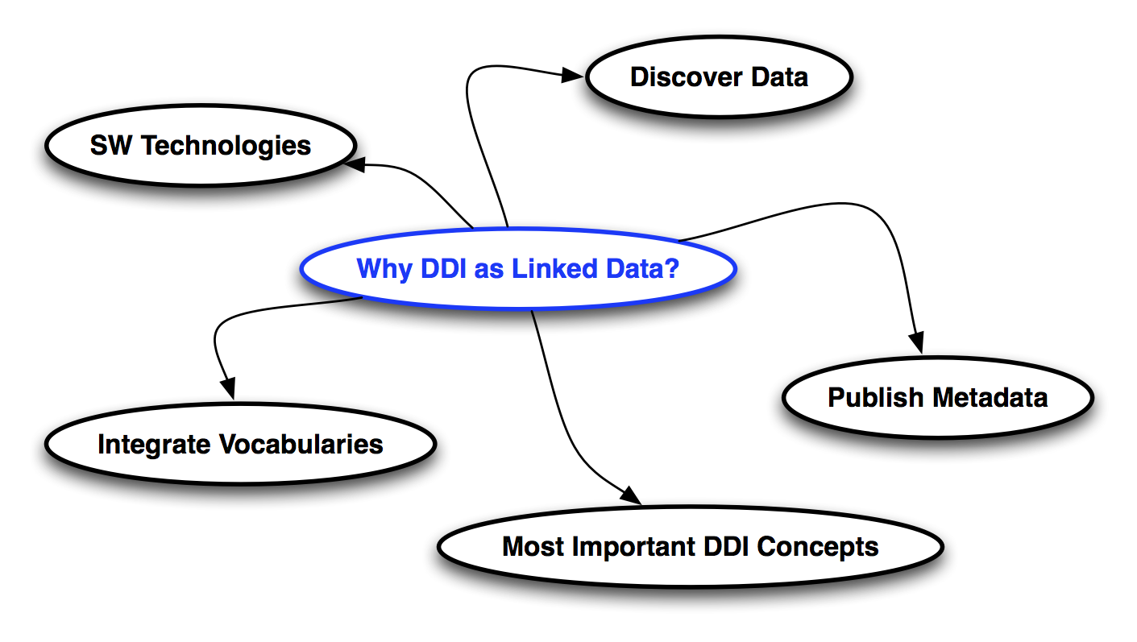
Why DDI as Linked Data?

Slide 3

Overview

Slide 4
Use Cases

Slide 5
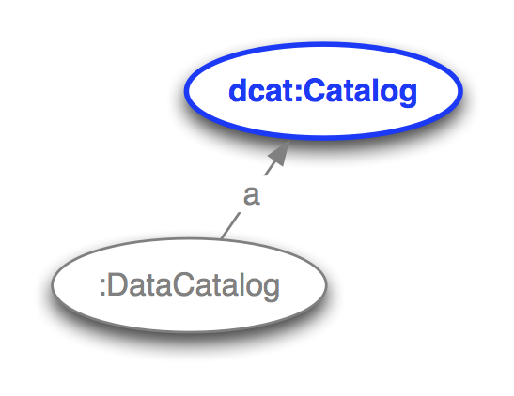
Where to search for specific data?
Notes:
Search for data in data collections / data catalogs

Slide 6
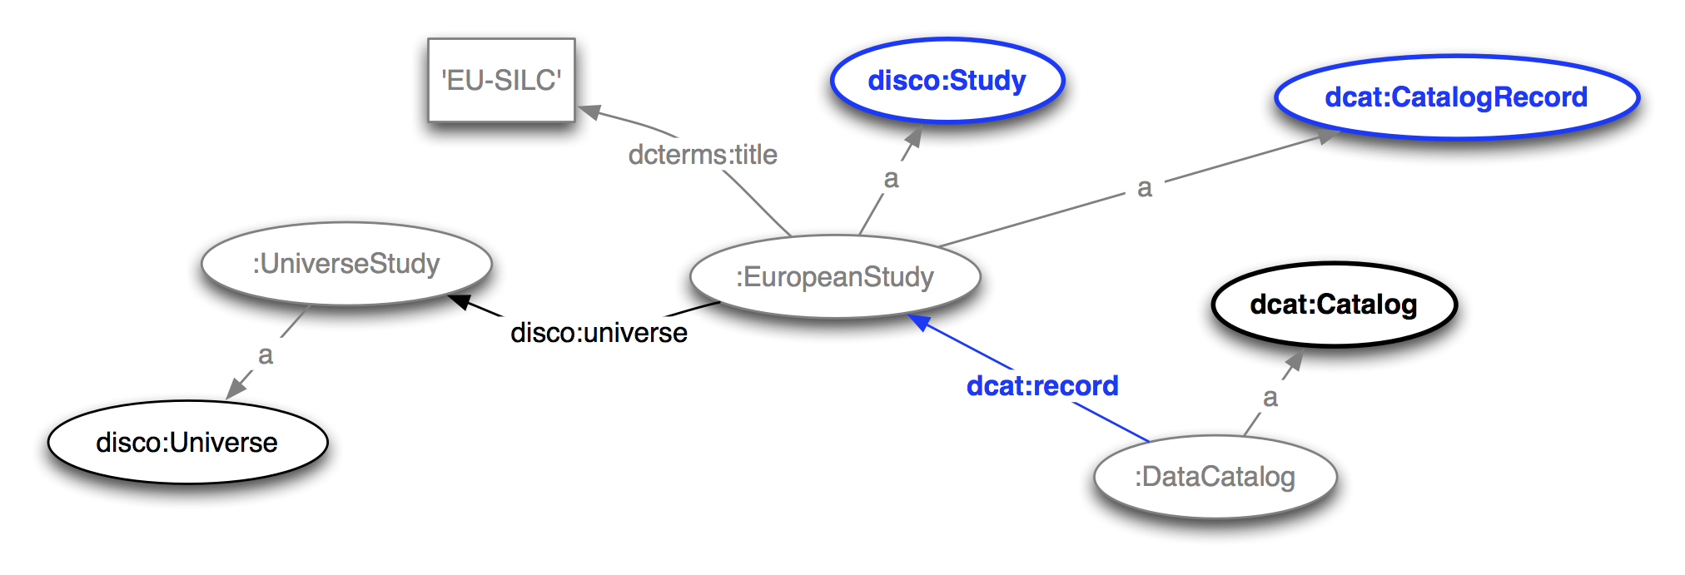
What microdata according to specific metadata exists?

Slide 7
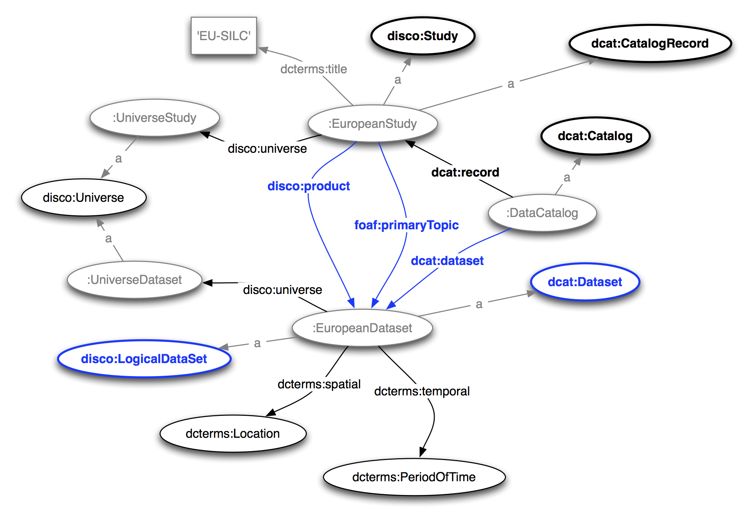
What datasets are associated with the microdata?

Slide 8
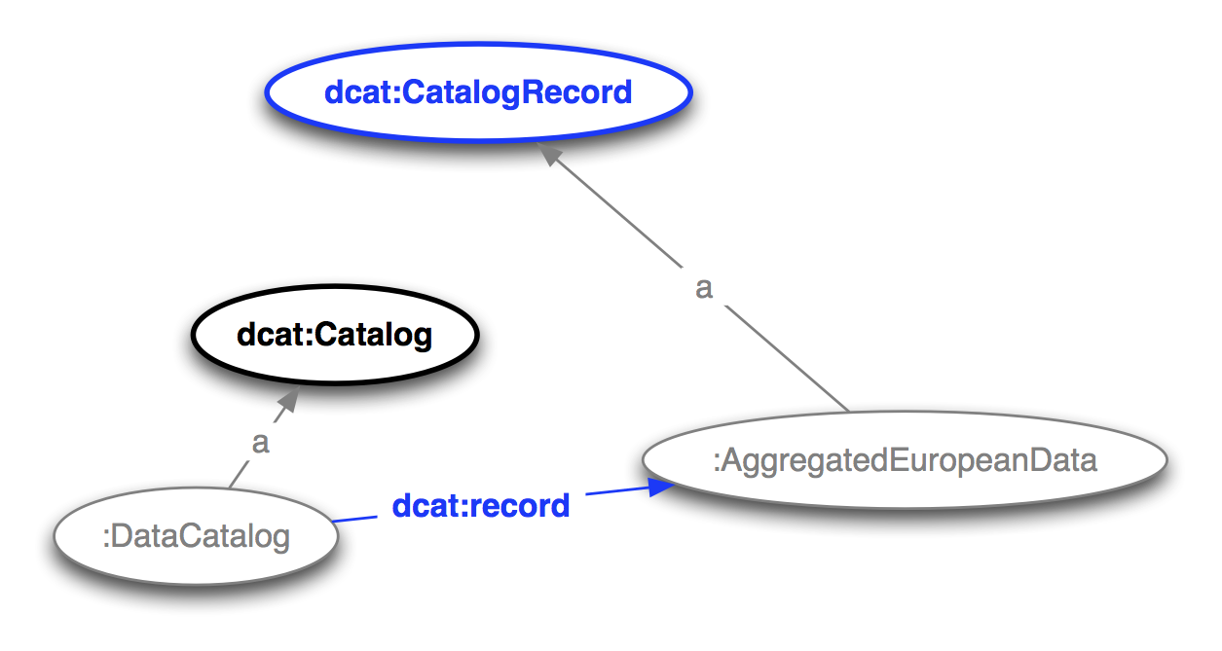
What aggregated data according to specific metadata exists?

Slide 9
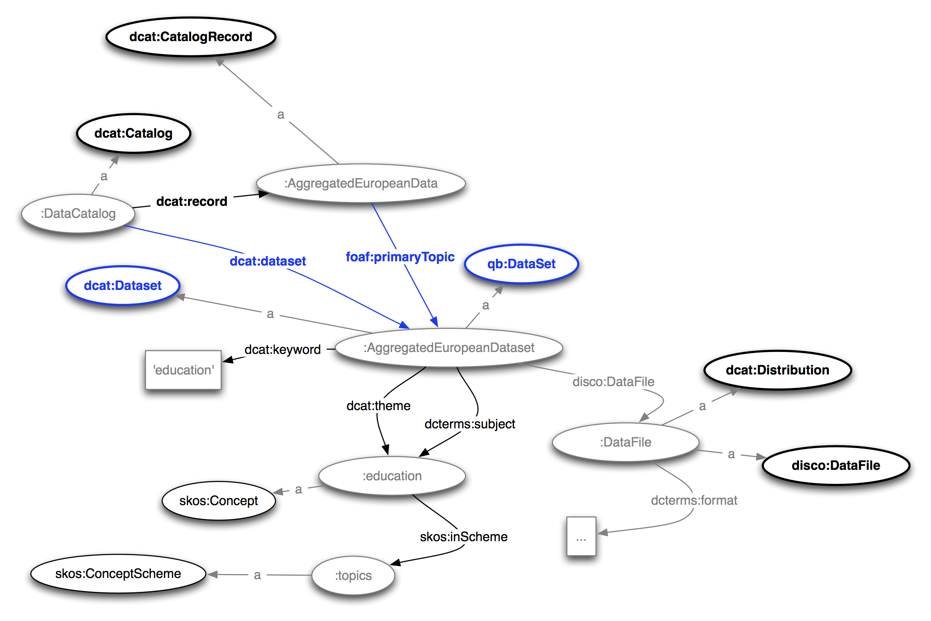
What datasets are associated with the aggregated data?

Slide 10
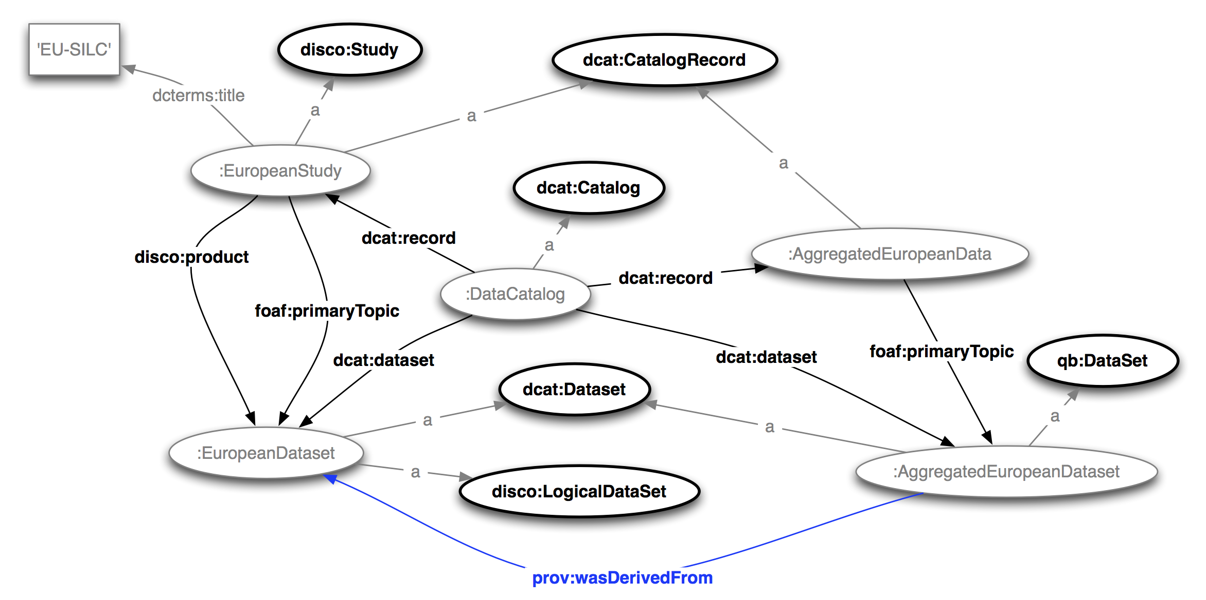
From which microdata datasets is the aggregated dataset derived?

Slide 11
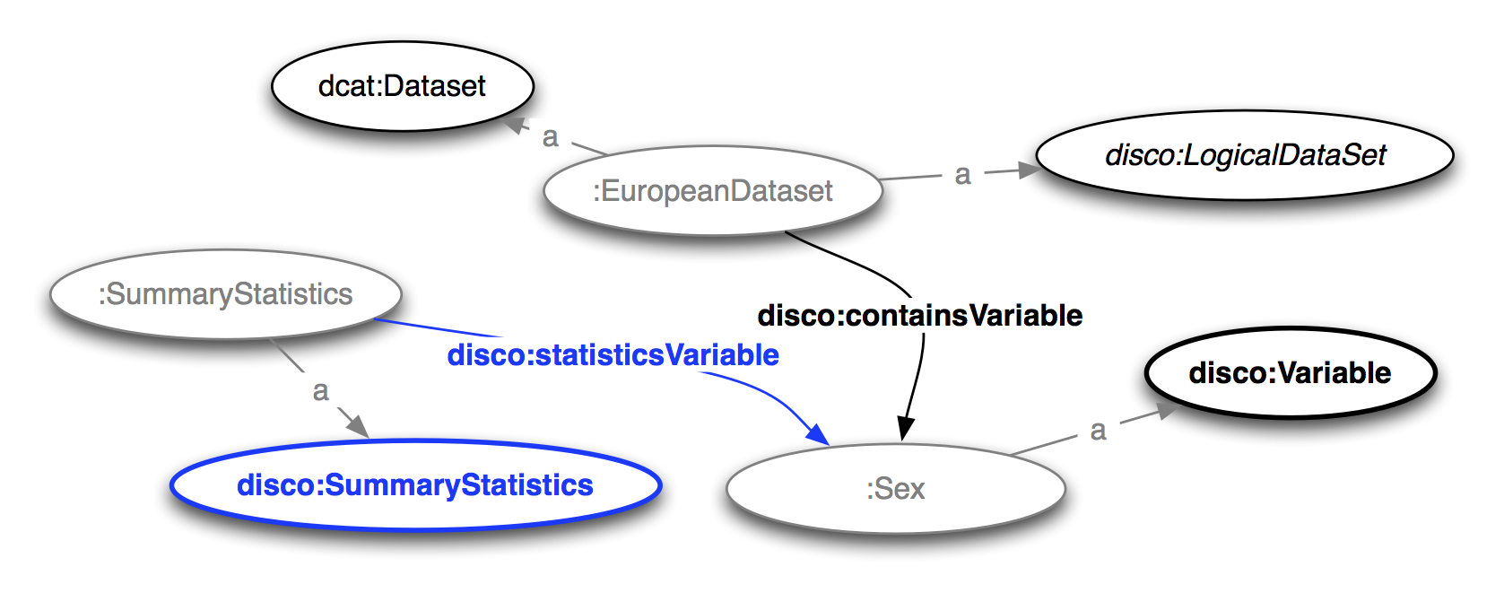
What summary statistics does a variable have?

Slide 12
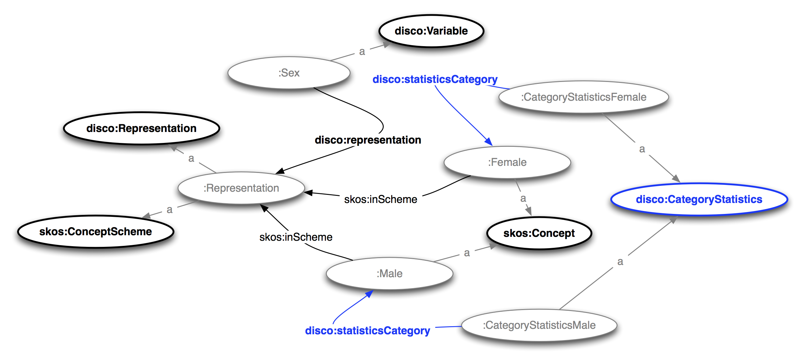
What category statistics does a variable representation have?

Slide 13
What microdata datasets are created by the research institute 'GESIS'

Slide 14
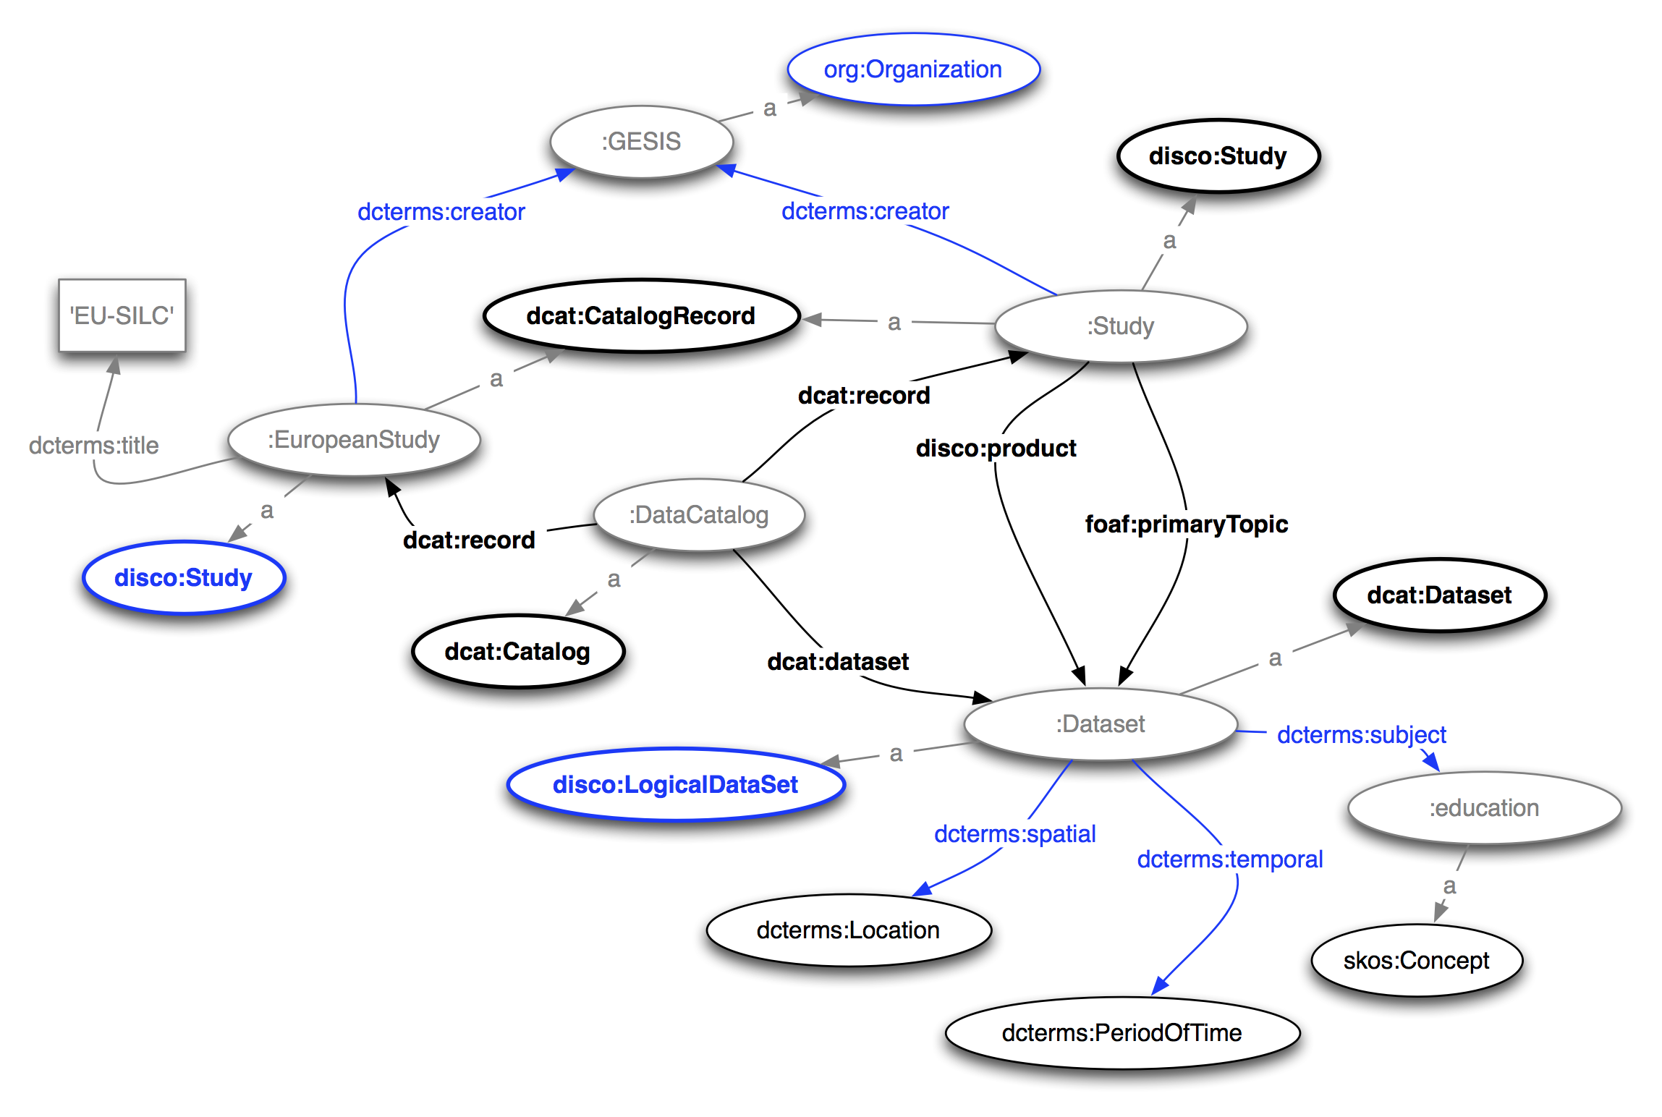

Slide 15
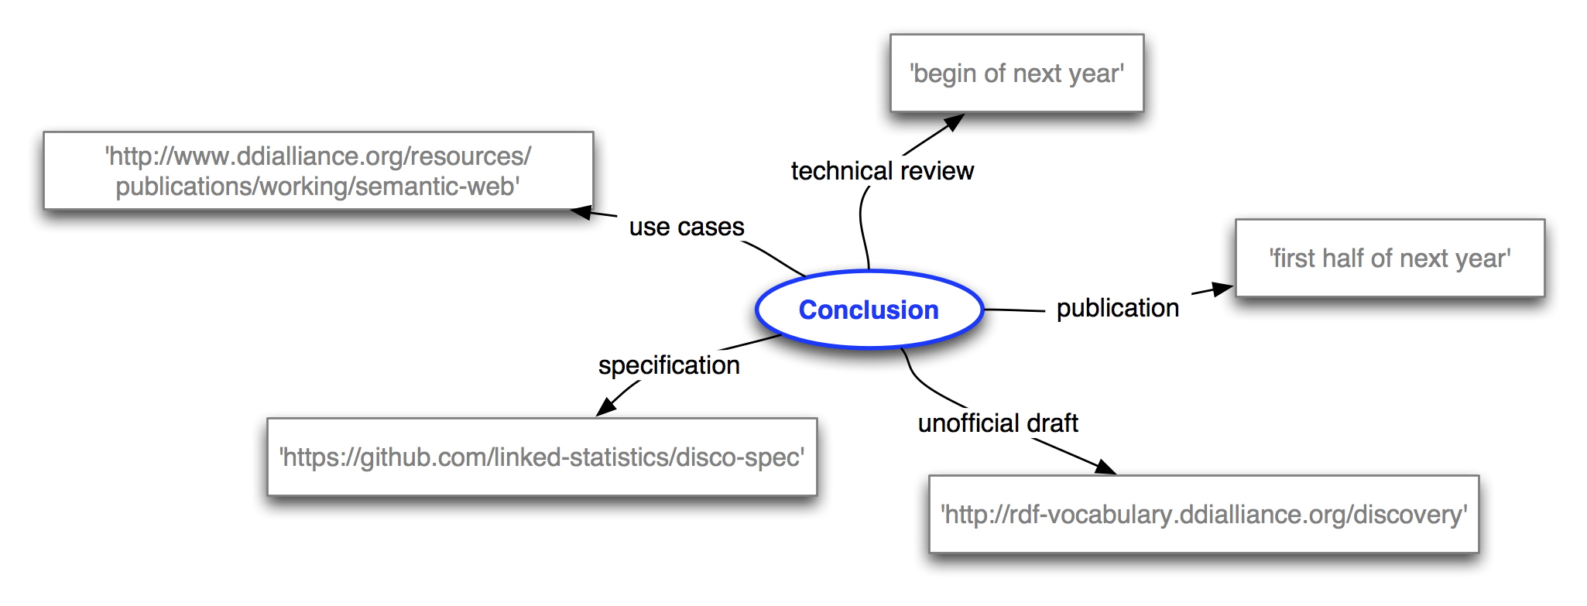
Conclusion

Slide 16
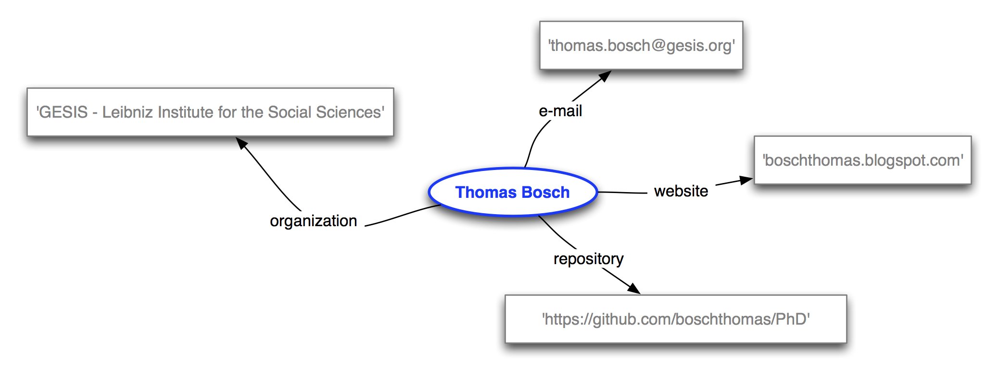
Thank you for your attention…

Slide 17
Backup Slides

Slide 18
Why DDI as Linked Data?
Users discover data in the Linked Open Data Cloud using DDI metadata
Users can search for data
Data providers publish searchable / accessable metadata
The Discovery specification contains the most important DDI concepts for the discovery purpose
We integrated well elaborated vocabularies
We use SW technologies

Slide 19
Overview
Study
LogicalDataSet: the dataset where we save the actual data
Universe: for whom is the study applied to? (e.g. all women in Germany)
Analysis Unit (e.g. persons or households)
Instrument: How do we want to measure? (e.g. 'What is your sex?')
Concept: What do we want to measure?
Variable: Where do we save what we measured? (e.g. sex)

Slide 20
Future Work
Physical description of rectangular data especially CSV data
We integrate this description in discovery
How originate aggregated data on the basis of microdata?
Aggregation method is described in the form machines can process it
We see a need that this area should be explored further in order to describe the relationship between aggregate data and microdata more detailed

Slide 21
Acknowledgements
26 experts from the statistical community and the Linked Data community coming from 12 different countries contributed to this work. They were participating in the events mentioned below.
1st workshop on 'Semantic Statistics for Social, Behavioural, and Economic Sciences: Leveraging the DDI Model for the Linked Data Web' at Schloss Dagstuhl - Leibniz Center for Informatics, Germany in September 2011
Working meeting in the course of the 3rd Annual European DDI Users Group Meeting (EDDI11) in Gothenburg, Sweden in December 2011
2nd workshop on 'Semantic Statistics for Social, Behavioural, and Economic Sciences: Leveraging the DDI Model for the Linked Data Web' at Schloss Dagstuhl - Leibniz Center for Informatics, Germany in October 2012
Working meeting at GESIS - Leibniz Institute for the Social Sciences in Mannheim, Germany in February 2013

