Slide 1
Classification Explorer:
Navigational Querying of Statistical Classifications
The application and the paper were a joint product of the participants of the Sprint Workshop of the UNECE HLG Linked Statistical Metadata project:
Raffaella Aracri, Mauro Bruno, Franck Cotton, Eric Debonnel, Taeke Gjaltema, Dennis Grofils, Hans van Hoof, Olivier Levitt, Enrico Orsini, Andrea Pagano, Jean-Baptiste Rudant, Monica Scannapieco, Romain Tailhurat, Laura Tosco and Luca Valentino

Slide 2
Linked Data and Statistical Classifications
Linked Data and Semantic Web standards are being progressively adopted by statistical organizations
Classifications are an indispensable instrument to disseminate statistical data: without classifications no statistics
An integrated system of activity and product classifications allows the comparability of statistics produced in different statistical domains and countries

Slide 3
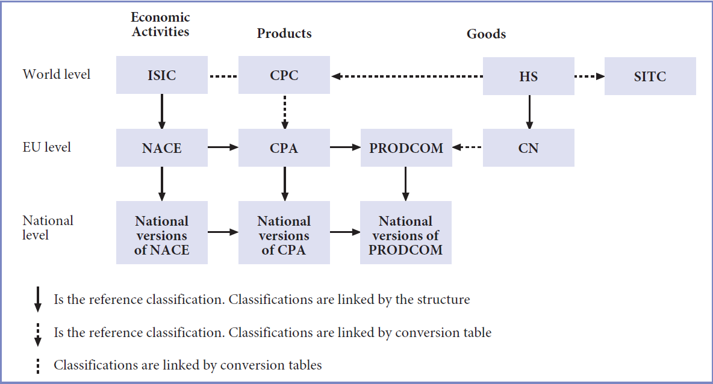
Example of Classifications: National Levels and Correspondence Tables
Picture from: https://joinup.ec.europa.eu/catalogue/asset_release/statistical-classification-economic-activities-european-community

Slide 4
UNECE Project: Implementing ModernStats Standards - IMS
High-Level Group for the Modernisation of Official Statistics (HLG-MOS)
Established in 2010 to oversee and coordinate international work relating to statistical modernisation. It is composed by Director Generals/Presidents of Statistical Organizations and promotes standards-based modernisation of official statistics
The HLG-MOS established a project in 2016 aimed to propose guidelines and concrete showcases on Linked Open Metadata
Implementing ModernStats Standards Project: http://www1.unece.org/stat/platform/display/hlgbas/Implementing+Modernstats+Standards

Slide 5
Classification Explorer
Resulting from the work done within the IMS project
Rome Sprint on Linked Open Metadata
National Statistical Institutes from France, Italy, Netherlands + UNECE + Eurostat
What does the application do? Starting from statistical classifications represented as Linked data artefacts, it allows for a rich user experience by enabling cross-classification navigation
The Classification Explorer application accesses and navigates classifications made available by the SemStats challenge

Slide 6
Technology Architecture -1
The Classification Explorer is a single-page browser app that communicates with an RDF triple store
The client is a JavaScript application written using NodeJS, ReactJS for building user interfaces and Webpack for packaging and deploying applications
The client is based on the React-Redux pattern that manages the state of the application
STARDOG
SPARQL 1.1/HTTP
Fetch()
State()
As the application is single-page, the navigation is entirely done on the browser

Slide 7
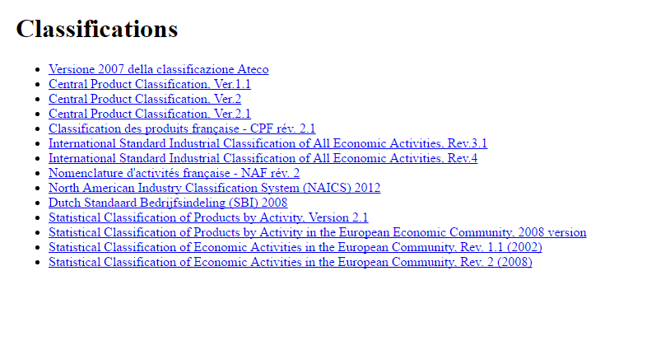
Technology Architecture - 2
The server-side is an RDF triple store implemented with Stardog
The data made available within the SemStats challenge have been all uploaded to the triple store
In particular, the classifications are organized in a single database with a named graph for each specific classification

Slide 8
Main Functionalities
Browsing classifications
By navigating at the different levels and displaying the related details
Cross-navigating classifications
For some classifications, correspondence tables are available, thus permitting to pass from one classification to another. E.g. by selecting a specific activity of NACE classification, through the correspondence table with CPA, it is it is possible to access all the products in CPA associated to the selected activity.
Search among classifications
Given a code of a classification item or a text to search returns all the matching classification items for all the available classifications
Export to CSV
Exports and downloads the displayed list of items in CSV format

Slide 9


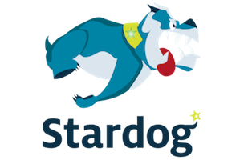

Technical architecture
Data integration
Data exploration

Slide 10
DEMO https://github.com/UNECE/Classification-Explorer

