Slide 1

The SemStats 2016 challenge

Slide 2
The challenge data
Classifications of activities and products
Cornerstone of most economic statistics (national accounts, trade, short-term indicators, etc.)
Very rich corpus, well organized
Versioning strictly managed
Lots of structured explanatory text
Correspondences between products and activities
International integration and management
A standard data model (Neuchâtel model → XKOS)

Slide 3
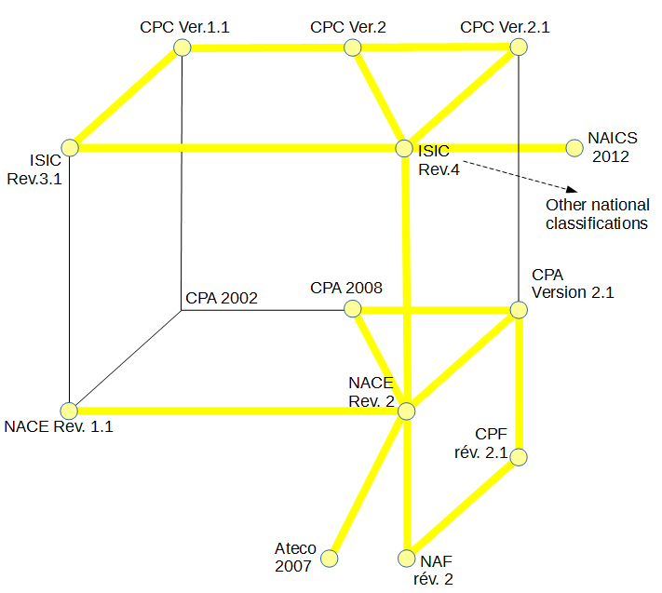
The challenge data
time
products
international
activities
european
national

Slide 4
The challenge data
13 classifications, 16 correspondence tables
Suggestions on how to use the data
debug
check (coherence, quality)
improve
enrich (add content)
visualize
publish
link
activate
Challenge award: $500 offered by Oracle

