Slide 1
Karin Becker Instituto de Informática - Federal University of Rio Grande do Sul, Brazil Shiva Jahangiri, Craig A. Knoblock Information Sciences Institute, University of Southern California, USA
A Quantitative Survey on the Use of the Cube Vocabulary in the Linked Open Data Cloud

Slide 2
Introduction
Statistical data is used as the foundation for policy prediction, planning and adjustments
Growing consensus that Linked Open Data (LOD) cloud is the right platform for sharing and integrating open data
The success of the LOD depends on basic principles
Common vocabulary reuse
Interlinking
Metadata provision
Otherwise, it is just another platform for making data available

Slide 3
Introduction
Cube vocabulary
W3C recommendation
Multidimensional representation of data
But designed to be compatible with statistical ISO SDMX standard
Popular (62% of datasets in the LOD in the governmental domain)
Several projects address platforms for publishing data using the cube
Is data being represented using the Cube in such a way that it can be easily found in the LOD cloud, consumed and integrated with other data ?

Slide 4
Goal
Quantitative survey on the current usage of the Cube vocabulary
Governmental data identified in the last LOD census (2014)
Focus: commonly used strategies for modeling multi-dimensional data
They affect how data can be found and consumed automatically
Contributions
Analysis of various ways the Cube vocabulary is used in practice
Guidance on the most useful representations
Baseline for comparison with the evolution of Cube usage
Input for methodological support and platforms addressing Cube usage

Slide 5
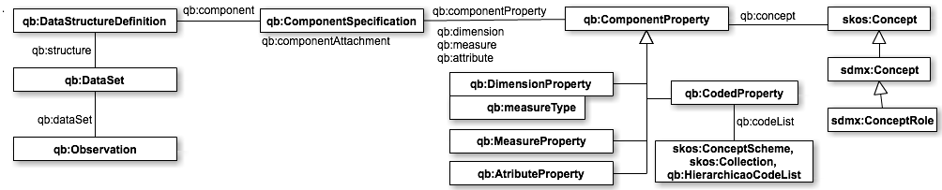
Cube Vocabulary
Notes:
I don`t think this should be discussed in detail (audience should be familiar with):
I grouped the concepts in the next slides to stress why they need to put information in the DSD, not on the actual data.

Slide 6
Cube Vocabulary
The actual data
The structure of the dataset is implicitly represented
Possibly large volumes of data

Slide 7
Cube Vocabulary
Advantages
Checking conformance of actual data with regard to expected structure
Simplification of data consumption, due to explicit properties
Reuse in the publication process
Build trust and normatization for consumption
The description of the data
Explicit representation
Concise description
Notes:
Adavantages of DSD
a) verification that a dataset
matches an expected structure; b) simplification of data consumption, by the easy
determination of available dimensions/measures and respective properties; c) reuse
in the publication process, as publishers are able to ensure that all publications
in a series follows the same structure, and consumers can be confident that the
data structure has not changed

Slide 8
Cube Vocabulary
Measures and dimensions
“measure dimension” (qb:measureType)
Possible values for dimensions
Notes:
Adavantages of DSD
a) verification that a dataset
matches an expected structure; b) simplification of data consumption, by the easy
determination of available dimensions/measures and respective properties; c) reuse
in the publication process, as publishers are able to ensure that all publications
in a series follows the same structure, and consumers can be confident that the
data structure has not changed

Slide 9
Cube Vocabulary
Concepts represented by measures and dimensions
Possibly SDMX concepts
Notes:
Advantages of DSD
a) verification that a dataset matches an expected structure;
b) simplification of data consumption, by the easy determination of available dimensions/measures and respective properties;
c) reuse in the publication process, as publishers are able to ensure that all publications in a series follows the same structure, and consumers can be confident that the data structure has not changed

Slide 10
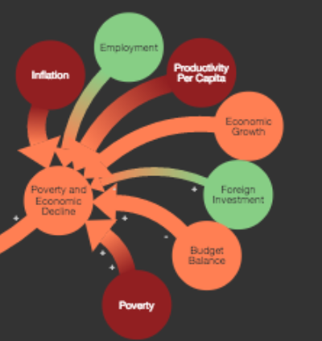



Motivating Example
Prediction of public indicators: Fragile State Index (FSI)
14 social, economic and political indicators
Methodology
software that collects millions of documents, select relevant ones, and values indicators (CAST)
human analysis
Can we predict FSI indicators using other indicators and data available in the LOD Cloud?
Automatic location and consumption
Otherwise, it is just another media where data is available ...
http://ffp.statesindex.org/methodology
Notes:
I suggest to use an example to understand what it is to locate data

Slide 11
Motivating Example
Find datasets that
Measures
Have the label "poverty"
Are described by using the term “poverty”
Are related to the concept poverty
etc
Dimensions
year time series
countries

Slide 12
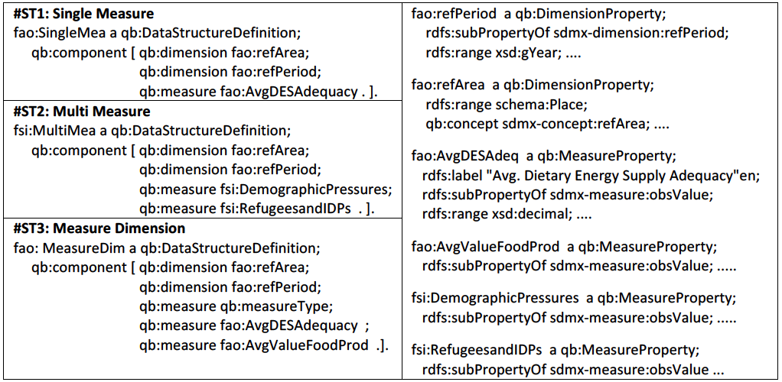
Modeling Strategies
Notes:
The Cube spec stresses these 3 modeling strategies

Slide 13
Modeling Strategies
Single Measure
Each observation contains a value for the measure
Several Dimensions
Measures and dimensions can be related to both
generic (statistical) concepts
domain concepts

Slide 14
Modeling Strategies
Multiple Measures
Each observation must contain values for all measures
Several Dimensions
Measures and dimensions can be related to both generic and domain concepts

Slide 15
Modeling Strategies
Measure Dimension
Each observation contains one value for one of the measures
The specific measure is the value of the “measure dimension”
Several Dimensions
Measures and dimensions can be related to both generic and domain concepts

Slide 16
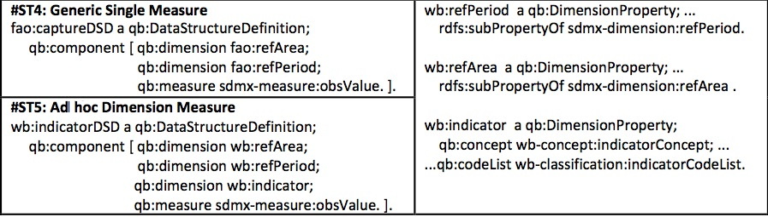
Modeling Strategies
Single Generic Measure
each observation contains a value for the measure
a generic statistical measure
cannot be related to domain concepts
Several Dimensions
DSD is limited in the explicit information it provides
Notes:
fao:captureDSD can virtually represent any
measure indexed by time and location
ST5 is a real example. This DSD has nearly 10.000 datasets for a huge list of variables (I do not remember how many, hundreds of them, maybe more)

Slide 17
Modeling Strategies
Ad hoc Dimension Measure
each observation contains a value for a measure
a generic statistical measure
cannot be related to domain concepts
Several Dimensions
one dimension is implicitly a measure dimension
a codelist might describe the measure, but only the actual dataset defines the measure
DSD is limited in the explicit information it provides
Notes:
This example is taken from a real dataset: for one DSD, there`s thousands of datasets
. wb:indicatorDSD aims at representing
the ST3 strategy, but without the appropriate constructs, and with significant
semantic loss. For instance, finding datasets involving a certain measure requires
a through inspection to identify a dimension with a particular role (the measure
dimension), finding in the list the code that represents the measure, and identifying
datasets whose observations contain that code. Building applications to consume
data, or make inferences, would have to deal with the same issues.

Slide 18
Modeling Strategies
Correct with regard to the Cube, but …
DSD fulfills its role partially
Conformance of the actual data with regard to structure is limited to structural properties
Semantics is poor
Harder to automatically locate useful datasets in the LOD cloud and consume
Notes:
I suggest you to refer to the paper where a more in depth analysis is found.

Slide 19
Goal-Question-Metric (GQM)
Proposed by Basili et al. in experimental SW engineering
Measurement model at three levels
Conceptual: Goal of the measurement
entity, purpose, focus, point of view and context
Operational: Questions define models of the object of study
characterize the assessment or achievement of a specific goal
Quantitative: a set of Metrics
defines a set of Measures that enable to answer the questions in a measurable way.

Slide 20
Survey: Goals
Goal 1: Analyze DSD and Datasets for the purpose of understanding with respect to DSD relevance and reuse from the point of view of the publisher
Do publishers agree that DSDs have several benefits?
Do publishers reuse DSDs and its underlying definitions?
Goal 2: Analyze DSD for the purpose of understanding with respect to modeling strategy from the point of view of the publisher
how frequent is each modeling strategy?
how easy it is to identify hidden semantics about measures and dimensions?
Goal 3: Analyze DSD for the purpose of understanding with respect to DSD conceptual enrichment from the point of view of the publisher
Do publishers practice semantic annotation on DSDs?

Slide 21
Survey: Method
Context
Data from the LOD cloud census (Aug. 2014)
Manheim Catalogue
Data Collection
114 catalogue entries
March-Apr. 2015
Tag cube-format
Operations
Sparql queries to all entries
All triples involving Cube constructs (except qb:Observation)
Results integrated in a local repository
Several issues for data extraction
Data about 16,563 cube datasets and 6,847 DSDs
Half of the data referred to a single publisher (Linked Eurostat)
https://github.com/KarinBecker/LODCubeSurvey/wiki
Notes:
Send them to the github where all this is available and is reproduceable

Slide 22
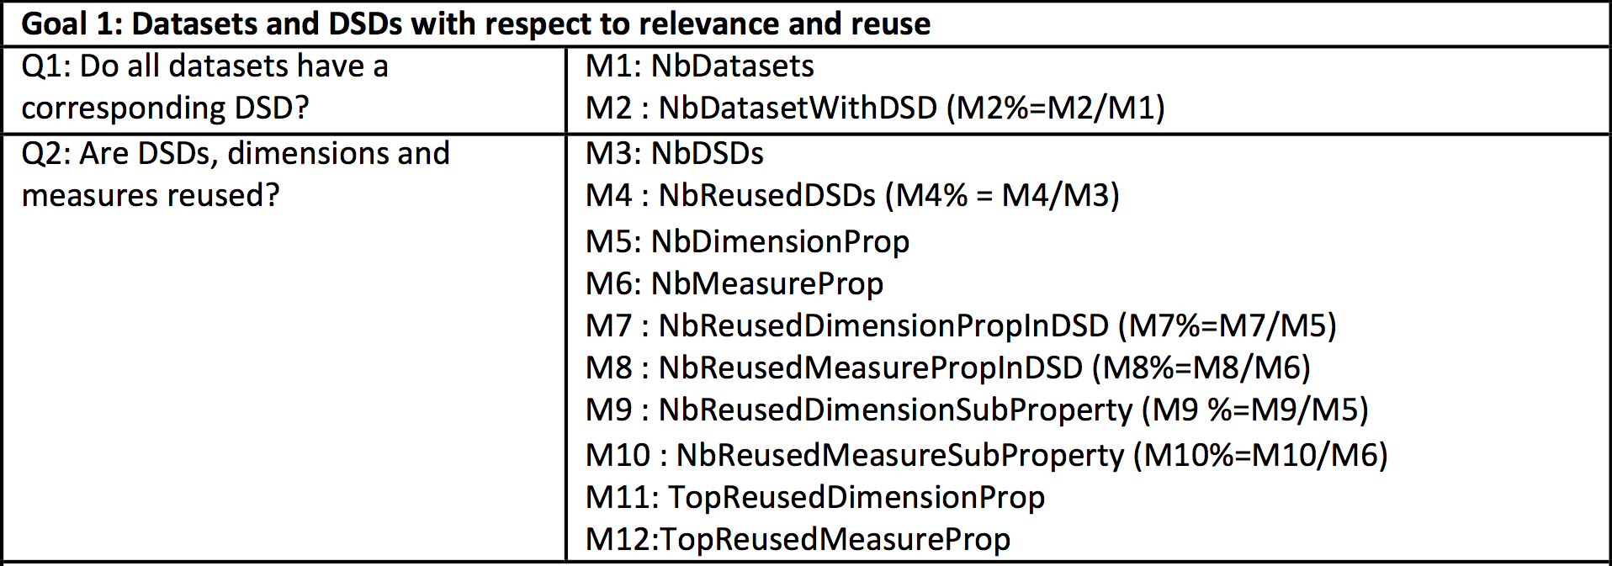
Goal 1: DSD and Reuse
Notes:
My suggestion is that you focus only on the questions

Slide 23

Goal 1: DSD and Reuse
We found 273 datasets without DSDs, referring to 2 publishers
Non-conformant cubes
Notes:
And then instead of going into details into the numbers, you focus on the conclusions

Slide 24
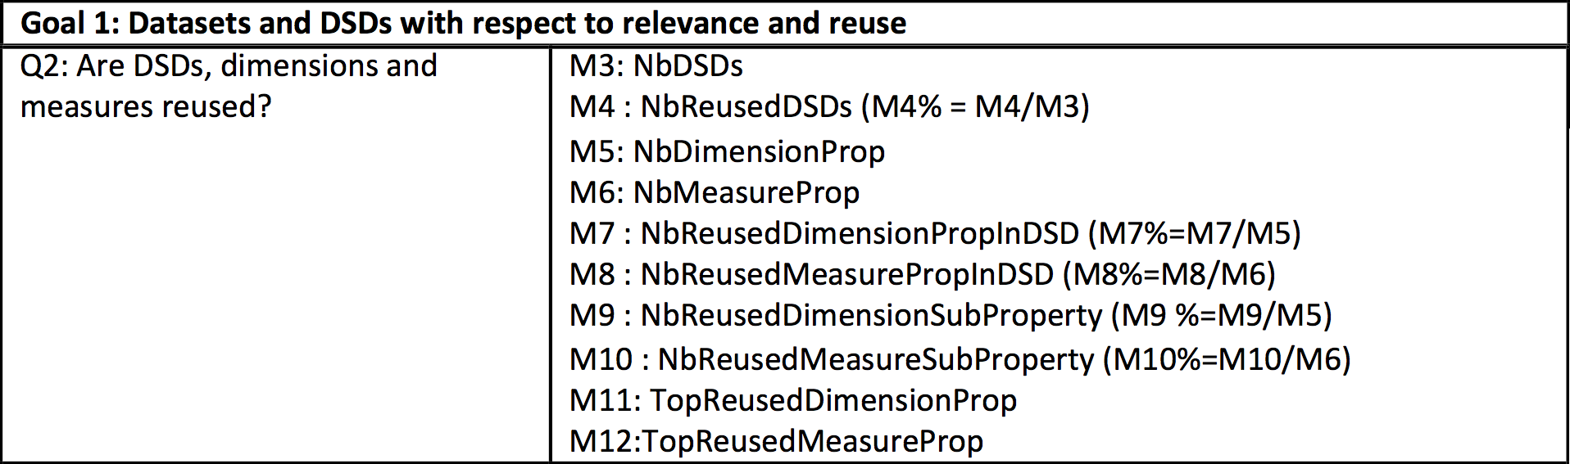
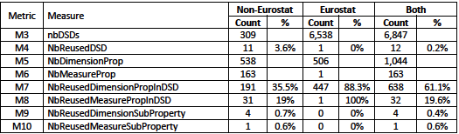
Goal 1: DSD and Reuse
DSD reuse is not a practice (3 publishers)
Reuse is limited within a same publisher despite they all share similar dimensions (e.g. time, location)
No interlinking of concepts
Reuse of SDMX concepts
Popular dimensions: in-house variations of Time, Location and Sex
Popular measures: sdmx:obs-value and its in-house variations

Slide 25
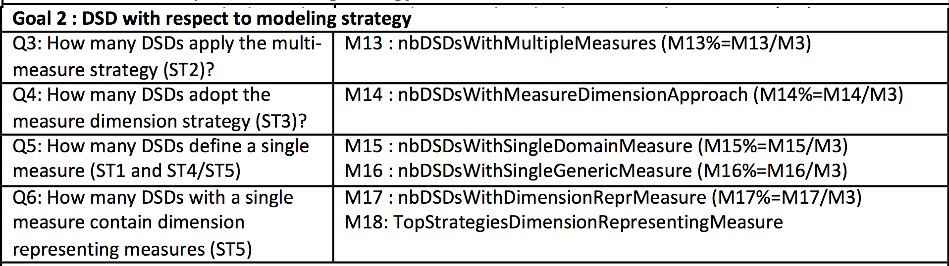
Goal 2: DSD Modeling Strategy

Slide 26
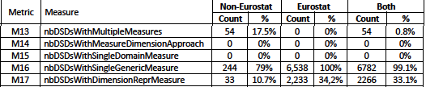
Goal 2: DSD Modeling Strategy
1st strategy: a single generic measure (ST4)
2nd strategy: a dimension implicitly representing a measure dimension (ST5)
Strategies to find dimensions representing measures (ST5):
Patterns involving the URI (e.g. included indic, variab, measur)
Concepts and codelists were not useful at all
Strategies to find generic measures also involved URI patterns

Slide 27
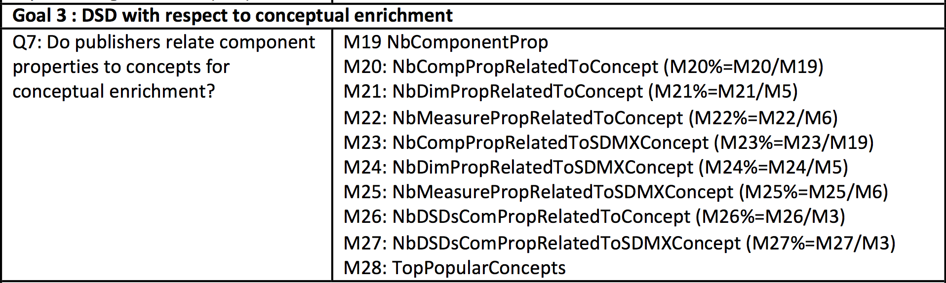
Goal 3: DSD Conceptual Enrichment

Slide 28

Goal 3: DSD Conceptual Enrichment
Dimensions are often related to concepts, however …
in-house concepts, not interlinked with external concepts (e.g. owl:same-as, skos:exactMatch)
frequently concepts are paired with codes from codelists (uri patterns)
Top concepts:
sdmx-concept:obsValue, sdmx-concept:freq
Different in-house representations for location, time, measuring unit and sex

Slide 29
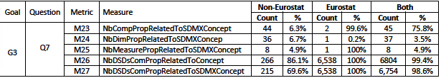
Goal 3: DSD Conceptual Enrichment
Common practice of defining a concept as an instance of sdmx:Concept
not adequate considering SDMX is a standard to be shared across datasets of various domains, with well-defined concepts (COG)
For the survey, we adopted a more strict interpretation
concept that belongs to the standard SDMX COG
(subproperty of) SDMX dimension/measure (which is always linked to a sdmx-concept)
Top concepts: sdmx-concept:obsValue, sdmx-concept:freq

Slide 30
Related Work
Surveys
LOD Census : growing importance of the Cube and governmental topical domain (Schmachtenberg et al. 2014)
Preferred reuse strategy: a single, popular vocabulary (Schaible et al.2014)
platforms that support using, publishing, validating and visualizing Cube datasets
LOD2 Statistical Workbench, OpenCube, Vital, OLAP4LD
Our results can be leveraged to integrate components that also provide methodological guidance to support modeling choices
Automatic search of open data for data mining (Becker et al. 2015; Janpuangtong et al. 2015)

Slide 31
Conclusions
Survey current practices of modeling datasets with the Cube vocabulary
Surprised by the number of non-conformant cube datasets
most Cube datasets are straightforward conversions of SDMX data
standard for exchanging statistical data: interoperability
LOD cloud: ability of automatically processing of data requires
Next step: more complex conversion rules
Cube constructs are underused
more normative ways of modeling multidimensional data, and explicitly defining in the structure and semantics of DSDs
the use of Cube is new, and its usage will reveal the importance of certain constructs/modeling strategies

Slide 32
Conclusions and Future Work
Publishers are concerned with establishing a proper, standard vocabulary to uniformly apply within the scope of a specific organization
Opportunity integrate commonly used dimensions, either by reuse, adoption of standard concepts, or concept-based linkage
Survey has a specific focus
Baseline for future comparison
Extended to other aspects
Results can be leveraged into supporting platforms
currently we are using the investigated patterns of Cube usage to automatically identify and integrate cube datasets for data mining applications

