Slide 1




Toward a framework for statistical data integration
Ba-Lam Do, Peb Ruswono Aryan, Tuan-Dat Trinh, Peter Wetz,
Elmar Kiesling, A Min Tjoa
Linked Data Lab, Vienna University of Technology
http://ldlab.ifs.tuwien.ac.at @linkeddatalab

Slide 2
Agenda
Introduction Data Integration Framework Use Case Conclusion and Future Work
Introduction
Data Integration Framework
Use case
Conclusion and Future Work

Slide 3





Problem Statement
Introduction Data Integration Framework Use Case Conclusion and Future Work
Statistical data
is growing fast
opens up opportunities for interesting applications
But: it is difficult to integrate statistical data due to
diversity in access mechanisms
inconsistencies in vocabulary and entity naming
limited adoption of existing standards
Data Cube Vocabulary

Slide 4
Integration Approach
Introduction Data Integration Framework Use Case Conclusion and Future Work
Propose a framework for statistical data integration based on:
Consolidation of
Data format: RDF
Access mechanism: SPARQL query
Standard adoption:
vocabulary - Data cube vocabulary
property, code list – SDMX’s content-oriented guidelines (COG)
Components
RML mapping service: transforms data from non-RDF formats to RDF format
Metadata repository: uses standards to provide interconnection between data sets
Mediator: queries and integrates data

Slide 5
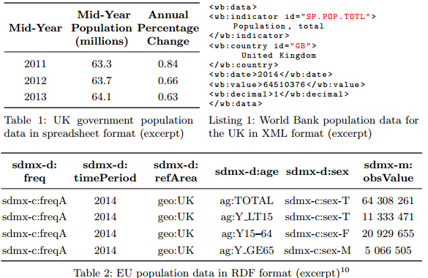
Example use case
Introduction Data Integration Framework Use Case Conclusion and Future Work
Compare the population of the UK according to three different data sources

Slide 6
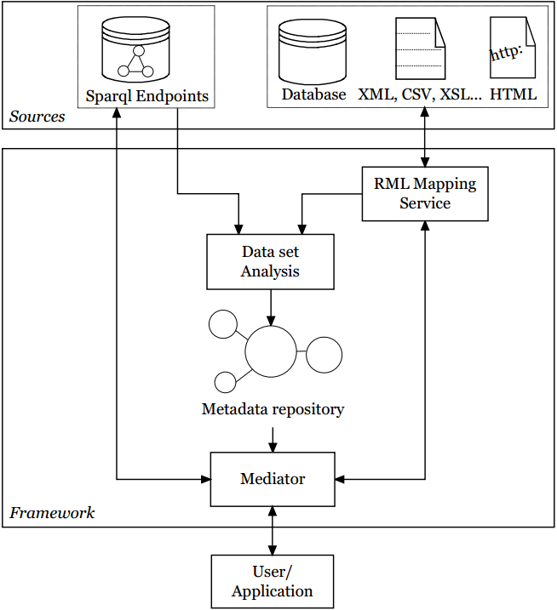
Architecture
Introduction Data Integration Framework Use Case Conclusion and Future Work

Slide 7
RML Mapping Service
Introduction Data Integration Framework Use Case Conclusion and Future Work
RML (RDF Mapping Language)
transform data from non-RDF formats into RDF format
supported formats: JSON, XML, CSV, TSV
Our service
Our extensions
XLS format support
parameterized RML mappings: variables in mapping e.g., country code, indicators
Mappings to RDF following Data cube vocabulary
RML Mapping Service
RDF
URI
JSON
XML
CSV
TSV
Data set

Slide 8
Two main parts in structure of metadata
Introduction Data Integration Framework Use Case Conclusion and Future Work
Structure and access method for the data set
represent components in each data set
represent method to query this data set: SPARQL, API, and RML mapping
Co-reference information: links each component/value to its corresponding identifier
use properties in COG: sdmx-d:refArea,sdmx-m:obsValue…
use code lists in COG: code list of sdmx-d:sex
define new code lists which are not available in COG: spatial values (use Google Geo coding service) and temporal values (use UK time reference service)

Slide 9
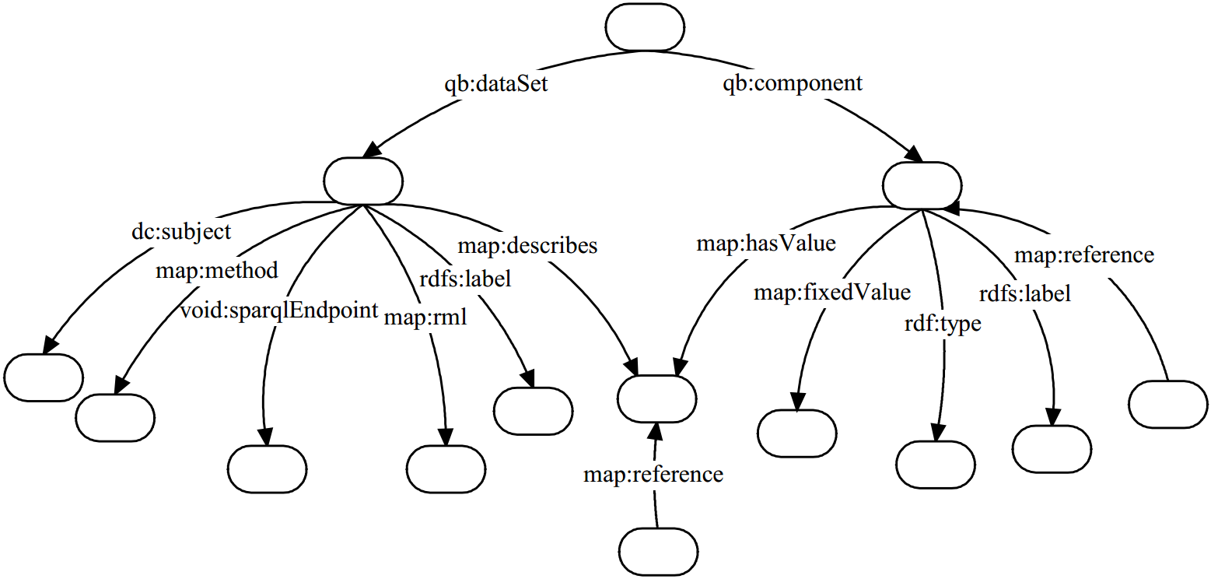
Structure of Semantic Metadata
Introduction Data Integration Framework Use Case Conclusion and Future Work
Metadata
WB’s indicators
Sparql,
Api,
Rml
Co-reference
property
Co-reference value

Slide 10
Issue with COG
Introduction Data Integration Framework Use Case Conclusion and Future Work
Issue
COG has only one measure property, sdmx-m:obsValue
Measure_{a}
Measure_{b}
loss of meaning of observed measure
querying and integrating data is difficult
a data set can have multiple measures
Approach
use World Bank’s indicators as topic set
assign topic to each data set
split a multi-measure data set into multiple single-measure data sets
DS_{a}
DS_{b}
sdmx-m:obsValue
Measure_{a}
Measure_{b}
sdmx-m:obsValue
Topic_{a}
Topic_{b}
RDF
RDF

Slide 11
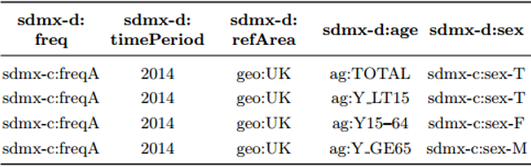
Inconsistent Number of Dimensions
Introduction Data Integration Framework Use Case Conclusion and Future Work
Inconsistent number of dimensions in each data set
WB, UK data sets: 2 dimensions
EU data set: 5 dimensions
Approach
identify a fixed value (if any) for each dimension
value: unique or aggregated value
assign dimensions that do not appear in both data sets with their fixed values

Slide 12
Mediator
Introduction Data Integration Framework Use Case Conclusion and Future Work

Slide 13
Mediator
Introduction Data Integration Framework Use Case Conclusion and Future Work
Query
Acceptance
Input: a SPARQL query uses consolidated properties/values
Query
Rewriting
Identify suitable data sets in the repository
Rewrite the input query based on co-reference information
Result
Rewriting
Rewrite each result based on co-reference information
Integrate results
Return
Result
Send queries to SPARQL endpoints or RML mapping service
Apply filter conditions to each result
Consolidate different units/scales to a common unit/scale
Output: Return integrated result to user/application

Slide 14
Role of Stakeholders
Introduction Data Integration Framework Use Case Conclusion and Future Work
Data providers
publish data in varying formats
create RML mapping to transform their data from non-RDF formats to RDF format
Developers
build innovative data integration applications
create RML mapping for their interest data sets
End users
lack semantic web knowledge and programming skills
use appropriate tools to generate SPARQL queries, compare, and visualize data

Slide 15
Requirements for Statistical Data Integration
Introduction Data Integration Framework Use Case Conclusion and Future Work
Principles
Object: two single-measure data sets
Comparison: based on the co-reference identifiers of data sets
Requirements of data structure
They have the same sets of dimensions, same measure, and same topic
They have the same sets of dimensions, same measure, but different topics
They have the same measure and same topic. We can use fixed values to assign dimensions that do not appear in both data sets
Requirement of value: same values

Slide 16
Example: data integration requirements
Introduction Data Integration Framework Use Case Conclusion and Future Work
UK
World Bank
EU

Slide 17
Mediator
Introduction Data Integration Framework Use Case Conclusion and Future Work
Query
Acceptance
Query
Rewriting
Result
Rewriting
Return
Result
PREFIX qb: <http://purl.org/linked-data/cube#>
SELECT * WHERE {
?ds dc:subject <http://data.worldbank.org/indicator/SP.POP.TOTL>.
?o qb:dataSet ?ds.
?o sdmx-m:obsValue ?obsValue.
?o sdmx-d:refPeriod ?refPeriod.
?o sdmx-d:refArea ?refArea. Filter(?refArea=<http://linkedwidgets.org/statisticalwidgets/ontology/geo/UnitedKingdom>)}

Slide 18
Mediator
Introduction Data Integration Framework Use Case Conclusion and Future Work
SELECT * WHERE {
?o qb:dataSet <http://rdfdata.eionet.europa.eu/eurostat/data/demo_pjanbroad>.
?o sdmx-m:obsValue ?obsValue.
?o sdmx-d:timePeriod ?timePeriod.
?o sdmx-d:refArea ?refArea.
?o sdmx-d:freq <http://purl.org/linked-data/sdmx/2009/code#freq-A>.
?o sdmx-d:age <http://dd.eionet.europa.eu/vocabulary/eurostat/age/TOTAL>.
?o sdmx-d:sex <http://purl.org/linked-data/sdmx/2009/code#sex-T>.
FILTER(?refArea= <http://dd.eionet.europa.eu/vocabulary/eurostat/geo/UK>) }
Query
Acceptance
Query
Rewriting
Result
Rewriting
Return
Result
EU data set query
http://pebbie.org/mashup/rml?rmlsource=http://pebbie.org/mashup/rml-source/wb&subject=http://data.worldbank.org/indicator/SP.POP.TOTL&refArea=http://pebbie.org/ns/wb/countries/GB
WB data set query
http://pebbie.org/mashup/rml?rmlsource=http://pebbie.org/mashup/rml-source/ons_pop
UK data set query

Slide 19
Mediator
Introduction Data Integration Framework Use Case Conclusion and Future Work
Query
Acceptance
Query
Rewriting
Result
Rewriting
Return
Result
Rewrite each result based on co-reference information
Apply filter conditions (refArea – UK) to results
Consolidate scales in three results
EU and WB data sets: absolute number scaling
UK data set: millions scale => multiply one million
Integrate results
http://dd.eionet.europa.eu/vocabulary/eurostat/geo/UK =>
http://linkedwidgets.org/statisticalwidgets/ontology/geo/UnitedKingdom
http://pebbie.org/ns/wb/countries/GB =>
http://linkedwidgets.org/statisticalwidgets/ontology/geo/UnitedKingdom
2014^^http://www.w3.org/2001/XMLSchema#year =>
http://reference.data.gov.uk/id/gregorian-year/2014
2014 =>
http://reference.data.gov.uk/id/gregorian-year/2014

Slide 20
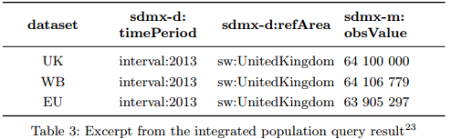
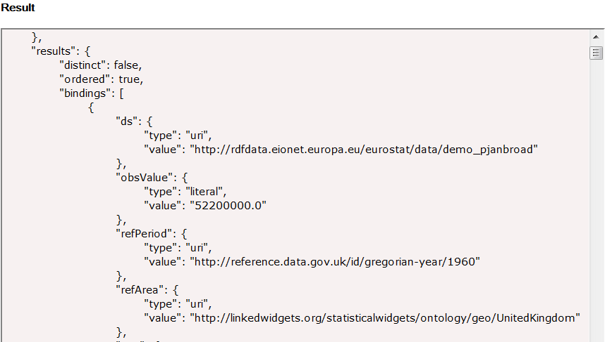
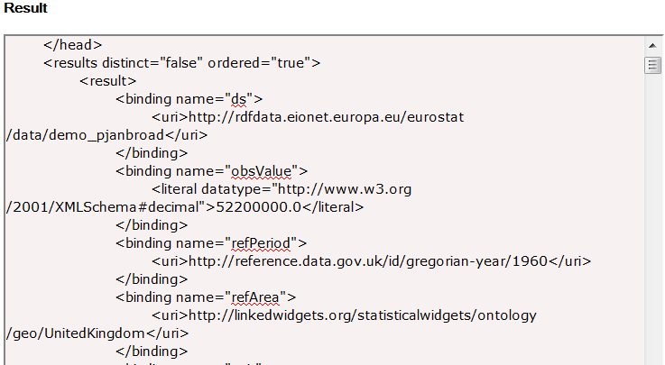
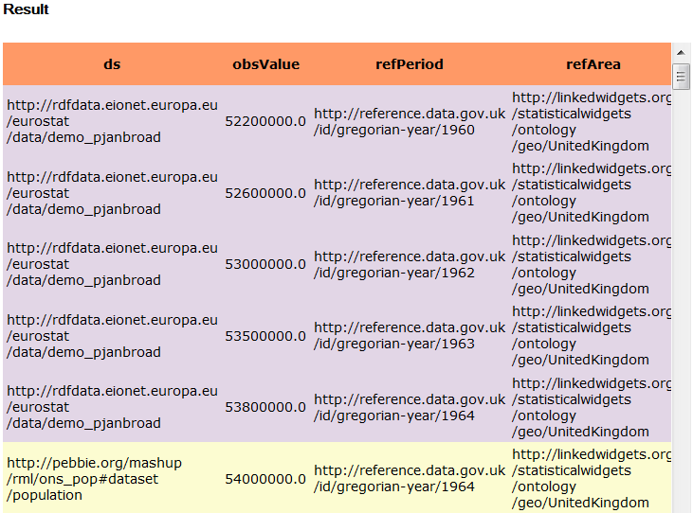
Mediator
Introduction Data Integration Framework Use Case Conclusion and Future Work
Query
Acceptance
Query
Rewriting
Result
Rewriting
Return
Result
XML format
JSON format
HTML format

Slide 21
Conclusion
Introduction Data Integration Framework Use Case Conclusion and Future Work
A framework for statistical data integration
RML mapping service transforms data into RDF
Semantic metadata repository provides interconnection between data sets
Mediator facilitates cross-datasets querying
Preliminary results
RML mapping service supports CSV, XML, TSV, JSON, XSL formats
Repository
focus on properties: sdmx-d:refArea, sdmx-d:refPeriod, sdmx-d: sex, sdmx-m:obsValue
generated semi-automatically
Mediator allows simple queries

Slide 22
Future Work
Introduction Data Integration Framework Use Case Conclusion and Future Work
RML Mapping Service
support users to create RML mappings
Repository
increase the number of data sources
split integrated properties/values into separated properties/values
consider to reuse available properties/code list from data publishers
Mediator
support complex queries
Framework
evaluate the performance of the framework

Slide 23
Thank you very much for your attention!
Introduction Data Integration Framework Use Case Conclusion and Future Work
Contact:
Ba-Lam Do
Linked Data Lab
Vienna University of Technology, Austria
http://ldlab.ifs.tuwien.ac.at
lam@ifs.tuwien.ac.at

