Slide 1
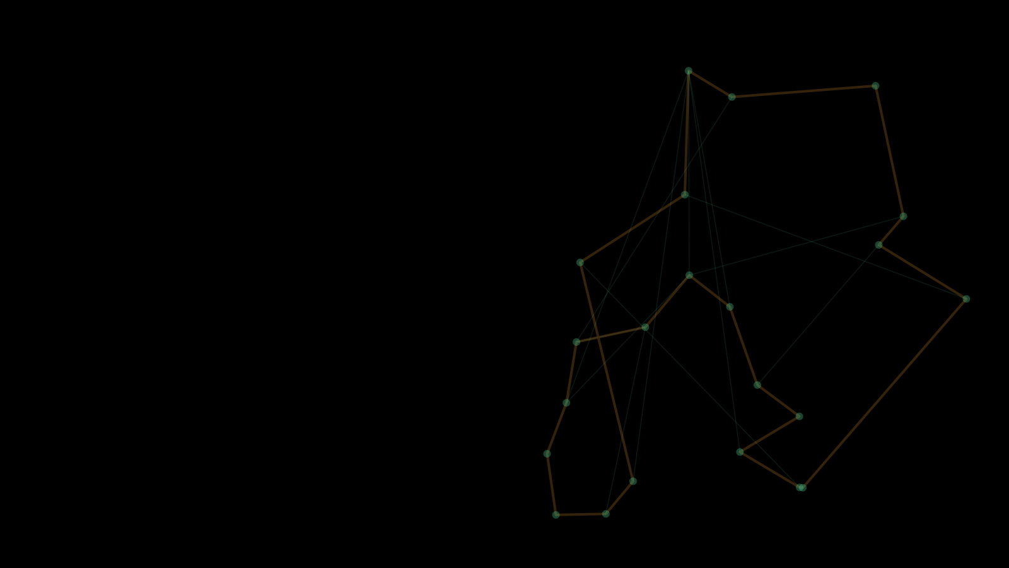

ETF SARAJEVO · DATA SCIENCE & ARTIFICIAL INTELLIGENCE · NUMERICAL OPTIMIZATION
ACO TSP Solver
Ant Colony Optimization for the Travelling Salesman Problem
Ant System on natID Dense Matrices, with Real-Time Visualization
STUDENT
COURSE
PROFESSOR
ACADEMIC YEAR
Armin Memišević · 20016
Numerical Optimization
Prof. Dr. Izudin Džafić
2025/26
github.com/arminn2206/ProjNO_TSPACO_Memisevic
Notes:
Good morning. My project is the ACO TSP Solver. In one sentence: a colony of artificial ants finds near-optimal tours through 15 to 25 real Bosnian towns, and the app shows it happening live. In the next fifteen minutes I will show how the problem is formulated over two natID dense matrices, how the Ant System works, how the GUI and the threading are built, and how I verified that the algorithm is genuine. Then I will finish with a short live demo.

Slide 2


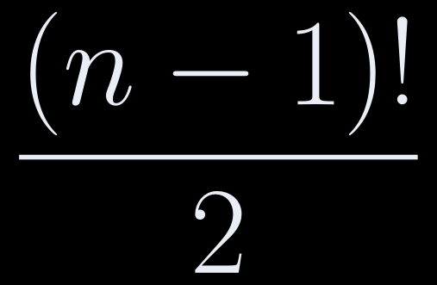

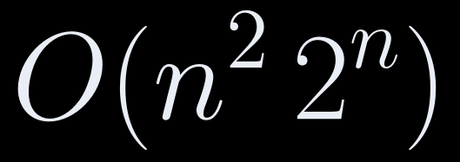

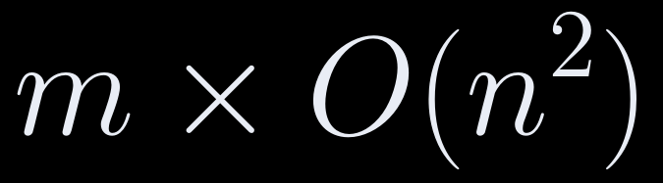
00 · INTRODUCTION
The Core Idea — Why a Metaheuristic, Not Exact Search
Exact search is hopeless even at 25 cities; ACO trades the optimality guarantee for controllable computation.
WHY NOT EXACT SEARCH?
The TSP is NP-hard.
Brute force / Held–Karp
INTRACTABLE
distinct tours
4.4×10¹⁰ at n = 15
3.1×10²³ at n = 25
Proposal: 15–25 cities, all parameters constant during a run.
at n = 25: ≈ 2×10¹⁰ operations, ≈ 8×10⁸ table entries (several GB)
Ant System / this project
Basic Ant System, no local search: every result traces to one textbook update rule.
per iteration
Within 0.7% of the optimum on average (slide 18)
ACO TSP SOLVER
Introduction
02 / 23
Notes:
The TSP is NP-hard, and the feasible set is exactly the Hamiltonian cycles of the complete graph on the selected cities. Even at fifteen cities there are 4.4 times ten to the ten distinct tours, and at twenty-five Held–Karp would need about two times ten to the ten operations and several gigabytes of table. So I chose a metaheuristic, and I deliberately implemented the basic Ant System with no local search. The point of the project is to show that two matrices and one feedback rule get this close to the optimum.

Slide 3
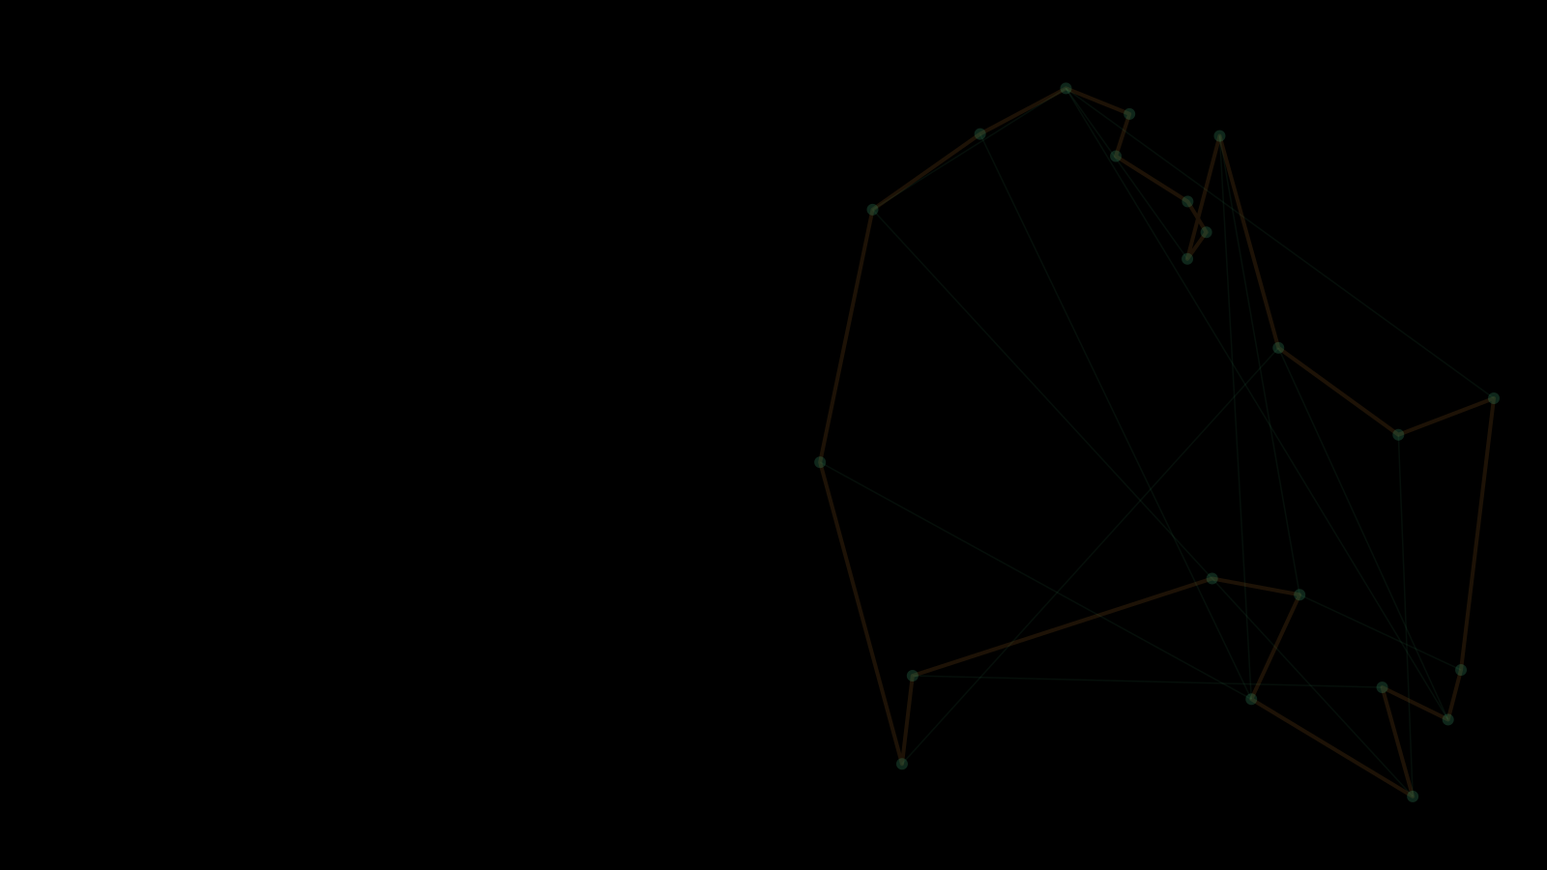
01
AGENDA
TSP objective & constraint
SECTION 01
Problem Formulation
Real-town instances and distance model
Distance & pheromone matrices
The TSP as a minimization problem over two natID dense matrices
ACO TSP SOLVER
03 / 23
Notes:
Section one is the problem formulation. I will first state the TSP as a minimization problem over permutations, with the single constraint that every city appears exactly once. Then I will show where the instances come from, 99 real Bosnian towns, and how accurate the distance model is compared to great-circle distance. Finally I will show the two natID dense matrices the whole algorithm operates on, the distance matrix and the pheromone matrix, and explain why their diagonals stay zero.

Slide 4


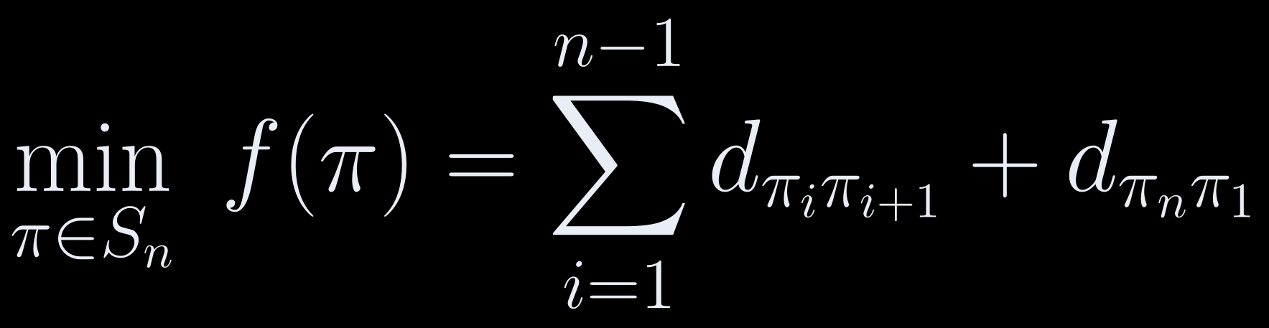


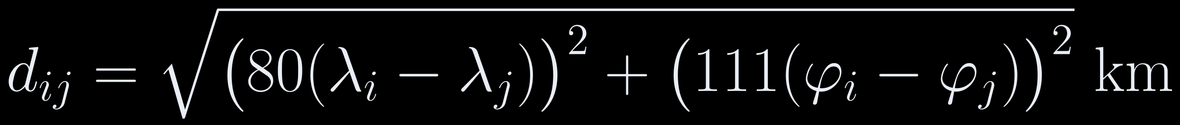
01 · PROBLEM FORMULATION
TSP Objective & Problem Instance
Real geography, with air distances within ±2% of great-circle distance.
99 real towns (Bosnia.xml)
OBJECTIVE
n drawn uniformly from 15–25
80 ≈ 111.3·cos 44.2°
DISTANCE MODEL (λ longitude, φ latitude, degrees)
VS. HAVERSINE (GREAT-CIRCLE)
4,755 pairs > 20 km
−1.8% to +2.0%
mean |error| 0.4% · max 4.7 km
ACO TSP SOLVER
Problem Formulation
04 / 23
Notes:
The objective is the length of a closed tour, including the edge back to the first city. The towns come from Bosnia.xml, between 42.71 and 45.18 degrees north and 15.80 and 19.34 degrees east. Every load shuffles them with a seeded Mersenne Twister and keeps 15 to 25. This is my one deviation from the proposal: real towns instead of synthetic points, so lengths are in kilometres. The constraint is enforced twice: structurally, because an ant only moves to unvisited cities, and by an explicit check that I show on slide 9.

Slide 5

01 · PROBLEM FORMULATION
Distance & Pheromone Matrices (natID)
All three matrices are dense::DblMatrix, and evaporation and deposit act on them directly.
dense::DblMatrix
dense::DblMatrix
dense::DblMatrix
_dist
_pheromone
_deltaPheromone
0
d
d
d
d
0
τ₀
τ₀
τ₀
τ₀
0
Δτ
0
0
Δτ
d
0
d
d
d
τ₀
0
τ₀
τ₀
τ₀
Δτ
0
0
Δτ
0
d
d
0
d
d
τ₀
τ₀
0
τ₀
τ₀
0
0
0
Δτ
Δτ
d
d
d
0
d
τ₀
τ₀
τ₀
0
τ₀
0
Δτ
Δτ
0
0
d
d
d
d
0
τ₀
τ₀
τ₀
τ₀
0
Δτ
0
Δτ
0
0
upper → mirrored to lower
schematic: one tour 1→2→4→3→5→1
symmetric · zero diagonal · upper triangle filled and mirrored
τ₀ = 1.0 off-diagonal · diagonal 0
zeroed each iteration · holds Δτ
reserve(n, n, nullptr, true) → zeros() → fill
ACO TSP SOLVER
Problem Formulation
05 / 23
Notes:
All three matrices are natID dense matrices. Each is reserved n by n, explicitly zeroed because the storage may be reused from a larger instance, and then filled. The diagonal of tau stays zero on purpose, because a self-loop is never a legal move. Seeding it with tau zero would not change the search, but it would decay under evaporation and distort the column sums I discuss on slide 10. The distance matrix is built in loadTowns, so the baseline exists before Start, and rebuilt at the start of every run on the worker thread.

Slide 6
02
AGENDA
Tour construction (roulette wheel)
SECTION 02
Pheromone update as matrix operations
The Ant System
The full loop & feasibility guard
Probabilistic construction + pheromone feedback, nothing else
Baseline & convergence indicators
ACO TSP SOLVER
06 / 23
Notes:
Section two is the algorithm itself: the basic Ant System and nothing else. There are really only two mechanisms, probabilistic tour construction by roulette wheel and pheromone feedback through evaporation and deposit. I will show both with the exact code from MapModel.h. Then I will show the complete loop, including the feasibility guard, and finally the nearest-neighbour baseline and the convergence indicators that tell us whether the colony is actually doing something useful.

Slide 7

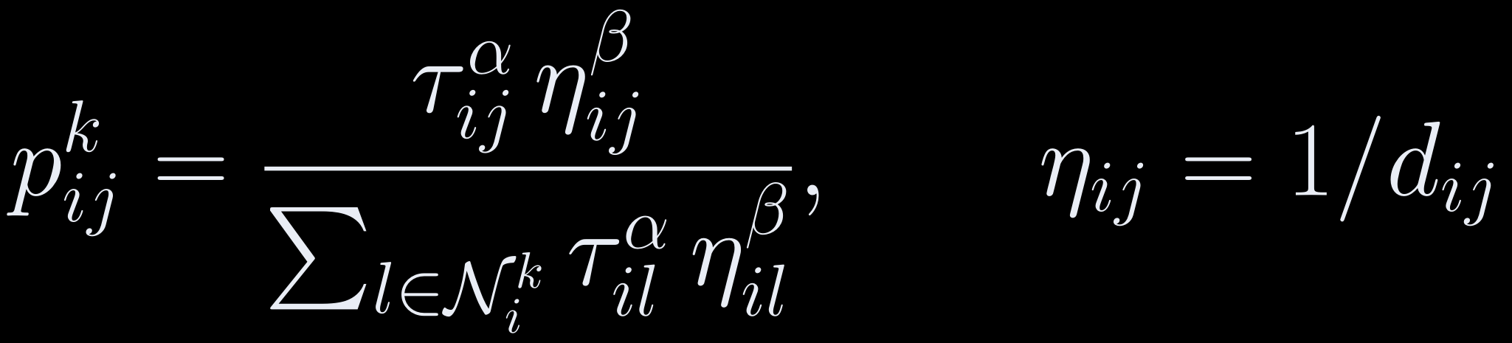
02 · THE ANT SYSTEM
Tour Construction — Roulette Wheel
Each step picks the next city in proportion to trail strength and inverse distance.
SCHEMATIC
MapModel.h
thickness ∝ weight
l₁
1
2
3
4
5
6
7
8
9
10
11
12
13
14
15
16
17
18
double tauVal = pher(current - 1, c - 1);
double d = dist(current - 1, c - 1);
double eta = (d > 1e-6) ? (1.0 / d) : 1e6;
double w = std::pow(tauVal, _options.alpha) * std::pow(eta, _options.beta);
// …
std::uniform_real_distribution<double> pick(0.0, sum);
double r = pick(rng);
double acc = 0;
next = candidates.back();
for (size_t k = 0; k < candidates.size(); ++k)
{
acc += weights[k];
if (r <= acc)
{
next = candidates[k];
break;
}
}
i
l₂
l₃
l₄
r ~ U[0, Σ)
w₁
w₂
w₃
w₄
0
→ picks l₃
Σ
ACO TSP SOLVER
The Ant System
07 / 23
Notes:
An ant at city i weights every unvisited city by tau to the alpha times eta to the beta. Alpha controls trail-following, beta the greedy pull toward short edges. In the code, pher and dist are manipulators on the two dense matrices, and the eta guard handles coincident cities. Then r is drawn uniformly up to the weight sum, and the first candidate whose running sum reaches r is chosen. If the sum underflows to zero, the choice falls back to uniform. Each ant starts at a uniformly random city, which avoids correlated first decisions.

Slide 8

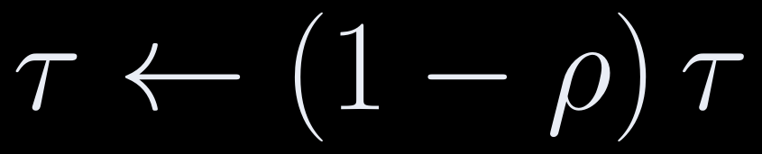
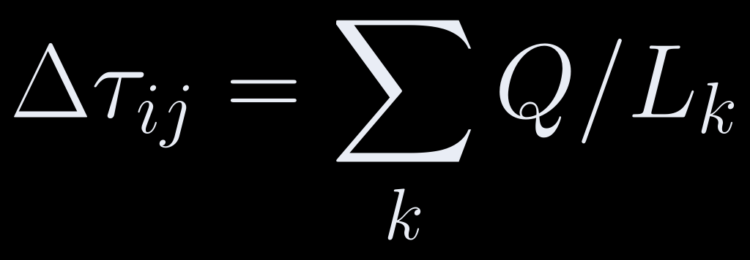
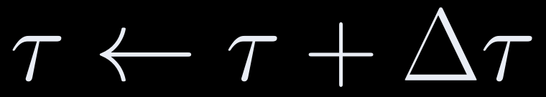



02 · THE ANT SYSTEM
Pheromone Update — Three Matrix Operations
The textbook Ant System rule, mapped one-to-one onto natID operators.
1
2
3
evaporatePheromone()
beginPheromoneDeposit()
+ depositPheromone()
applyPheromoneDeposit()
_pheromone *= keep
zeros(), then per-edge += Q/L
_pheromone += _deltaPheromone
MapModel.h
Evaporate the old trail first
1
2
3
4
5
6
evaporatePheromone();
beginPheromoneDeposit();
for (int a = 0; a < _options.numAnts; ++a)
depositPheromone(antTours[a], antLengths[a]);
applyPheromoneDeposit();
Accumulate, then apply — no ant sees another's deposit
Symmetric, including the closing edge
ACO TSP SOLVER
The Ant System
08 / 23
Notes:
After all ants finish, the update is three named steps. First the whole trail is scaled by one minus rho. Second, delta tau is zeroed and every feasible ant adds Q over its tour length along its edges, symmetrically and including the closing edge. Third, delta tau is added to tau in one operation. Steps one and three are whole-matrix library operators. The deposit has to be per edge, because a tour touches only n of the n squared entries. Summing into delta tau first also adds small deposits at full precision before they meet the much larger trail.

Slide 9

02 · THE ANT SYSTEM
The Complete Loop & Feasibility Guard
Every tour is checked before it can count.
Model::runACO()
MapModel.h
init D, τ
1
2
3
4
5
6
7
8
9
10
11
12
13
14
15
16
17
bool isHamiltonianTour(const std::vector<GraphType>& tour) const
{
size_t n = _towns.size();
if (n < 2 || tour.size() != n)
return false;
std::vector<bool> seen(n + 1, false); // 1-based ids
for (GraphType id : tour)
{
if (id < 1 || id >(GraphType)n)
return false;
if (seen[id])
return false;
seen[id] = true;
}
return true;
}
stop?
yes → end run
stop?
yes → go to update
random start → constructTour
next ant
isHamiltonianTour?
no
skip ant
next iteration
yes
→ next ant
cost L_{k} → update best (mutex)
evaporate → deposit → apply
record series + publish τ snapshot
sleep sleepMS
Checked twice: before costing, and again inside depositPheromone.
ACO TSP SOLVER
The Ant System
09 / 23
Notes:
This is the whole loop in runACO, with Stop checked before each iteration and before each ant. The step I want to highlight is the orange diamond. Every tour is checked before it is costed, and the check runs again inside depositPheromone. Construction cannot currently produce an infeasible tour, so why check? Because the failure would be silent: a short infeasible tour is cheaper than any real one, so it would become the reported best and poison the trail. The best tour is rotated to the start marker for display only; rotation changes neither the tour nor its length.

Slide 10

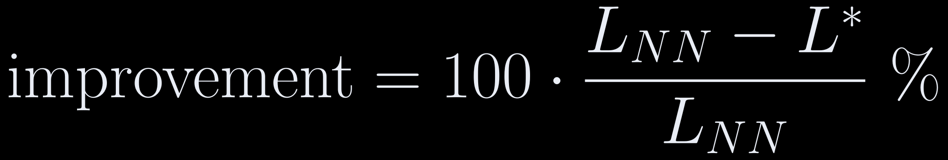

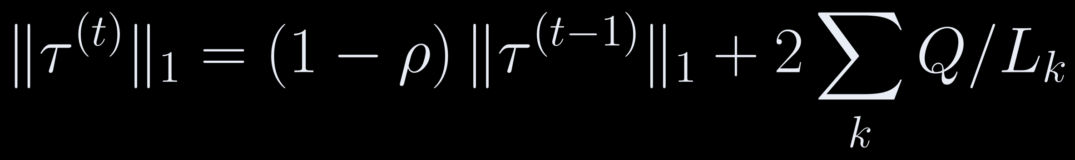
02 · THE ANT SYSTEM
Nearest-Neighbour Baseline & Convergence Indicators
A best-so-far curve alone proves little; the baseline and iteration-best do.
Best-so-far
Repetitive nearest neighbour
monotone
Greedy tour from every start city, shortest kept · O(n³), once per instance · never seeds the colony
Iteration best
noisy, settles toward best-so-far
signed · unclamped
Pheromone L1 norm
exported only
The L1-norm trap
Every tour enters and leaves each city once ⇒ all column sums stay equal. It measures trail mass, not concentration.
verified to nine decimal places
ACO TSP SOLVER
The Ant System
10 / 23
Notes:
A best-so-far curve is monotone by construction, so on its own it proves nothing. That is why I also plot the iteration best and anchor everything to a repetitive nearest-neighbour tour, which never seeds the colony. The Converged label means fifteen iterations without improvement; it is display only, and the run always does all its iterations. I also exported the pheromone L1 norm, and then found it cannot measure concentration, because all column sums stay equal. With the defaults the norm falls from n minus one times tau zero toward about two m Q over rho L-bar, roughly seven.

Slide 11
03
AGENDA
Interface overview
SECTION 03
Real-Time GUI Application
Threading model
Experiments: parameters, compare, export
A natID desktop app for watching and measuring the colony
ACO TSP SOLVER
11 / 23
Notes:
Section three is the application around the algorithm. The proposal asked for a live visualization, so I will first walk through the interface on a real screenshot taken during a run. Then I will explain the threading model, which is what keeps the visualization from ever reading half-updated state. Last, I will show the features that make this a tool for experiments rather than just a demo: parameter clamping, the comparison of two completed runs, and CSV export.

Slide 12

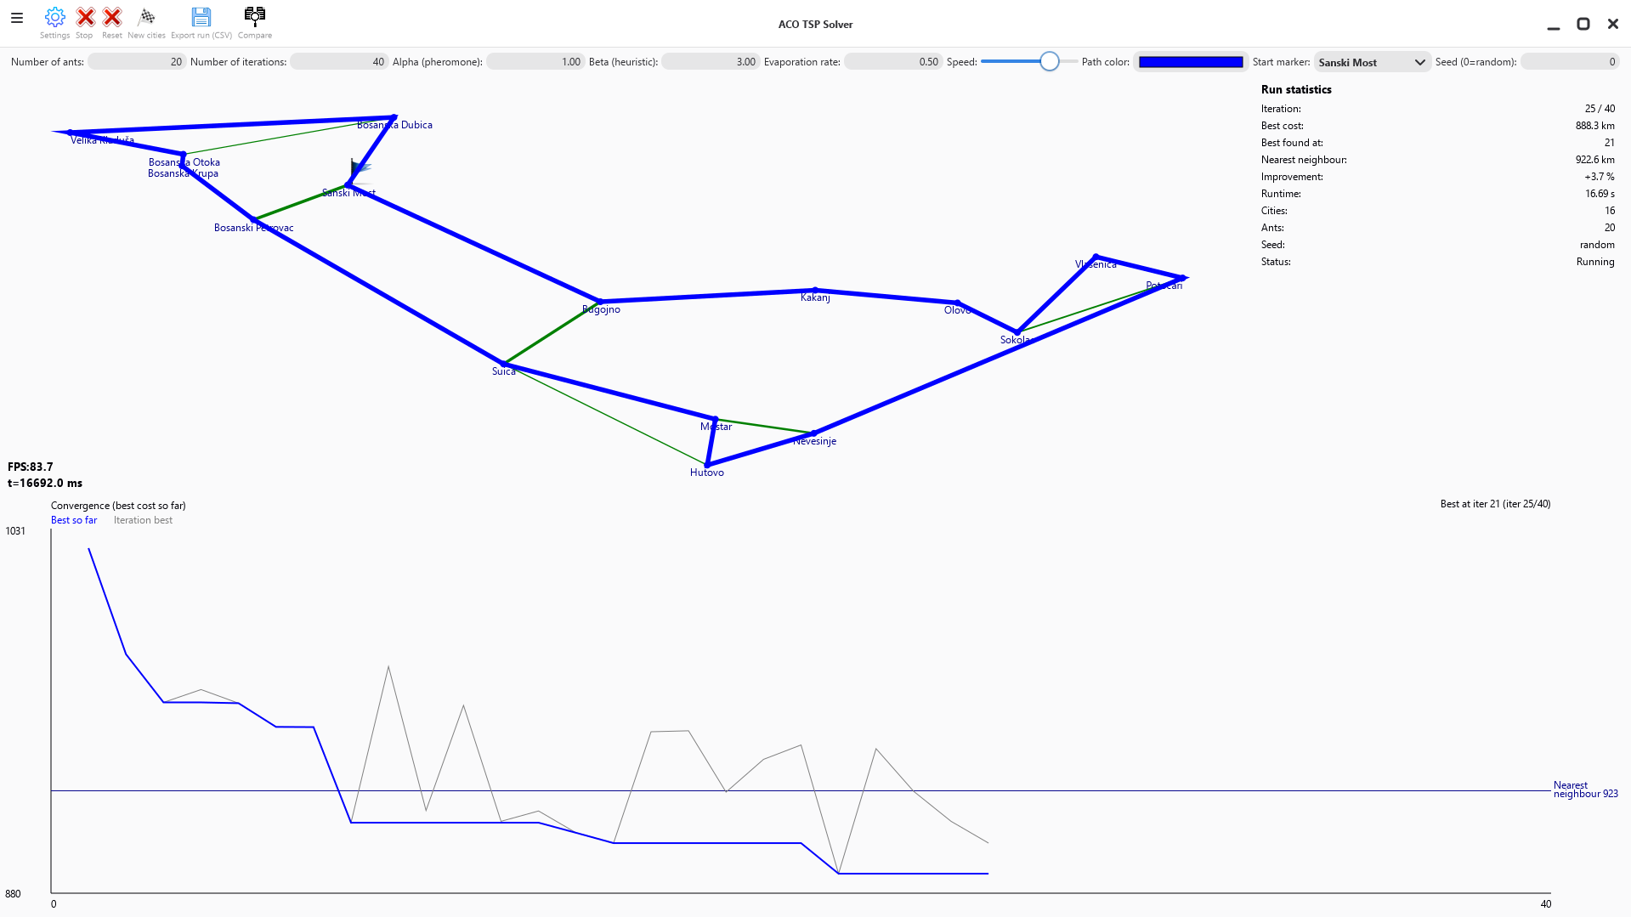


03 · REAL-TIME GUI APPLICATION
Interface Overview
Map, pheromone trail, chart and statistics all update live.
1
Map canvas
1 parameter bar
animation loop requests 60 fps
4
3
Chart & sidebar
2
4 statistics sidebar
3 best tour
request 10 fps, drawn from thread-safe snapshots
2 pheromone edges (Threshold: > 1.5× mean)
Edge thickness
0.5–4.0 px, scaled to trail
5 convergence chart + NN line
5
Grid: parameter bar · map (15/20 cols) + sidebar (5/20) · full-width chart
16 cities, 20 ants, 40 iterations, α=1, β=3, ρ=0.5, at iteration 25: best tour 888.3 km (found at iter 21), 3.7% shorter than NN 922.6 km.
ACO TSP SOLVER
Real-Time GUI Application
12 / 23
Notes:
Here is the main window mid-run, with sixteen cities, twenty ants and forty iterations. Across the top is the parameter bar. The thin green lines are pheromone edges above one and a half times the mean, the thick line is the best tour, the statistics sidebar is on the right and the convergence chart is below. The chart's y-range includes the baseline with six percent padding, so the scale is anchored to the instance and an auto-scaled staircase cannot exaggerate a 0.3 percent gain. The toolbar has Settings, Start/Stop, Reset, New cities, Export and Compare.

Slide 13




03 · REAL-TIME GUI APPLICATION
Threading Model
The worker owns the matrices; the UI only ever sees complete snapshots.
Main (UI) thread
Start: findPath()
Worker thread
LEGEND
map canvas, chart and sidebar (polling)
Model::runACO()
std::atomic flags & counters
asyncExecInMainThread
→ threadCompleted()
updates
gui::Shape main-thread only (_tourShapeDirty)
polled once per frame
publishes after each iteration
Worker-owned
no lock: τ, Δτ
Stop = flag, checked per iteration & per ant
Shared state (mutex)
best tour/length, 3 series, τ snapshot
ACO TSP SOLVER
Real-Time GUI Application
13 / 23
Notes:
The worker thread owns tau and delta tau and updates them without locking. Tau is copied to the snapshot only after a complete update, so the UI can never see the trail mid-evaporation. The best tour, the three series and that snapshot sit behind one mutex, and both chart curves are copied in one lock block, so they always have equal length. Flags and counters that cross threads are std::atomic, gui::Shape objects are only built on the main thread, and Stop is just a flag. The window also refuses to close during a run.

Slide 14

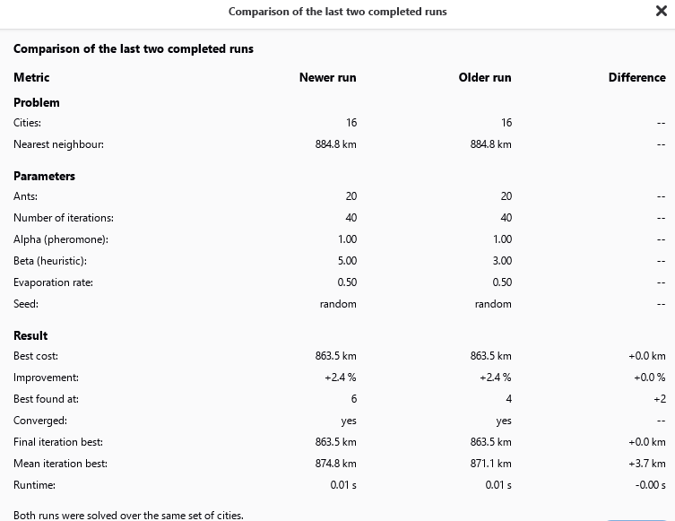


03 · REAL-TIME GUI APPLICATION
Built for Experiments — Parameters, Compare, Export
Change one parameter, rerun on the same cities, compare with numbers.
Parameter
Symbol
Default
Range
Ants
m
20
1–500
Iterations
N_{iter}
100
1–100,000
Alpha
α
1.0
0–10
Beta
β
3.0
0–10
Evaporation
ρ
0.5
0.01–0.99
Q
Q
100
fixed
τ₀
τ₀
1.0
fixed
Seed
—
0 = random
—
CSV: convergence series + full instance (cities, tour legs, n×n distance matrix)
Same 16 cities, only β differs (5 vs 3): both reach 863.5 km (2.4% below NN); β=5 finds it 2 iterations later, mean iteration best 3.7 km higher.
Reproducible run = seed + city_draw_index
ACO TSP SOLVER
Real-Time GUI Application
14 / 23
Notes:
Parameters are read and clamped once at Start and stay constant during the run, which is a proposal requirement, and they persist across restarts. Compare shows the last two runs, but only completed runs are stored, because stopped runs would fake a quality difference. In this example the only change is beta, and both runs reach the same tour. CSV export writes the convergence series and the full instance, in the C locale with a UTF-8 byte order mark, so names like Goražde display correctly. A run is reproducible from the seed plus the city draw index.

Slide 15
04
AGENDA
Control-flow audit — "no cheating"
SECTION 04
Verification & Results
Mathematical verification
Independent numerical check
Auditing the implementation and checking it against exact optima
ACO TSP SOLVER
15 / 23
Notes:
Section four is verification, which I think is the most important part of this defence. I will show three layers. First, a control-flow audit: one path from Start to every reported tour, with no bypass, which is what no cheating means concretely. Second, a mathematical check of the implementation against the proposal and against Dorigo and Stützle. Third, an independent numerical check of the same algorithm against exact Held–Karp optima.

Slide 16


04 · VERIFICATION & RESULTS
Control-Flow Audit — "No Cheating"
One control path from Start to every reported tour, with no bypass.
control flow (condensed)
WHAT 'NO CHEATING' MEANS
1
2
3
4
5
6
7
8
9
10
11
MainWindow::onActionItem (Start)
-> MainView::startStop -> readACOParamsFromUI
-> ViewMap::start -> Model::findPath -> std::thread
-> Model::runACO
-> buildDistanceMatrix, initPheromone
-> for iter: for ant:
constructTour -> isHamiltonianTour -> tourLength
-> evaporatePheromone -> beginPheromoneDeposit
-> depositPheromone x m -> applyPheromoneDeposit
-> getL1Norm, publishPheromoneSnapshot
-> asyncExecInMainThread(ViewMap::threadCompleted)
No local search (no 2-opt / 3-opt / Or-opt)
No precomputed solutions
The baseline never seeds the colony
No infeasible tours reported or reinforced
No elitism, no τ_{min}/τ_{max} limits
ACO TSP SOLVER
Verification & Results
16 / 23
Notes:
Because the question is whether the algorithm is genuine, I traced the only control path from pressing Start to any reported result. It goes from the menu action through readACOParamsFromUI into findPath, onto the worker thread and through runACO. Every tour that is shown, plotted, compared or exported passed through constructTour and isHamiltonianTour in this chain. On the right is exactly what no cheating means here: no local search, no stored solutions, the greedy baseline never touches the colony, no infeasible tours, and no elitism or trail limits.

Slide 17

04 · VERIFICATION & RESULTS
Mathematical Verification
The src/ and res/ trees were cross-checked against the proposal and against Dorigo & Stützle.
Transition rule
τ^{α}η^{β} over unvisited cities, sampled in proportion to weight
Update rule
evaporate, accumulate Q/L_{k} from feasible ants, one addition; symmetric, including the closing edge
Objective
tourLength includes the return edge; the exported per-leg column sums to the reported cost
Parameters constant
written only on the UI thread when no run is active, only read by the worker
Matrices
D, τ, Δτ are dense::DblMatrix; evaporation and apply are library operators
ACO TSP SOLVER
Verification & Results
17 / 23
Notes:
I cross-checked the src and res trees against the proposal and against Dorigo and Stützle. The transition rule, the update rule, the objective including the return edge, constant parameters and the dense matrices all match. But I want to say this plainly: inspection alone is not enough. Code can look exactly like the textbook and still be wrong in one detail, and a reviewer reading it would not notice. So I also checked the algorithm numerically, against exact optima, and that is the next slide.

Slide 18

04 · VERIFICATION & RESULTS
Independent Numerical Check — Results
Within 0.68% of the true optimum on average, and never worse than the greedy baseline.
SETUP Faithful C++ re-implementation (same RNG streams, same float/double types) · real Bosnia.xml · defaults m=20, 100 iter, α=1, β=3, ρ=0.5, Q=100, τ₀=1 · 30 instances (seeds 1–30) · Held–Karp optimum for n ≤ 20 (18 instances)
10 / 18
+6.0%
+0.0% to +16.4%
Optimum found
Mean improvement over NN (all 30)
Range
best 920.5 km at iter 38 — 0.05% above optimum; NN 11.8% above
ACO TSP SOLVER
Verification & Results
18 / 23
Notes:
I re-implemented the generator, the distances, the baseline and runACO in a standalone C++ program and ran thirty seeds with the defaults. For the eighteen instances with at most twenty cities, Held–Karp gave the true optimum. The colony found it exactly ten times and was 0.68 percent above it on average; nearest neighbour was 7.02 percent above. These figures characterize the algorithm, not one app run: the port used libstdc++, and the app on MSVC or libc++ draws different cities for the same seed. In three instances ACO tied the baseline, which was already optimal or within 1.7 percent.

Slide 19
05
AGENDA
Proposal vs. delivered
SECTION 05
Features, Limitations & Conclusions
Tech stack & known limitations
Lessons learned & future work
What shipped, how it maps to the proposal, and what it taught me
ACO TSP SOLVER
19 / 23
Notes:
The last section closes the loop with the proposal. I will map every proposal item to what was delivered and list the additions, then summarize the tech stack and state the known limitations honestly, so that no number in the application is read as more than it is. I will finish with the lessons I learned and what I would build next, and then we move on to the live demo of the application.

Slide 20

05 · FEATURES, LIMITATIONS & CONCLUSIONS
Proposal vs. Delivered
Every proposal item delivered, plus additions.
PROPOSED
ADDITIONALLY DELIVERED
15–25 random cities
Hamiltonian feasibility check
N×N distance and pheromone matrices as natID dense matrices
separate Δτ matrix
roulette-wheel construction with α, β
per-iteration best curve + nearest-neighbour baseline
evaporation + deposit ∝ 1/L
All/Threshold pheromone modes
constant parameters
seed reproducibility
background thread from B_S03_Maps
CSV export (series + full instance)
live convergence curve
comparison of the last two completed runs
map with best tour and pheromone edge thickness
EN/BA UI, Settings, Help, sounds
sidebar with iteration, best cost, runtime
GitHub Actions builds for Windows, macOS (Apple Silicon + Intel), Linux
Start/Stop/Reset
✓ One substantive deviation: real towns instead of synthetic points (lengths in km)
ACO TSP SOLVER
Features, Limitations & Conclusions
20 / 23
Notes:
Every item in the proposal was delivered. Of the additions, I only want to point at the three that strengthen correctness rather than usability. The Hamiltonian feasibility check means no infeasible tour can ever be reported or reinforced. The nearest-neighbour baseline turns it seems to work into a measurable claim. And the comparison stores only completed runs, so a run stopped early cannot masquerade as a worse parameter setting. The one substantive deviation is using real towns instead of synthetic points, so all lengths are in kilometres.

Slide 21

05 · FEATURES, LIMITATIONS & CONCLUSIONS
Tech Stack & Known Limitations
Every number in the app is stated for what it is.
BUILT WITH
C++
CMake 3.18+
natID SDK (MatrixLib, natGUI, mainUtils)
dense::DblMatrix
GitHub Actions + SetupCollector
Windows
macOS
Linux
No dependency outside the natID SDK.
KNOWN LIMITATIONS
Reproducibility is per toolchain
std distributions are implementation-defined; the instance CSV compensates
Runtime is wall-clock
includes the animation delay (500 ms default ⇒ 100 iterations ≈ 50 s)
pheromone_l1 ≠ concentration
it records trail mass per city
Stopping mid-iteration
still applies that update; stopped runs are not compared
Fixed τ₀ = 1 instead of m/C^{nn}
initial trail < 1% after 7 iterations at ρ = 0.5
Air distances
not road distances
ACO TSP SOLVER
Features, Limitations & Conclusions
21 / 23
Notes:
The project is C++ with CMake and nothing outside the natID SDK: MatrixLib for the dense matrices, natGUI for the interface and mainUtils. GitHub Actions builds packages for Windows, both macOS architectures and Linux through SetupCollector. I list the limitations as a matter of rigor, so every number in the app is stated for what it is. Reproducibility is per toolchain, runtime includes the animation delay, the L1 norm is not concentration, stopped runs are not compared, tau zero is fixed at one, and distances are air distances.

Slide 22



05 · FEATURES, LIMITATIONS & CONCLUSIONS
Lessons Learned & Future Work
Two lessons I defend hardest: the feasibility guard and the L1-norm insight.
LESSONS
FUTURE WORK
01
A best-so-far curve alone proves little
01
ACS and MAX–MIN AS selectable at runtime
02
A solver must check its own constraints
02
2-opt local search
03
Instrumentation must be checked against the math (L1 norm)
03
A real concentration measure (row entropy / share of trail on the best tour's edges)
04
Threading discipline is part of correctness
04
Platform-independent sampling on mt19937
05
Reproducibility needs more than a seed
05
TSPLIB instances with known optima
ACO TSP SOLVER
Features, Limitations & Conclusions
22 / 23
Notes:
Five lessons, and I would defend two of them hardest. First, a solver must check its own constraints: an infeasible tour is cheaper than a feasible one, so a construction bug would look like a spectacular result instead of a failure. Second, instrumentation must be checked against the mathematics: the L1 norm looked like a convergence signal, but the Hamiltonian structure makes every column sum equal. For future work, the natural next steps are ACS and MAX–MIN Ant System, 2-opt, a real concentration measure, platform-independent sampling and TSPLIB instances.

Slide 23


ACO TSP SOLVER
Thank You
Every tour shown is the direct output of a live Ant System run over natID dense matrices; the algorithm was verified against exact optima.
Download for
Windows
Download for
Linux
Download for
macOS Intel
Download for
macOS Silicon
github.com/arminn2206/ProjNO_TSPACO_Memisevic
Armin Memišević · ETF Sarajevo · Data Science and Artificial Intelligence
Notes:
Thank you. Now the live demo, about three minutes. One: I launch the app, and an instance and its nearest-neighbour baseline are already shown. Two: I press Start with the defaults, and you can watch the trail thin out in Threshold mode and the two curves converge. Three: I let the run finish. Four: I set beta to five and press Start again on the same cities. Five: I open Compare. Six: I export the CSV. Seven: I draw new cities. Installers for every platform are on the releases page.

