Slide 1
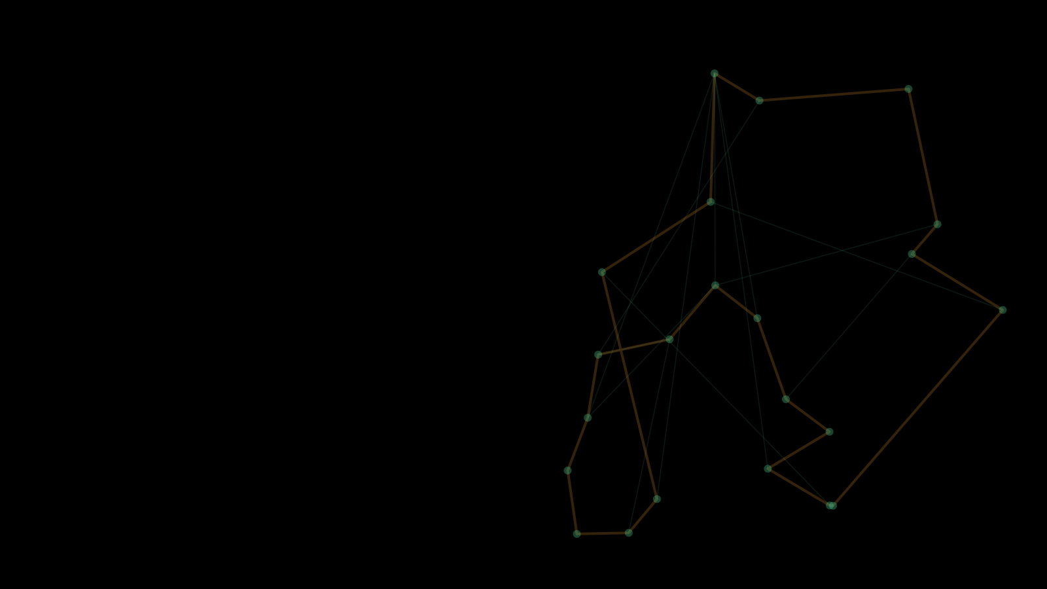

PROJECT PRESENTATION · NUMERICAL OPTIMIZATION · ETF SARAJEVO
ACO TSP Solver
Ant Colony Optimization for the Travelling Salesman Problem
Artificial ants find short round trips through real Bosnian towns, live on screen
STUDENT
COURSE
PROFESSOR
ACADEMIC YEAR
Armin Memišević · 20016
Numerical Optimization
Prof. Dr. Izudin Džafić
2025/26
Available on:
github.com/arminn2206/ProjNO_TSPACO_Memisevic
Notes:
Hi, I'm Armin, and my project is the ACO TSP Solver. It tackles the Travelling Salesman Problem, finding a short round trip through a set of towns, using Ant Colony Optimization. The towns are real towns in Bosnia and Herzegovina, and the whole search is shown live on screen. I'll explain the idea in one slide, show what's implemented, and then go straight to the demo.

Slide 2

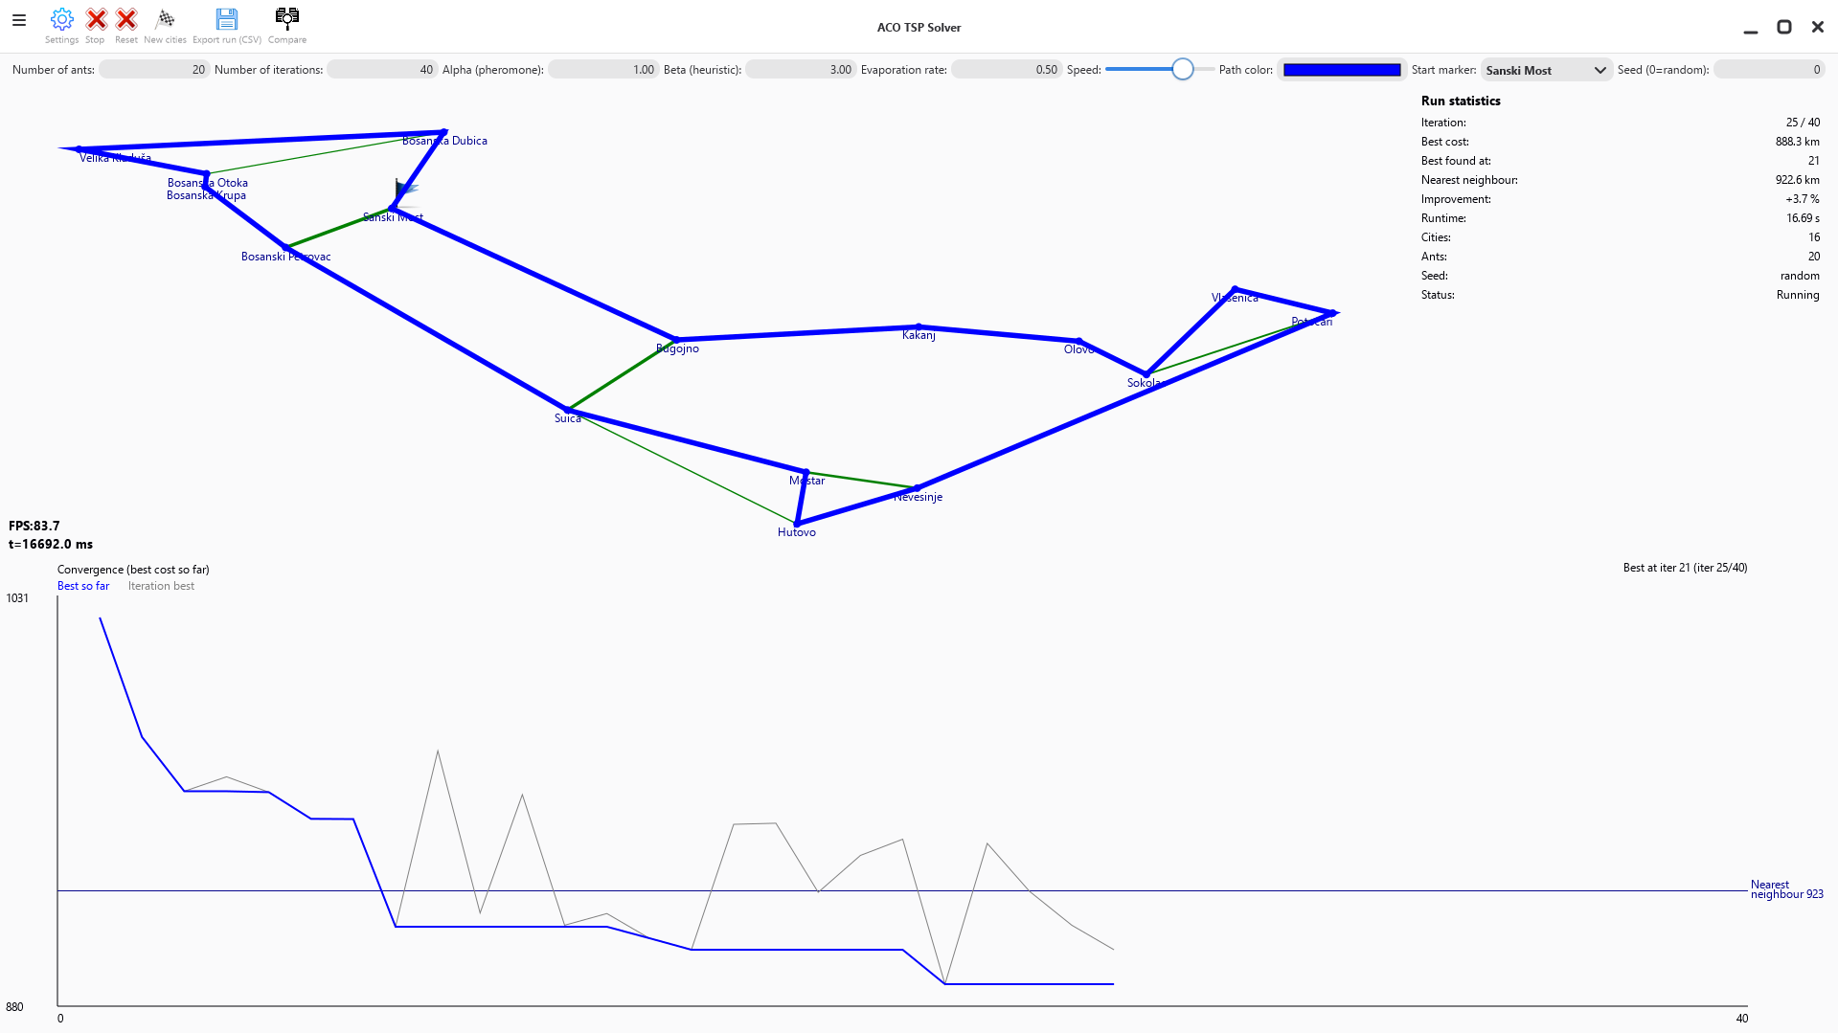
THE IDEA IN 30 SECONDS
How It Works
A colony of virtual ants learns a short round trip, and you watch it happen.
The app picks 15–25 real Bosnian towns. Goal: the shortest trip that visits each town once and returns home.
1
3
Each round, virtual ants build trips, preferring short hops and links other ants liked.
2
1
2
1 best trip so far
3 live statistics
Shorter trips leave more pheromone; old pheromone evaporates. The colony converges on good routes.
3
2 pheromone trail
Every result is measured against a greedy nearest-neighbour route.
4 convergence chart
4
4
TEST RESULTS · 30 INSTANCES · DEFAULT SETTINGS
0.68%
10 / 18
0 / 30
Live run: 16 towns, iteration 25 of 40. Best trip 888.3 km, 3.7% shorter than the greedy route (922.6 km).
Test figures: reference re-implementation, 30 instances; optimum computed exactly for the 18 with ≤ 20 towns.
avg. above optimum
optimum found
worse than greedy
ACO TSP SOLVER
How It Works
02 / 03
Notes:
The app picks 15 to 25 real towns. Each round, a colony of virtual ants builds complete trips. They prefer short hops and links that other ants used. Short trips leave more pheromone, and old pheromone evaporates, so the colony gradually settles on a good route. On the map you see the best trip and the trail; below is the convergence chart. In tests on thirty instances, the colony was on average 0.68 percent above the true optimum where it could be computed, and never worse than the greedy route.

Slide 3



WHAT'S IMPLEMENTED
Features & Controls
Everything from the proposal, plus tools to experiment and compare.
✓
Real maps: 15–25 towns drawn from 99 real Bosnian towns
✓
Start / Stop / Reset run control
✓
Ant System: basic Ant Colony Optimization, no shortcuts or local search
✓
New cities fresh instance anytime
✓
Parameters: ants, iterations, α, β, evaporation, seed
✓
Speed slider watch slow or instantly
✓
Live map: best trip + pheromone trail as line thickness
✓
Compare last two completed runs
✓
Convergence chart: best so far, per-iteration best, greedy reference
✓
Export (CSV) run data + full instance
✓
Settings language, sound, trail display
✓
Statistics: iteration, best cost, improvement, runtime
✓
Reproducible runs: fixed seed replays a run on the same platform
Download for
Windows
Download for
Linux
✓
Languages: English and Bosnian
✓
Platforms: Windows, macOS and Linux
Download for
macOS Intel
Download for
macOS Silicon
ACO TSP SOLVER
Features & Controls
03 / 03
Notes:
Everything from the proposal is implemented: real maps, the Ant System, adjustable parameters, the live map, the convergence chart and statistics. On top of that there are reproducible runs, a comparison of the last two runs, CSV export, English and Bosnian, and builds for Windows, macOS and Linux, downloadable from the releases page. Now let me show you the app running.

